Slide 1

Hilcorp Alaska, LLC
2014 / 2015 Drilling Activity
A Company Built on Energy
Integrity Urgency Ownership Alignment Innovation

Slide 2
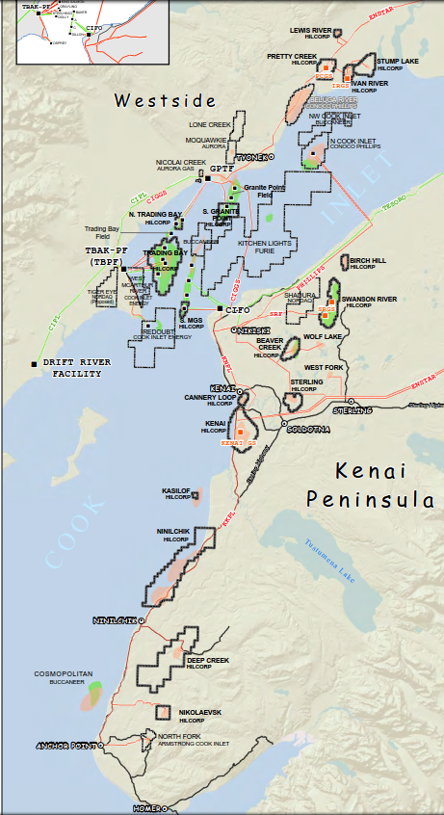
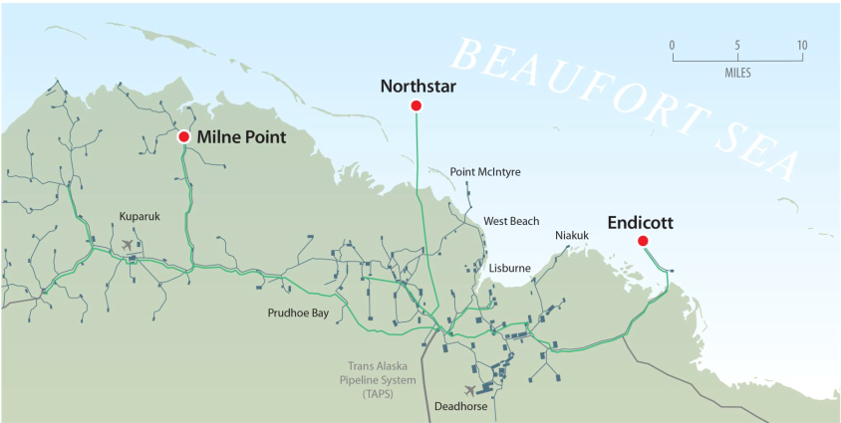
Current Areas Of Operation

Slide 3
2014 Drilling Recap
Kenai Peninsula:
Rig: Saxon # 169 & # 147
7 Beaver Creek Wells (Gas)
6 Swanson River Wells (Oil)
6 Kenai Gas Field Wells (Gas)
5 Ninilchik Wells (Gas)
Cook Inlet Offshore
2 grassroots oil wells (A-31 & M-34)
Drilling Performance
Wells drilled : 26 in 2014 / 11 in 2013
Total Footage : 186,609 ft in 2014 / 89,339 ft in 2013
Reduced days/10M ft : 28.9 in 2013 to 18.9 in 2014
Reduced avg flat time / well from 30 days to 24.2 days
Kuukpik Drilling : 365 days w/o recordable (offshore)
1 recordable spill / 1 recordable injury (onshore)

Slide 4
Drilling Performance Improvements
Improved performance of rig crews
Use of technology, PWD, RSS & Geo Steering
PDC bit durability
More effective pre-planning
Improved performance of vendors
  Equipment maintenance
  Increased level of crew experience

Slide 5
2015 Drilling Outlook
Kenai Peninsula:
Rig: Saxon # 169
3 Kenai Gas Field wells
2 Cannery Loop wells
3 Ninilchik wells
2 Swanson River wells
North Slope:
Rig: Nordic #3
3 Milne Point, Schrader Bluff wells
3 Milne Point, Sag River wells
Cook Inlet Offshore
Rig: Monopod & Steelhead
Obtain 3D seismic data, no offshore drilling

Slide 6
Drilling Challenges
Kenai Peninsula (onshore):
Depletion zones
Coal seams
High pressure water flows
Swelling clays
North Slope:
Learning curve
Infrastructure costs
Charged up Kalubik & Kuparuk Sands / Shales.
LCU & reactive shales,
Cook Inlet Offshore
Slot availability
Directional drilling complexity to reach targets
Coal seams
Abrasive conglomerates
Faulting
Depleted zones

