Slide 1
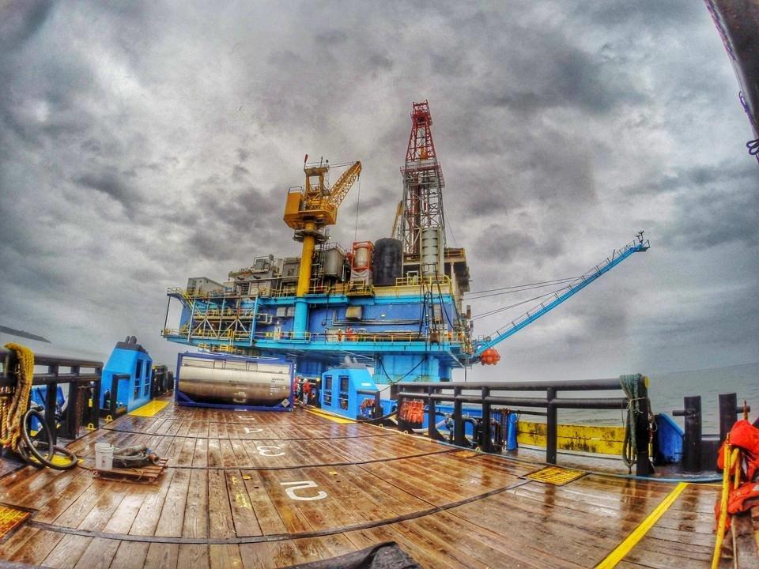
Cook Inlet Energy, LLC
A Wholly Owned Subsidiary of Miller Energy Resources

Slide 2
FORWARD LOOKING STATEMENT
Certain statements in this presentation and elsewhere by Miller Energy Resources¸ Inc. are "forward-looking statements" within the meaning of the Private Securities Litigation Reform Act of 1995. These forward-looking statements involve the implied assessment that the resources described can be profitably produced in the future, based on certain estimates and assumptions. Forward-looking statements are based on current expectations, estimates and projections that involve a number of risks, uncertainties and other factors that could cause actual results to differ materially from those anticipated by Miller Energy Resources, Inc. and described in the forward-looking statements. These risks, uncertainties and other factors include, but are not limited to, the potential for additional operating losses; material weaknesses in internal control over financial reporting and the need to enhance systems, accounting, controls and reporting performance; potential limitations imposed by debt covenants under the senior credit facilities on growth and the ability to meet business objectives; debt costs under existing senior credit facilities; the ability of the lenders to re-determine the borrowing base under the First Lien RBL; Miller's ability to meet the financial and production covenants contained in the First Lien RBL and/or Second Lien Credit Facility; whether Miller is able to complete or commence its drilling projects within its expected time frame or expected budget; the ability to recover proved undeveloped reserves; whether new productive assets can be successfully acquired, integrated and exploited in the future; whether production can be established on certain leases in a timely manner before expiration; whether the work commitments can be completed as required under the terms of the Susitna Basin Exploration Licenses; Miller's experience with horizontal drilling; risks associated with the hedging of commodity prices; dependence on third party transportation facilities; concentration risk in the market for the oil and natural gas produced in Alaska; the ability to perform under the terms of its oil and gas leases and exploration licenses with the Alaska DNR, including meeting the funding or work commitments of those agreements; uncertainties related to deficiencies identified by the SEC in our Form 10-K for 2011; the impact of natural disasters on Miller's Cook Inlet Basin operations; the effect of global market conditions on the ability to obtain reasonable financing and on the prices of Miller's publicly traded equity; limitations with respect to the issuance and/or designation of additional preferred stock; litigation risks; the imprecise nature of reserve estimates; risks related to drilling dry holes or wells without commercial quantities of hydrocarbons; fluctuating oil and gas prices and the impact on results from operations; the need to discover or acquire new reserves in the future to avoid declines in production; differences between the present value of cash flows from proved reserves and the market value of those reserves; industry risks that may be uninsurable; the potential for shortages or increases in costs of equipment, services and qualified personnel; strong industry competition; constraints on production and costs of compliance that may arise from current and future environmental, FERC and other statutes, rules and regulations at the state and federal level; the potential to incur substantial penalties and fines for noncompliance with applicable FERC administered statutes, rules, regulations and orders; new regulation on derivative instruments used to manage risk against fluctuating commodity prices; the potential impact of proposed federal, state, or local regulation regarding hydraulic fracturing; the effect that future environmental legislation could have on various costs; the impact of certain provisions included in the FY2015 U.S. federal budget on certain tax incentives and deductions Miller currently uses; that no dividends may be paid on our common stock for some time; cashless exercise provisions of outstanding warrants; market overhang related to outstanding options and warrants; the impact of non-cash gains and losses from derivative accounting on future financial results; risks to non-affiliate shareholders arising from the substantial ownership positions of affiliates; the effects of the change of control conversion features of the Series C and Series D Preferred Stock on a potential change of control; the junior ranking of the Series C and Series D Preferred Stock to the Series B Preferred Stock and all indebtedness; the ability to pay dividends on the Series C or Series D Preferred Stock; whether the Series C or Series D Preferred Stock is rated; the ability of the Series C or Series D Preferred Stockholders to exercise conversion rights upon a change of control; fluctuations in the market price of our Series C or Series D Preferred Stock; whether additional shares of Series C or Series D Preferred Stock or additional series of preferred stock that rank on parity with the Series C and Series D Preferred Stock are issued; the very limited voting rights held by the Series C and Series D Preferred Stockholders; the newness of the Series D Preferred Stock and the limited trading market of the Series C and Series D Preferred Stock; and risks related to the continued listing of the Series C and Series D Preferred Stock on the NYSE. Additional information on these and other factors, which could affect Miller's operations or financial results, are included in Miller Energy Resources, Inc.'s reports on file with United States Securities and Exchange Commission including its Annual Report on Form 10-K, as amended, for the fiscal year ended April 30, 2014. Capitalized terms used above but not defined above are defined in Miller's Annual Report. Miller Energy Resources, Inc.'s actual results could differ materially from those anticipated in these forward- looking statements as a result of a variety of factors, including those discussed in its periodic reports that are filed with the Securities and Exchange Commission and available on its Web site www.sec.gov). All forward-looking statements attributable to Miller Energy Resources or to persons acting on its behalf are expressly qualified in their entirety by these factors. Investors should not place undue reliance on these forward-looking statements, which speak only as of the date of this presentation. We assume no obligation to update forward-looking statements should circumstances or management's estimates or opinions change unless otherwise required under securities law.

Slide 3
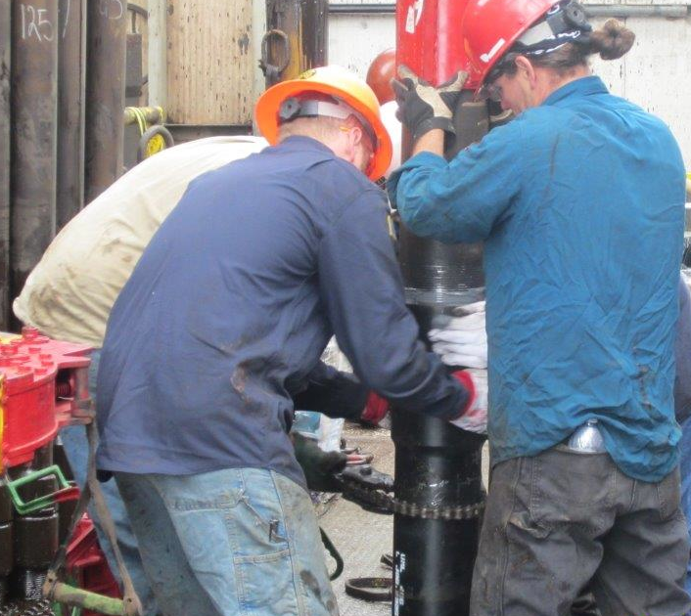
Cook Inlet Energy, LLC A Wholly Owned Subsidiary of Miller Energy Resources
Founded in 2009 in Anchorage, Alaska
Alaskan focused Oil & Gas Exploration & Production Company
offices in:
Anchorage, AK
Knoxville, TN
Houston, TX
84 Alaskan based employees
Aggressive Development and Exploration Activities
Significant Lease positions in Cook Inlet & on the North Slope
New production facilities in Alaska
Ryder Scot Total Proved Oil Reserves 11.7 MMBOE
Notes:
1.) As shown here 4 fields we currently operate in, however, we do have an appetite for exploration, Inshkin, Olson Creek, Otter, Susitna basin

Slide 4
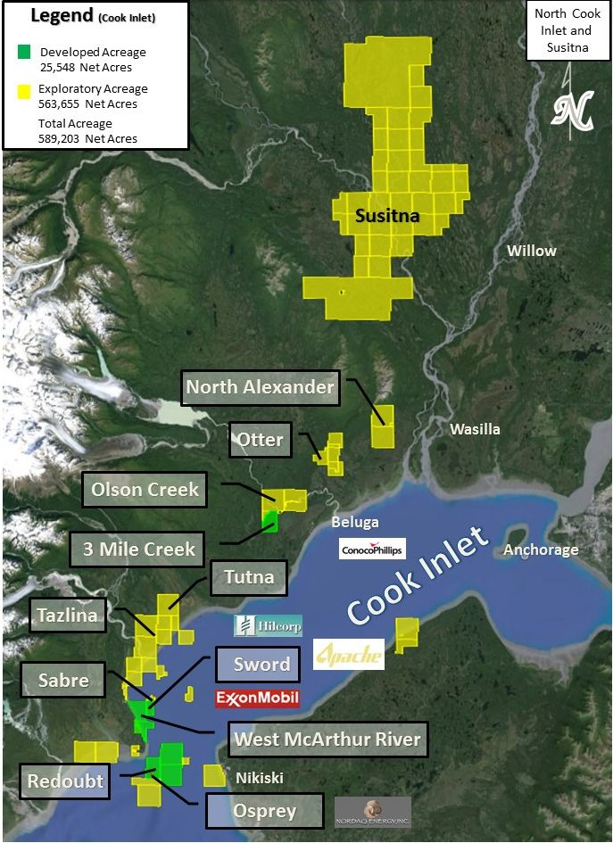
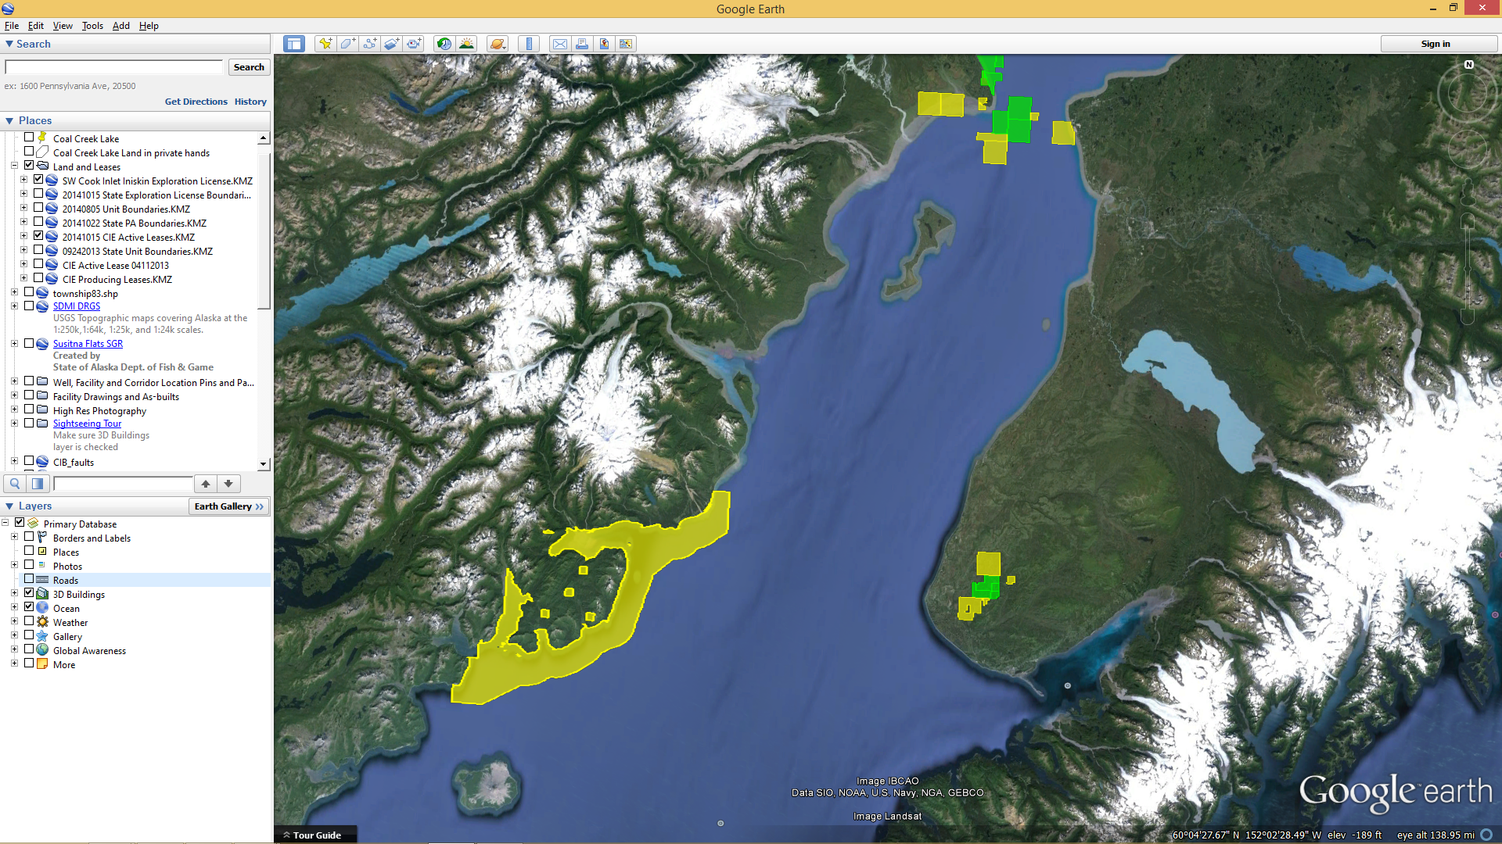
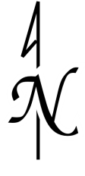
Cook Inlet Lease Acreage
South Cook
Inlet
Redoubt
Osprey
Cook Inlet
Sterling Hwy.
Anchor Point
Homer
Iniskin Exploration License
North Fork Unit and Pipeline
Notes:
1.) As shown here 4 fields we currently operate in, however, we do have an appetite for exploration, Inshkin, Olson Creek, Otter, Susitna basin

Slide 5
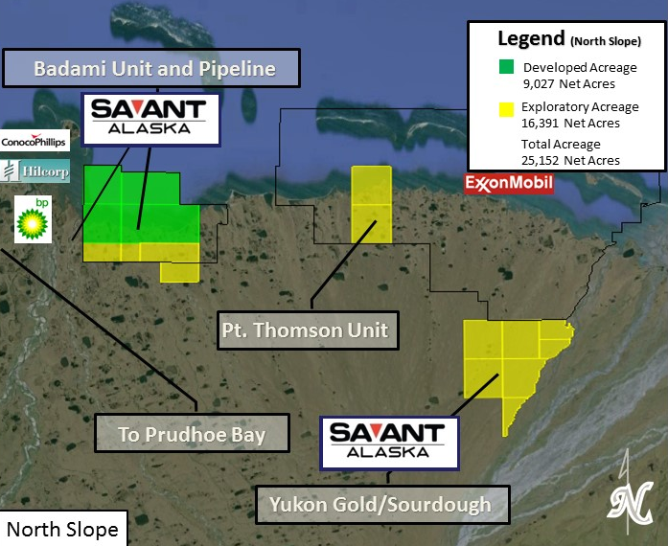
North Slope Acreage
Notes:
1.) As shown here 4 fields we currently operate in, however, we do have an appetite for exploration, Inshkin, Olson Creek, Otter, Susitna basin

Slide 6
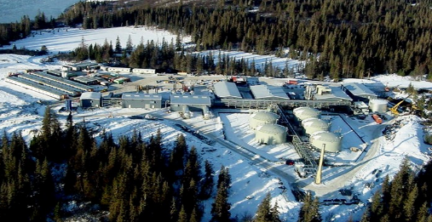
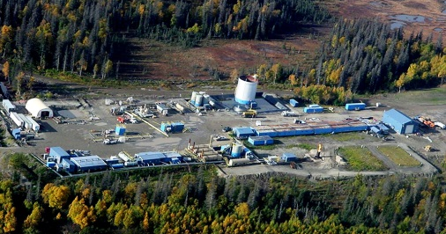
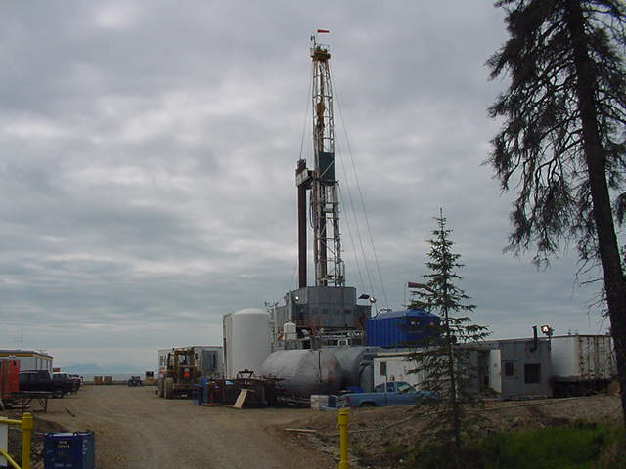
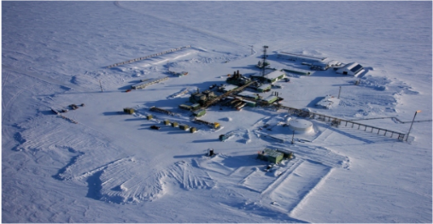
Four Distinct Fields in Alaska
Cook Inlet, AK
North Slope, AK
Redoubt
West McArthur River (WMRU)
North Fork
Badami (Savant)
^{Oil Production}
^{Oil Production}
^{Gas Production}
Midstream assets located in the Alaska North Slope with a design capacity of 38,500 BOPD and 50 miles of pipeline
Closed December of 2014
Notes:
1.) As shown here 4 fields we currently operate in, however, we do have an appetite for exploration, Inshkin, Olson Creek, Otter, Susitna basin

Slide 7
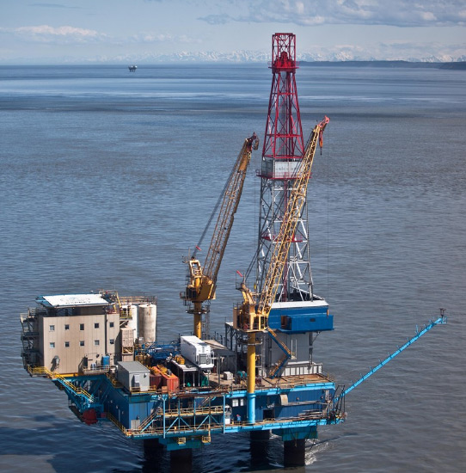

Redoubt Shoal Hemlock Structure
RU-7b SideTrack with 15K Frac
RU-12 Grass Root NW Step Out
Various Sidetracks and Workovers

Slide 8
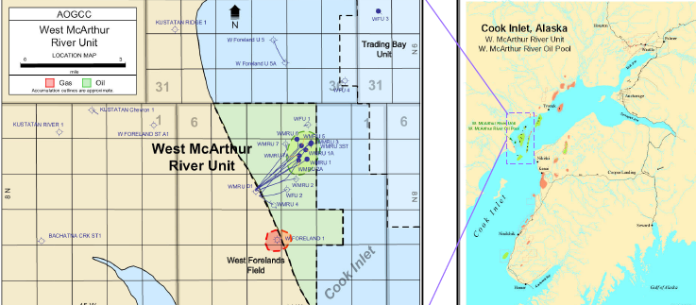
West McArthur River Unit
Highlights
WMRU-2B oil well successfully drilled in June of 2014
Sword-1 oil well successfully drilled in November of 2013
WMRU-8 sidetrack potential

Slide 9
North Fork Unit
Includes six (6) natural gas wells, production and processing equipment and 15,464 acres
Rig-37 (Glacier Rig) now at North Fork pad
First Well Drilled and Completed
Second Well TD’d
Evaluating oil potential
Preparing for pad & facilities expansion

Slide 10
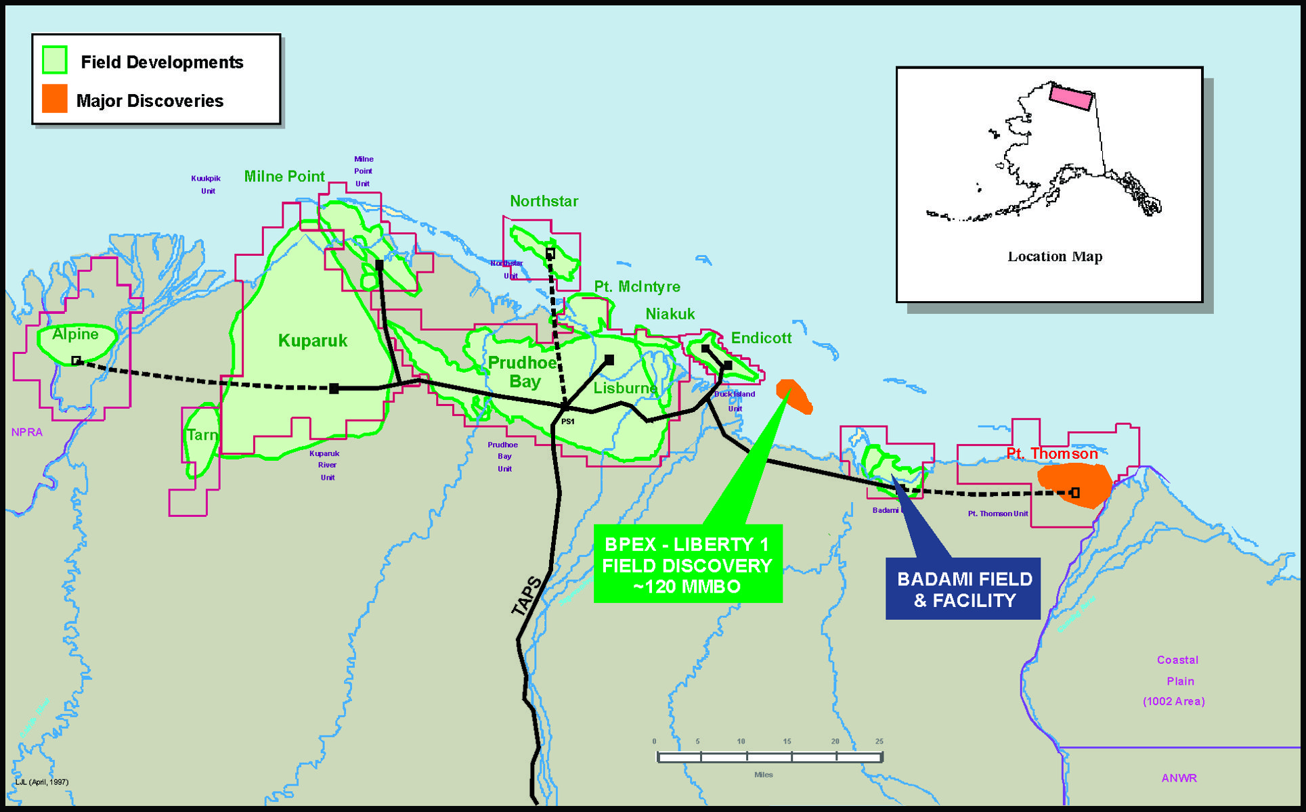
Badami
Acquired Savant Alaska, LLC in December of 2014
Assets would bring current production and ownership of midstream assets located in the Alaska North Slope with a design capacity of 38,500 BOPD and 50 miles of pipeline
Planned 2 Grass Root Wells in Summer of 2015

Slide 11
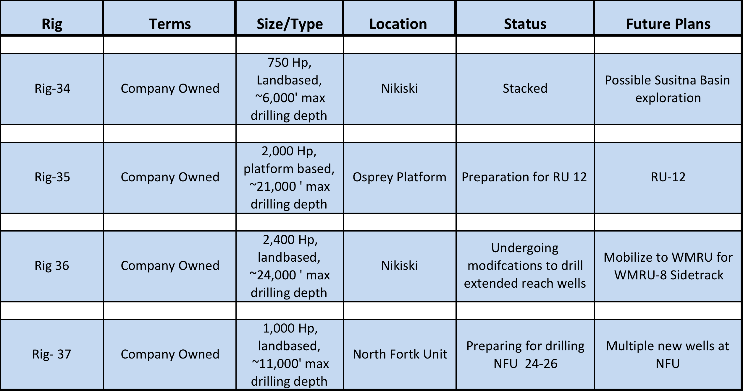
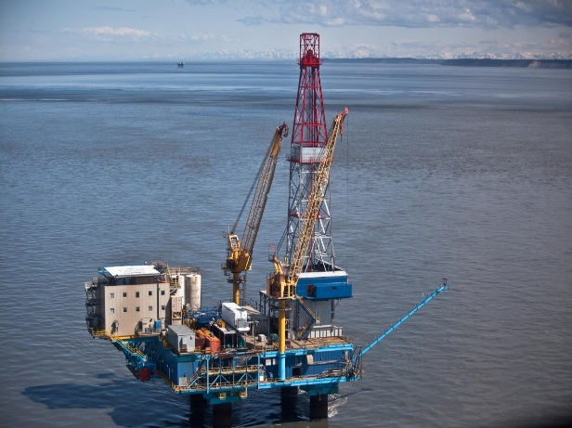
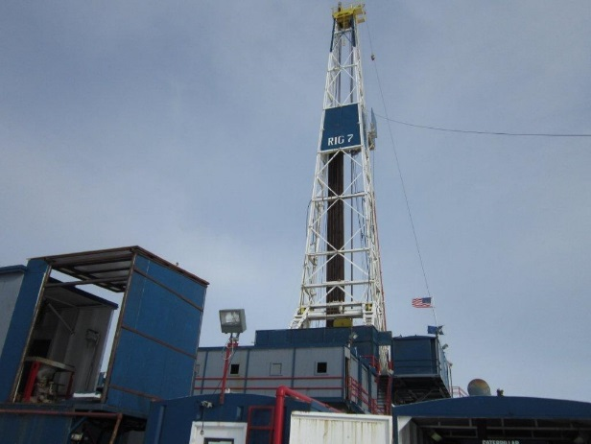
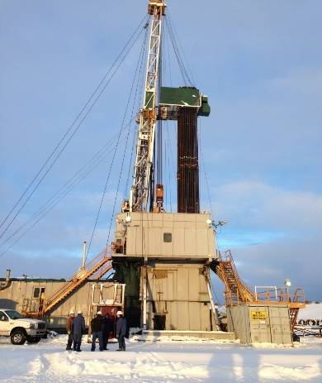
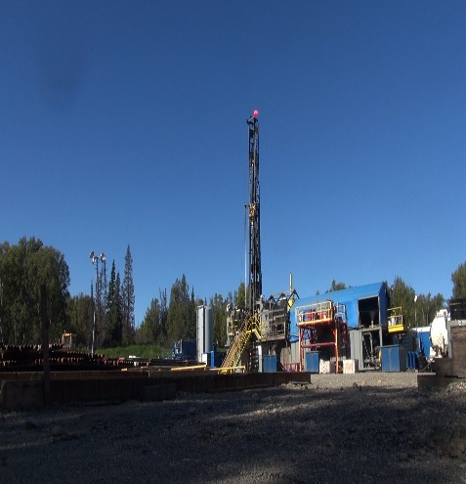
Alaska Drilling Rig Status
Leaving State
Rig 35 on Osprey
Rig 36
Rig 37
Rig 34

Slide 12
Drilling Inventory
Cook Inlet, AK
North Slope, AK
Redoubt
West McArthur River (WMRU)
North Fork
Badami (Savant)
RU 7B – 15K Frac
RU 6: Behind Pipe Location
RU 12: Northern Fault Block
RU 3: sidetrack of existing gas well
RU 4: sidetrack of existing gas well
South Step Out
WMRU-8 side-track
Sabre 1
NFU 24 – 26 - completed
NFU 42 – 35 – TD’d
NFU 22 - 26
Multiple PUD locations
Re-works of existing wells
2 potential fracs
2 Grass Root wells this spring/summer
2 – 4 Fracs
Other Areas
Susitna Basin Exploration License

Slide 13

Q & A

