Slide 1
AADE Operator’s Forum
ConocoPhillips Alaska, Inc.
2015 Outlook
Randall Kanady
Staff Drilling Engineer
CPA Drilling and Wells

Slide 2
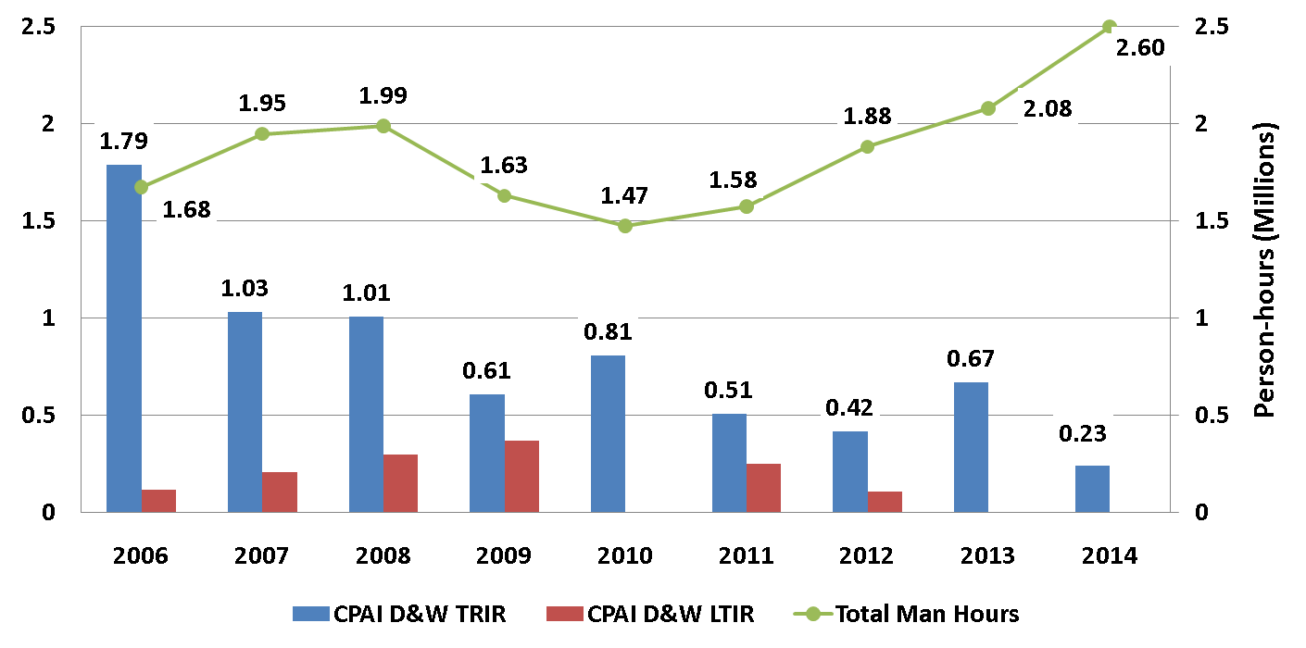
Health, Safety, & Environment – 2014 D&W Update
Short Service Employee policy
Hands-Free lifting policy
Proactive HSE Measures: Everyone Participates, Every Day
DROPS Audit review and corrective actions including enhanced lifting/rigging focus

Slide 3
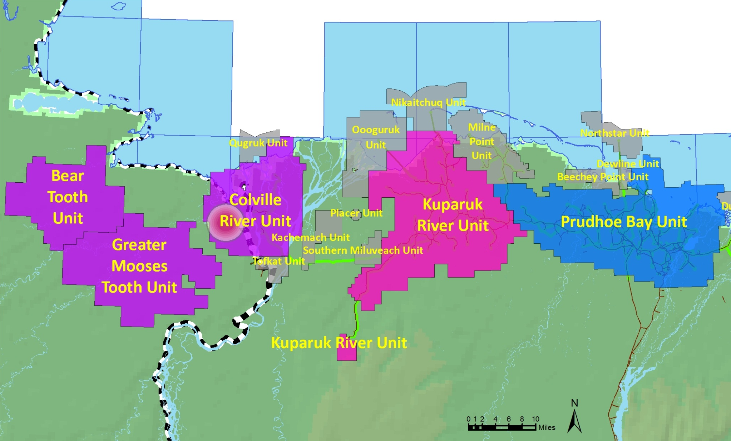
ConocoPhillips North Slope Assets
CD5
NPR-A
Western North Slope (“WNS”) – 78% WI
Kuparuk – 52-55% WI
Prudhoe – 36% WI

Slide 4
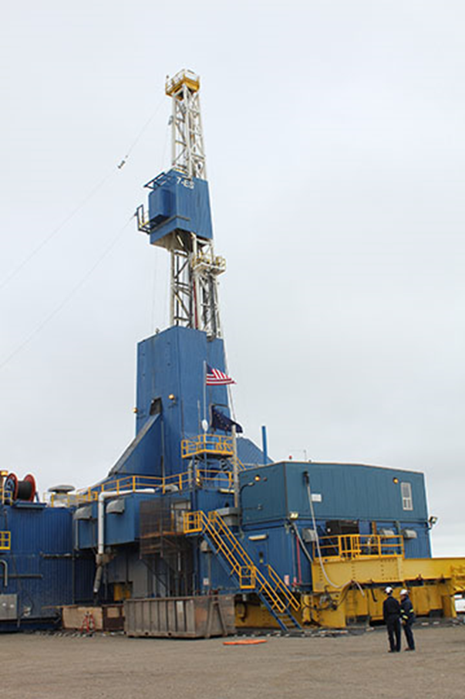
ConocoPhillips Alaska Rig and Well Intervention
North Slope Drilling
  1 Rotary Rig for Alpine (Doyon 19)
  2 Rotary Rigs for Kuparuk
    (Doyon 25 and Doyon 141)
  2 Work Over Rigs Kuparuk
    (Nabors 7ES and Nabors 9ES)
  1 CTD rig (Nabors CDR2)
North Slope Well Intervention
  7.5 Slickline Units
  1 Digital Slickline Unit
  2 Coil Tubing Units
  2 E-Line Units

Slide 5
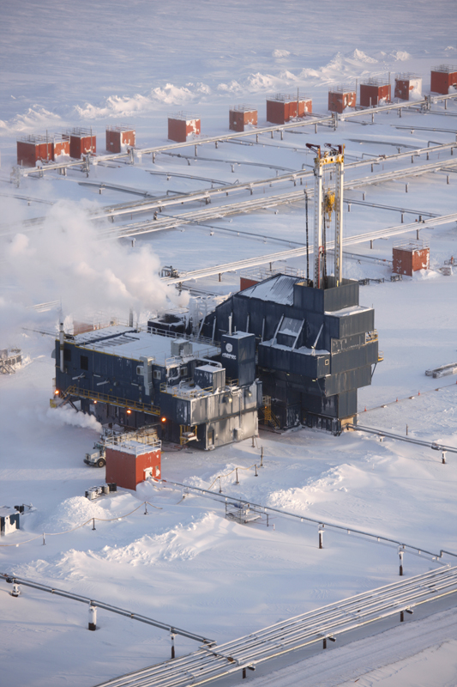
Rigs Added to Kuparuk
Nabors 7ES
  Began drilling summer 2013
  Approximately 100 direct and hundreds more indirect jobs
Nabors 9ES
  Began drilling in 2014
  Approximately 100 direct and hundreds more indirect jobs
Doyon 25 added in 4Q 2014
Signed a contract with Nabors Alaska for new-build CTD rig; begin drilling in late 2016
In July: Announced Contract with Doyon Drilling for New-Build Rig (Doyon 142)
  Slated to begin drilling wells in early 2016
  First new-build rotary rig added to Kuparuk’s rig fleet since 2000
Additional Drilling Has Added ~9,000 BOPD

Slide 6
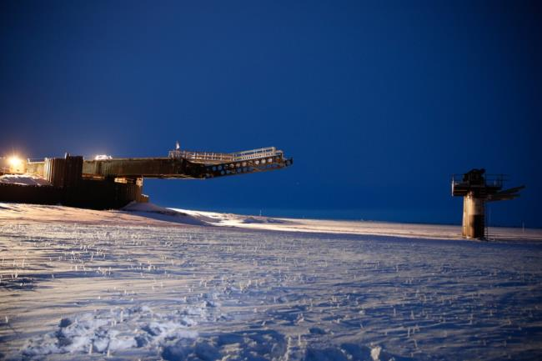
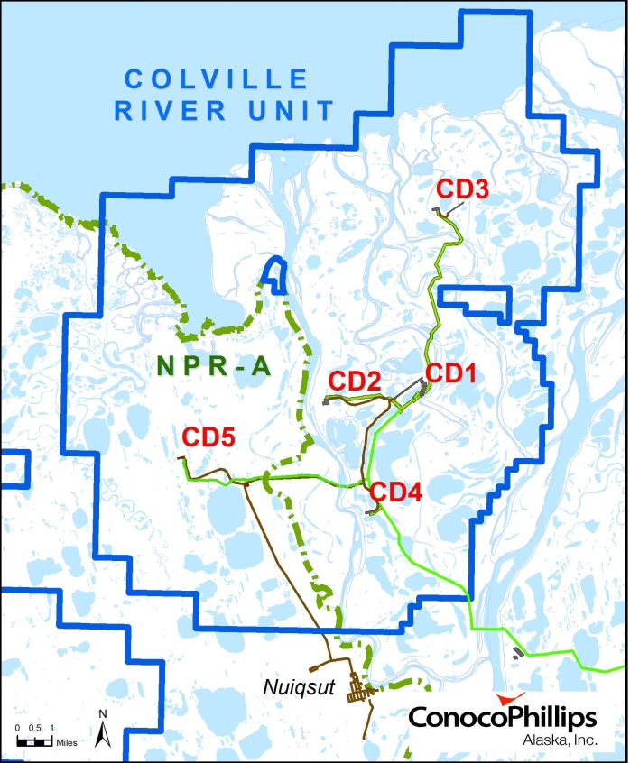
CD5 Development Progress
CD5: On Schedule – On Budget ~$1 billion
Successfully Completed
  6-mile gravel access road and pad
  Three smaller bridges
Nigliq Channel Bridge Completion
Planned Activities 2015
  Pipeline installation
  Drilling to start in ~April
  Installation of production facilities
Employment
  ~600 North Slope jobs required during two winter construction seasons
  Major fabrication activities in Anchorage and Fairbanks
Standard Alpine Drilling
Initial CD5 Development Plan
  13 Alpine A Sand Wells
  2 Kuparuk Wells
  Commence drilling April 2015
  First Production December 2015
Similar to Wells Drilled From CD2 and CD4
  15,000’ to 22,000’ MD

Slide 7
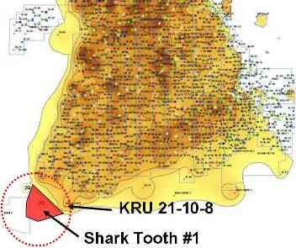
Kuparuk Drillsite 2S (Shark Tooth) Approved for Construction
New drill site development targeting thin sands on the periphery of the field
Peak workforce during construction: estimate 250+ jobs in 2015
Approximate cost to develop: ~$500 million (gross)
Start Drilling in ~June 2015
  Initial development is 14 wells
Estimated peak production: 8,000 BOPD (gross) in late 2015
Notes:
Record Kuparuk well drilled by Doyon 141 2F-22 22,009’ TD w/ 8549’ lateral in Kuparuk C Sand

Slide 8
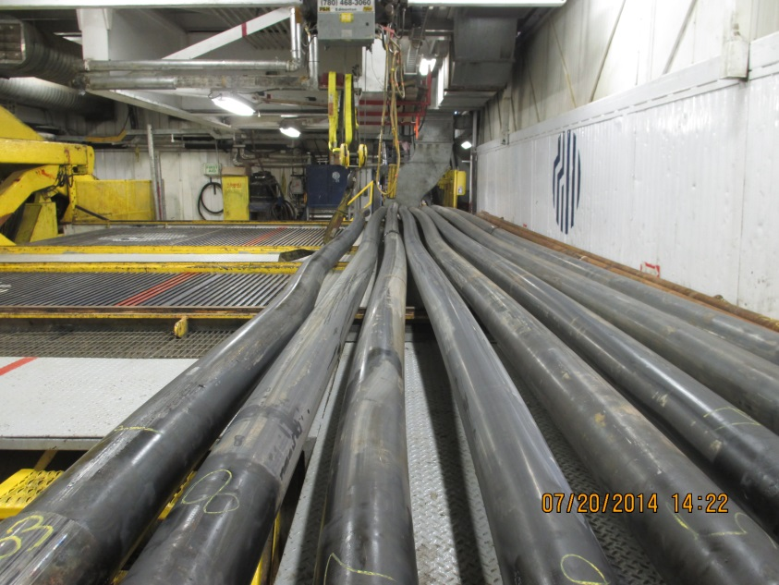
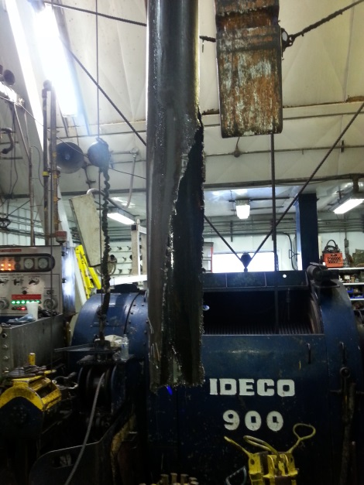
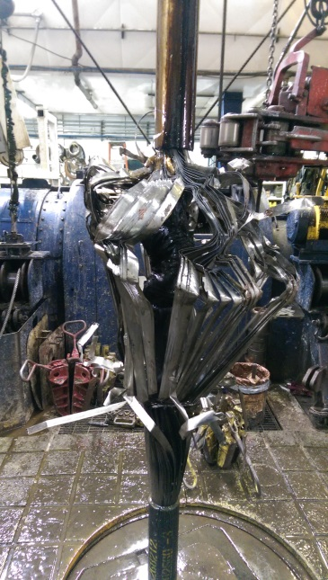
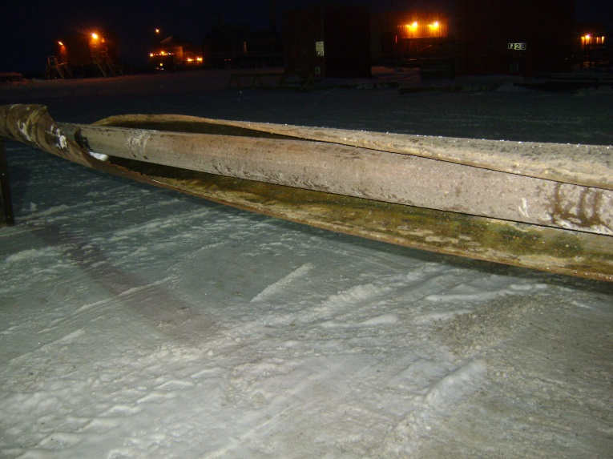
Rig Workovers
Workovers focus on CTD set-up and tubing swaps
Increasing difficulty pulling SSSV’s through buckled 7” casing
  SSSV’s part instantly when tight spots are encountered
  Procedures continue to change in order to manage new obstacles.
    Stretch casing prior to pulling tubing
    Deployment sleeve to drop off tubing
    2-stage cut & pull of 7” casing

Slide 9
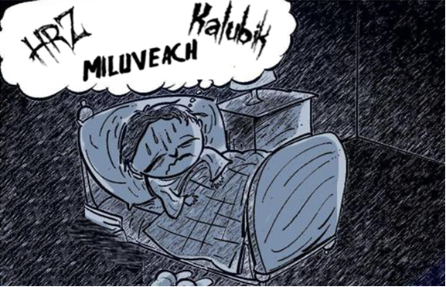
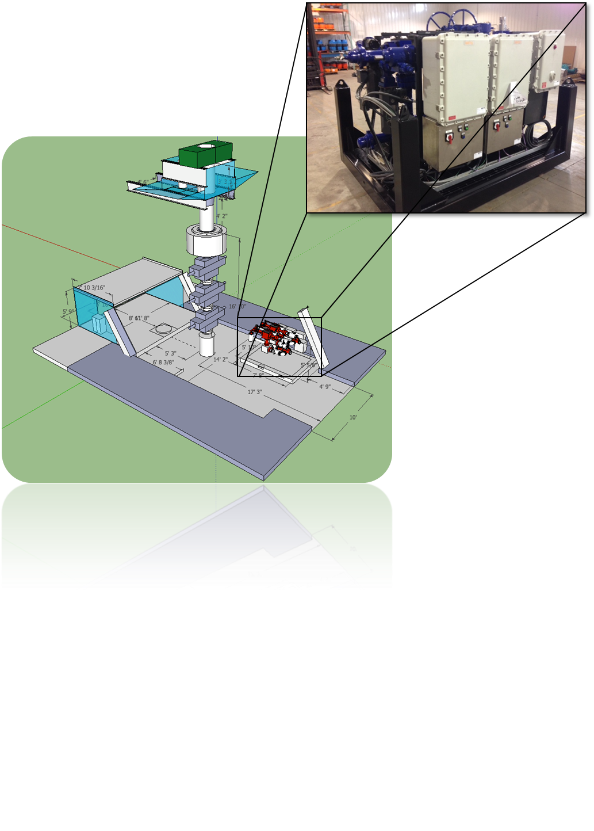
Managed Pressure Drilling Update
MPD allows for application of a stabilized equivalent mud weight while at the same time preventing pressure cycling
MPD also allows for tripping without swabbing
Since June 2014, 6 wells drilled and cased with MPD – 100% success rate
Baker System
Safekick Pressure Trapping System
    Electrically actuated chokes – No hydraulics
    Fully automated
    No auxiliary pump required
    Run via touchscreen by the driller on the rig floor

Slide 10
Questions?

