Slide 1

Improving NPT / Flat Time
as a Drilling Contractor

Slide 2
Outline
Introduction
How to approach “reduce NPT/Flat time”
Identification of areas to improve
How can they be improved?
Examples of time savings
Improvements in today’s market
How to look at savings differently
Conclusion

Slide 3
As contractors, we are constantly looking for ways to reduce our well cycle time to be competitive. With the current market especially, we must strive to reduce times on the items we control:
NPT/Flat time

Slide 4
Reducing NPT/Flat Time
Two perspectives exist in today’s market:
Overall time reduction of flat time / NPT
Remove limitations
Define processes
Reduce critical path operations
Standardization of human inputs
Remove the unknowns
Improvements to fit the market
Eliminate cost with changes in time / work
Cost benefits versus time

Slide 5
Potential Areas of Improvement
Rig Moves
Limitations in our Processes
Any Lesson’s Learned?
Nipple Up / Test
Critical Path Flat time
Drilling / Tripping Connections
High Impact on Overall Well Cycle Time
Unexpected Events
Mud Pump Expendables

Slide 6
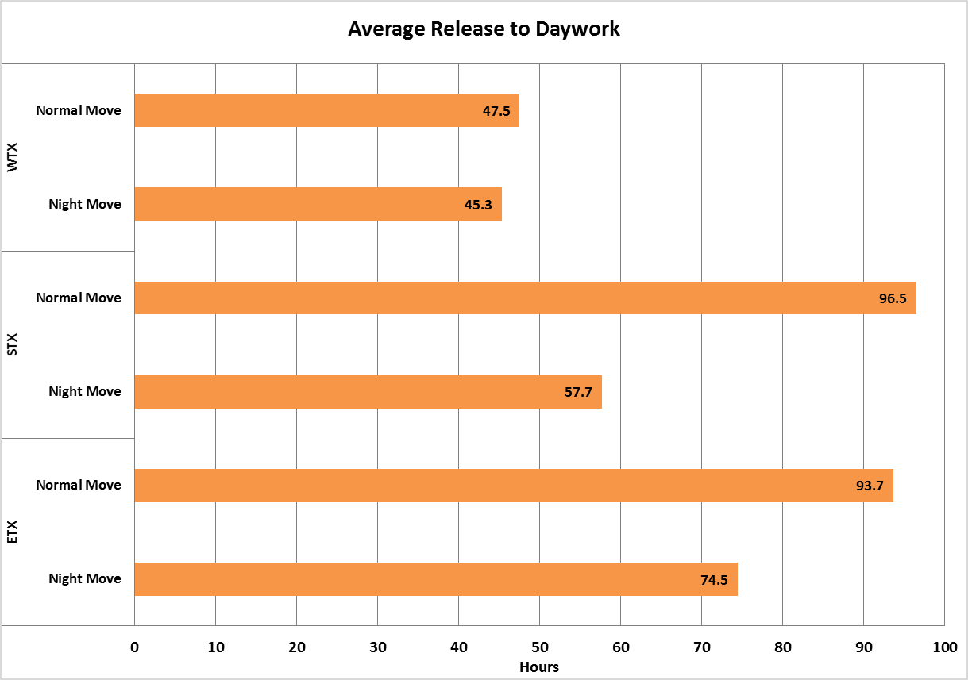
Improvement Areas – Rig Moves
Initially Identified Areas
1. Limited by daylight hours
Implemented use of 24 hrs slowly
2. Better planning for all circumstances
Created plans based on release time
3. Better communication of all involved
Rig Move Prep Meetings
After Action Reviews
*9 Months Implementation
*4 Months Implementation
*2 Months Implementation

Slide 7
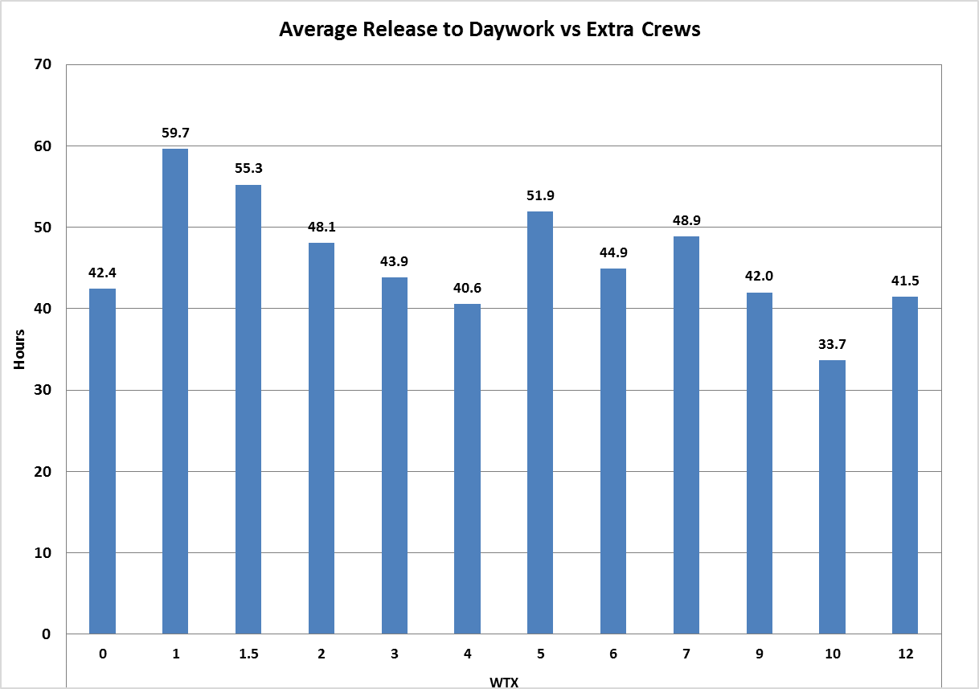
Improvement Areas – Rig Moves
Fine Tuning
Improvements
1. Looking at the use of Crews
Better planning / usage
2. Plan for the unexpected
Maintenance / Audits
Better prep meetings
3. Train for the future
Extra Crew Members

Slide 8
Improvement Areas – Nipple Up
Current Critical Path
Install well head -> Skid to next well -> Nipple Up BOP ≈ 8-10 hours
How can we remove this from the critical path
or improve the critical path…
SIMOPs

Slide 9
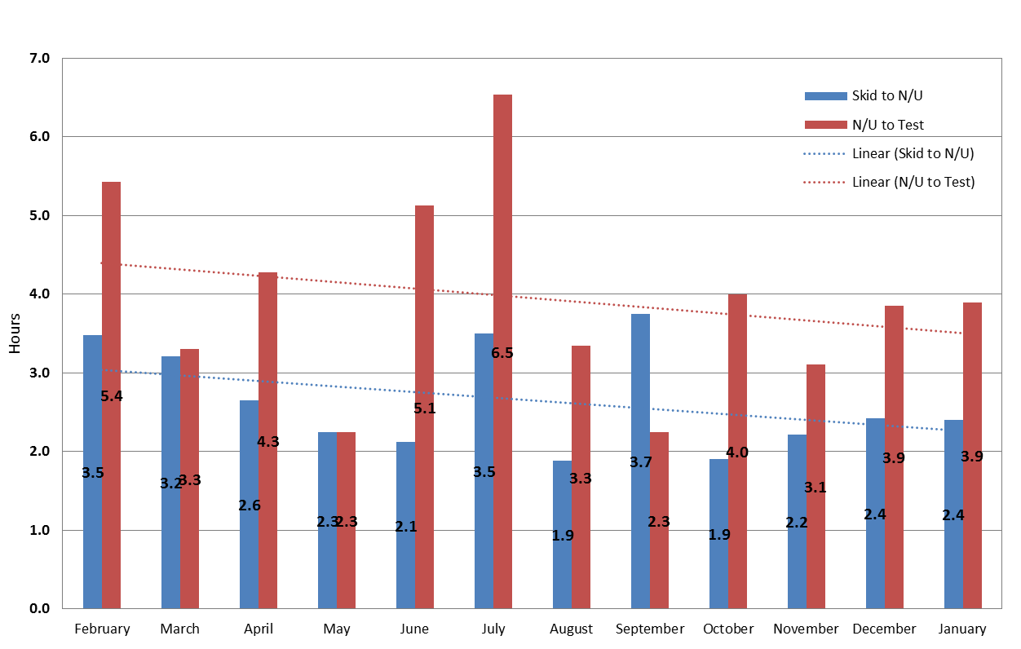

Improvement Areas – Nipple Up
New Critical Path
Skid to the next well < $\frac{Install well head @ the side of the sub}{Nipple Up BOP }$ ≈ 6-8 hours
*Better planning of our business helps us utilize the same number of crews but reduce overall hours
Notes:
Coordinate with operator on well centers up to 22 – stop mid skid to lower chain falls – coordinate with nipple up crews to bring two individuals with two torque wrenchs

Slide 10
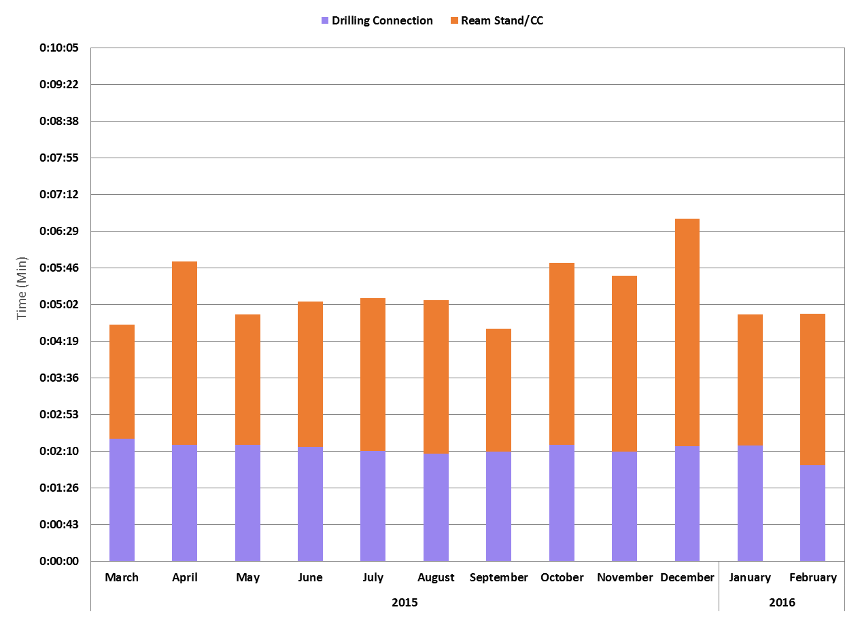
Improvement Areas – Connections
Measure
Implement
Improve
Standardizing interactions with the system:
What are we doing different between rigs?
What makes one connection better than another?
What can we control and what can we not?

Slide 11
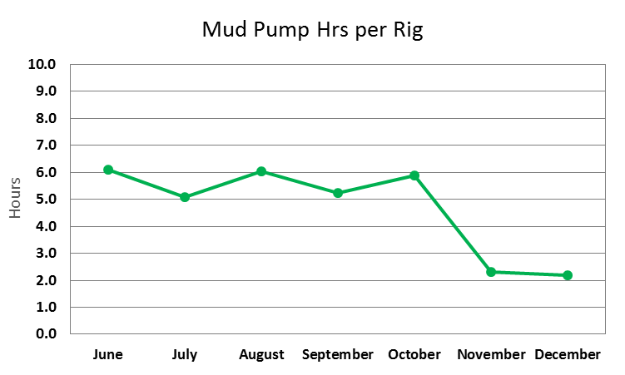
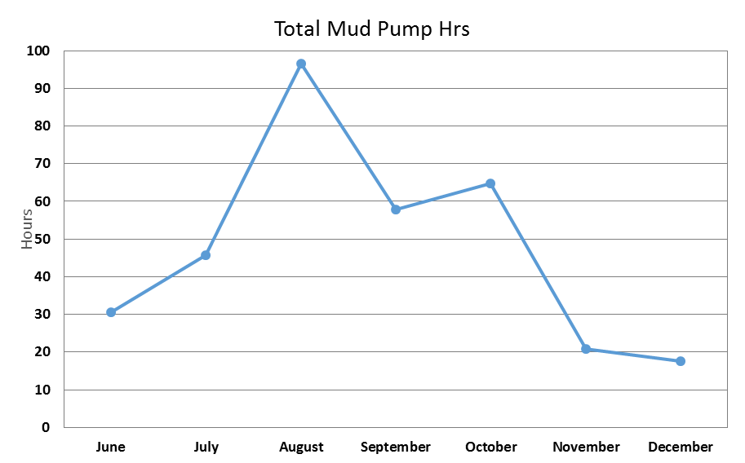
Improvement Areas – Other
Planning for the Expected
& the Unexpected
Mud Pump Expendables: We know they will not last but can we predict when they will fail?
Using our data and planning ahead can be an easy solution with tremendous results

Slide 12
How does today’s market affect these initiatives?

Slide 13
Improving in Today’s Market
Rig Moves
Improvement Requirements:
Added extra crews
Added extra trucks
Current Considerations:
Where / when do we need extra crews & trucks?
Utilizing 1 extra crew & extra trucks 2 days
*Numbers above are arbitrary and reflect cost % comparison & do not reflect true actual cost

Slide 14
Improving in Today’s Market
Rig Utilization
Potential Batch Drilling Savings
Fewer times laying down pipe
Few mud changes / pit cleanings
End back @ home position for improved move times
Potential Sequential Drilling Savings
Few instances of Nipple Up / Test BOP
Can utilize SIMOPs for Nipple Up
So initially what would you say is the best option?

Slide 15
Improving in Today’s Market
Looking at time and cost you get a different picture:
- Coordinating our planning can save both time and money which is essential in this market.
*Numbers above are arbitrary and reflect cost % comparison & do not reflect true actual cost
Notes:
Assuming 3 string well

Slide 16
Conclusion
Decreasing NPT / Flat time
Looking into a single activity can lead to inefficiencies in other areas
Systematic approach helps improve efficiencies with the least amount of effort & helps define success/failure
All around better communication and group efforts in planning and review makes the biggest difference
Looking at time savings from a cost perspective
Spending more can be more cost effective
The intuitive answer may not be the logical path in today’s conditions
And….

Slide 17
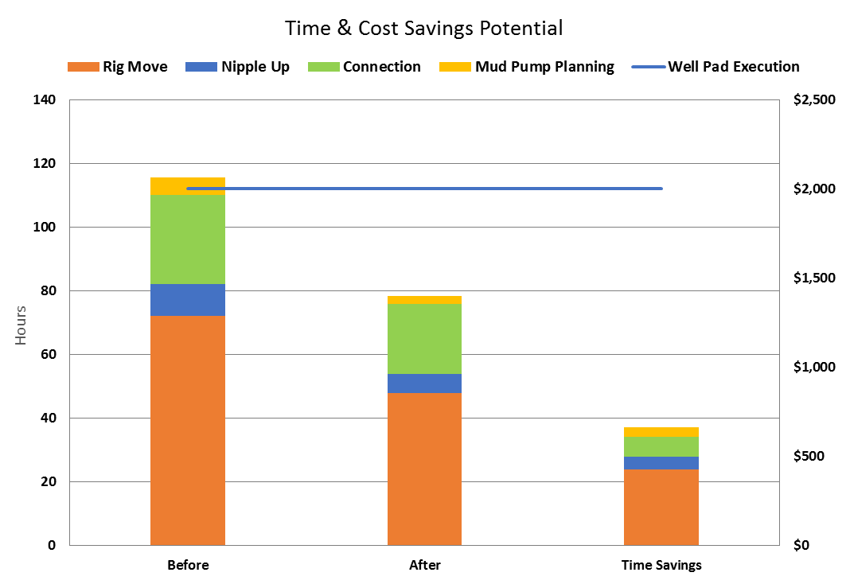
Conclusion
Small changes can make vast improvements from both perspectives

Slide 18
Questions?

