Slide 1
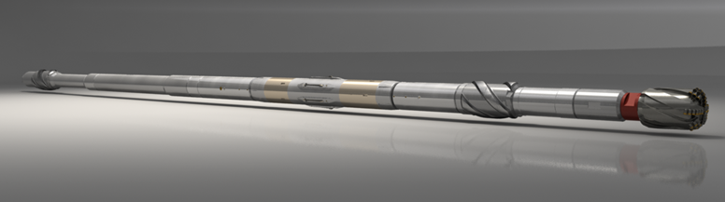
Revolution® RSS
Jerid Achord – U.S. RSS Product Line Manager

Slide 2
How Improving Technology Improves Performance

Slide 3
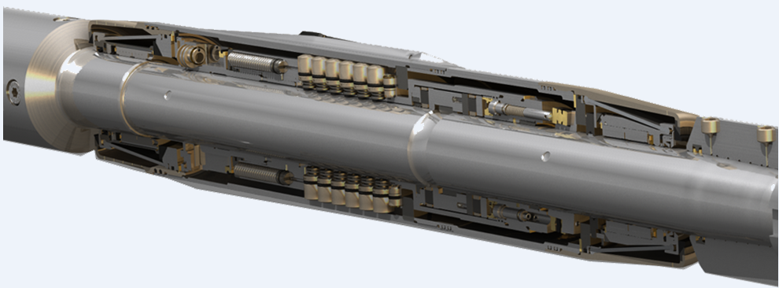
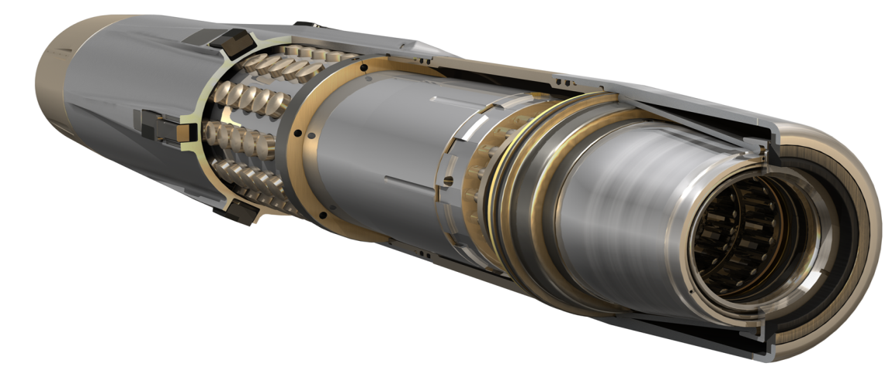
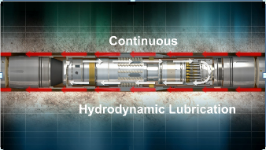
Revolution® – Mechanical Bias Unit
Mechanical Bias Unit:-
  Hydraulic powered piston manifold
  Swash Plate pump
  Minimal Battery Power Usage
Notes:
- Relative rotation between the center shaft and a non-rotating outer housing
drives a hydraulic pump, which generates the force to deflect the
drillstring according to the well plan

Slide 4
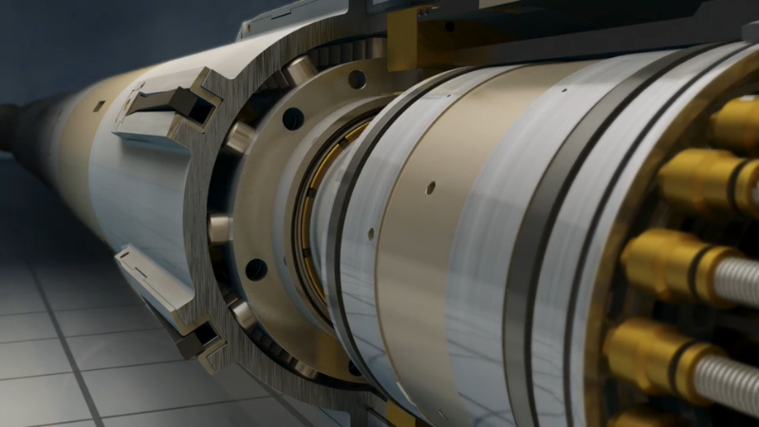
Revolution® - Directional Control
Drill vertical, curve, and lateral sections in one run
Toolface Modes
  Magnetic (Kick Off from Vertical)
  Gravity (Highside over 10 degrees)
Autopilot Feature
  Inclination Hold Mode
  3D directional control

Slide 5

Real Efficiency Producing Real Results

Slide 6
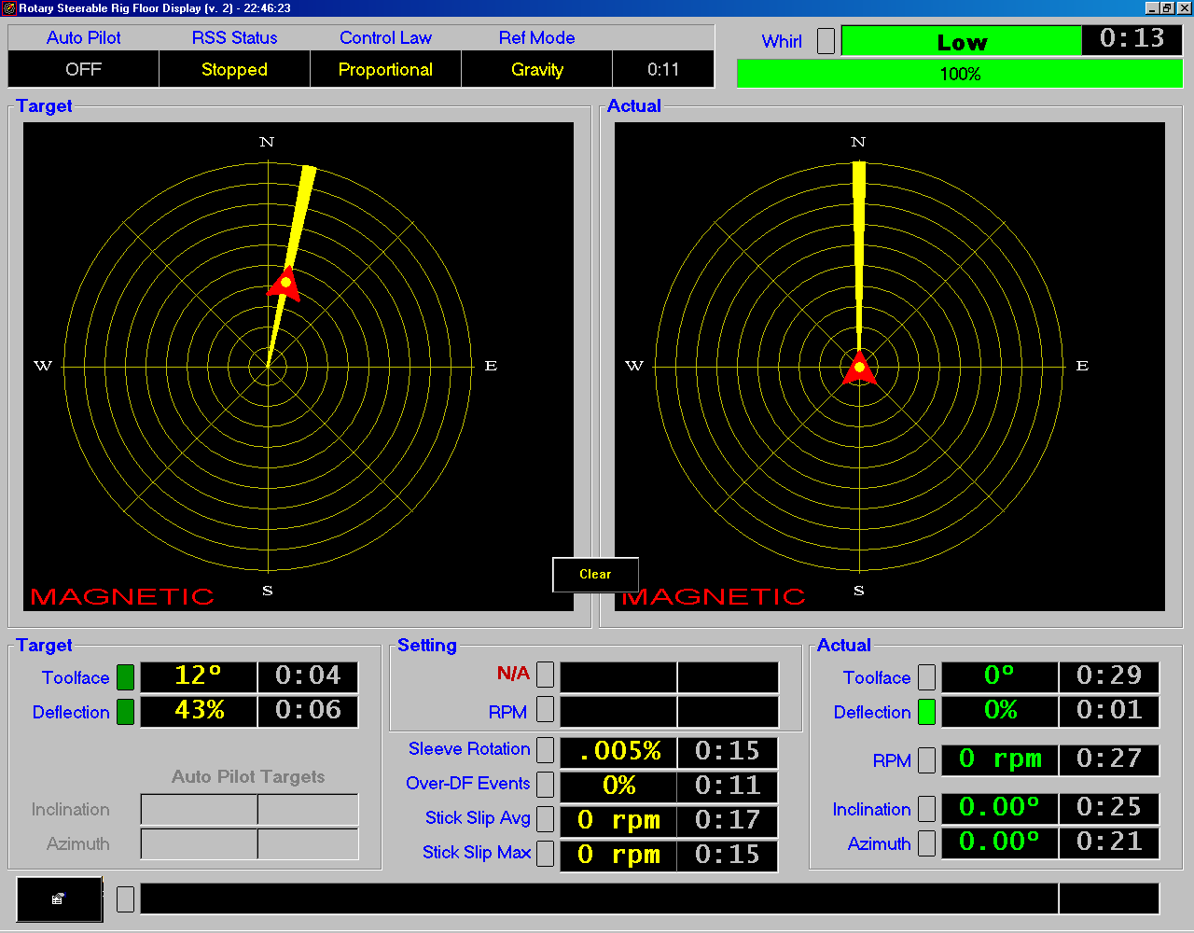
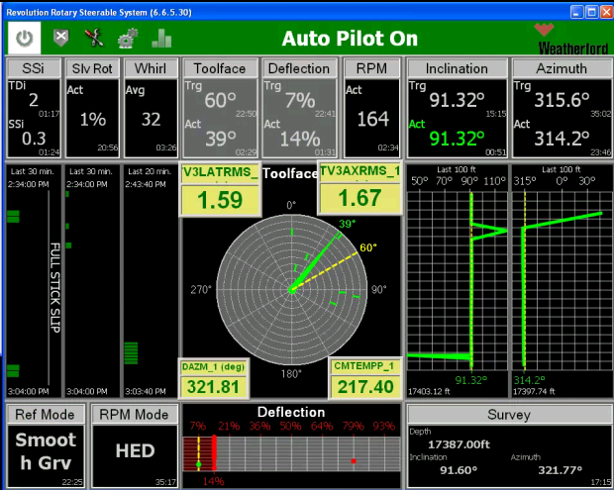
From Then to Now (Making a Difference)
Original Display with Realtime data
  Only Stick Slip Data
  No Whirl or Recorded Burst Data
  Average Run Distance of 3,100’
2014 Implement new sensors
  Whirl Values
  Torsional Dynamic Indicator
  Stick Slip Index Values
  Burst Data to Analyze Freq.
  Average Run Distance of 5,900’
  4 Global Records Set in U.S. of 16,000’ + Sections

Slide 7
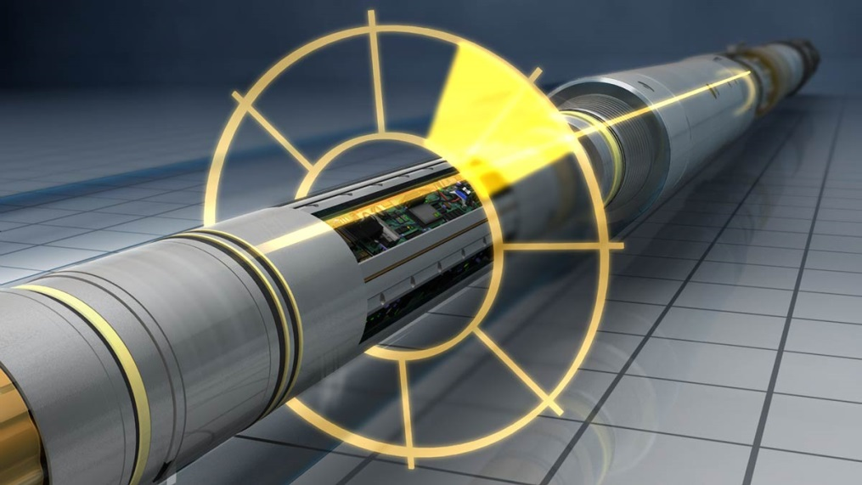
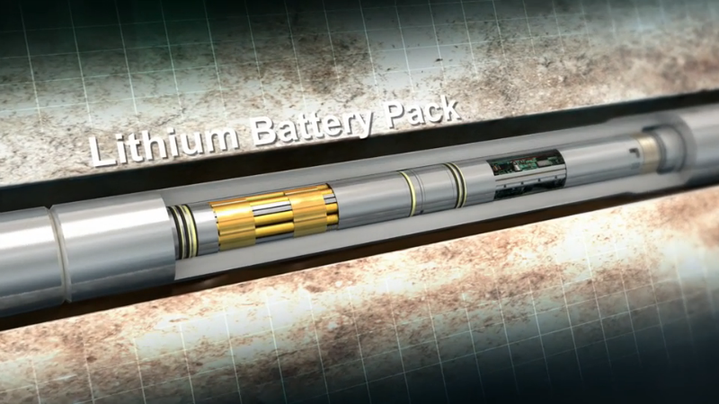
Revolution® - Control Unit
Features
  On-the-fly downlinking delivers command changes while Drilling
  On board sensors measure vibrations , whirl, and stick-slip allowing for real-time mitigation
  Near bit inclination and azimuth measurements (9 – 12 ft back)
Notes:
Battery Specs:
Standard: 475 (24) / 675 (48) / 825 (60)
Medium: 475 (18) / 675 (34) / 825 (42)
High: 475 (14) / 675 (33) / 825 (41)
Avg. consumption rate = .15 Ah

Slide 8
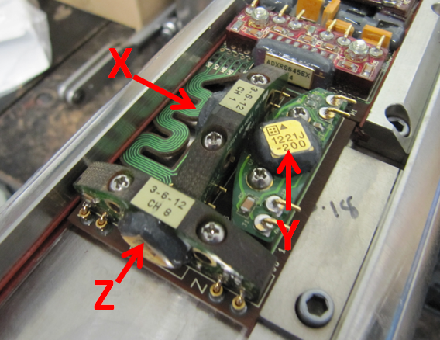
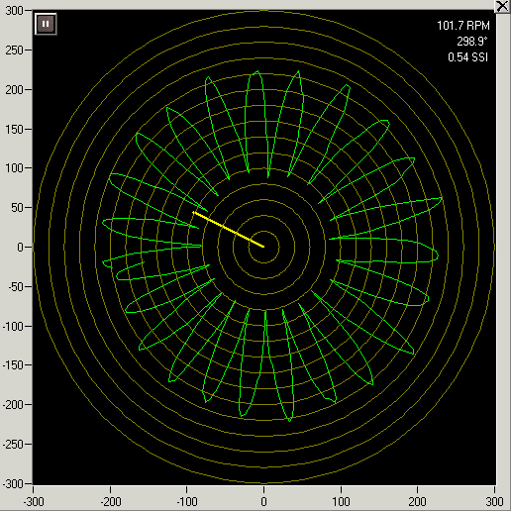
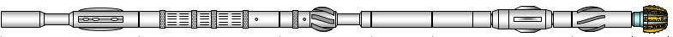
Next Generation Technology Now
3 Orthogonal +/- 200g Accelerometers
  Measures Tangential, Radial and Axial
  1000Hz sample rate
  Shock and vibration burst data
Angular Rate Gyro (TVM2+ only)
  High fidelity RPM measurement
  +/- 800rpm
  High Temp
  1000Hz sample rate
  Can measure negative rotation (Actual Backward Whirl)
Applications
  LWD/MWD/RSS BHAs – Capable of being utilized in 9 different BHA components
  RSS pivot stabilizer
  Real-time telemetry

Slide 9

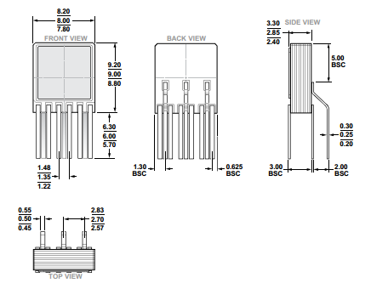
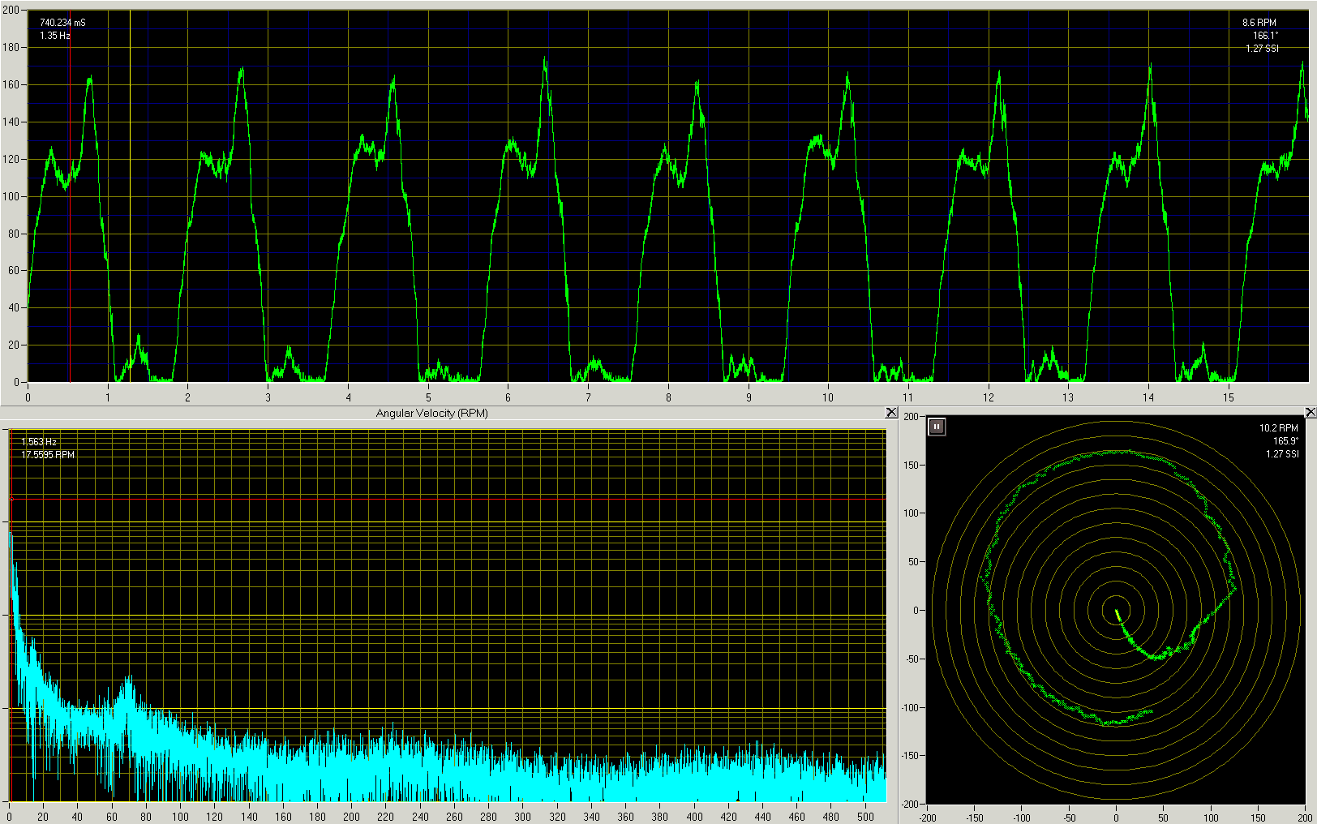
Putting in Use across all Product Lines
Angular Rate Gyro
  Small form factor
  High bandwidth measurement
  Azimuthal RPM capability
  Patented application
Animation:
  Steerable motor BHA
  Rotating in curved (build) hole
  String rotation ‘sticks’ when bend on low-side of the hole

Slide 10
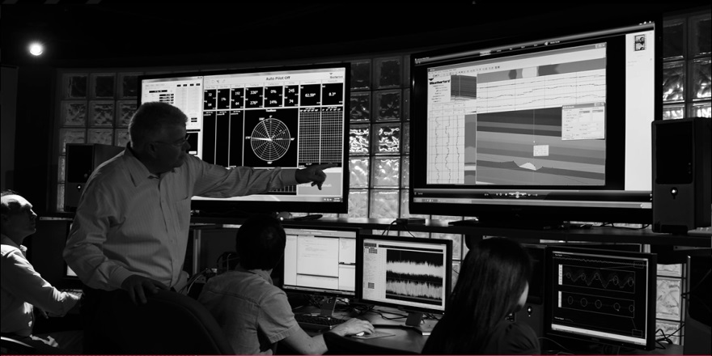
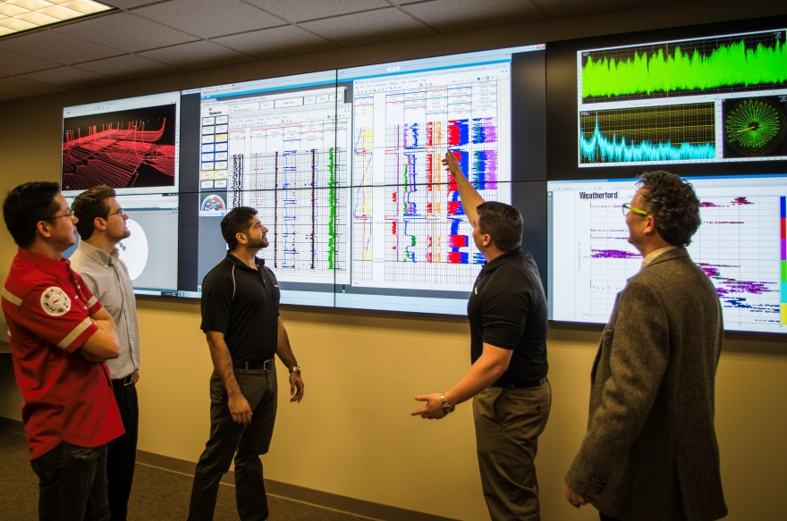
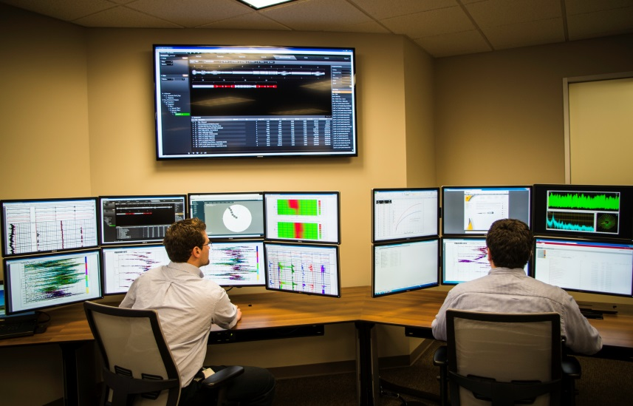
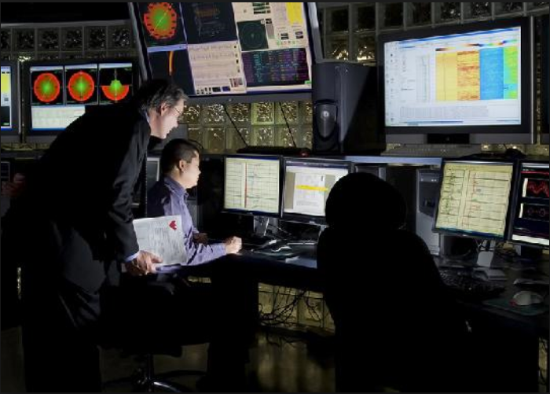
Welcome to Weatherford’s RTOC

