Slide 1
The 2018 Oilfield
Richard Spears
Spears & Associates
Tulsa

Slide 2
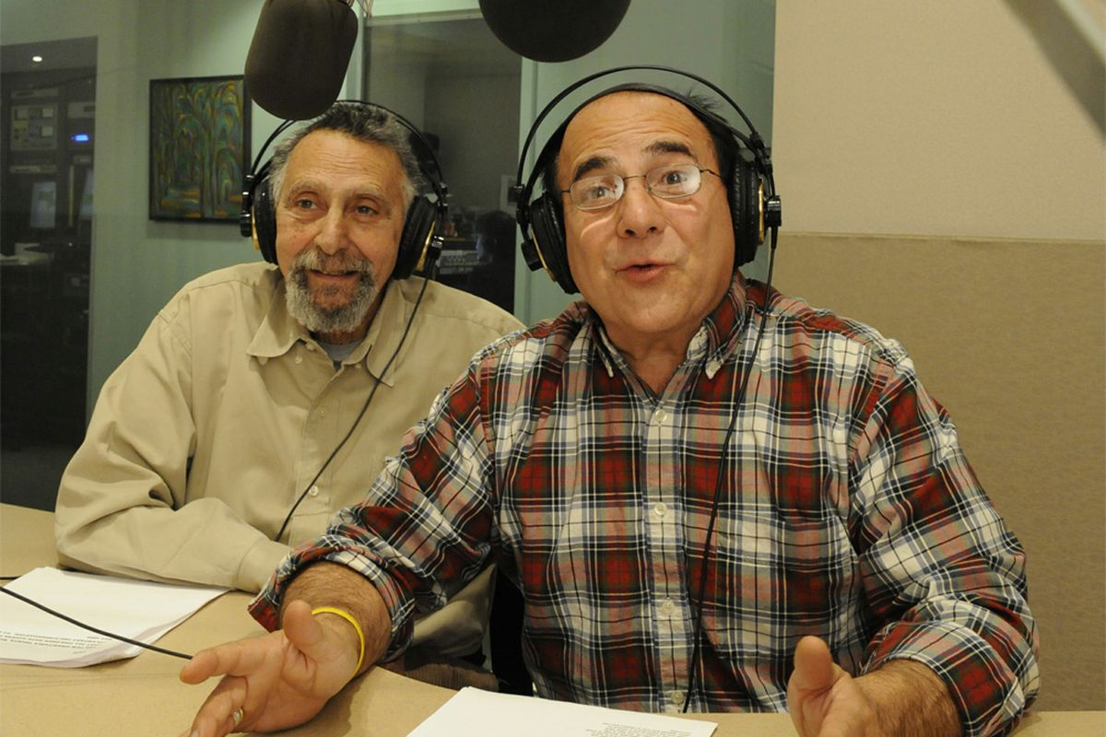
2017: End of Car Talk

Slide 3
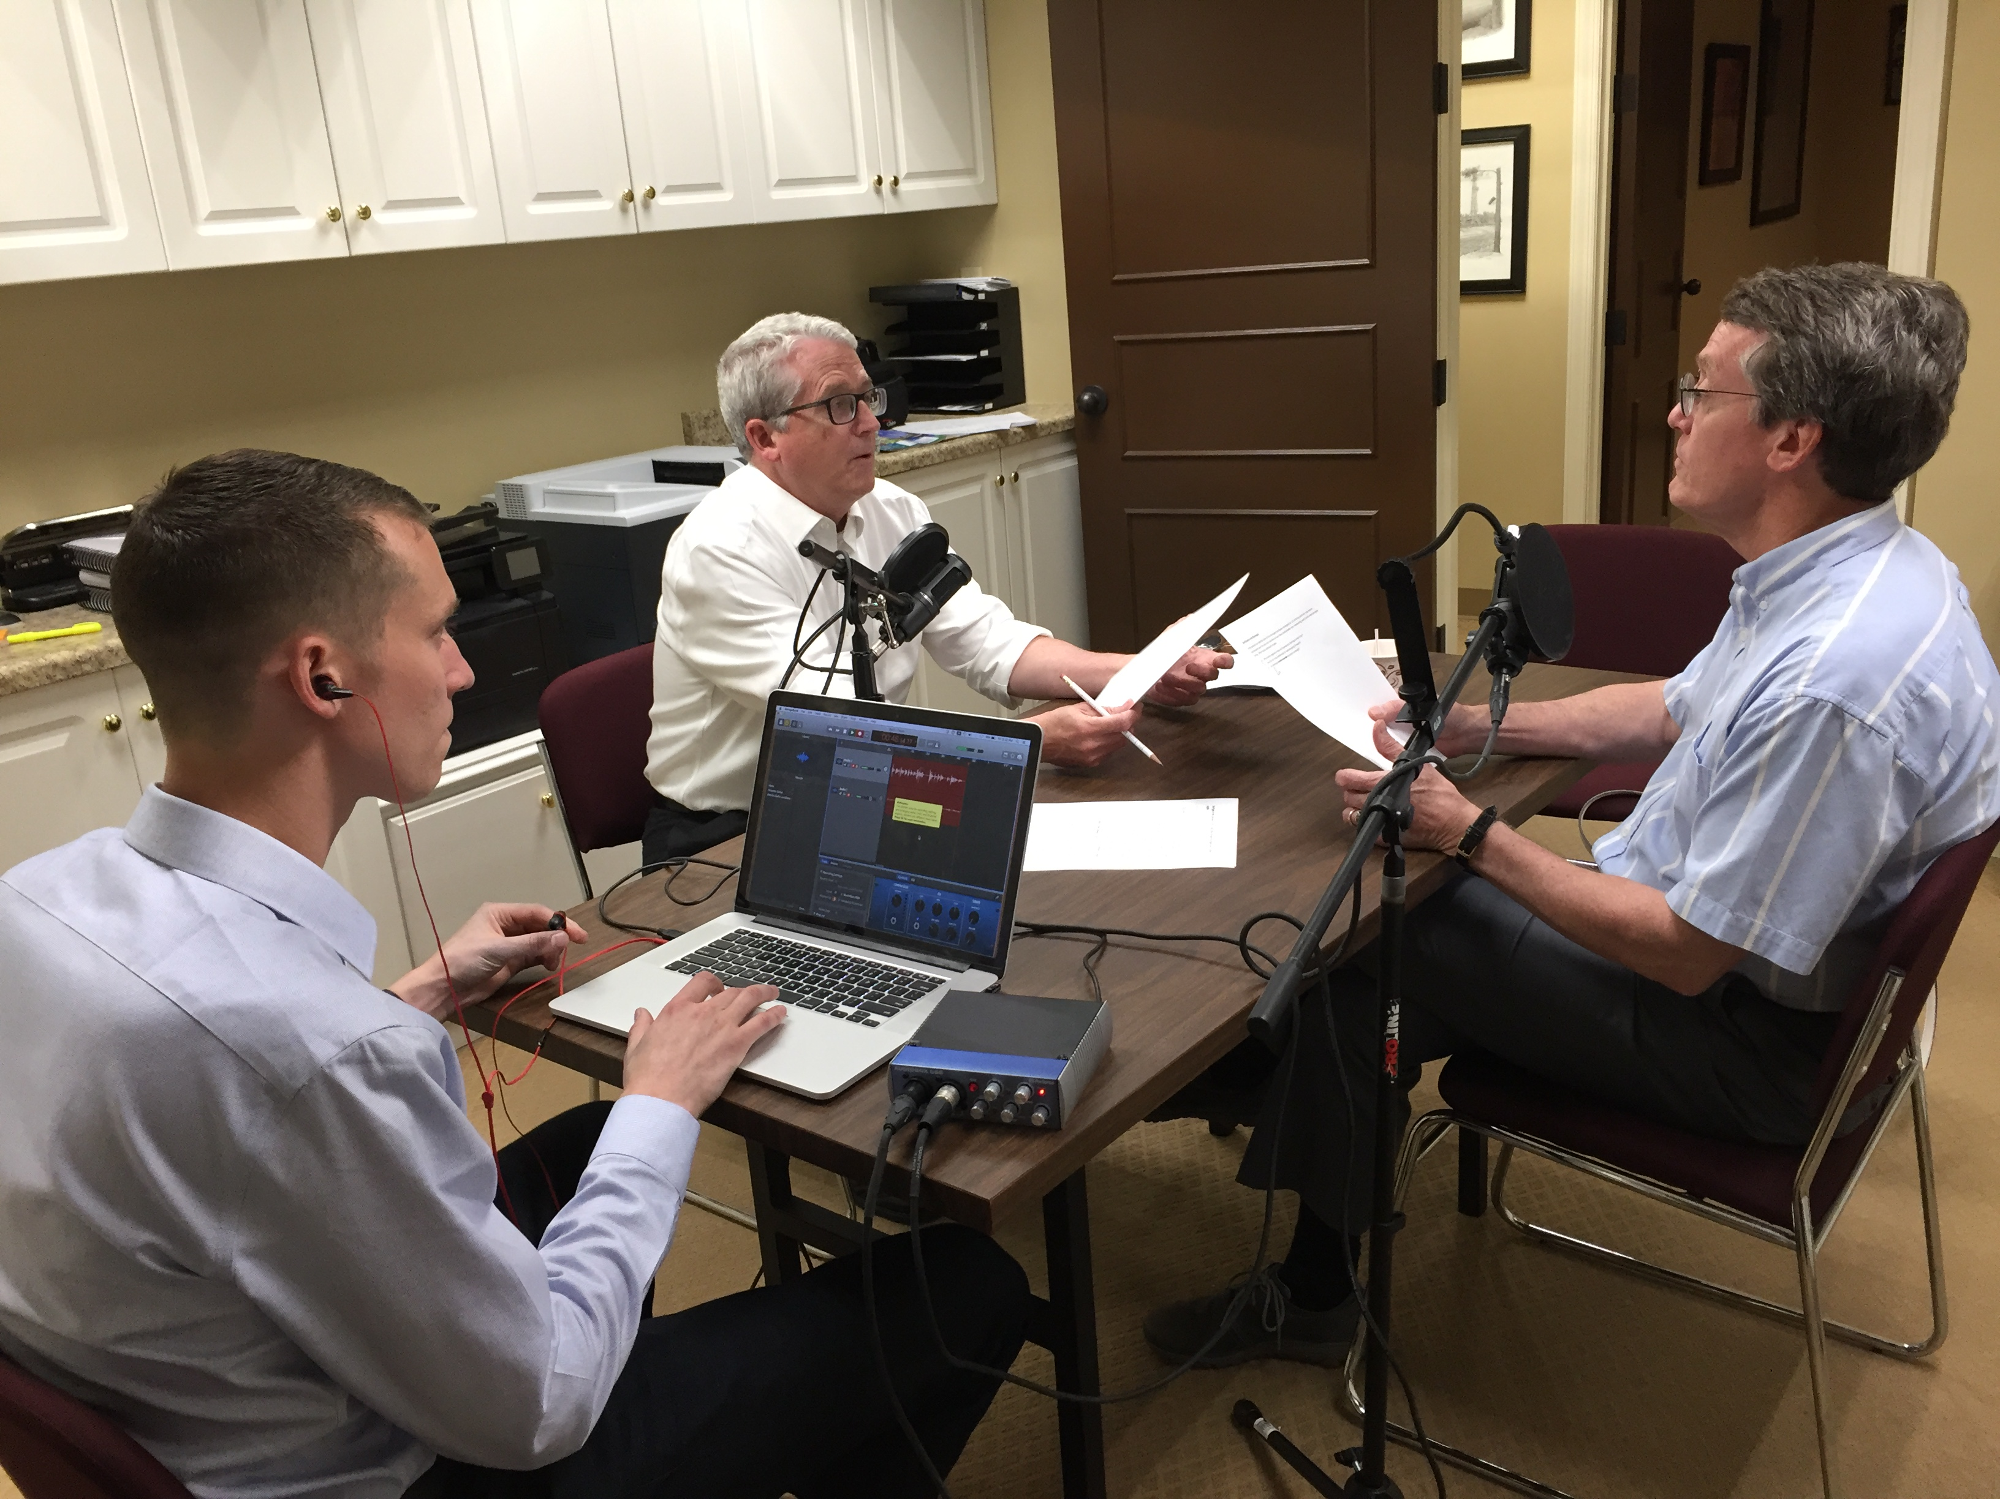
The Drilldown Podcast

Slide 4

The Drilldown Podcast

Slide 5
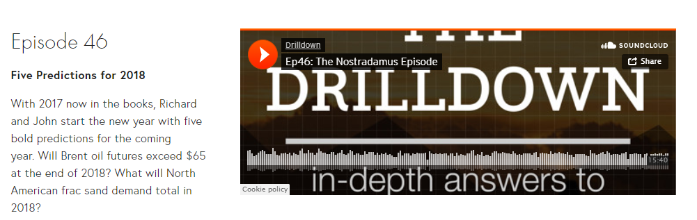
The Drilldown Podcast
spearsresearch.com

Slide 6
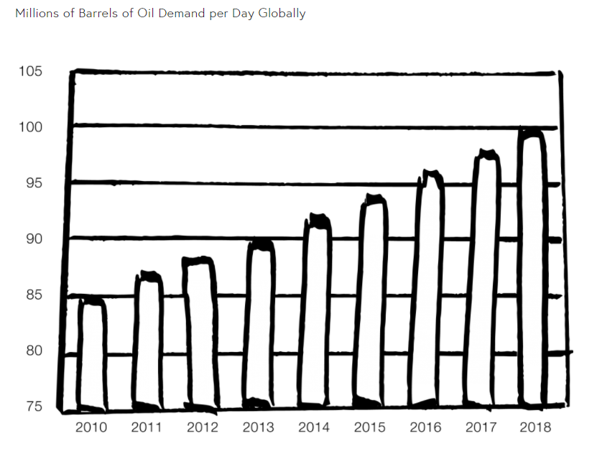
Oil Demand

Slide 7

Snow in Algeria Jan ‘18

Slide 8
‘18 Assumed Oil Price
$60 WTI

Slide 9
Today’s Oil Price
$64 WTI

Slide 10
Global Oilfield
Oilfield Market Report, Spears & Associates

Slide 11
2018 Market Growth
Oilfield Market Report, Spears & Associates

Slide 12
2018 Market Growth
Oilfield Market Report, Spears & Associates

Slide 13
US Laterals
DrillingInfo

Slide 14
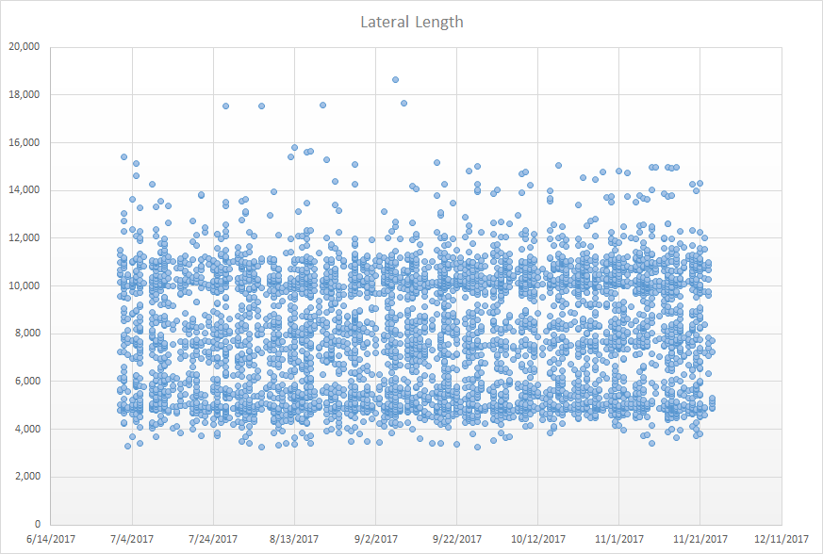
DrillingInfo

Slide 15
US Land Drilling
Oilfield Logix Series, Spears & Associates

Slide 16
US Directional
Oilfield Logix Series, Spears & Associates

Slide 17
Directional Drilling
 | Land | Offshore | Total
US | $2.9 | $0.2 | $3.1
Canada | $0.4 | $0.1 | $0.5
Intl | $1.0 | $3.0 | $4.0
Total | $4.3 | $3.3 | $7.6
Directional Drilling Report, Spears & Associates

Slide 18
US Frac
Oilfield Logix Series, Spears & Associates

Slide 19
US Frac Mkt vs Sand
Hydraulic Fracturing Market by Spears & Associates

Slide 20
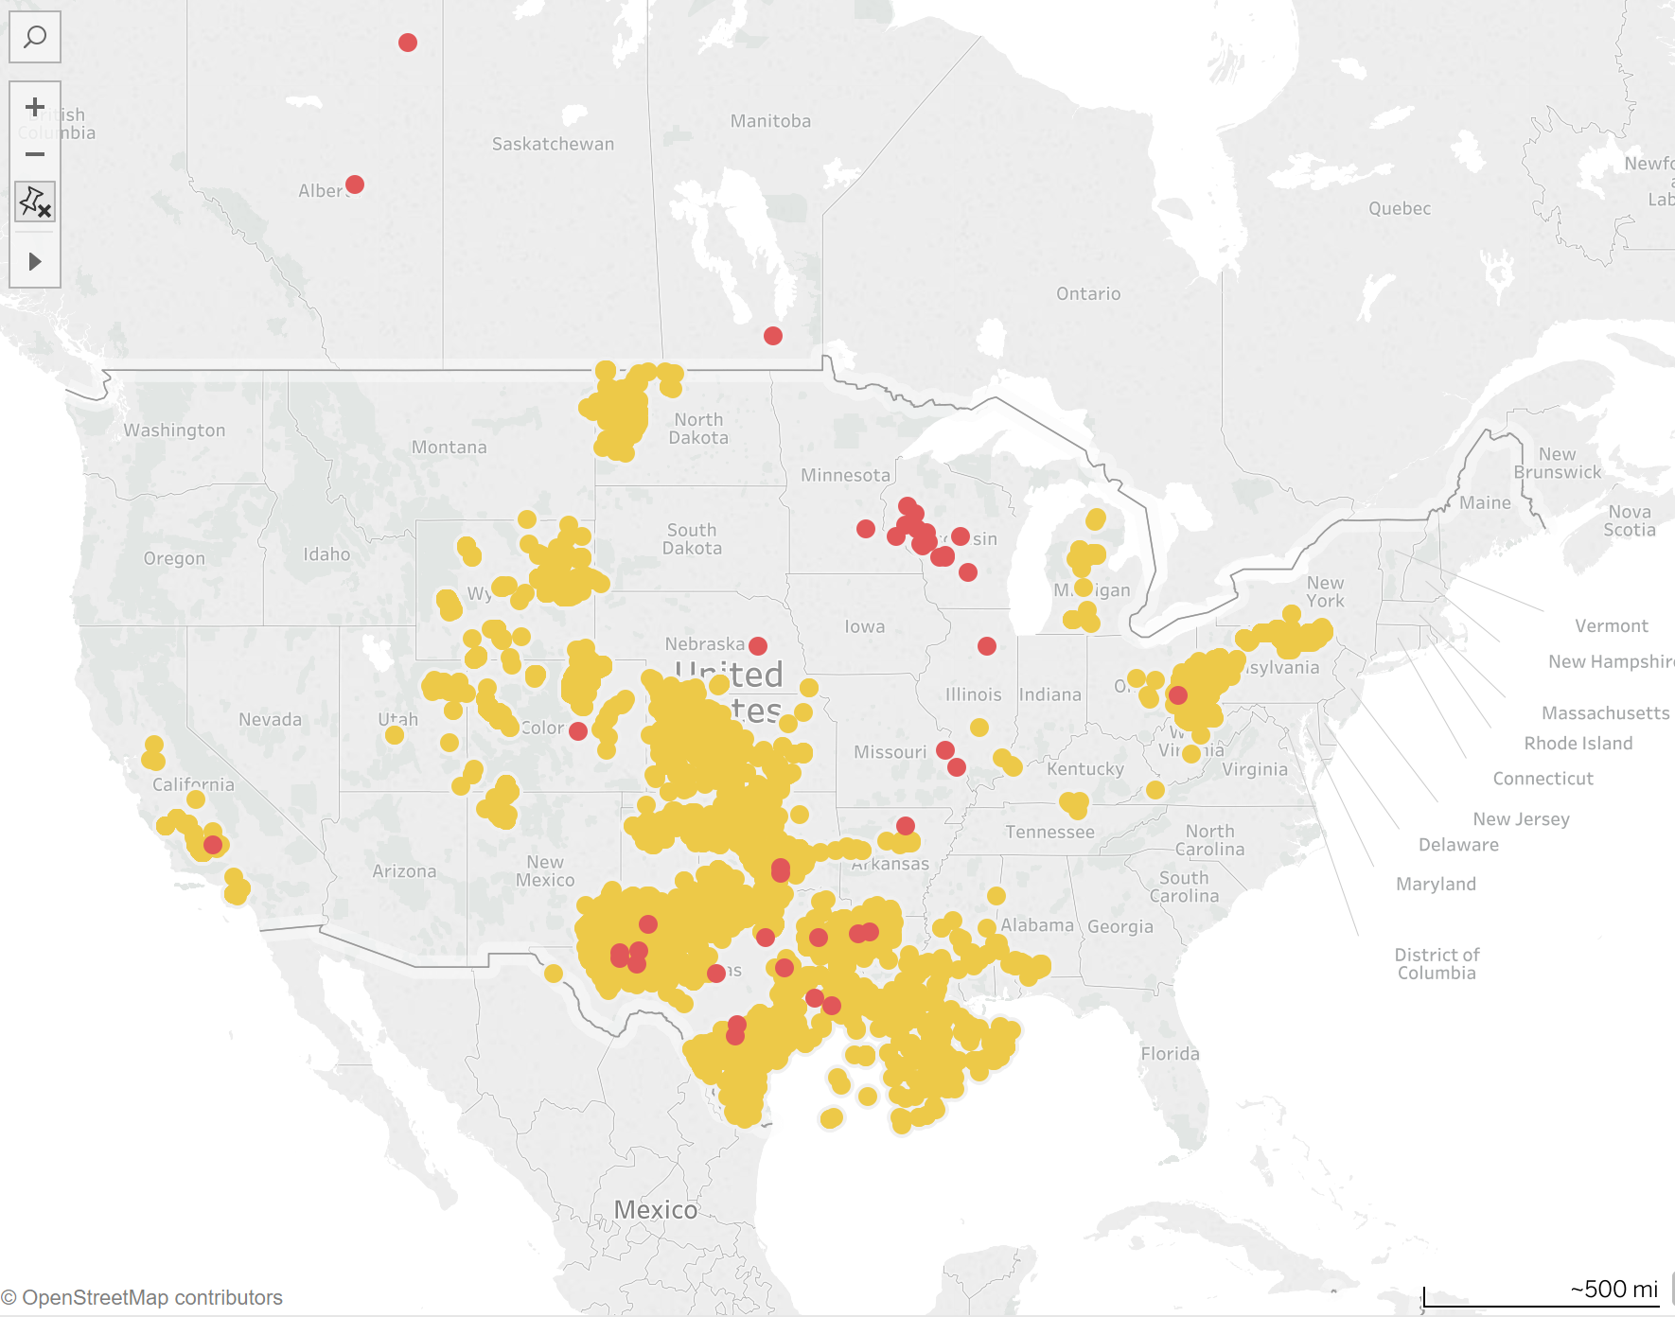
SAND MINES +
HORIZONTAL WELLS
~ 70 mi

Slide 21
SAND MINES +
HORIZONTAL WELLS
~ 70 mi

Slide 22
Offshore Drillers
Forecast
Public companies only
Product Line Forecast, Spears & Associates

Slide 23
Headlines for 2018
Will January 2019 oil price futures stay at $52?
In-basin sand…is it too dirty?
Can frac catch up with drilling in the Permian?
How real is death by bubble point?

Slide 24
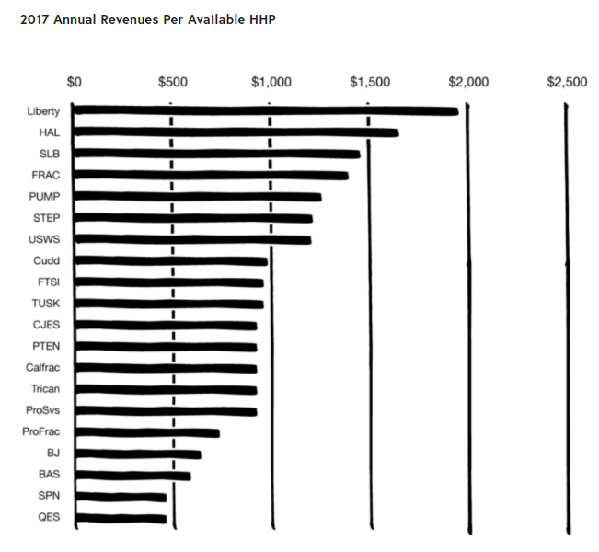
Friday Essay
spearsresearch.com

Slide 25
The 2018 Oilfield
Richard Spears
Spears & Associates
Tulsa

