Slide 1
Budget Conscious Horizontals
In The Big Lime $$$$
Charter Oak Production Co., LLC
Oklahoma City, OK
AADE Symposium
Norman, Oklahoma
13 September 2022

Slide 2

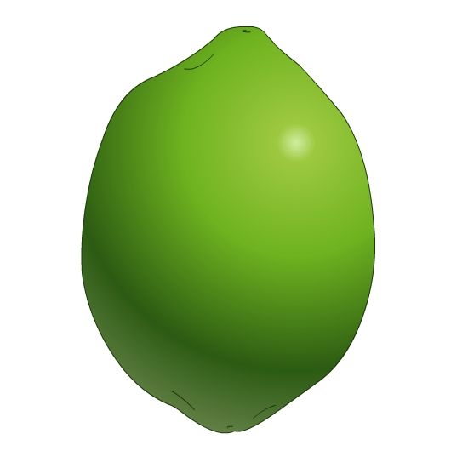
What is the Big Lime?

Slide 3
What is the Big Lime?
Clean carbonate (Limestone)
Can have highly porous interval
Pennsylvanian (Marmaton) age
AKA 1st Oswego
Present in N Central Oklahoma
Porosity can be oolitic
Often oil saturated

Slide 4
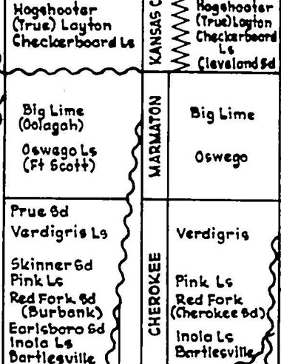
The Big Lime?

Slide 5
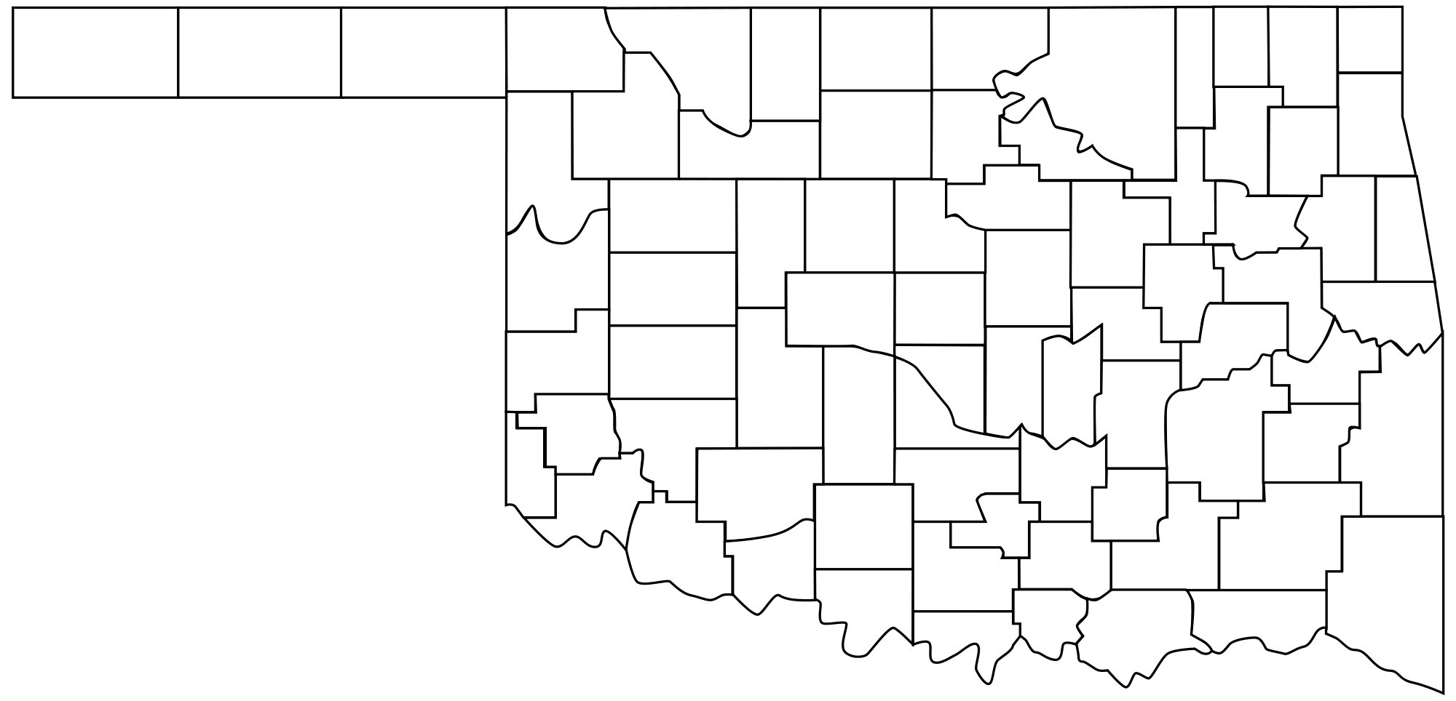
Location Of Perry Lake Project
Noble County
Oklahoma City

Slide 6
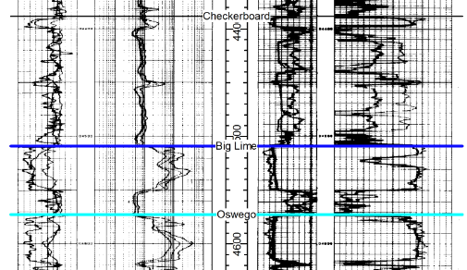
Big Lime Type Log Yarbrough #1 Section 36-21N-2W
20% Porosity

Slide 7
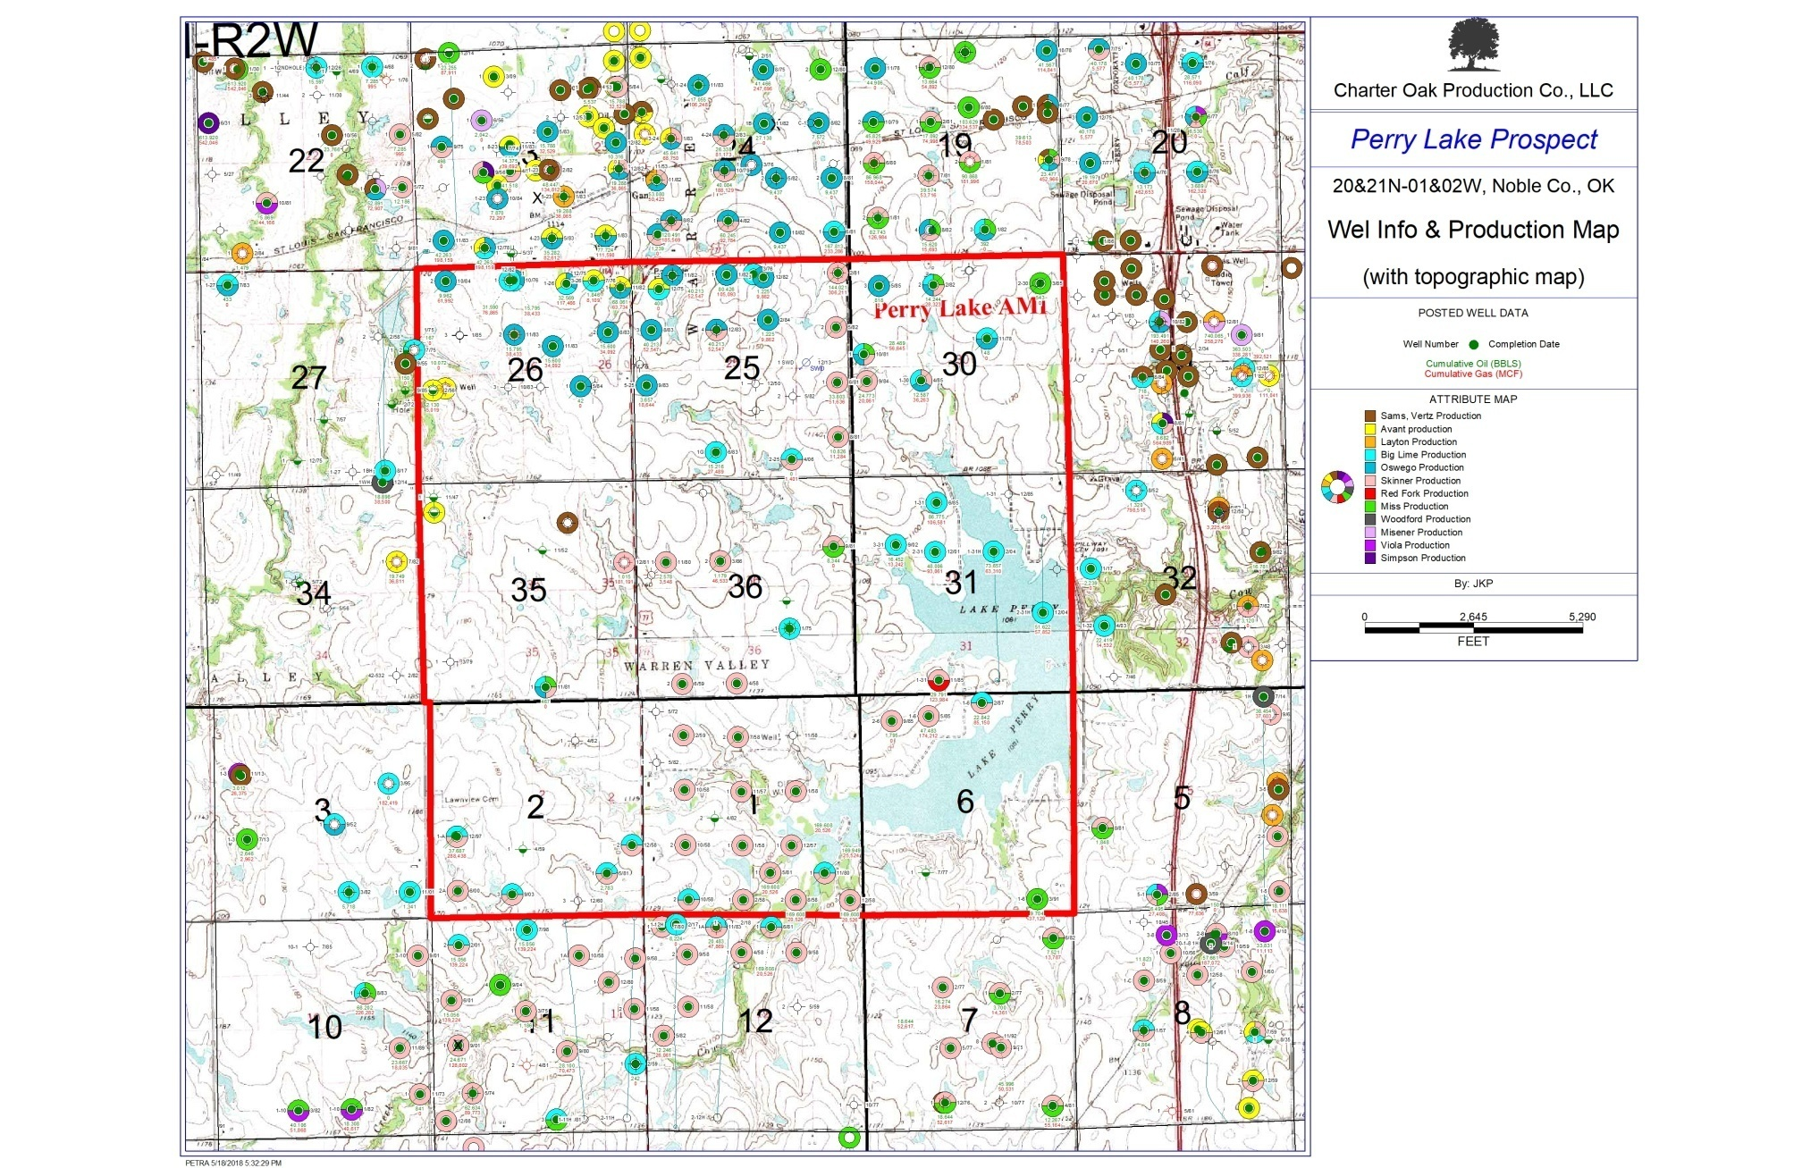
Big Lime Early Production
Two Big Lime Laterals
Open Hold Acid Job – Not Frac’d
Completed 2004
IP’s: 302 & 960 BOPD
Four Big Lime Laterals
Completed Mid-2017
Cased, Cemented, Frac’d
IP 180: 800 BOPD
IP 360: 450 BOPD

Slide 8
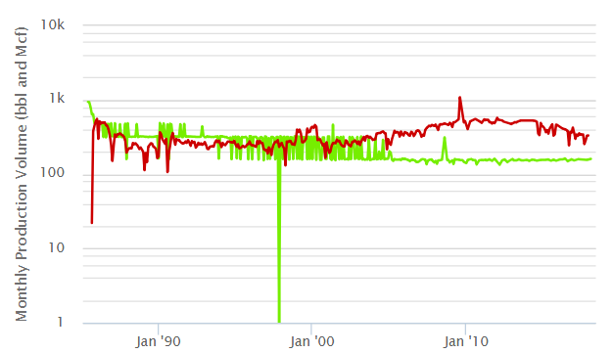
Nadel & Gussman-Wagner #1 Vertical 3500 Gallons 15% HCL IP: 51 BOPD with 37 MCF/D
86,496 BO and 113 MMCF Since 06/1985

Slide 9
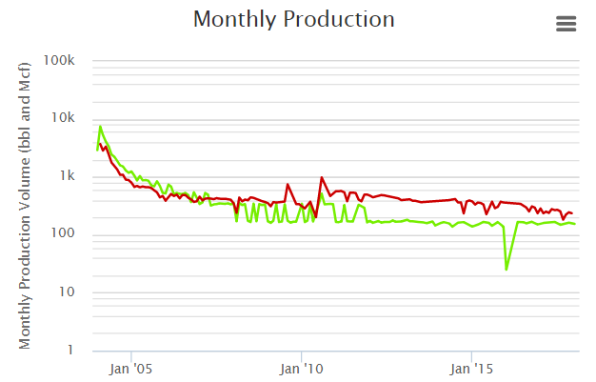
Nadel & Gussman-Perry Lake 1-31H Single 7000 Gallons 20% HCL Open Hole IP: 302 BOPD with 220 MCF/D
73,767 BO and 68 MMCF Since 02/2004

Slide 10
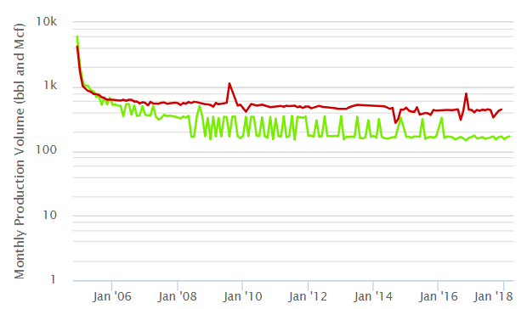
Nadel & Gussman-Perry Lake 2-31H Single 8500 Gallons 20% HCL Open Hole IP: 960 BOPD with 383 MCF/D
52,529 BO and 66 MMCF Since 12/2004

Slide 11
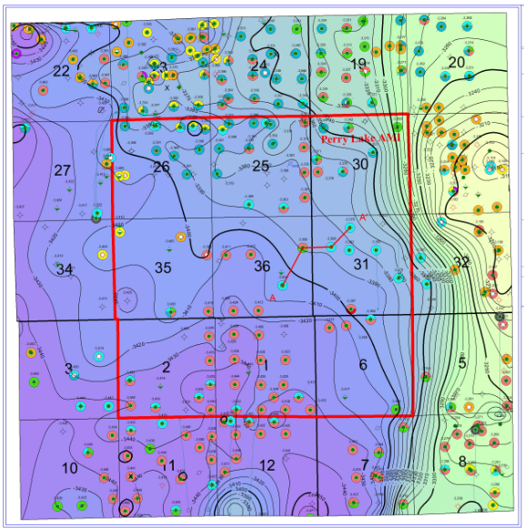
Perry Lake Big Lime Structure

Slide 12
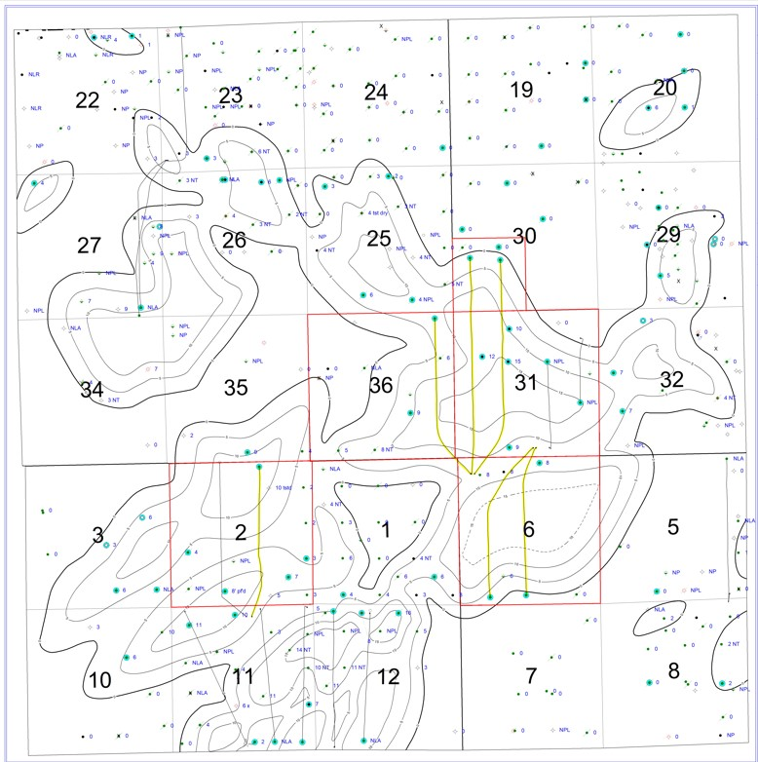
Perry Lake Big Lime Net Pay

Slide 13
Big Lime Reservoir Properties
Effective Porosity from 18-24%
Water Saturation Approximately 20%
Net Pay from 8 to 14 Feet
Pore Pressure Gradient of 0.433 psi/ft
Milidarcy Range Permeability
GOR 1200 SCF/BBL, BTU = 1260
Oil Gravity = 40 API
Clean Limestone Lithology
Approx 4500’ TVD

Slide 14
Perry Lake Big Lime Economics
5.7MMBO In-Place Per Section
4 Well Development Per Section
215 MBO Primary EUR per Well
360 MMcf Primary per Well
Currently $3.3MM/Well D&C Cost
Secondary Recovery = 400 MBO per Section?

Slide 15
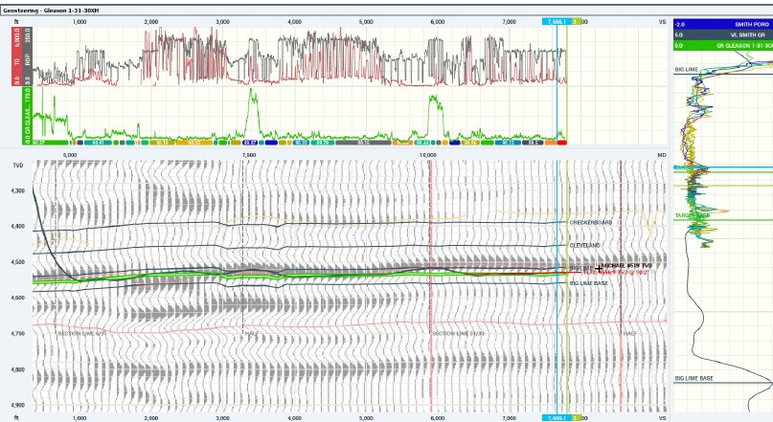
Gleason 1-31-30 XH Geosteering Plot

Slide 16
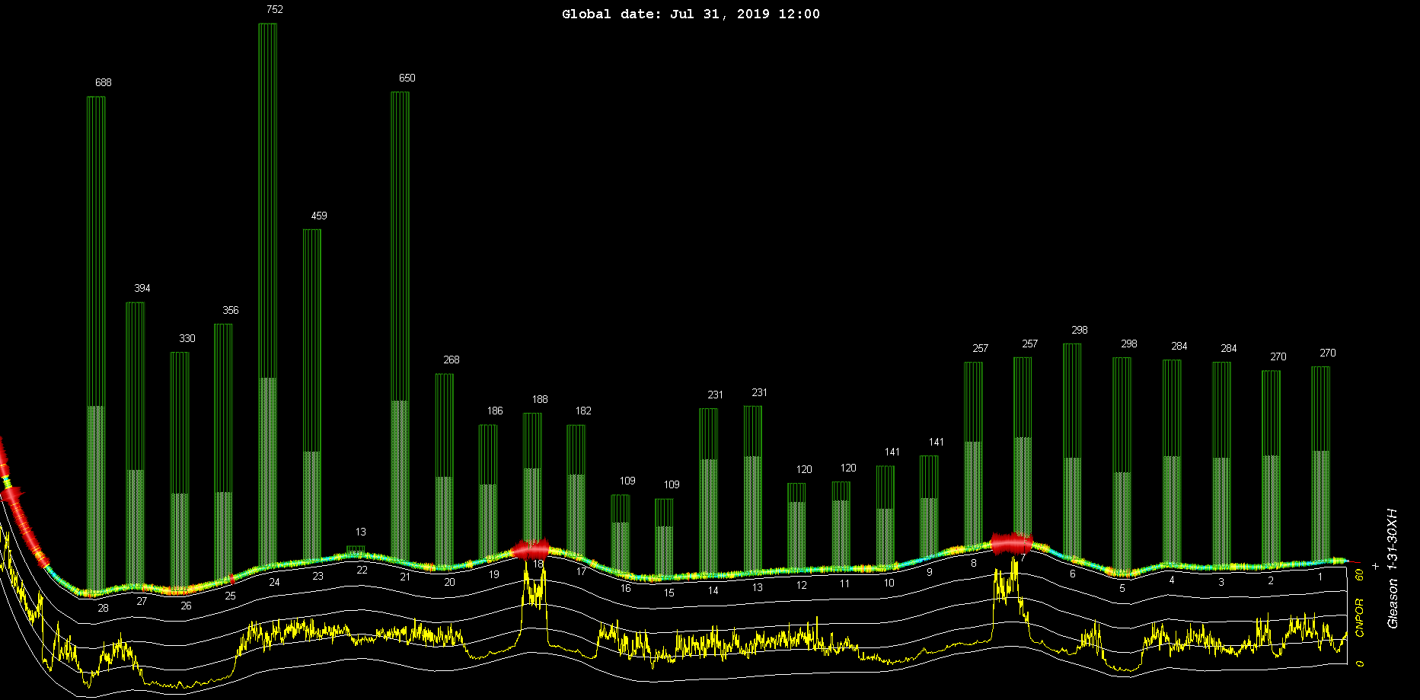
Gleason 1-31-30 XH Oil Tracers vs Porosity

Slide 17
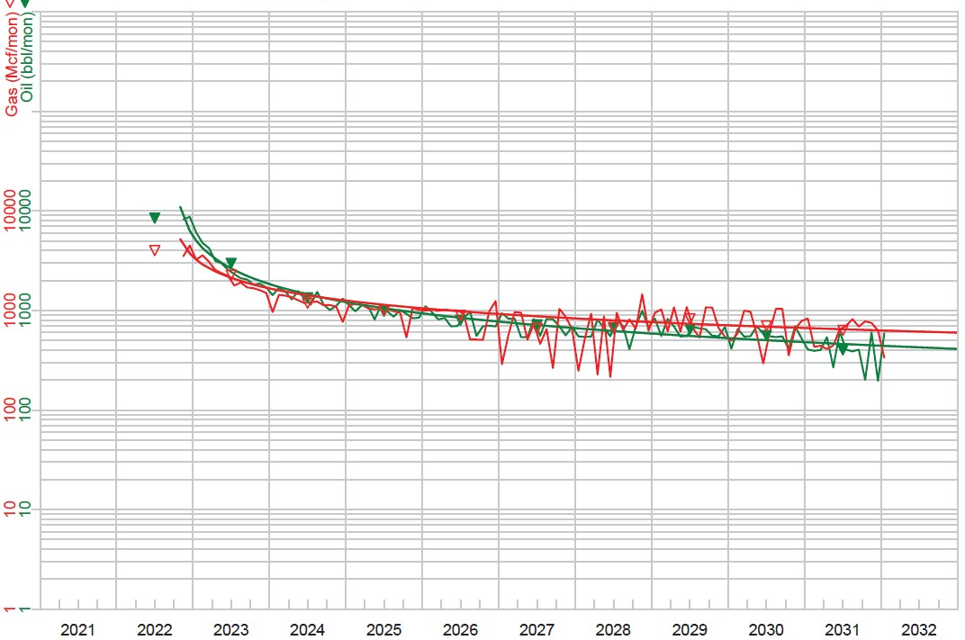
Perry Lake 5000’ Lateral Type Curve Projected IP: 200 BOPD with 250 MCF/D
EUR: 215 MBO and 264 MMCF

Slide 18
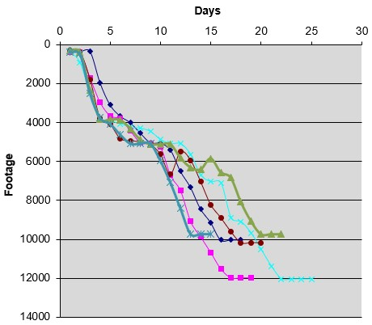
Perry Lake Big Lime Drill Rate

Slide 19
Cost Savings Items
Smaller rig has move and rig up efficiency
Lower pad costs for smaller rig
Fresh mud system
Soil farm mud adjacent to pad
Lower water costs due to proximity to lake
Use of conventional directional vs RSS
Use of alternate surface/intermediate casing
Savings in tapered casing string

Slide 20
Perry Lake Casing Cost Savings (One Mile Lateral)
Surface: 350’ of 10 ¾” @ $50/ft vs 13 3/8” @ $88/ft results in $13,300 savings
Intermediate: 5000’ of 7 5/8” @ $45/ft vs 9 5/8” @ $90/ft results in $225,000 savings
Production: Tapered string of 5 ½” to 4 ½” with 5000’ of 4 ½” @ $24/ft vs 5 ½” @ $34/ft results in $50,000 savings
Total casing savings = $288,300

Slide 21
Budget Conscious Lateral Summary
Drilling costs are approx $1MM for one mile lateral
Total well costs slightly over $3MM (Note that frac is over $1MM)
Current ROI is high double digits at BOKF strip pricing with 3X undiscounted return
Most significant savings from alternate casing program without use of a liner
Watching the small items can add up, just don’t step on $100 bills to pick up a dime!

