Slide 1
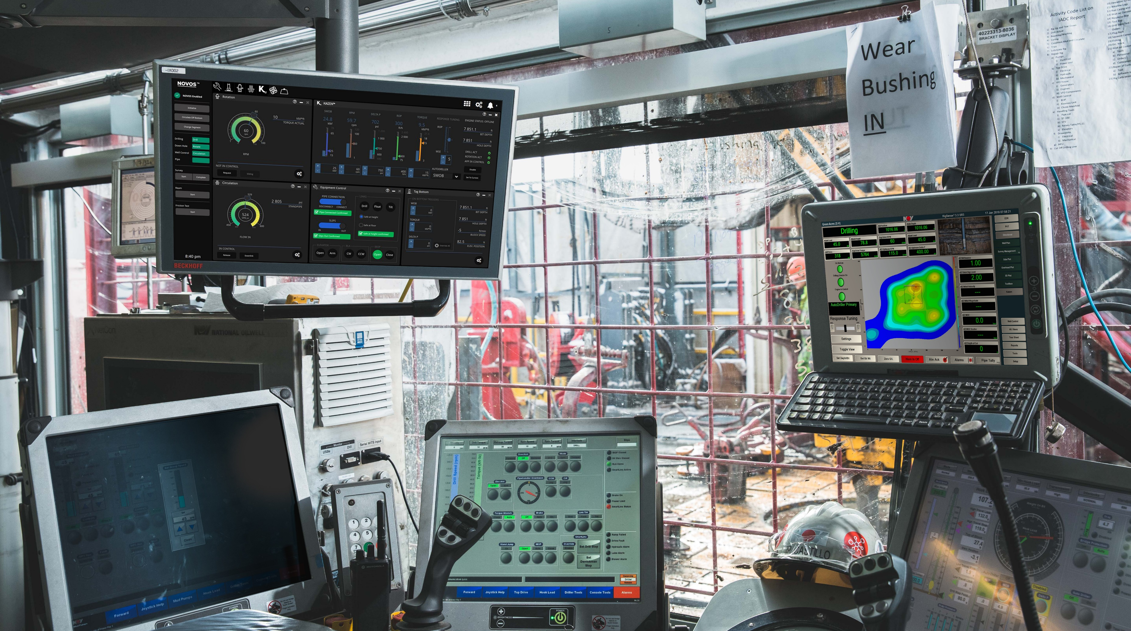
DRILLING OPTIMIZER
Automation with Machine Learning and Digital Twin
Rodrigo Serrano (NOV)
PLM - Kaizen
©2019 NOV | Proprietary and confidential.

Slide 2
What is Machine Learning
Algorithm to help support in trying to identify patterns or find connections in data.
Type of ML
Supervised learning
model relationships and dependencies between the target prediction output and the input features
Unsupervised Learning
mainly used in pattern detection and descriptive modeling
Semi-supervised Learning
Falls between the two above mentioned
Reinforcement Learning (branch of AI)
reward feedback is required for the agent to learn its behavior; this is known as the reinforcement signal

Slide 3
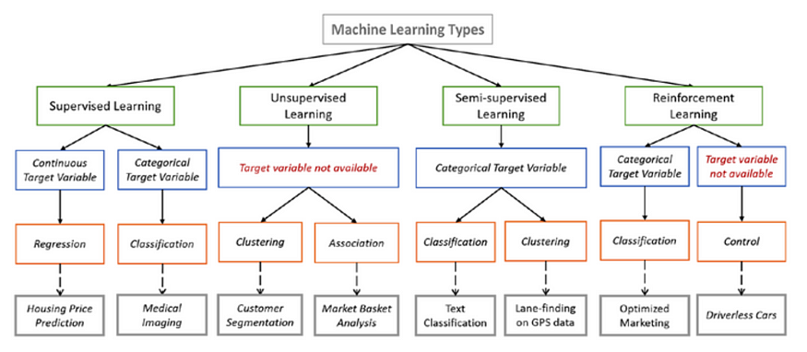
ML Examples
Image from en.proft.me

Slide 4
Digital Twin
Its the physics model or mechanical model.
  Digital Twin is reference to one being the model and the other being the real-time sensors data being picked up.
This can model:
  Torque and Drag
  Side forces
  Resonance frequency (vibrations)
  Downhole WOB and RPM
  Hydraulics

Slide 5
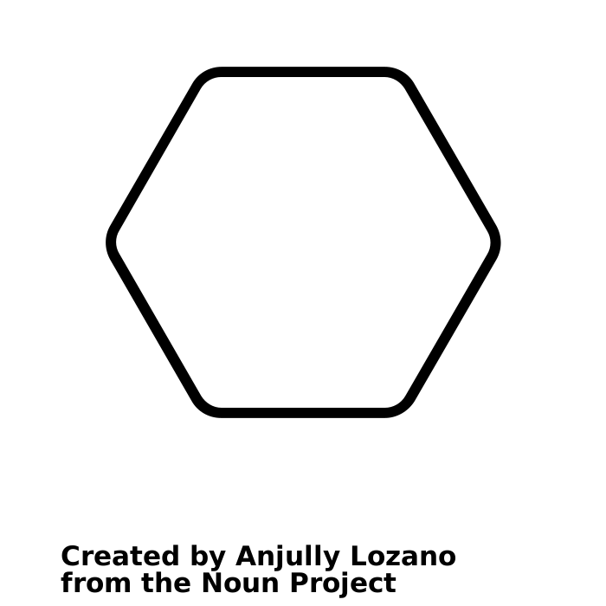
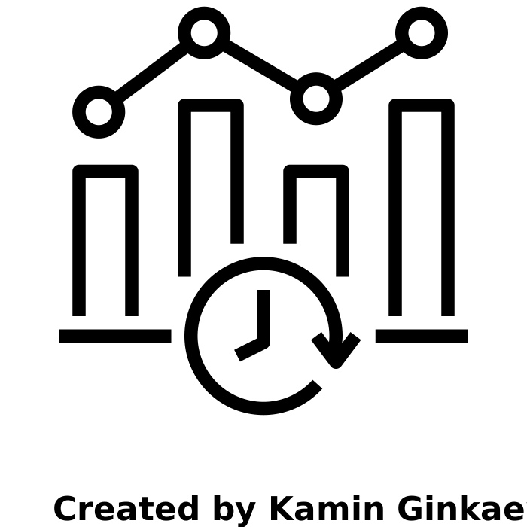

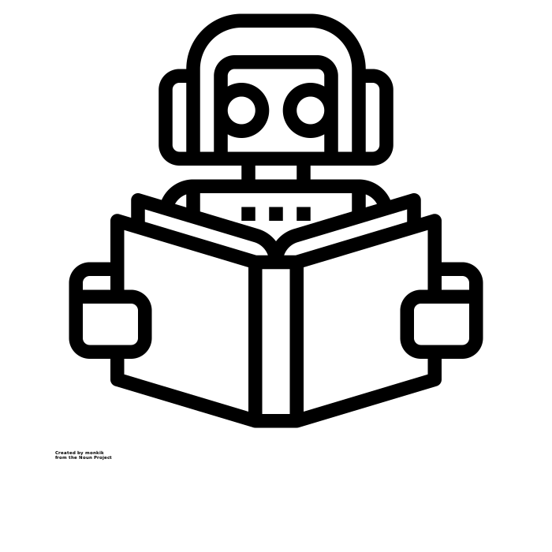
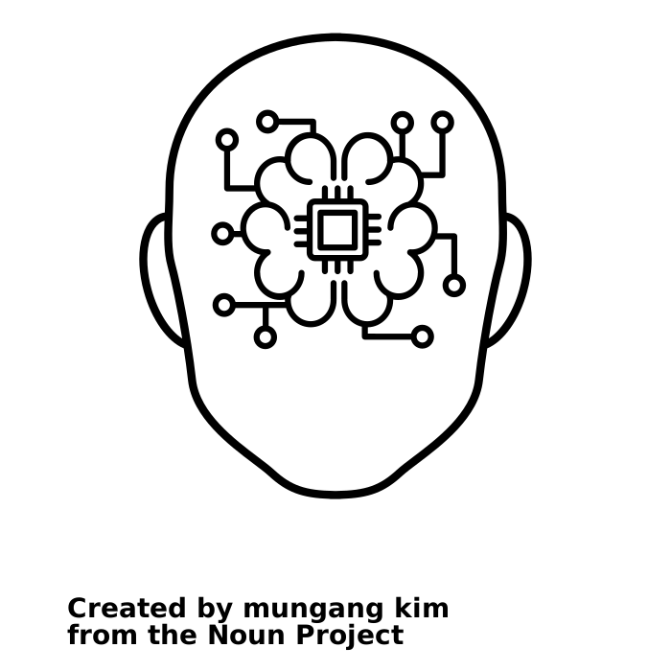
How do they work together
Machine Learning
Digital Twin
Real Time Data
Artificial Intelligence

Slide 6
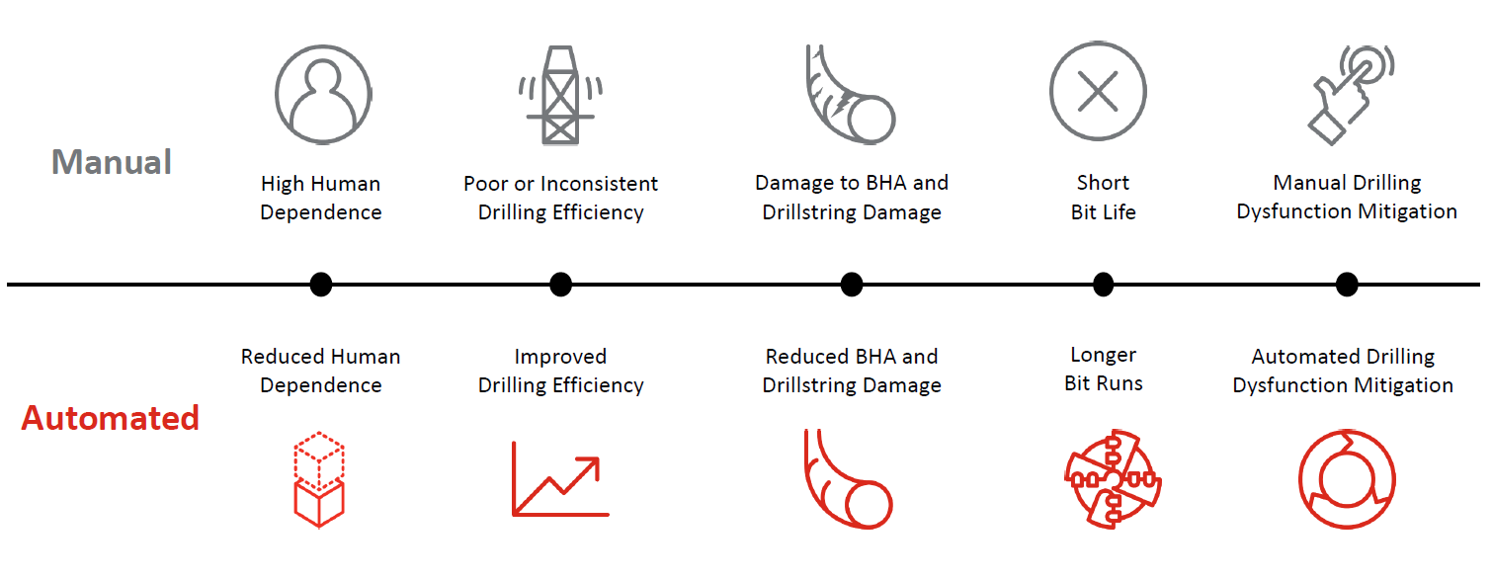
Manual vs Automated
Notes:
High Human Dependence
Relies on drill to observe and recognize performance patterns, wellbore conditions, and instantaneously and continuously know and apply optimal parameters
Reduced Human Dependence
Using digital twin and machine learning algorithms against its historical unlimited data sets to:
Instantaneously assesses wellbore conditions and drilling performance
Apply optimal setpoints
Manual Drilling Dysfunction Mitigation
Potential for unrecognized and addressed dysfunction
Slow response time
Overcorrection causing additional dysfunction
Automated Drilling Dysfunction Mitigation
Automatically detects and mitigates drilling dysfunction
Optimizes parameter selection for efficient dysfunction mitigation

Slide 7
Manual vs Automated
Current Status: High Human Involvement
Drilling is performed mostly by human
Engineering teams perform pre-analysis of the process
  Create road maps, etc. to help drillers drill faster and safer
Drillers use road maps, their experiences, and live drilling data to perform their job
Future: Autonomous Drilling Rigs
Minimizes engineering work required for each well
Helps with directional drilling decisions
Minimizes real-time review of the drilling job
Safer, Faster, and Cheaper
Optimizer
Notes:
High Human Dependence
Relies on drill to observe and recognize performance patterns, wellbore conditions, and instantaneously and continuously know and apply optimal parameters
Reduced Human Dependence
Using digital twin and machine learning algorithms against its historical unlimited data sets to:
Instantaneously assesses wellbore conditions and drilling performance
Apply optimal setpoints
Manual Drilling Dysfunction Mitigation
Potential for unrecognized and addressed dysfunction
Slow response time
Overcorrection causing additional dysfunction
Automated Drilling Dysfunction Mitigation
Automatically detects and mitigates drilling dysfunction
Optimizes parameter selection for efficient dysfunction mitigation

Slide 8
Automation and Acceptance
O&G is:
  Very risk-averse
  Change is done at a very slow pace
  Understanding new technology and how to apply into the workflow
  Hard to change to culture of “its not broke why fix it”

Slide 9
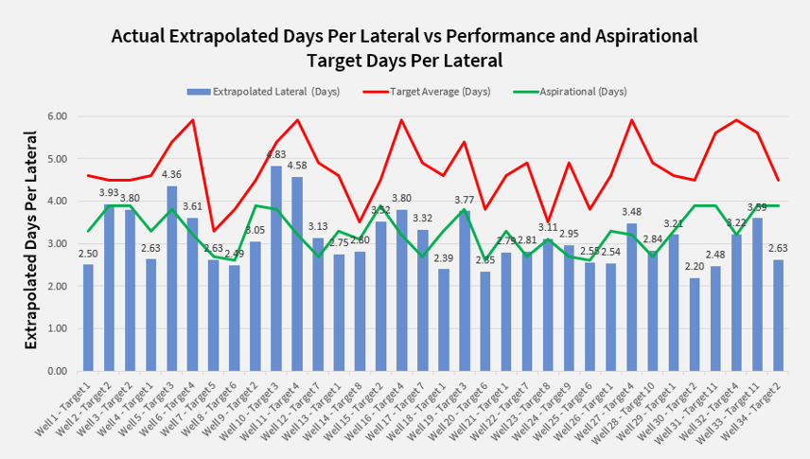
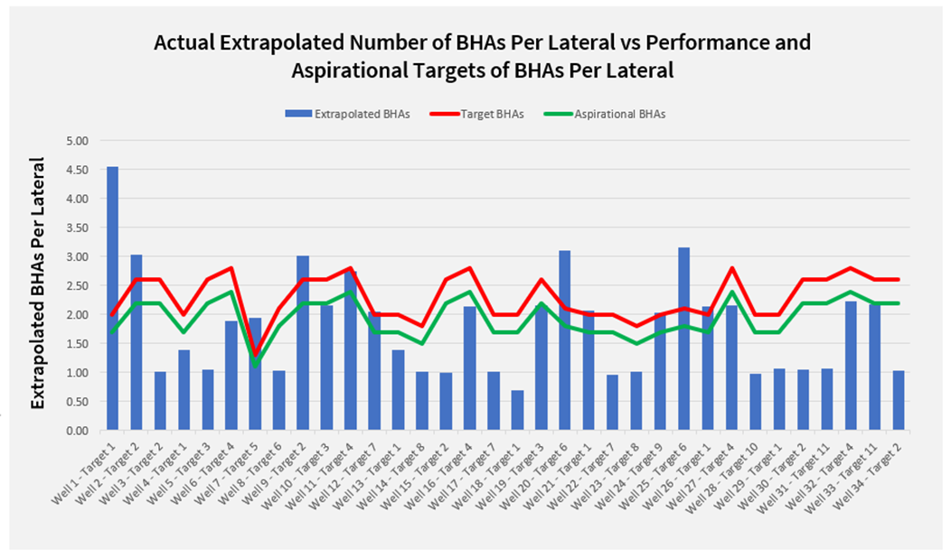
Proven Results – Lateral Permian
Drilling Cycle Time Reduction
100% outperformed average target
85% exceeded aspirational goal
BHA & Bit Trips Reduction
74% outperformed BHA average target
68% exceeded BHA aspirational goal
SPE-215087

Slide 10
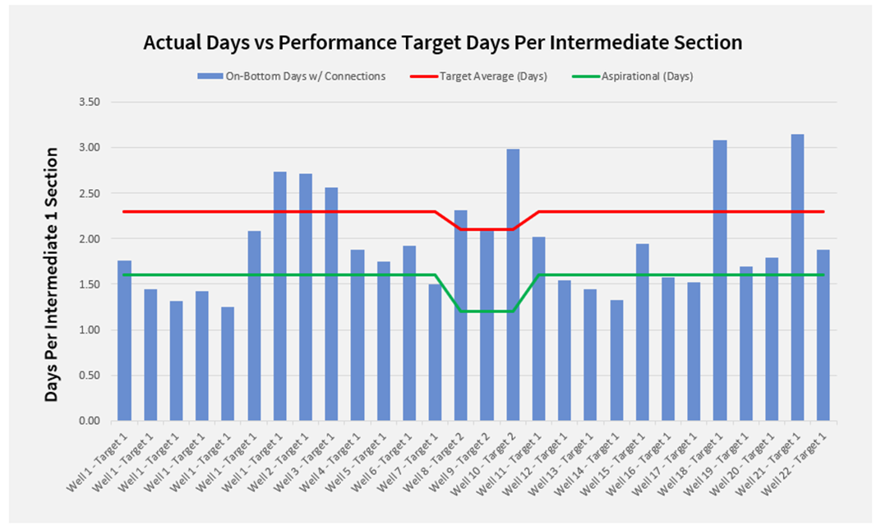
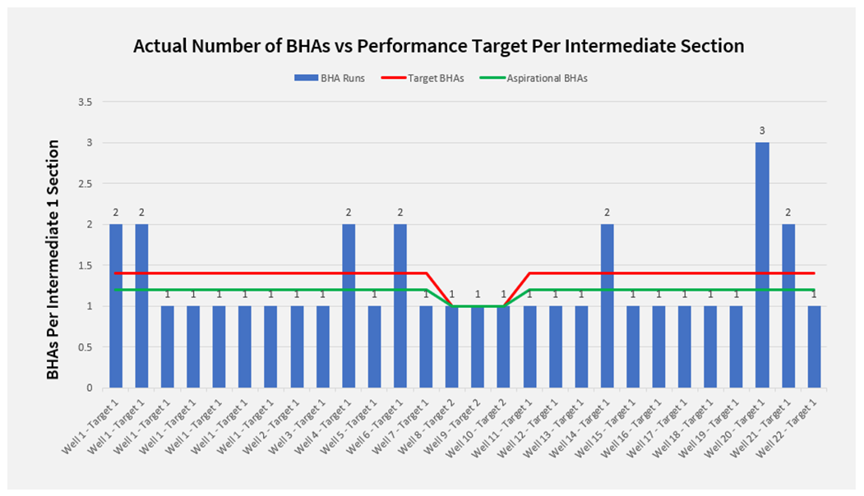
Proven Results – Lateral Permian
Drilling Cycle Time Reduction
75% outperformed average target
46% exceeded aspirational goal
BHA & Bit Trips Reduction
75% outperformed BHA average target
75% exceeded BHA aspirational goal
SPE-215087

Slide 11
Summary
Reduction in drilling cost
  Saved Trips due to Drill Bit and BHA tool failures
  BHA configuration exhibits different feedback and dysfunctions
Optimized drilling parameters compared to traditional drill off tests
Top tier drilling performance consistency was achieve

