Slide 1
Hole Cleaning Awareness:
Indicators, Solutions and Modeling
AADE Houston
Greg Mullen – Engineering Software Manager
November 17, 2011

Slide 2
Topics
Definition
Indicators
Solutions
Pre-Well planning
Hole Cleaning Model

Slide 3
Hole Cleaning: One Definition
Simply put, hole cleaning is the ability to remove sufficient drilled formation allowing uninterrupted operations due to poor hole cleaning.
  This does not mean 100 percent cuttings removal
  The intention is to remove enough cuttings to prevent NPT due to poor hole cleaning
    Can drilling fluid alone clean the all wellbores?

Slide 4
Poor Hole Cleaning Indicators
Abnormally high down hole pressure
  Trends from pressure tools
High torque and drag: drilling/tripping
Lack of cuttings return over shakers
Pack off events
Stuck drill pipe
Loss circulation
Required back-reaming**
Fill on connections / TIH
Stuck casing**
Difficult logging

Slide 5
Solutions for Poor Hole Cleaning
Flow rate, flow rate, flow rate
Maximum allowable drill string RPM
Reduce sliding to rotation ratio
Control / balance ROP
  Avoid high instantaneous ROP
Utilize Rotary Steerable
Drill pipe size 5 1/2”, 5 7/8”, 6 5/8”?
Alter drilling fluid properties
Increase circulation time between connections
Minimize downhole drill string restrictions
Flow bypass subs

Slide 6
Solutions for Poor Hole Cleaning
Sweeps – use as an indicator of poor hole cleaning
  High density
  Low viscosity / high viscosity
  Fibrous / granular / flaked / cellophane materials
  Mixtures of materials
Remove cuttings beds
  Sweeps (hi vis weighted) with increased drill string rotation
  Pump / rotate / reciprocate until sweep arrives at surface (> 1 bttms up)
Short trip
Backream**
Casing design

Slide 7
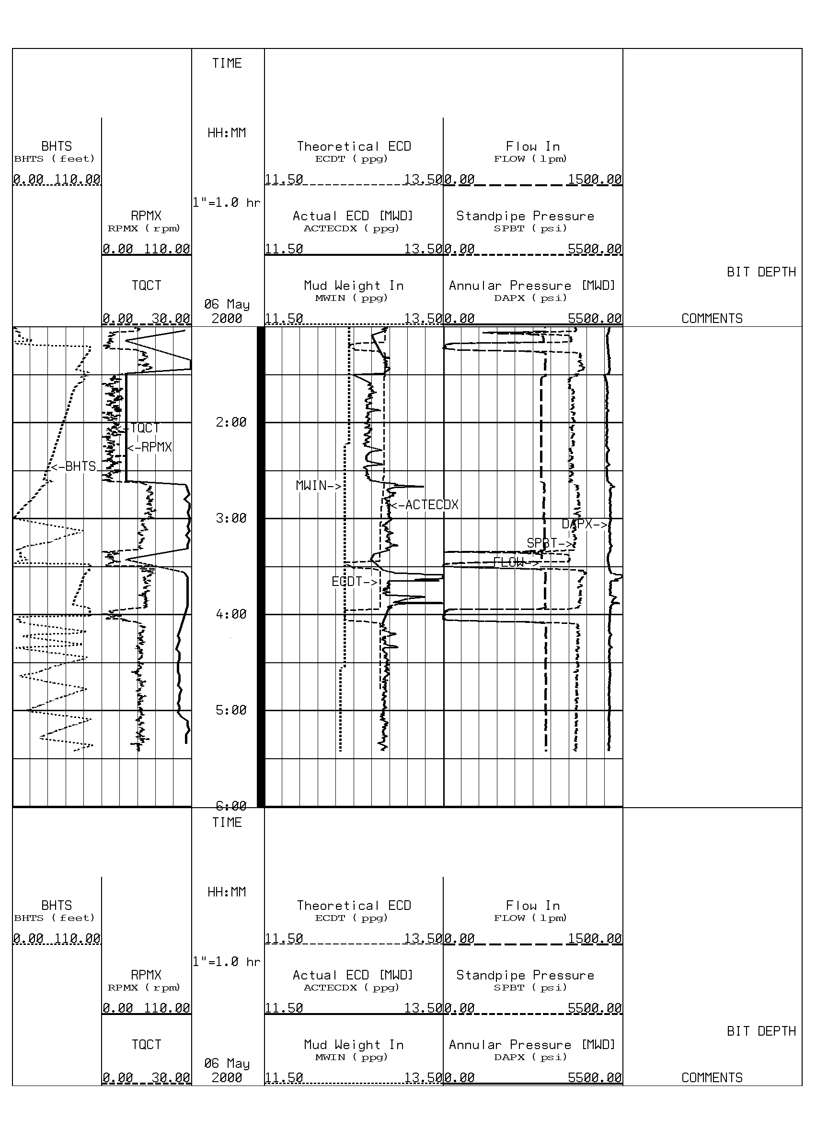
Solution: Remedial Action Due to Sliding
BACKGROUND
12 1/4” hole at 63 degrees inclination
Mud weight 12.5ppg and FIT 14ppg
Drilling ahead with steerable motor
REALTIME OBSERVATIONS
While going from sliding to rotary modes, occasional ECD spikes
ECD 13.5-13.8 PPG spikes at connection
ACTION:
Circulate 1.5xB/U prior to drlg ahead.
KEYPOINTS
SPP did not reflect ECD at bit
Real-time data clearly showed increasing ‘pack-off’ trend.
Sliding
Rotating
Circ b/u
Notes:
Real-time observation of ECD trends can be a valuable key in preventing hole stability problems. Early detection and reaction can lead to large cost savings especially when possibilities of excessive circulation times, stuck pipe, lost BHA’s and lost holes are considered.
In this application, with a 12 1/4” hole at 63 degrees inclination using a MW of 12.5 PPG and a FIT of 14.0PPG. 13.5-13.8 PPG ECD spikes were observed, roughly a 1 PPG over the 12.5 PPG mud weight. These spikes or pack-offs were approaching the FIT of 14.0 PPG. They appearing when changing from sliding to rotary modes, along with the increased ECD from the stirring up of the cuttings beds while rotating.
Typically, sliding operations don’t effectively clean the hole. Early detection and reaction to these spikes and ECD trends can prevent major hole stability problems. In this case, the decision was made to circulate bottoms-up to reduce the tendency to packoff.

Slide 8
Pre-Well Planning-Step 1, Review Data
If deepwater– water depth
Surface temperature / mud-line temperature
Formation temperature gradient(s)
Pore and fracture gradients
BHA’s w/flow rate limitations and bit TFA
Casing design / hole diameters – opening hole while drilling
Directional profile
Drilling fluid density requirements
SPP / flow rate limits for each interval

Slide 9
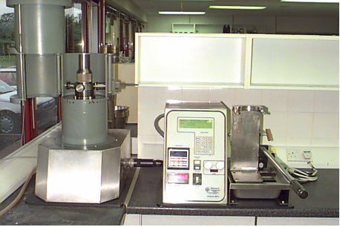
Pre-Well Planning-Step 2 – Model Hole Cleaning Requirements
Determine fluid type – usually IE
Select representative fluid with proper viscosity matrix
  HPHT viscometer data base
Model the required flow rates for hole cleaning:
  ROP and drill string rpm
  Cutting size and density
    Are the flow rates achievable (ECD)
Booster flow rate

Slide 10
Pre-Well Planning-Step 3 – Model for E.C.D.
Fluid properties
  High viscosity / low viscosity
Circulating temperature profile(s)
  Fluid viscosity matrix / ESD
Hole size restrictions
Drill string restrictions
Tool restrictions
Drilling window
ROP restrictions

Slide 11
Pre-Well Planning-Step 4 – Optimize
Review results and identify areas of concern
SPP
  H.S.I
  Drill string design
E.C.D
  Fluid properties
  Reduce flow rate
  ROP
  Hole opening
Flow rate limited
  Down hole tool flow rate restrictions
  Flow bypass sub

Slide 12
Pre-Well Planning-Step 5 – Review Options
Is initial design sufficient
  Achieve hole cleaning objective
  Maintain acceptable E.C.D.
  Is ROP / drill string rpm optimized
  Is ROP acceptable to achieve days vs depth goals
Risk analysis – areas of concern
  Hole cleaning
  SPP
  E.C.D.
  Loss zones

Slide 13
Pre-Well Planning-Step 5 – Review Options
Contingency plan for areas of concern
    Hole cleaning – plan to eliminate / minimize NPT
      Sweep program - Extended circulation between connections
      Control ROP - Rotate and circulate hole clean
      Fluid viscosity - Short trips
    E.C.D.
      Reduce flow rate - Control ROP
      Sweeps - Circulate hole clean
    SPP
      Tapered drill string - Open bit jets
      Optimize tool selection
    Tool max. allowable flow rate
      Review tool selection - Flow bypass sub

Slide 14
Hole Cleaning / Hydraulics Models
First and foremost, the model is as good as the user
  It’s easy, just select run
  WRONG
Second why the need for a model?
  Pressure tools tell the story
  Torque / drag trends tell the story
  Observations at shakers tell the story
  Sweeps may or may not tell the story
  Measure; volume drilled vs volume over shakers
Yes, to be proactive in the pre-planning stage vs reactive while drilling

Slide 15
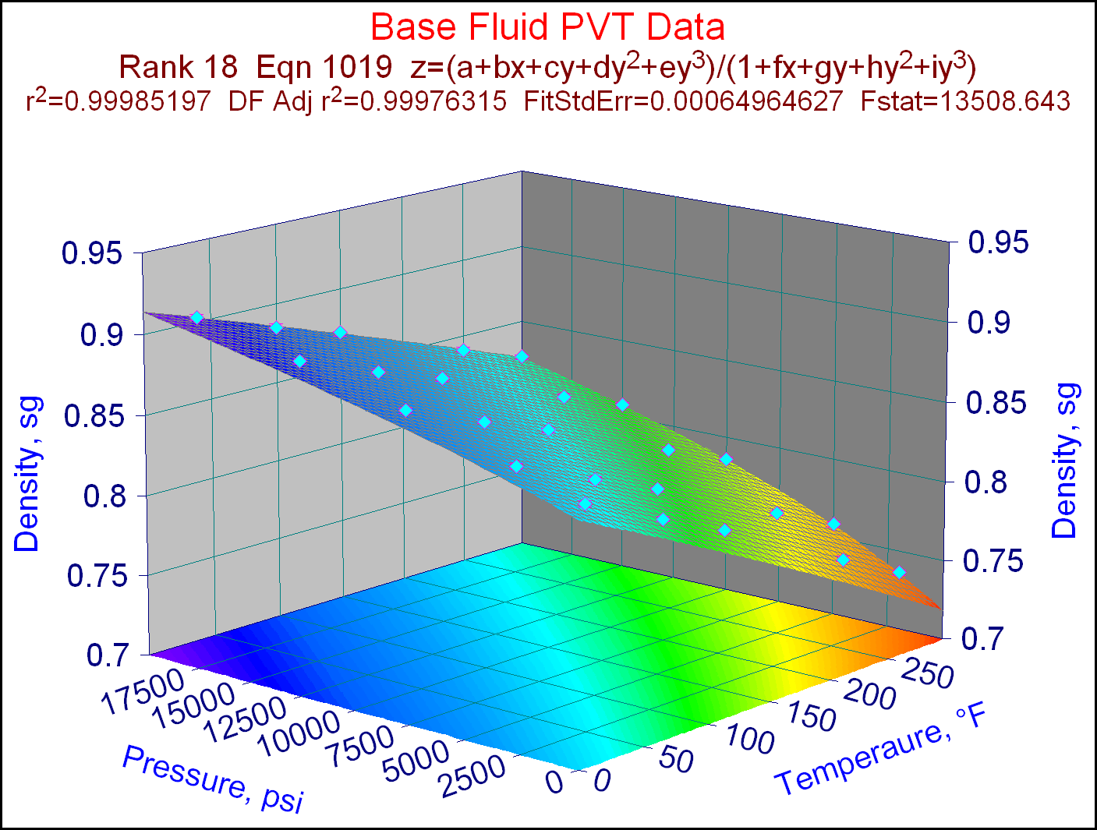
Attributes of an Integrated Model
Temperature combined with pressure affects:

Slide 16
Attributes of an Integrated Model
Considers T and P
Eccentricity
Drill string rpm
Coring
Multiple component BHA’s
Riserless mud returns
DKD – mudline returns
Compressed mud volume
Hole opening -existing
Hole opening – while drilling
Split flow
Swab w/ pumps on
Surge w/auto-fill
USER FRIENDLY
Informative reports
Messaging

Slide 17
Advantage Hole Cleaning Model
SPE 28306 - Clark, Bickham, “A mechanistic model for Cuttings Transport”
The model is based on the balance of the forces acting on a cutting in the annulus.
    Settling - The cuttings moving downwards due to the gravitational force against the buoyancy and the drag force
    Lifting - A cyclic motion of moving the particle in the area of higher fluid velocity due to lift and buoyancy forces, moving the particle suspended in the fluid and continuously settling down again
    Rolling - Particles roll on the low side of the annulus when the Lift and Drag force exceed the gravitational force and the plastic force.

Slide 18
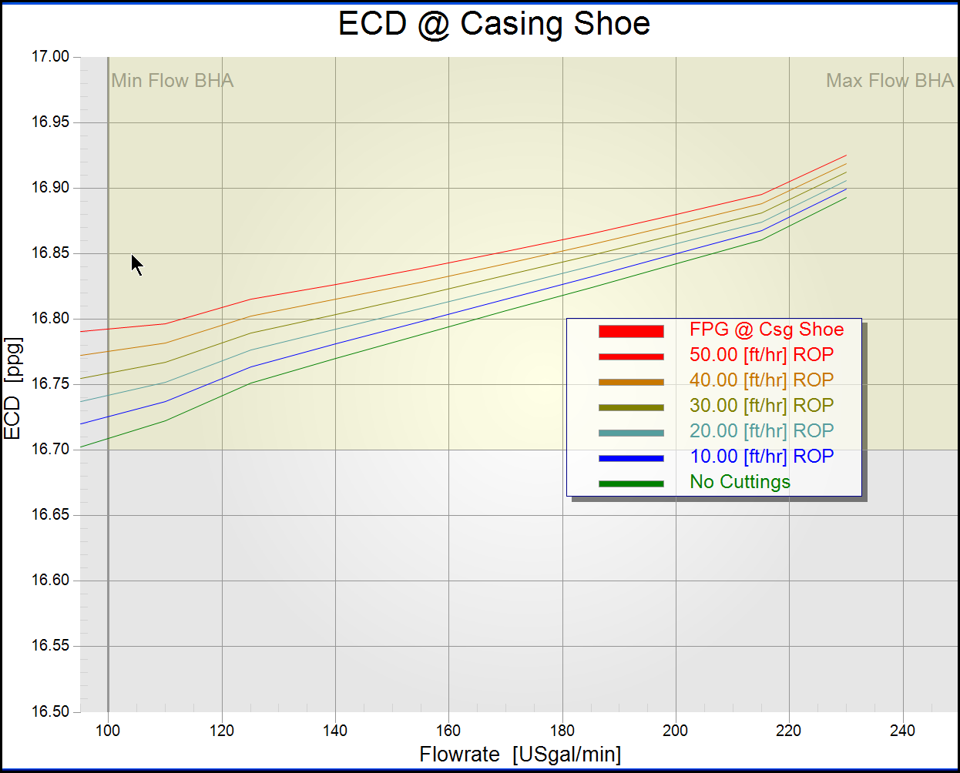
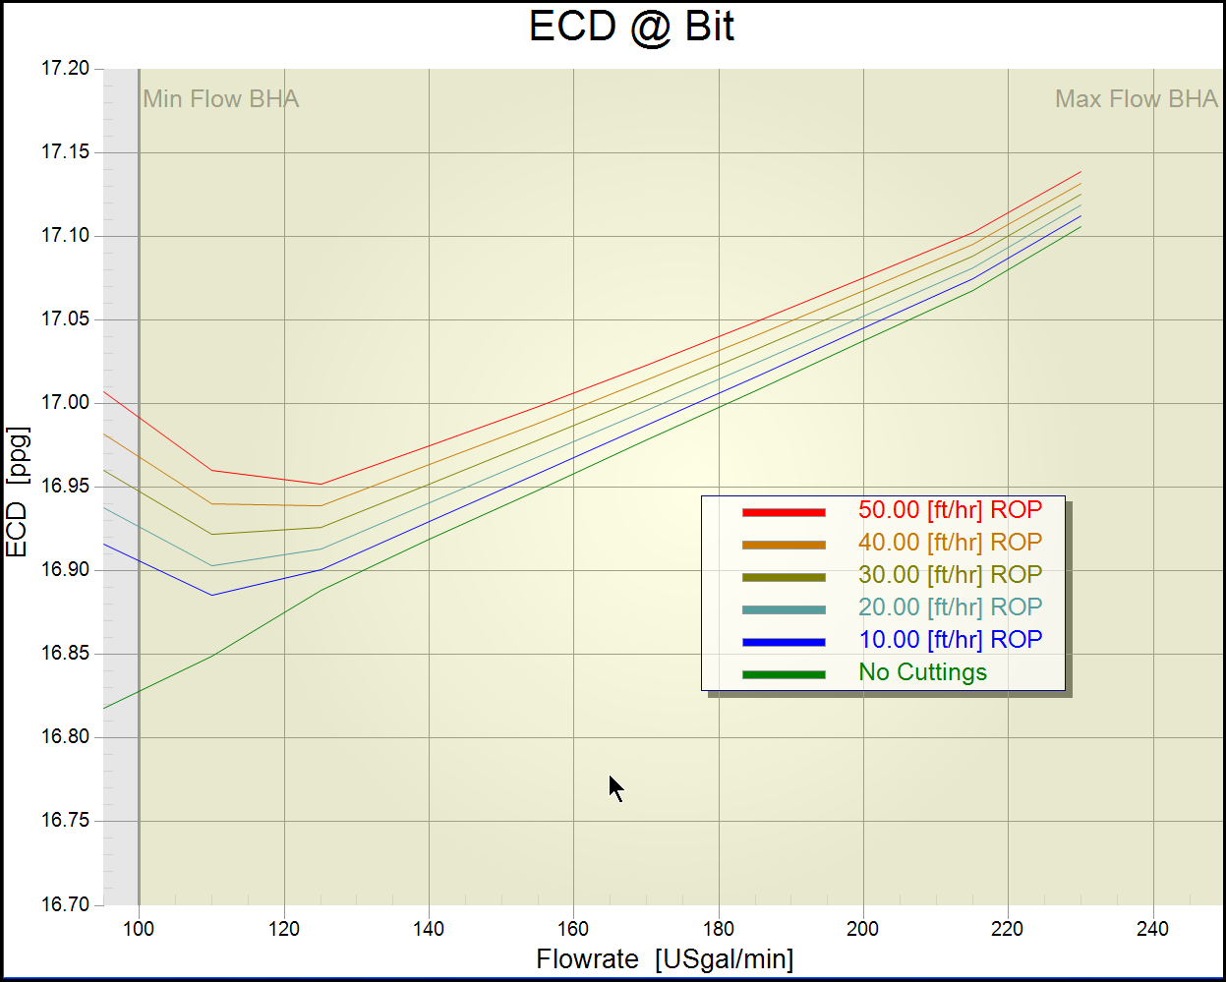
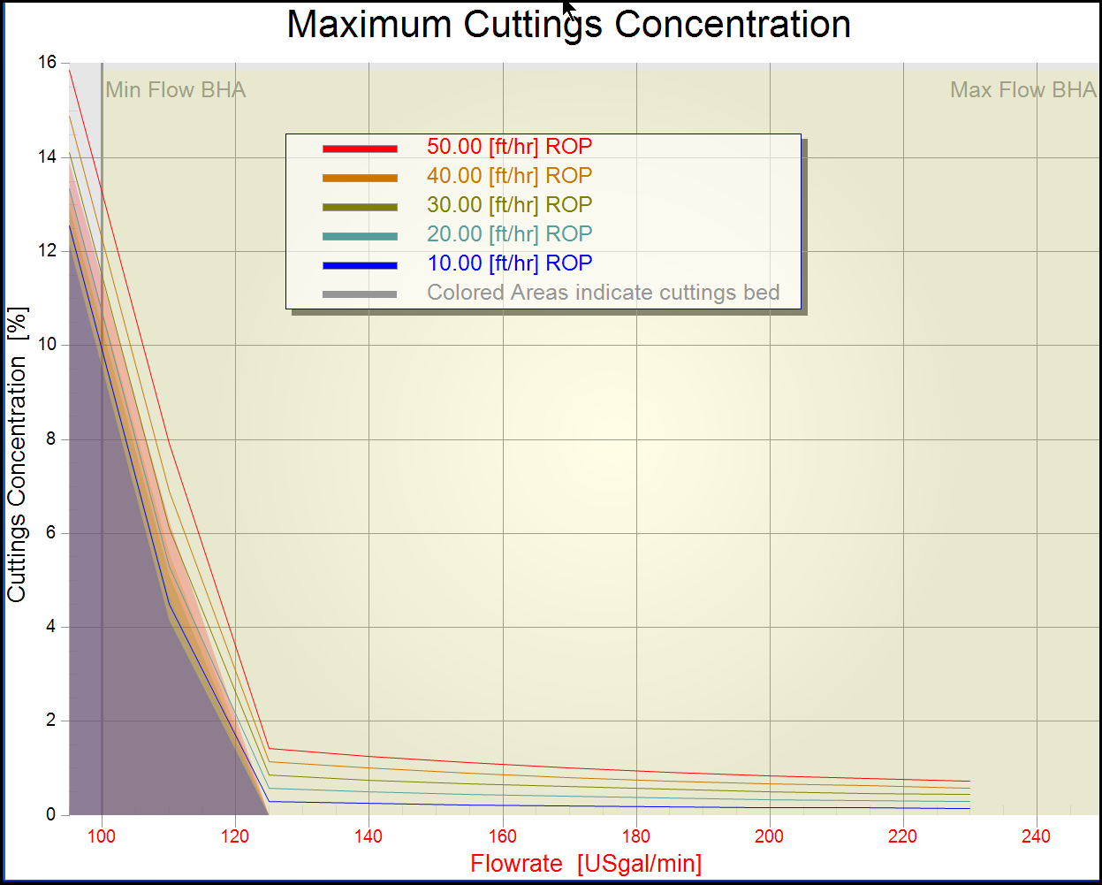
Results Example

Slide 19
What Next
RT hydraulics / hole cleaning
  Monitored by manned BEACON Centers
  Independent of user input – all data automatically populated
  Automatically runs on footage drilled or time interval
  Display all drilling activities associated with hydraulics / hole cleaning
  Compare modeled to measured data
  Alert alarms when trends indicate actions are needed
    Take some of the human element out of the picture
    Recommend operational procedures to eradicate potential NPT events – case based reasoning

Slide 20

Thank You for Attending – Questions?
Tough Day on the Water

