Slide 1
Dual Gradient basic hydraulics
Gas Injection through Concentric casing or Parasite String
November 20, 2014. Houston, TX
Maurizio Arnone – SDS US Engineering
Notes:
Good Morning,
I am going to touch on a subject that might be considered slightly controversial by making the statement that
“Closed Loop Circulating Systems Enhance Well Control while also Increasing the efficiency of the drilling and completion of a well”
Over the next 20 minutes, I plan on walking through the steps that brought us to the point that allow me to feel comfortable in making this statement.

Slide 2
Opening
Introduction with Participants
Objectives
  Describe basic concepts of drilling fluids hydraulics.
  Understand the standard definition for DG.
  Describe DG classification at today.
  Review the DG case for concentric casing or parasite string gas injection methods.
  Evaluate applicability on offshore environments based on land experience.

Slide 3
IADC DG Sub-Committee

Slide 4
DG Standard Definition

Slide 5
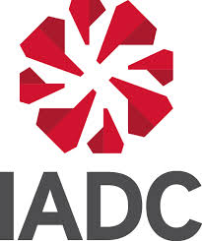
Managed Pressure Drilling Concept
IADC Definition:
MPD is an adaptive drilling process used to
throughout the wellbore.
The objectives are to
environment limits and to manage the annular pressure profile accordingly.
It is the intention of MPD to
. Any influx incidental to the operation will be safely contained using an appropriate process.
precisely
precisely
control the annular pressure profile
control the annular pressure profile
ascertain the downhole pressure
ascertain the downhole pressure
avoid continuous influx of
avoid continuous influx of
formation fluids to surface
formation fluids to surface

Slide 6
MPD Variations
HSE
Returns-flow-control (HSE) MPD reduces risk to personnel and the environment from drilling fluids and well control incidents.
The goal of managed pressure drilling (MPD) is to use a closed and pressurizable circulating fluid system to control the pressure profile throughout the wellbore in a way that eliminates many of the drilling and wellbore stability issues that are inherent to conventional drilling.
CBHP
Constant bottomhole pressure MPD reduces NPT and enables fewer and deeper casing strings when pore- to fracture-pressure gradient windows are narrow,
PMCD
Pressurized mud-cap drilling MPD enables high ROP, less flat time and lower-cost drilling in extreme-loss situations.
DG
Dual gradient MPD enables total well depth in the right hole size in deep-well and deepwater drilling.

Slide 7
Basic Hydraulic Concepts – Pressure Gradient
Energy Balance Equation
Static Term
Dynamic Term

Slide 8
Basic Hydraulic Concepts – Pressure Gradient
With the standard drilling engineering approach, In dynamic conditions, bottomhole pressure is the sum of the hydrostatic pressure of the mud and any friction in the annulus.
In this case bottomhole pressure can be calculated as follows:
Where:
g_{AFP} is the annular frictional pressure loss gradient, in psi/ft
D_{MD} is the total Measured Depth, in ft.

Slide 9
DGD Approaches and Systems
Seabed Pumping
Max Lift Drilling
Controlled Mud Pressure
Dilution
With Liquids
With Solids
With Gas
Continuous Annular Pressure Management
Controlled Mud Level
EC-Drill
Pre-BOP
DGD Systems
Post-BOP
Riserless Mud Return

Slide 10


Basic Hydraulic Concepts – Riser Fluid Mgmt.
Sea bed
BHP2 = 0.052 * ρ2 * TVD
Lower pressure at Casing Shoe
ρ1 = ρ3
ρ4 > ρ3
BHP1 = 0.052 * ρ1 * TVD
BHP3 = 0.052 * ρ3 * TVD +BHP2
Same BHP
BHP4 = 0.052 * ρ4 * TVD +BHP2

Slide 11
Basic Hydraulic Concepts – Riser Fluid Mgmt.
Sea bed
BHP2 = 0.052 * ρ2 * TVD
Lower pressure at Casing Shoe
ρ1 = ρ3
ρ4 > ρ3
BHP1 = 0.052 * ρ1 * TVD
BHP3 = 0.052 * ρ3 * TVD +BHP2
Same BHP
BHP4 = 0.052 * ρ4 * TVD +BHP2

Slide 12

Operating Margins - Conventional
EMW (ppg)
TVD (ft)
Collapse Pressure
Pore Pressure
Fracture Pressure

Slide 13
Operating Margins - DG
EMW (ppg)
TVD (ft)
Collapse Pressure
Pore Pressure
Fracture Pressure

Slide 14
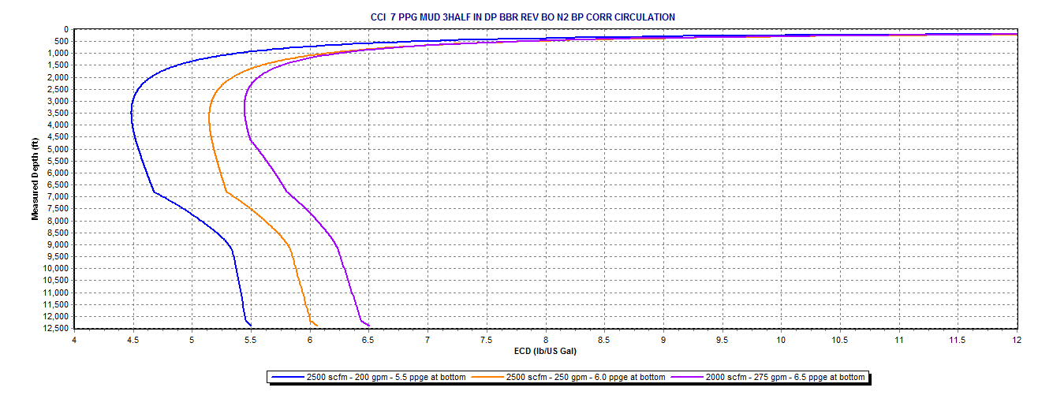
Basic Hydraulic Concepts – Gas Injection
ECD Multiphase Flow
ρ2 << ρ1
ECD Singlephase Flow
BHP1 = 0.052 * ρ1 * TVD
Lower BHP

Slide 15
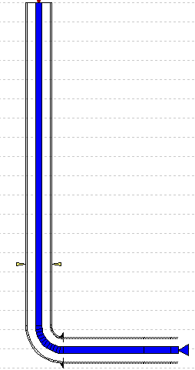
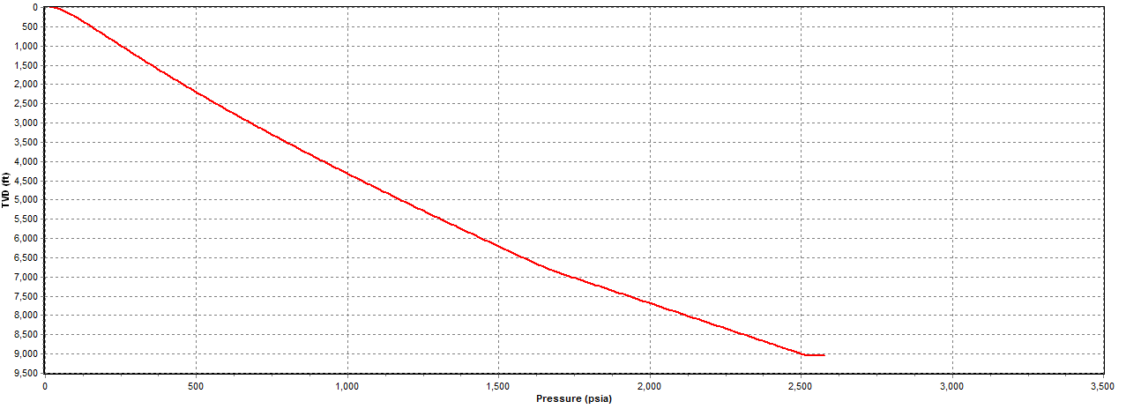
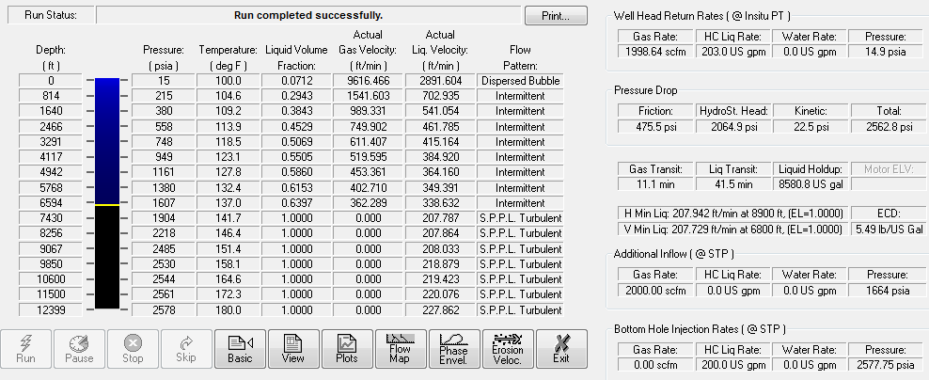
Annular Pressure Profile – Gas Injection
Gradient 1
(gas + Liquid)
Gradient
w/o gas injection
Gradient 2
(liquid)

Slide 16
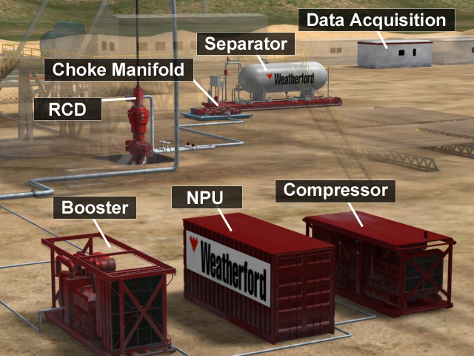
Surface Equipment Setup
Notes:
Describe the process of how compressible fluids are injected into a well using membrane nitrogen as example.
Air is taken from the atmosphere, compressed and send to a NPU which divides it into a rich oxygen and poor oxygen air. The oxygen rich air is discarded and the oxygen poor air (Membrane Nitrogen) used to drill. The booster compresses membrane nitrogen to the required pressure to pump it into the hole.
Gasses may then mix with liquid. We usually don’t provide the liquids but we do provide the pump to mist or foam and we do provide chemicals to mist or foam.
The NPU is not required drilling with air . Cryogenic Nitrogen andnatural goes do not require compressors nor NPU.
When returning fluids pass by the Rotating Control Device (RCD):
Ask students why is a RCD required in CPD if it is not required in conventional drilling?
Drilling with pressure at the wellhead and with compressible fluids. We need the RCD to be able to maintain pressure at the wellhead and to redirect fast fluids so they don’t keep going by inertia to the rig floor.
- Then the fluids may go to a choke, Why do we need a choke?
To reduce the pressure from whatever pressure is required at the wellhead to control the well to the working pressure of the separator downstream. Also because we need the reduce velocities in the flow line to reduce erosion.
- Do we always need to have a choke.
No. The choke is not used when the application does not require back pressure (air, mist or foam with blooie line and some two phase applications).
Then we fluids got to the separator. Why do we need a separator?
To separate gases, water based liquids and hydrocarbons. A separator (atmospheric or pressurized) required with two phase fluids. There are not required for air, mist or foam when environmental regulations allow it.
Now indicate we need data acquisition in order to track what is happening in the well.
The above equipment is commonly provided by WFT and renting equipment it is how we primarily make money!!!

Slide 17
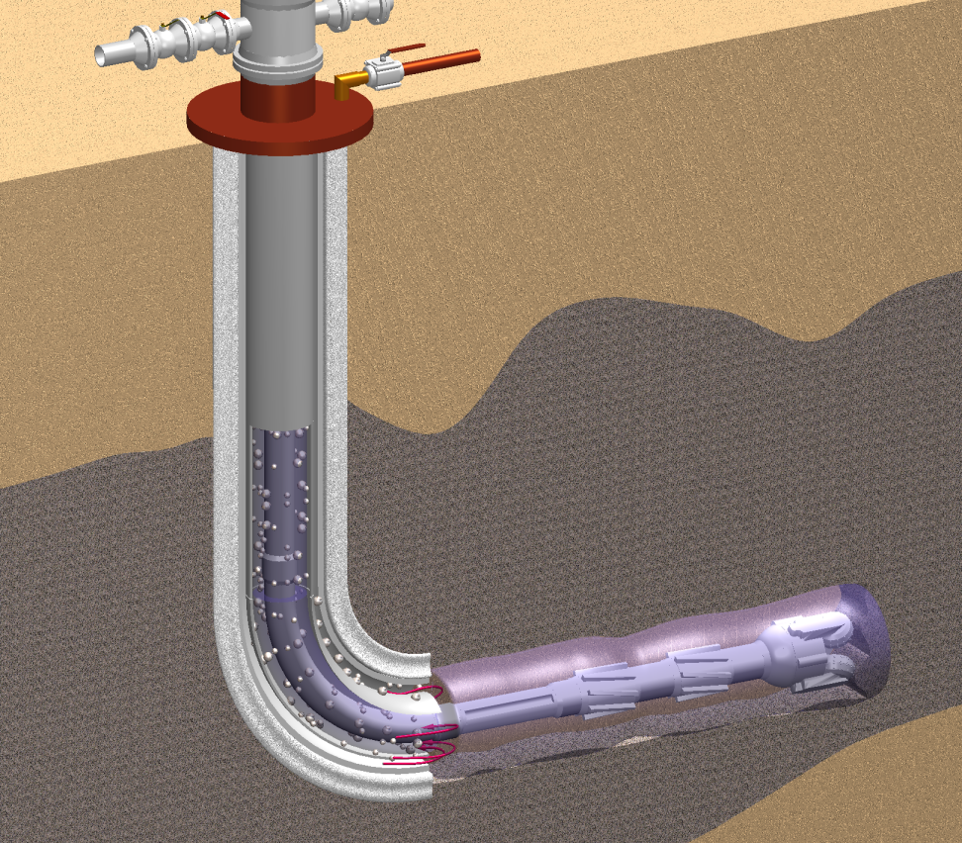
Annulus Injection - Concentric String
Notes:
Note that a liner and tie back are required.
The tie back may be pulled out after finished drilling the well when the following string is a liner
Gas goes to simple holes in the casing. Some people have proposed the use of gas lifting valves but it has not been considered worth the excess complication.
Gas injection can be started when tripping to bottom before going into the target formation facilitating tripping without fluid loss,
There is a accumulator effect that makes the flow of gas to be in batches and may result in extra gas flowing from the annular during connections and less gas flowing immediately after connections
Holding backpressure during connection can help reduce the accumulator effect

Slide 18
Annulus Injection - Concentric String
Advantages
  Single phase down the drillstring
  Mud Pulse tools work
  Can continue injection during
  connections & trips
  Can pull and re-use tie back
Drawbacks
  Requires suitable casing scheme
  Injection point fixed by casing depth
  Bottom hole pressure driven by injection point
Notes:
Advantages
Single phase in offers a more stable fluid system in open hole and reduced velocities that reduce the risk of erosion,
Gas injection can be stopped or maintained during connections.
Depending on well characteristics it may be desirable to maintain or cut the gas injection for connections. Strictly from the fluid loss point of vie maintaining gas injection should be preferred.
The concentric casing tie back can be pulled out and the casing use in other wells without leaving weak casing points.
Drawbacks
It requires liner + tie back with injection collar on bottom.
The injection point 3-4 joint above the liner hanger or higher.
The injection point can be a casing string with ports
The bottomhole pressure reduction is limited because gas can only be in the section above the injection point. Liquid hydrostatic will be present down below.
The injection point requires the wellhead to be modified to allow gas injection and hanging the tieback.
Well control need to be guarantied in the annular.

Slide 19


Annulus Injection - Parasite String
Notes:
Similar to the concentric casing injection but gas is injected thru a small (1-2”) pipe at the side called parasite string,
The parasite string can be joined pipe or coiled tubing,
Gas goes into the annular in a special piece of casing called “injection collar”,
The hole in the previous sections needs to accommodate both the casing and the parasite string → bigger hole size
Parasite strings are usually cemented when they are not required anymore.

Slide 20

Annulus Injection - Parasite String
Advantages
  Continue injection during connections & trips
  Mud down the drillstring
  Mud pulse tools work
  No accumulator effect
Drawbacks
  Cannot be retrofitted in existing wells
  Weak point in casing
  Wellhead modification, Injection Pressure
  Only in vertical wells, do not rotate
Notes:
Advantages:
Presents similar advantages as concentric casing over drill string injection
The total parasite string volume is much smaller than the annular resulting in minimum accumulator effect,
Disadvantages:
A parasite string needs to be run with the casing, if not run already cannot be introduced.
The injection point is a weak point in the casing that stays into the productive stage,
As the concentric casing it requires modifications to the wellhead to be able to have a conduit (the parasite) coming out of the annular between casings,
Injection pressures are generally higher than in concentric casing for the same injection depth due to the smaller area of flow,
Special considerations are required not to damage the parasite running casing.
It will be damaged by rotation on setting too much stresses on the parasite string.
Do not set the slips on the parasite string (slips need to allow space for parasite),
The parasite small pipe will not stand the stresses required to run it in highly deviated wells,
It requires a larger hole size to accommodate parasite and casing,

Slide 21
DG Gas Injection – Offshore Approach

Slide 22
DG Gas Injection – Offshore Approach

Slide 23
DG Gas Injection – Offshore Approach

Slide 24
Summary
MPD DG Technique of Injecting a gas phase through a concentric casing or parasite string will allow to:
  Drill depleted formations, avoiding circulation losses and reducing reservoir damage.
  Drill with higher density in environments where the bottomhole is requiring it but where the shoe or shallower formation represents the weakest point.
More than “Dilution”, the dual gradient effect is obtained by gas bubble expansion in the annulus occupying the liquid space and reducing hydrostatic.
The applicability of this technique in offshore environments remains function of equipment space constraints.

Slide 25
QUESTIONS AND answers
Notes:
Good Morning,
I am going to touch on a subject that might be considered slightly controversial by making the statement that
“Closed Loop Circulating Systems Enhance Well Control while also Increasing the efficiency of the drilling and completion of a well”
Over the next 20 minutes, I plan on walking through the steps that brought us to the point that allow me to feel comfortable in making this statement.

Slide 26
thanks
Notes:
Good Morning,
I am going to touch on a subject that might be considered slightly controversial by making the statement that
“Closed Loop Circulating Systems Enhance Well Control while also Increasing the efficiency of the drilling and completion of a well”
Over the next 20 minutes, I plan on walking through the steps that brought us to the point that allow me to feel comfortable in making this statement.

