Slide 1
Technological Revolution and the changing landscape
Lisa Shava Grant, PE
AADE

Slide 2
What Enables an Operator to Have First Quartile Performance?
Have great cross discipline integration and communication
Continually challenge status quo
Cultivate a culture not afraid of change, understands risk, and accepts “good” failure as a stepping stone to success
Utilize “Value Adding” technology and understand a Cost of Utilization approach
Understand that Technology comes in many forms; new widgets, processes and procedures, re-purposing
Understand the full impact of well design changes
Embrace the “What If” mentality

Slide 3
The Challenge of Change
Failure to fully understand the value proposition
Failure to fully understand the risk profile
Fear of the unknown
Changing to an engineering mindset
Having “good” performance
Silo approach

Slide 4
Reducing $/BBL
Design Optimization
Reduce NPT
  During Drilling
  During the Life Cycle
Improve Efficiencies
Improve Recovery

Slide 5
Operational and Design Optimization
Improved overall Operational Performance - balancing the cost of operating vs the cost of total installation.
Cost reduction by minimizing the number/size of casing strings without incurring significant cost
  Longer open hole sections generally increases the risk of trouble events.
  Longer sections often obtainable by:
  Understanding and utilizing modeling key for success
  Utilizing technologies that improve performance or reduce the risk of NPT employed to reduce the likelihood of these events

Slide 6
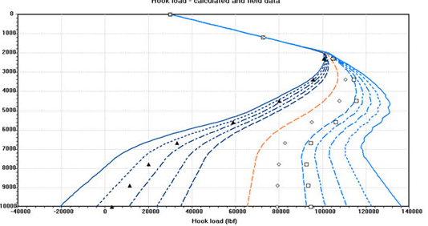
Advanced Planning and Modeling Essential for Success
Advanced modeling traditionally reserved for offshore applications
3-D Visualizations allow for better communications and faster, optimized solutions
Modeling essential for understanding design limits
Plan vs Actual to anticipate onset of problematic conditions
Embrace the “What If” mentality
Anticipation of Risks
and a clear response
plan greatly reduces
“train wreck”
escalations of events.

Slide 7
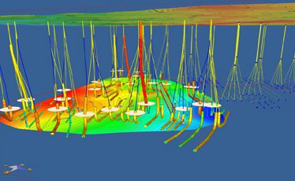
Integrated Planning Through Visualization
Integrate
Land requirements
Subsurface Hazards
Spacing
Completions and Production
Drilling constraints
Faster, More Powerful Planning

Slide 8
Using Real-Time Monitoring to Improve Performance
Real-time monitoring can be used to evaluate Plan vs Actual events, such as Hydraulics and TD
Real-time/ and post well data assessment can also be used to find hidden lost time and identify and learn from highly efficient operations

Slide 9
Technologies Utilized to Reduce NPT and Improve Performance- Repurposed From Offshore
Rotary Steerable Systems
Becoming more common place
Used in conjunction with MTRs to maximize ROP.
Historical barriers have been: Reliability, DLS capability, Cost – a Cost of Utilization approach should be used to assess viability
The tools have been adapted to land and simplified to be more fit for purpose – Improving Cost and Reliability
A Cost of Utilization approach should be used to assess viability
More flexible directional plans have been embraced to maximize section also reduce the DLS requirement – greater negative section to limit DLS to 10 deg/100ft

Slide 10
RSS Advantage
Better hole cleaning due to continual rotation
Faster ROP due to weight transfer and higher RPM
Less tortuous hole – lower friction, higher likelihood of landing casings at planned depth

Slide 11
Technologies utilized to reduce NPT - Repurposed From Offshore
A “hole finder” or Flex Shoe reduces stuck casing events
Originally developed for Offshore applications
Adapted in a fit-for-purpose to land operations
Benefits:
Proven to reduce the requirement to “rotate and ream” the casing.
Why does it work?
The increased flexibility of the last joint reduces casing point loading thus guiding the pipe over ledges.

Slide 12
How Flexibility Helps
DLS and ledges increase the force required to run the casing, increasing the risk of getting stuck in open hole.
FlexShoe reduces the bending and side loads at the casing shoe by more than 90% by reducing point loading
Normal Casing:
Stiff casing requires a large deflection force at the leading edge or ‘shoe’, as shown by the red arrow.
Risk of digging in to the side of the wellbore.
Flexible Guide Shoe:
Less force to enter curve. The length and stiffness of the guide distribute the normal casing deflection force.
Reduce the risk of sticking the casing through a curved wellbore section.

Slide 13
Hole Integrity Essential for Successful Optimization
Fluids developments are continually evolving.
Progressive Operators are taking a more “fit for purpose” scientific approach. This is yielding improved performance.
Factors influencing fluids selection:
Presence of Formation Fractures,
Reactive Shales,
Stability Requirements,
Lubricity,
Environmental Impact
Disposal

Slide 14
WBM Vs Non-Aqueous Fluids
The ideal system:
Easily disposable and low environmental impact, low friction, non reactive, fracture resistance.
Examples:
Thixotropic systems
Glycol systems
Evolution of low cost nanotechnology that interface with the rock face to improve rock stability – different mechanisms

Slide 15
Improved Well Placement
Reduce Horizontal uncertainty > 60 percent with advanced wellbore surveying techniques
Magnetic Surveying Options (HD Magnetic Models, In-Field Referencing Models (IFR) and Multi Station Analysis corrections (MSA)
Advanced Gyro Surveying (Continuous High / Angle Gyros)
Average MWD survey can have > 400 ft horizontal displacement uncertainty @10,000 ft displacement (This can be significantly larger with poor Quality Assurance)
Poor wellbore surveying can lead to misplaced wells and lost reserves and wellbore collisions

Slide 16
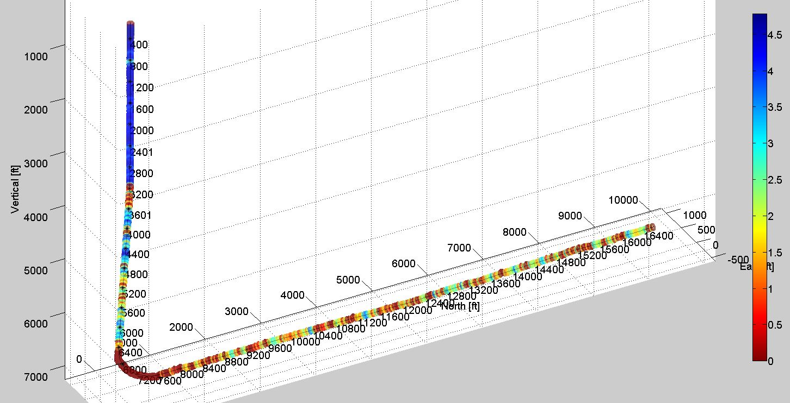
Additional Solutions From Survey Tools
High density continuous surveys can be used to generate caliper and ID imagery
Detect casing buckling (from installation in compression)
Micro-Doglegs
Effective Drift

Slide 17
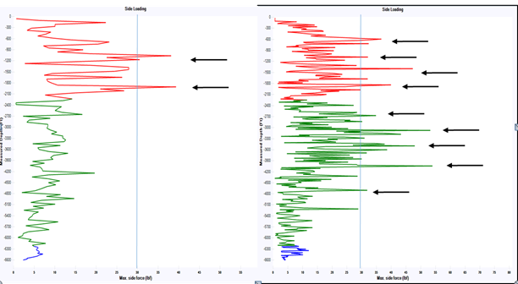
Tortuosity can greatly impact artificial lift
Increased Survey Density improves Artificial Lift design and better predicts performance

Slide 18
Closing Thoughts
Understand the Full Cost of Utilization
Every Change may have both Benefits and Risks
Understand the full impact to the well designs
Technology comes in many forms
There is no one Single Solution
Applying a single solution to all applications will likely not yield the same results.

Slide 19
Lisa Shava Grant, PE
Grant Energy, LLC lisagrantPE@yahoo.com

