Slide 1





Slide 2
Problem: API Collapse is based on minimums, potentially a higher collapse could be used to design wells.
Solution:
Laserstream, LP with the BEMISTM system measures the ID and Ovality of Casing to .002” inch – End to End. This data, along with full length UT data, will allow an inventory of pipe to be sorted into groups based on physical characteristics. Properties of each group can be quantified by collapse testing.

Slide 3
Phase 1: Data Collection
Heat and Batch (Yield)
ID Profilometry for min/max/average ID (Ovality)
Full Length UT to obtain min/max/average wall (Eccentricity)
  may have been performed during receiving inspection

Slide 4
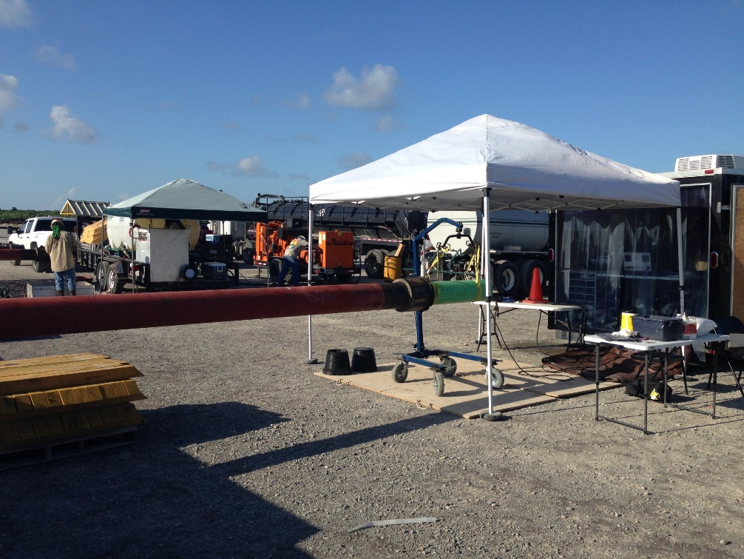
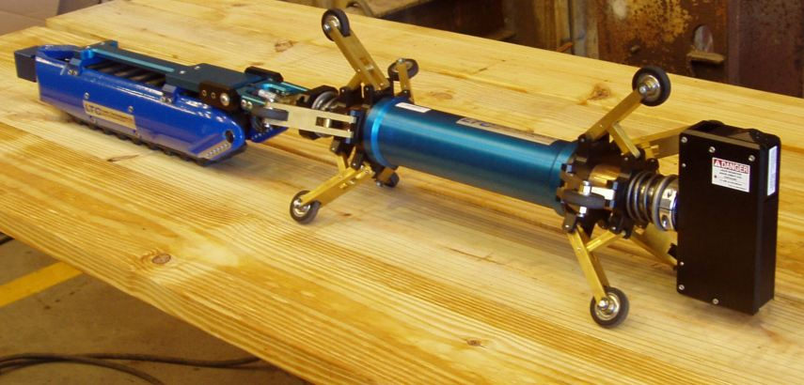
Laser ID Profilometry
BEMIS™ Pipe Scanner
Adjustable scan head

Slide 5
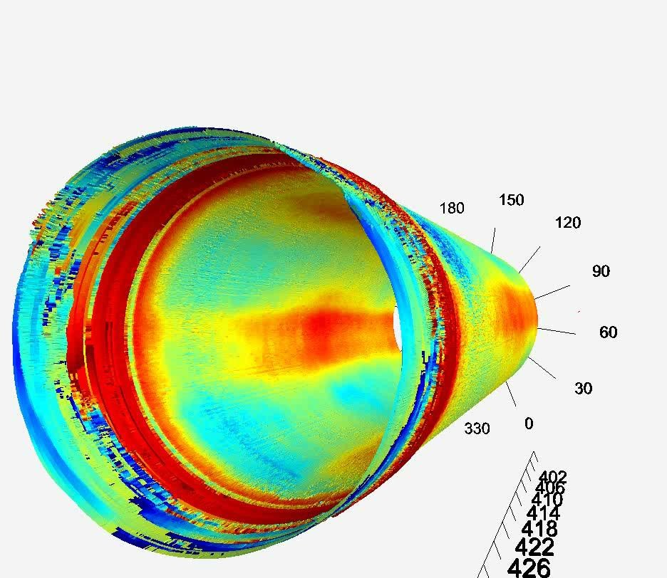
Threads and Ovality
9 7/8” CSG

Slide 6
ID Stats of 9 7/8” CSG
8.778” - 8.625” = .15”
Actual = 8.778”
Book Value = 8.625”
Distance from Pin

Slide 7
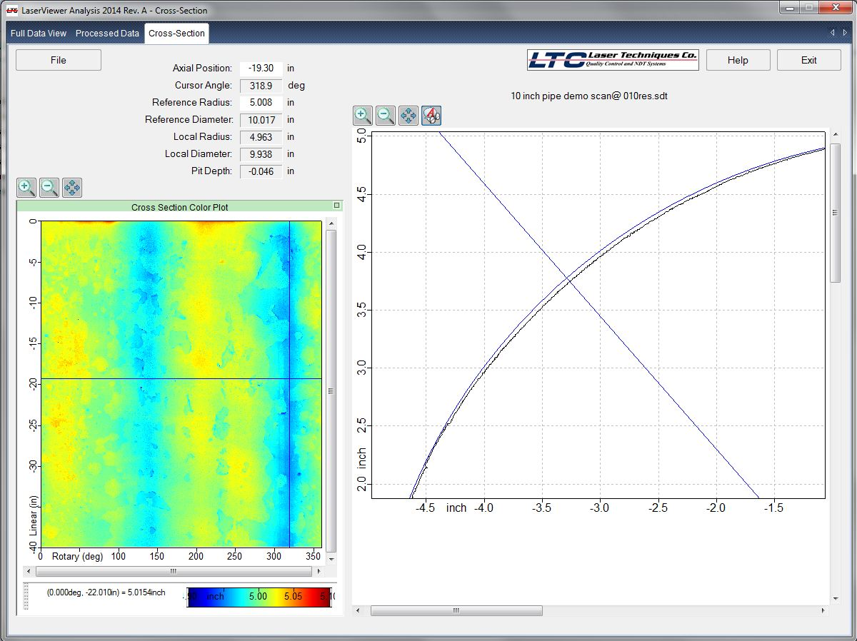
Laser Measurement of Ovality
Reference Surface
Actual pipe wall
Radial Cursor Measures Difference

Slide 8
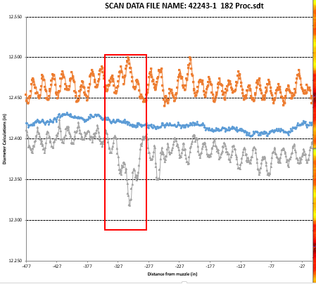
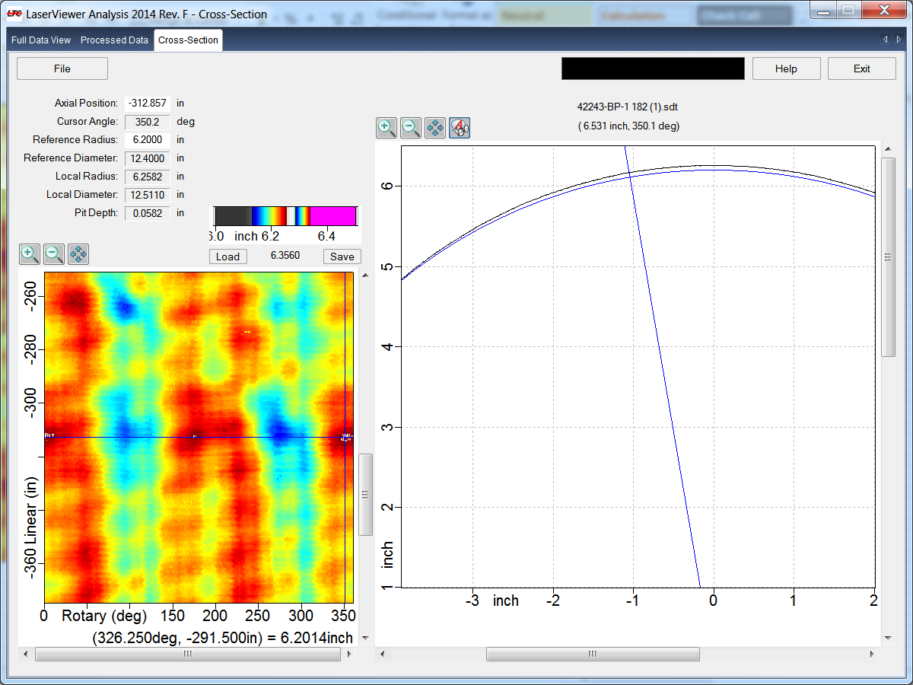
Pipe Out of Round for Short Section

Slide 9
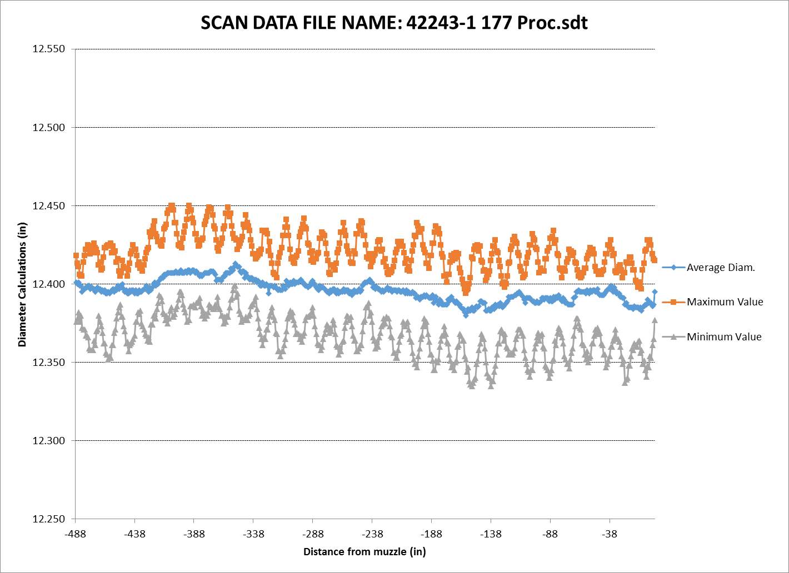
Distance from Pin
Distance from Pin

Slide 10
ID Variance Provided Every Inch Over the Length of the Joint
Note: Exact ID for Cement Displacements, Max ID for Packer Setting Integrity, and Caliper Baseline

Slide 11
Phase 2: The ID Data Would be Entered Into a Tally Sheet, with Wall Thickness Data, and Collapse Calculated
#57
Joint # | AVERAGE ID ENTIRE JOINT | AVERAGE ID VARIANCE | MAX ID VARIANCE | MIN WALL | ECCEN-TRICITY | Length | BBLs/jt | Calculated Collapse
57 | 12.464 | 0.21% | 0.70% | 0.708 | 14 % | 41.8 | 6.3082 | 7255
58 | 12.378 | 0.25% | 0.89% | 0.67 | 12% | 44.2 | 6.5787 | 7585
59 | 12.489 | 0.24% | 1.10% | 0.68 | 13% | 38 | 5.7578 | 7047
Klever–Tamano equations can be used to estimate collapse based on actual characteristics.

Slide 12
Phase 3: Pipe is Grouped Based on Estimated Value
Joint # | Group Number | AVERAGE ID ENTIRE JOINT | Length | Calculated Collapse
58 | A | 12.378 | 44.2 | 7585
60 | A | 12.337 | 44.5 | 7430
57 | A | 12.464 | 42.8 | 7255
61 | A | 12.443 | 41.3 | 7135
56 | B | 12.389 | 43.4 | 7077
59 | B | 12.489 | 38 | 7047
Joints that meet a set criteria would be given a certain Grouping (A, B, C). The lowest value in the grouping would be sent for collapse testing.
For example: Group A is sorted as everything that calculates greater than 7100 psi. Therefore joint #61 would be sent for collapse testing.

Slide 13
Phase 4: Collapse Testing to Be Done Per API TR 5C3
Collapse Testing to be performed on specimens for each grouping.
Minimums for each grouping established.
Tally would be designed to place pipe for optimized string performance.

Slide 14
What else can Laserstream Do?

Slide 15
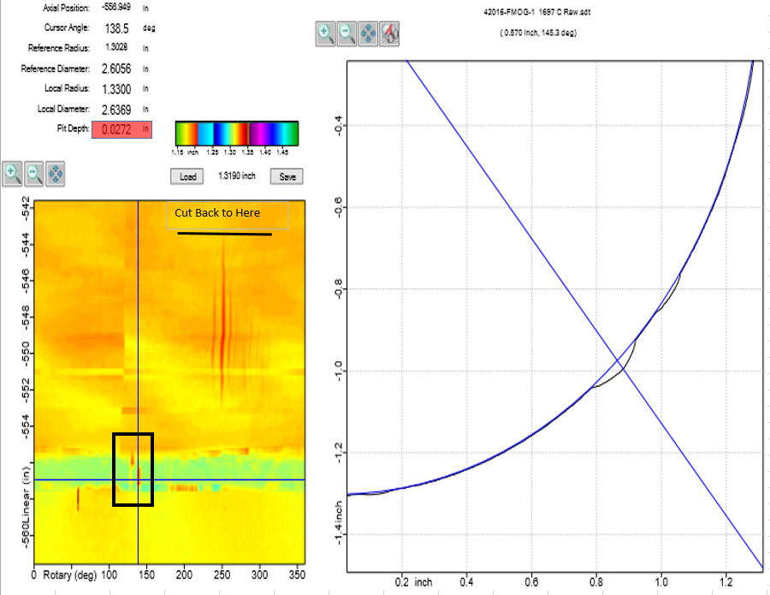
CRA Tubing / VIT

Slide 16
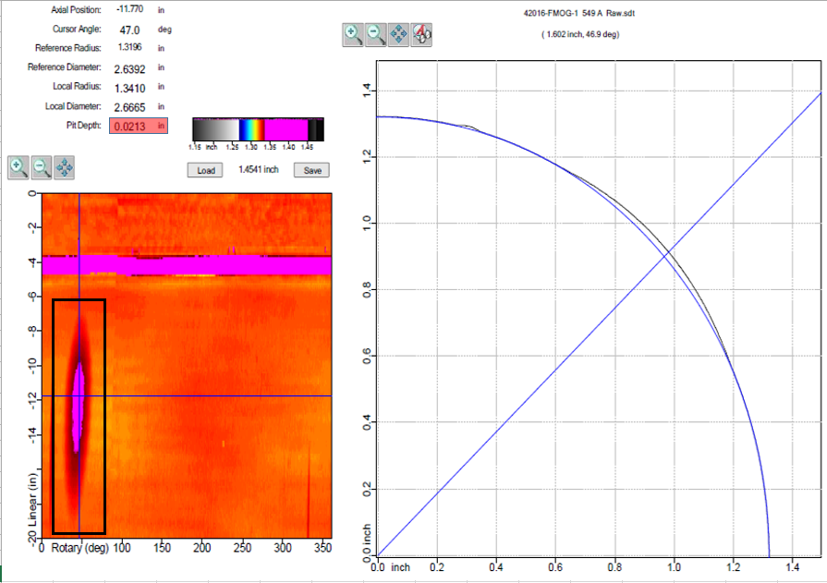
CRA Tubing

Slide 17
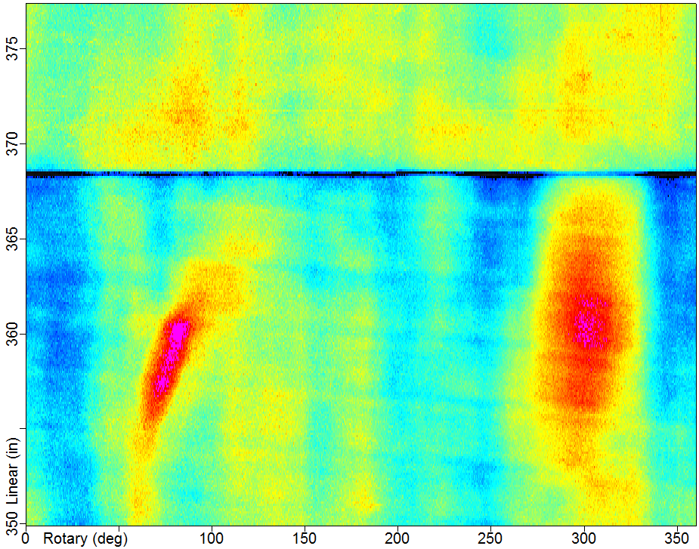

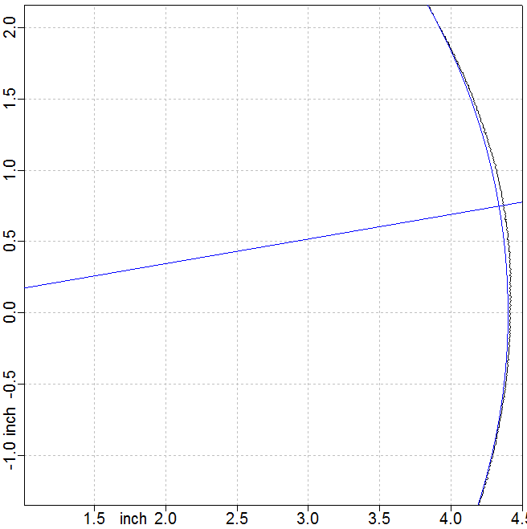
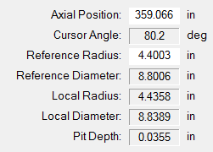
Risers
Note: linear position and azimuthal position
Laser scan image and measurement of wall loss

Slide 18
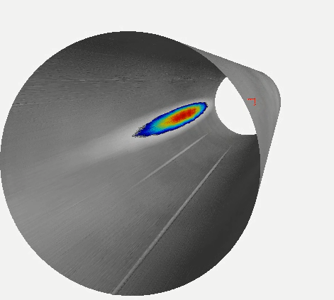
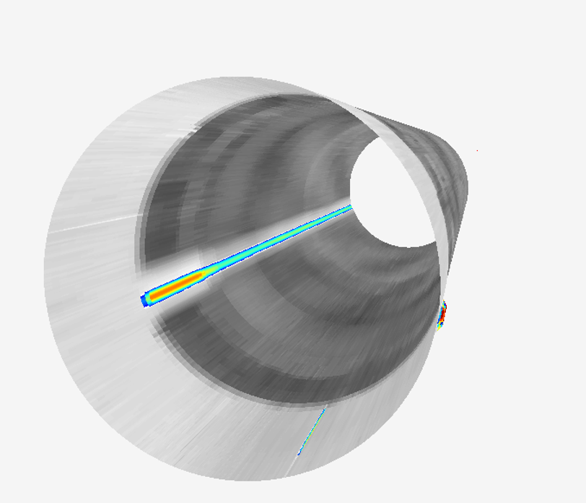
LaserViewer 3D™
Visualization/ Analysis Software
Coil Tubing Wear and
Wireline gouges
Wireline Gouge under threads

Slide 19
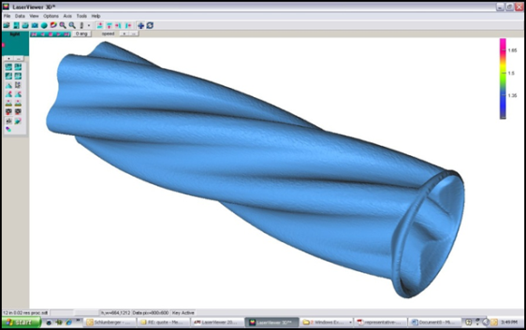
Progressive Cavity Stator
ID Scan

Slide 20
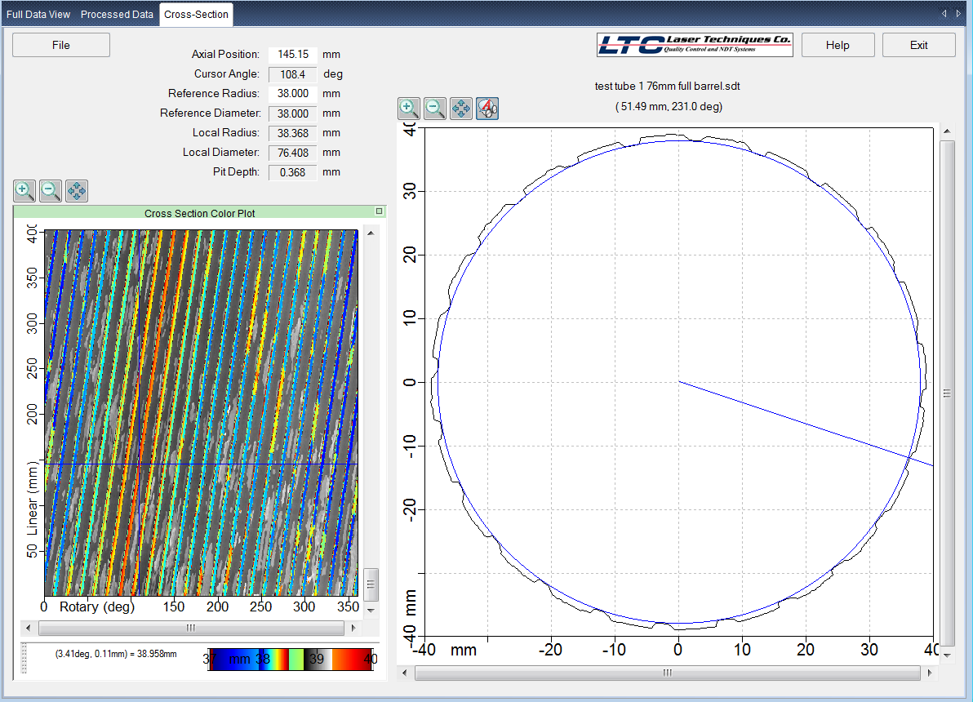
Cross Section
Rifled Barrel
The cross section tab displays a scaled
two-dimensional cross-section of the scan data.

Slide 21


Scott King – 281-883-3697
jscott.king@laserstreamlp.com
Jason Waligura – 713-775-4455
jason.waligura@laserstreamlp.com

