Slide 1
Investigation of Frictional Heat Check Casing
Failures in Offshore Deepwater Wells
Leads to New Mitigation Strategy
Michael Fitzsimmons / Rollyn Reyes
Chevron

Slide 2

Presenter #1 – Michael Fitzsimmons
Biography
Michael Fitzsimmons, joined Chevron in 2002 as a Production Engineer and has held the following roles:
  Bakersfield, California
    Production Engineer, 2002-2005
    Drill Site Manager, 2005-2006
    Drilling Engineer, 2006-2008
  Bangkok, Thailand
    Drilling Engineer, 2008-2010
    Production Engineer, 2010-2012
  Houston, Texas
    ETC Drilling Engineering Team Lead, 2012-2014
    GOM Drilling Engineer, 2014-2016
    GOM Well Design, 2016 - Present
Michael Fitzsimmons has a B.S. in Petroleum Engineering from Texas A&M University
Drilling Engineer
Chevron
Houston, Texas

Slide 3

Presenter #2 – Rollyn Reyes
Biography
Rollyn Reyes was previously employed as a contractor and as an employee for Chevron in various roles including:
  ETC DSC Operations Drilling Engineer, 2019
  GOMBU Contract Well Design Engineer, 2015 – 2019
  DWEP Contract Halliburton Landmark Drilling Consultant, 2012 – 2014
Before Chevron, Rollyn Reyes worked for SandRidge Energy as a Drilling Engineer from 2014 – 2015 and Halliburton Landmark as a Sr. Drilling Consultant Team Lead from 2011 to 2014
Rollyn Reyes has a B.S. in Petroleum Engineering from the University of Texas at Austin
Petroleum Engineer
Houston, Texas

Slide 4
Introduction
Topics
Introduction
What is heat checking?
RCA summary / FEA analysis
Mitigations / implementation
Challenges and lessons learned
Key messages
Chevron experienced four casing leaks between 2014 and 2018 in subsea deepwater environments that were not explained by traditional failure modes (wear / improper make up)
A RCA looking at various industry failures concluded drill pipe rotation can cause the surface of the casing to exceed steel austenitizing temperatures and when followed by rapid quenching from the mud can result in heat check cracks, potentially leading to through wall propagation and failure.
Objectives and value
Share with industry the realization / understanding of a new casing failure mode
Share with industry the mitigations put in place to avoid future failures including a proposed operational guideline and real time monitoring plan based on 3D FEA modeling

Slide 5
What is heat checking?
API RP 96, First Edition, March 2013
“Heat checking in casing is thought to be a result of the drill pipe rubbing against the ID of casing during normal drilling operations. Friction associated with the rubbing action causes shallow, localized contact points in the ID of the casing to heat to extremely high temperatures [possibly as high as ±1500 °F (816 °C)]. As the drilling fluid contacts the heated region, the contact points rapidly cool, transforming the microstructure of the casing ID and resulting in localized brittle areas and cracking. The heat checking cracks can continue to grow and cause a casing leak.”
In other words
In the deepwater setting, a combination of high side loads from heavy drill strings and/or increased wellbore tortuosity, increased RPM, and low ROP increases susceptibility to heat checking.
High strength casing grades with potentially lower fracture toughness increases risk of fracture propagation and through wall failure.

Slide 6
Characteristics of failed casings
Similar size casing
High yield strength
Occurred in the presence of either planned (build section) or unplanned directional work (random tortuosity and/or bypass) and observed casing wear from drill pipe rotation
  Wear was as expected and within defined / acceptable limits
Wells experienced a range of drilling rotating hours with estimated side loading between 4000 lb / joint and 8500 lb / joint

Slide 7
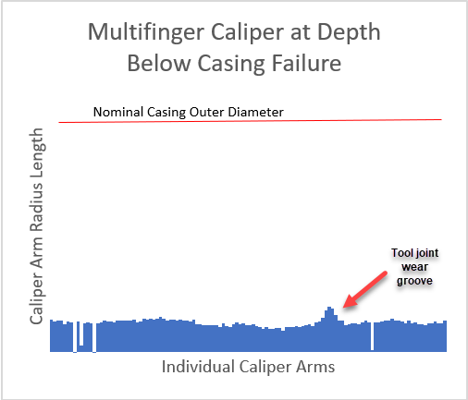
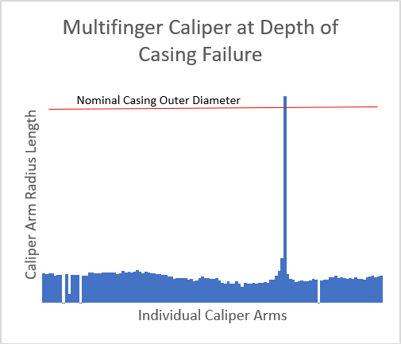
Caliper log image of casing failure
Most recent leak
Leak occurred in the planned build section, started at 10 bph and increased to 500 bph (9,000 bbls total lost)
3 bit runs with ~111 drilling hours
Max measured wear ~ 10% of tube
Hole description
Through wall, ~2.5” x 1” size hole about 3” below the box transition taper.
Located in wear groove, below box swage/thread area in tube

Slide 8
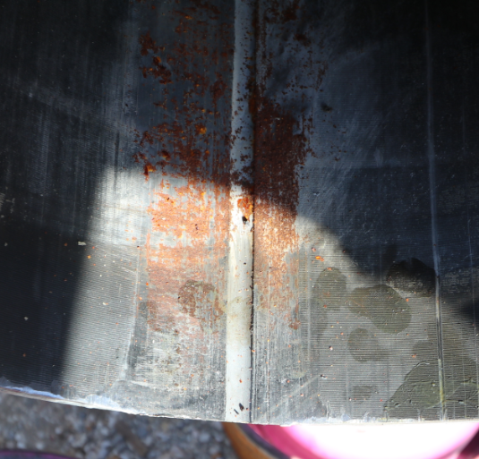
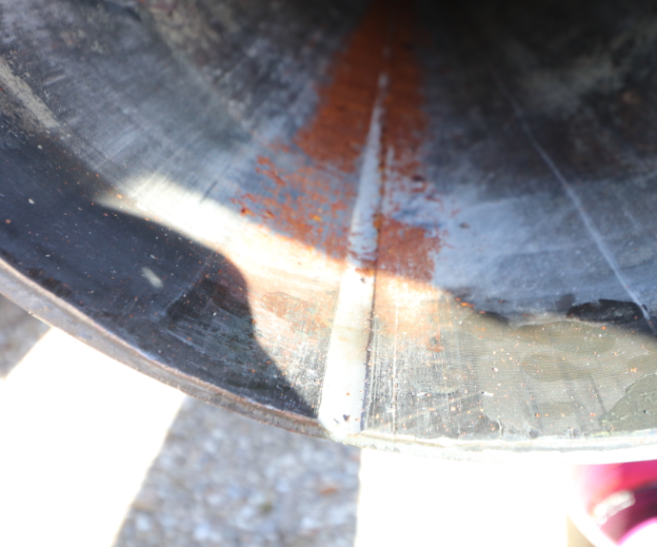
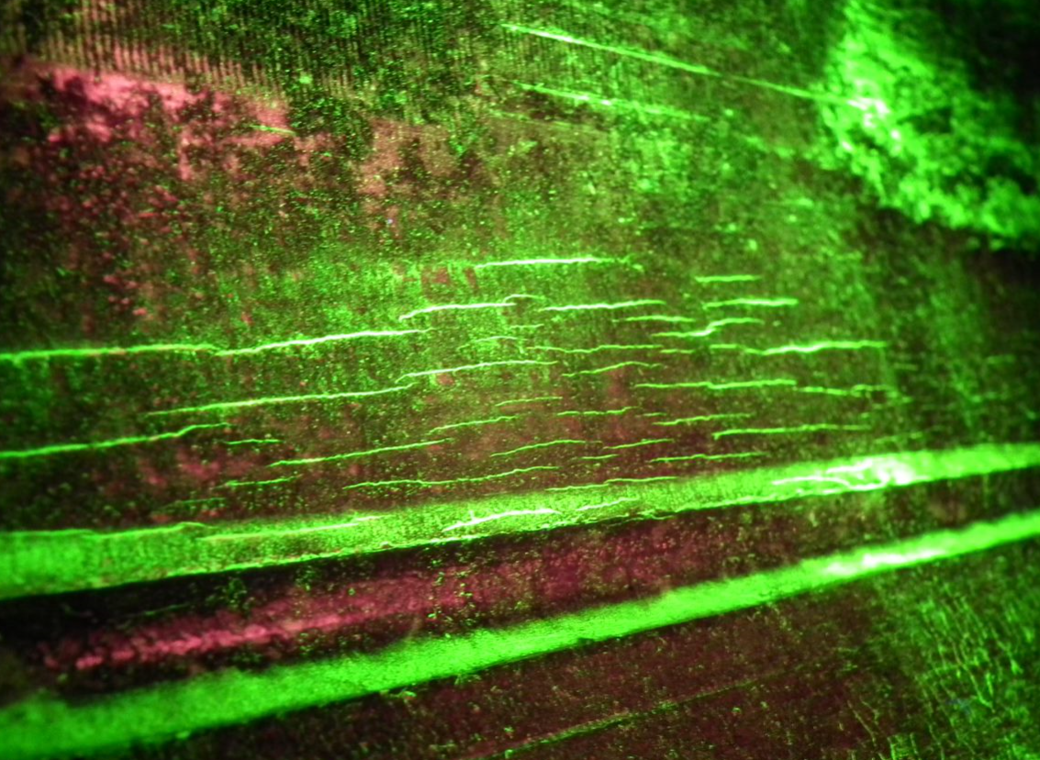
Wet magnetic particle inspection of wear groove
Pulled drilling tieback from a different well (pulled for P&A purposes)
Casing held pressure test
Observed wear from drill pipe and wireline along with heat check cracks

Slide 9
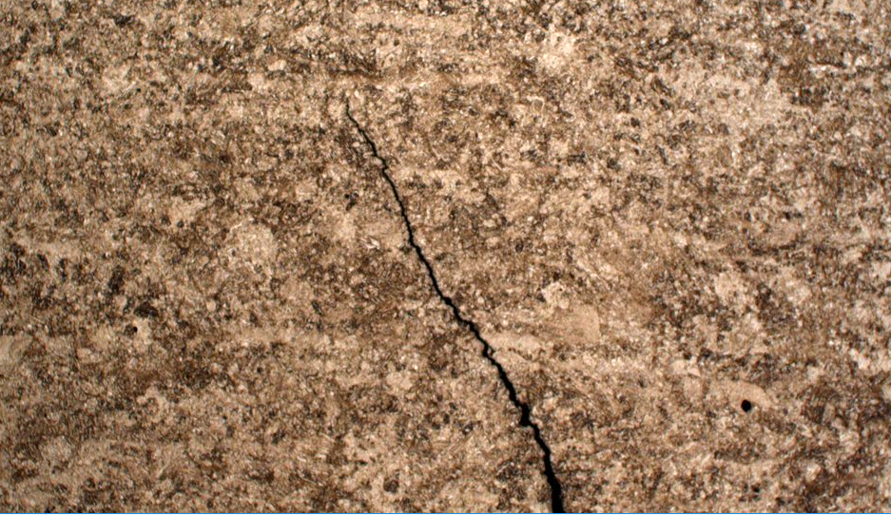
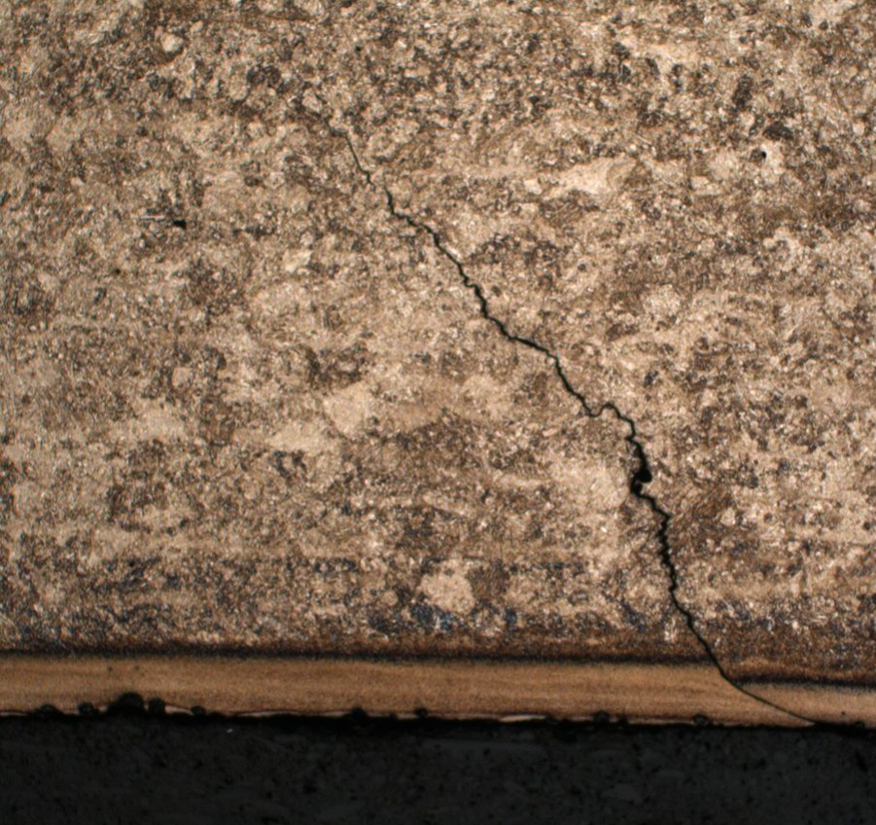
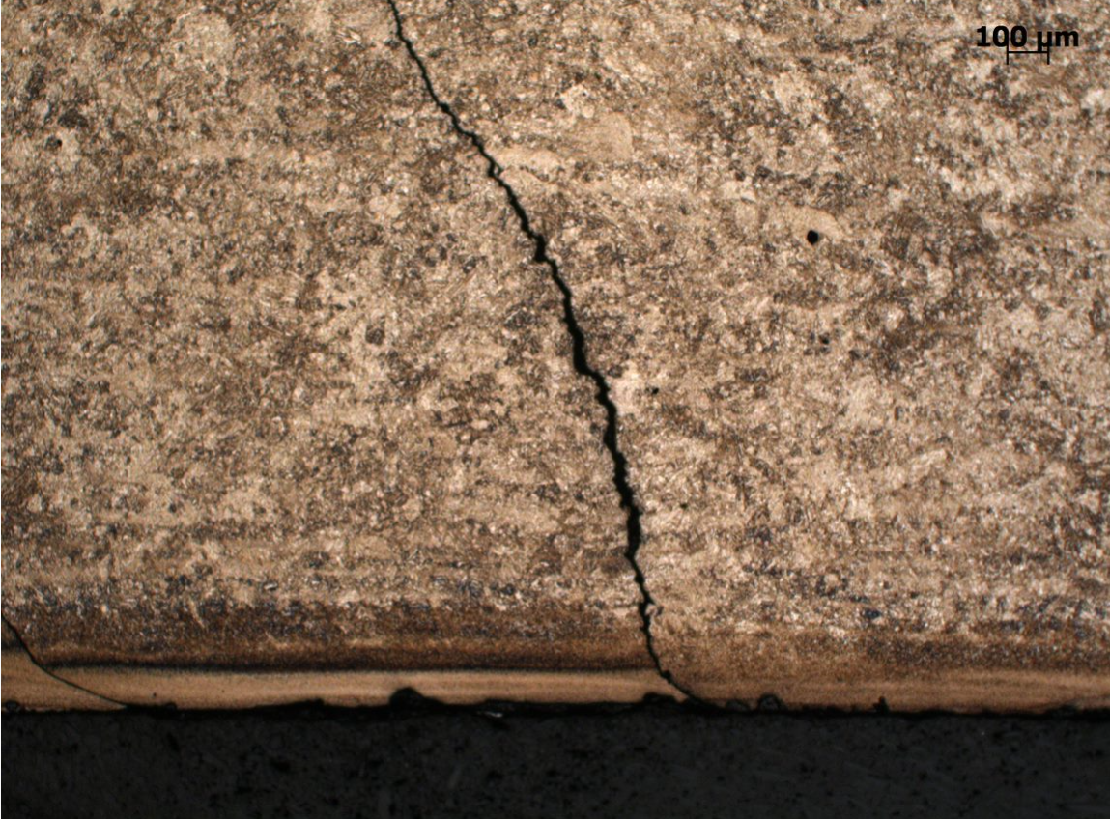
Through wall micrograph in the etched condition
Features
A clear light-etching transformation layer of increased hardness at the casing ID (A)
Darker tempered region with lower hardness readings (B)
Unaltered grain structure with hardness readings consistent with unaffected prime casing (C)
368
Vickers to RWC
300 – 29.8
400 – 40.8
500 – 49.1
600 – 55.2
358
380
331
362
361
364
~0.070”
397
349
347
342
~0.040”
367
354
344
337
341
356
C
371
349
335
343
346
B
292
305
313
338
300
317
307
~0.005”
A
561
561
550
293
317
319
553
532
593
603
339
Casing ID

Slide 10
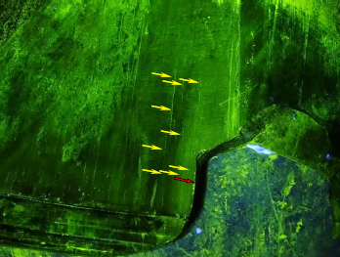
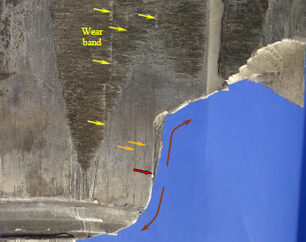
Wet magnetic particle inspection of wear groove / parted casing
Recovered failed casing
Fracture initiated in the wear groove along a heat check crack in the longitudinal direction before radiating out circumferentially leading to a full casing part.

Slide 11
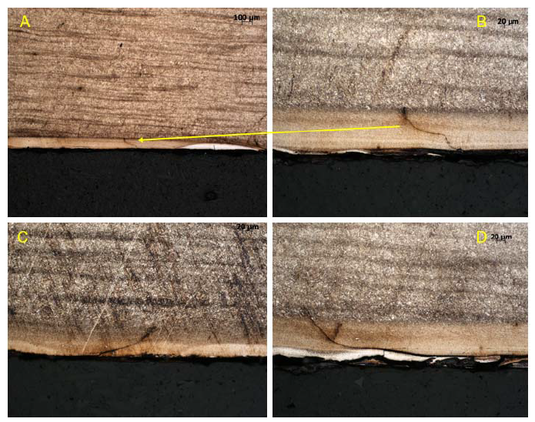
Through wall micrograph in the etched condition (different casing grade)
Pictures
Image B is a zoomed in view of the same fracture in Image A
Image C and D are close up views of different fractures
Key observations
Heat checking / untempered martensite and fracture initiation is present, fractures terminate in unaltertered grain structure
Different casing grades have different fracture toughness properties

Slide 12
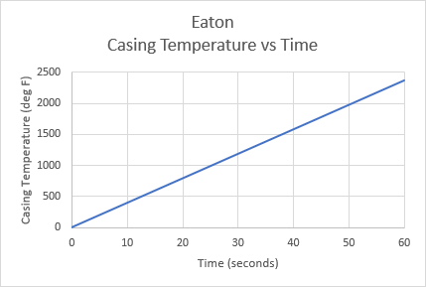
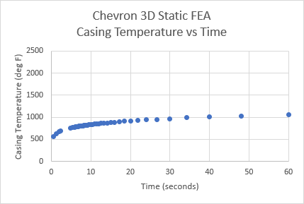
Understanding and development of mitigations
Eaton Friction Energy Equation
Does not account for heat loss
3D static FEA model (new equation)
Accounts for heat loss, pure conduction

Slide 13
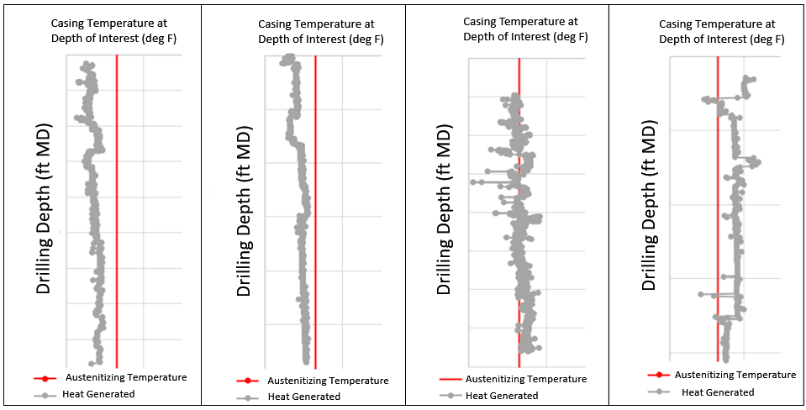
Understanding and development of mitigations
Applied equation to historical data
Equation predicts temperature as a function of side force, RPM, and ROP
Constants for contact area, friction factor, and power to heat efficiency

Slide 14
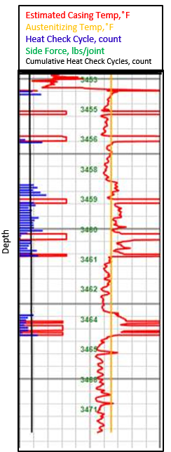
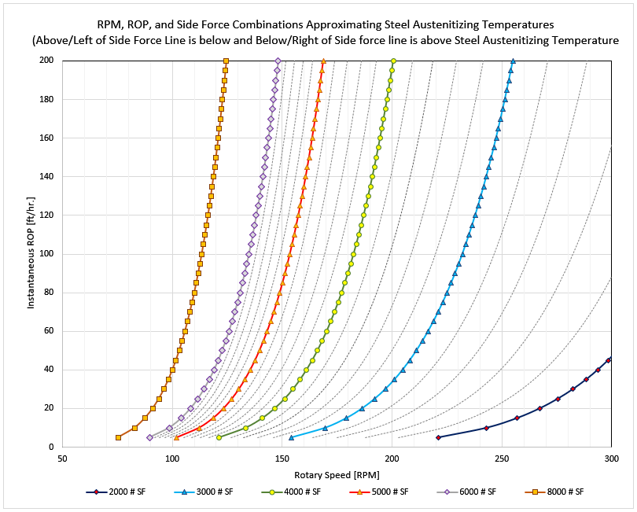
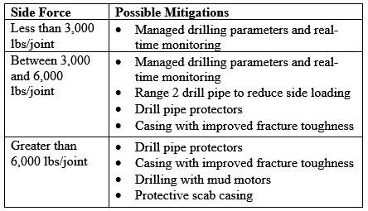
Understanding and development of mitigations
Operational guideline
Function of side force, RPM, ROP
Heat austenitizing temperature lines
Real time monitoring
Algorithm predicts temperature real time when pipe is rotating and tracks in cumulative fashion
Mitigation table
Chevron Guidance Document

Slide 15
Challenges and lessons learned
Lessons learned
Never say never
Get it done
Cast a wide net
Challenges
Lack of recovered failed casing required inferences from non-failed wells and external collaboration to draw conclusions
Inability to calibrate FEA temperature prediction model with physical lab testing
Implementation of mitigation measures increased cost / risk and needed to be justified

Slide 16
Q&A

