Slide 1
Casing Deformation
Causes
01/21/2021
AADE Presentation
George E. King, P.E.
Notes:
At Viking Engineering, we make sure that issues such as these do NOT occur.

Slide 2
Casing Deformation – Not Always Failure
Casing Deformation = not being able to get a frac plug or production equipment past a casing restriction after fracturing.
Causes?
  DLS >> average DLS. Worst seen is 25º to 35º w/ finger caliper
  Poor Cementing = seen in nearly every casing deformation/failure
  Non-uniform loading is VERY common. Cementing usually poor.
  Rock Fabric = Faults, bedding plane & formation slippage
  ΔT reduction in frac = axial tension = collapse resistance reduction
  More……….

Slide 3
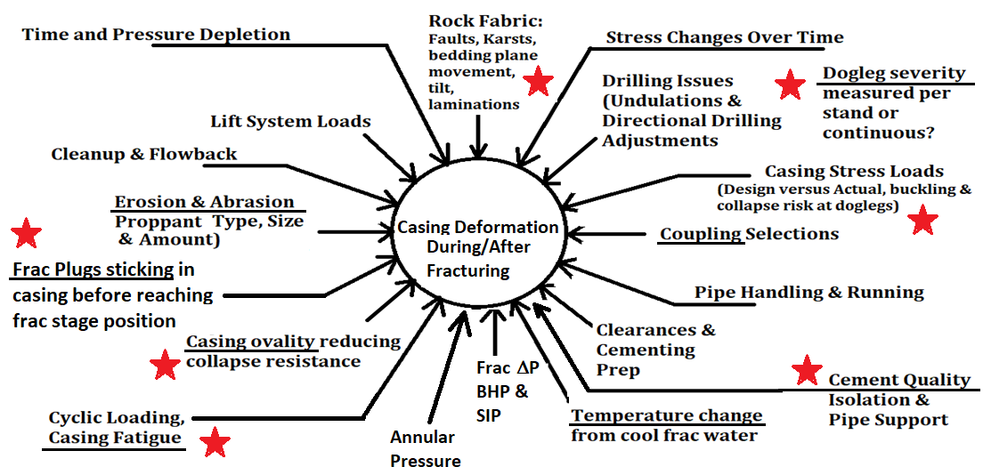

Slide 4
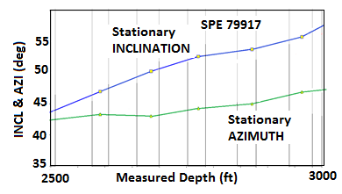
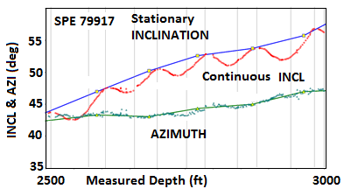
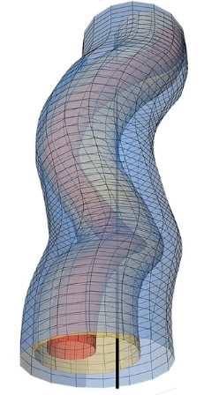
Dog Leg Severity – often much higher than an Average would Indicate…….
(Graphic courtesy of Gyrodata – SPE Dec 2015)
Source: Rassenfoss, S., “Drilling Wells Ever Faster May Not Be the Measure of Success,” SPE JPT

Slide 5
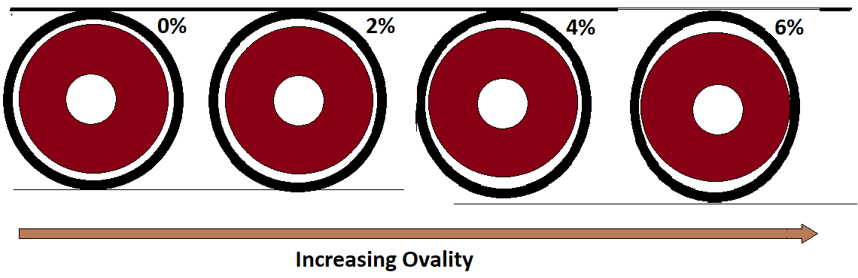
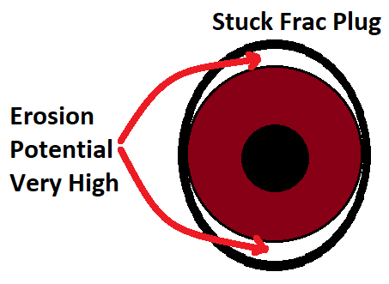
Casing Ovaling = stuck plugs + Erosion
URTeC 2902463
Casing often eroded at the plug setting site.

