Slide 1

Life Cycle Well Integrity of CO₂ Storage Wells:
Engineering Imperatives for Success
AADE - IETG Conference – March 25, 2021
Talib Syed, P.E.
www.talibsyed-assoc.com
Email: talibs@ecentral.com
Phone: +1 720.877.1272 (m)

Slide 2
Outline of Presentation – Life Cycle Well Integrity of CO₂ Storage Injectors
Well Integrity
- Definition and Importance
- Life Cycle Well Integrity
Life Cycle Well Integrity – Key Engineering Imperatives for Success
- Well Design and Construction Phase
- Casing design
- Cement design/ primary cementing
- Material selection/tubulars/completion
- Operations/Production Phase (including well interventions/workovers)
- Maintaining Well Integrity
- Plugging & Abandonment
Summary

Slide 3
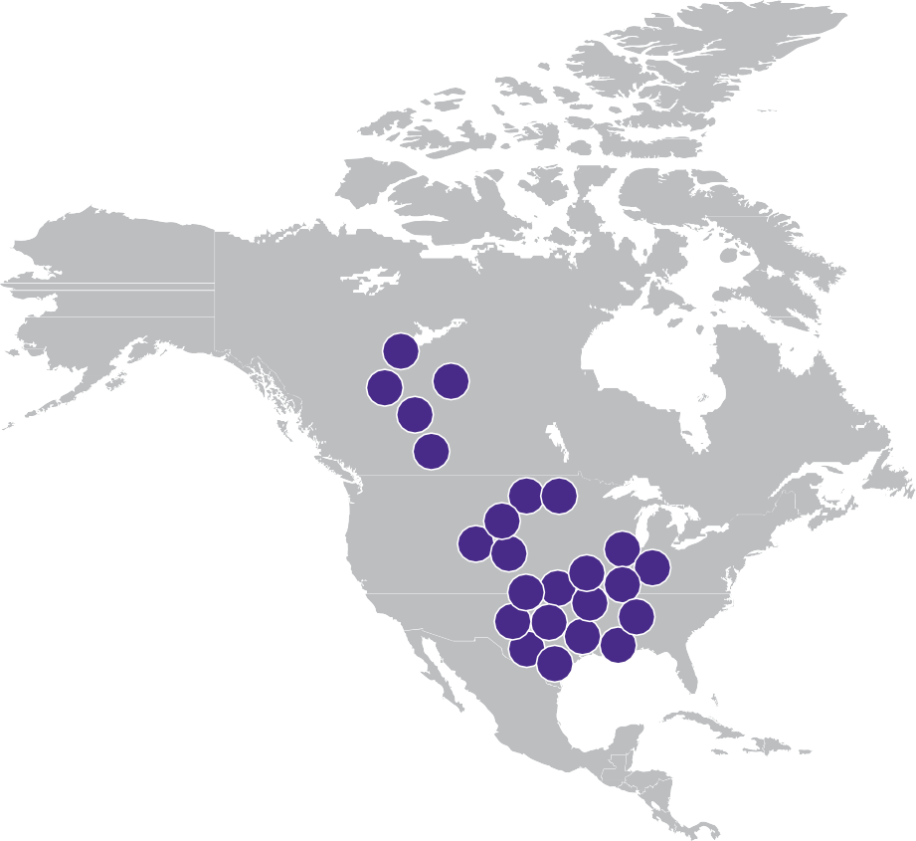

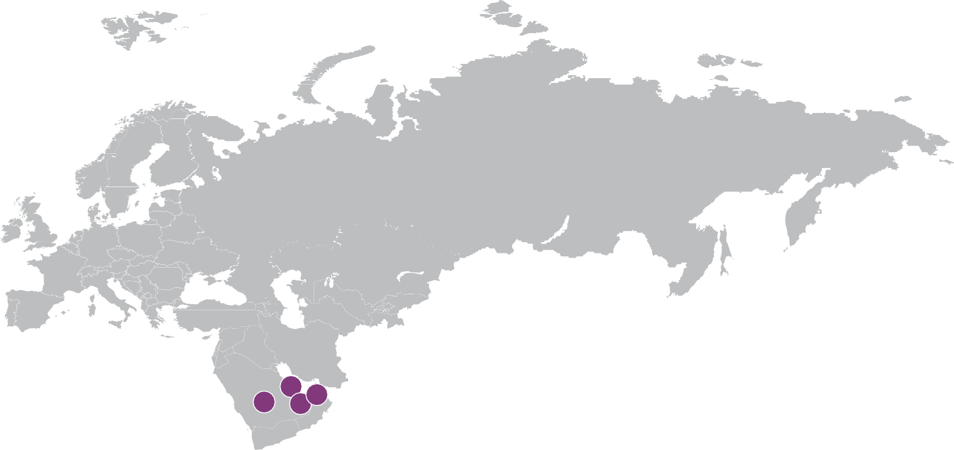






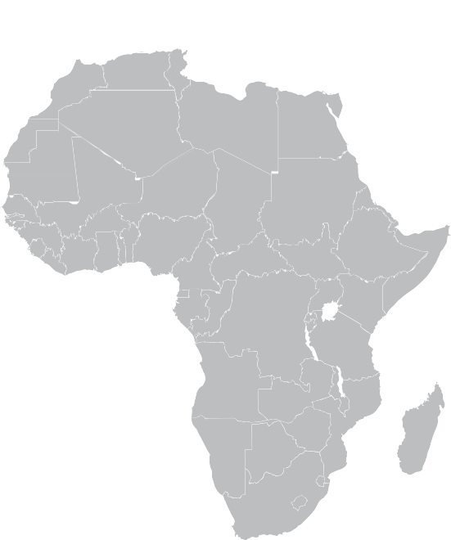







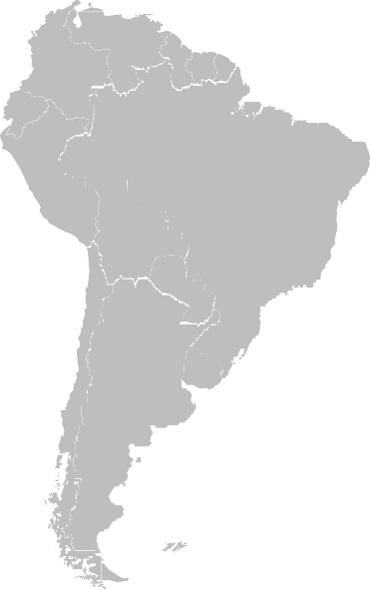



Global CCS projects
Overview of existing and planned CCS facilities
EUROPE
Leilac
Port of Antwerp
CO2 EOR Project Croatia
iCORD
Bio-Refinery plant
Lacq
DMX Demonstration in Dunkirk
ERVIA
Porthos (Port of Rotterdam)
Athos (Ijmond)
Magnum (Eemshaven)
Aramis (Den Helder)
Sleipner CO2 Storage
Snøhvit CO2 Storage
Northern Lights
Acorn
Caledonia Clean Energy
Preem CCS
H21 North of England
Liverpool-Manchester Hydrogen Cluster
Net Zero Teesside
Humber Zero Carbon Cluster
14
15
1
16
13
3
2
17
20 21
18
ASIA PACIFIC
Gorgon Carbon Dioxide Injection
CarbonNet
South West Hub
Jilin Oil Field CO2-EOR
Sinopec Qilu Petrolchemical CCS
Yanchang Integrated CCS Demonstration
Sinopec Eastern China CCS
China Resource Power (Haifeng) Integrated CCUS Demonstration
Huaneng Greengen IGCC Project (Phase3)
Shenhua Ningxia CTL
N/A
Sinopec Shengli Power Plant CCS
N/A
Korea-CCS 1 & 2
4
19 ₂₂ ₉ 10
5
8
₂ ₁₁ 12
12 20
18
7
6
1
3
₄ 5
10 ₁₃
6
11
9
5
12
4
₂₃ ₈ ₂₁ ₁₉ 16
10
14
22 7
14
24
6
9
15
11 ₁₇
7
NORTH AMERICA
Quest
Boundary Dam CCS
Alberta Carbon Trunk Line (ACTL) with North West Redwater Partnership's Sturgeon Refinery CO2 Stream
Lehigh’s Edmonton plant
Alberta Carbon Trunk Line (ACTL) with Agrium CO2 Stream
Illinois Industrial Carbon Capture and Storage (ICCS)
Petra Nova
Coffeyville Gasification Plant
Air Products Steam Methane Reformer
Lost Cabin Gas Plant
Century Plant
Great Plains Synfuels Plant and Weyburn-Midale
2
1
₃ 4
13
8
Shute Creek Gas Processing Plant
Enid Fertilizer
Terrell Natural Gas Processing Plant (formerly Del Verde)
Wabash CO2 Sequestration
Lake Charles Methanol
Dry Fork Integrated Commercial CCS
CarbonSAFE Illinois -Macon County
Project Tundra
Integrated Mid-Continent Stacked Carbon Storage Hub
Oxy and White Energy Ethanol EOR Facility
Oxy and Carbon Engineering Direct Air Capture and Eor Facility
Project ECO2S: Early CO2 Storage Complex in Kemper County
MIDDLE EAST
N/A
Uthmaniyah CO2-EOR Demonstration
Abu Dhabi CCS (Phase 1 being Emirates Steel Cindustires)
Abu Dhabi CCS Phase 2 - Natural Gas Processing Plant
1
1
3
CENTRAL AND SOUTH AMERICA
1. Petrobras Santos Basin Pre-salt Oil Field CCS
2

Slide 4
Well Integrity - Definition
“Application of technical, operational, and organizational solutions to reduce the risk of an uncontrolled release and/or unintended movement of well fluids throughout the life-cycle of a well” (NORSOK Standard D-010 and API RP 90)
“Containment and the prevention of the escape of fluids to subterranean formations or surface” (ISO 16530-1)
Note: Well integrity differs from wellbore integrity (borehole instability) – open hole interval that does not retain its gauge and/or structural integrity
Notes:
NORSOK D-010 is a functional standard and sets the minimum requirements for the equipment/solutions to be used in a well, leaving it to the operating companies to choose the solutions that meet the requirements and fully comply.

Slide 5
Well Integrity vs. Wellbore Integrity
Well integrity differs from Wellbore integrity (Borehole instability) – open hole interval that does not retain its gauge and/or structural integrity
Types of borehole instabilities:
  Hole closure/narrowing;
  Hole enlargement/washouts
  Fracturing
  Collapse
Borehole instability prevention:
  Maintain proper mud-weight; borehole fluid compatible with drilled formation
  Use proper hydraulics to control equivalent circulating density (ECD)
  Select proper hole trajectory
Notes:
Mechanical borehole failure occurs when stresses acting on the rock exceed the compressive or tensile strength of the rock. Shales cause most well-instability formations (> 75% of all drilled formations are shales). Shale instability due to (1) mechanical and (2) chemical – shale-fluid interaction – prevent shale hydration and dispersion – OBMs and SBMs in lieu of WBMs.
ECD is effective density exerted by a circulating fluid against the formation based on the pressure drop in the annulus above the point being considered. ECD = d + P/(0.052*D), with P is pressure drop between depth D (TVD) and surface. ECD is important in avoiding kicks and losses, especially where there is a narrow window between FG and Pore Pressure gradient.

Slide 6
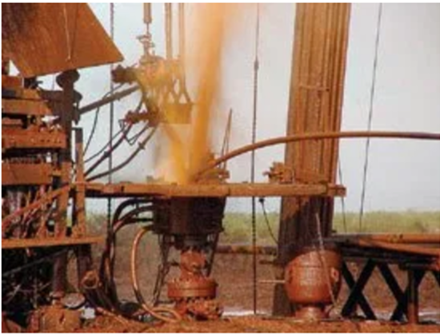
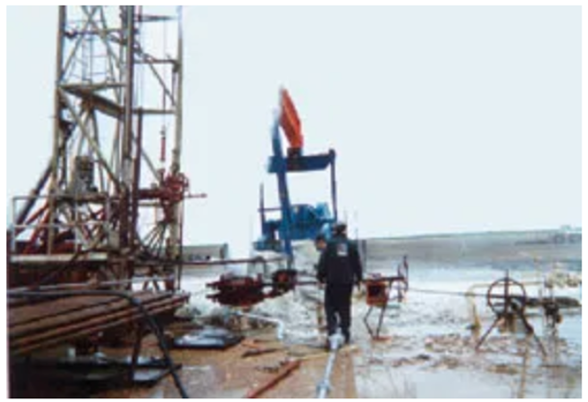
Why is Well Integrity Important?
(Skinner – http://www.worldoil.com/January 2003)
Blowout during workover to clean out fill in miscible CO2 injector
Blowout showing effects of expansion cooling when pressure containment is lost –dry ice
Notes:
Stinger (made from 1.5 inch tubing screwed to bottom of a tubing joint to CO fill lowered into well. Well started flowing – pipe rams unable to seal around stinger (annular rams not installed). Stinger bent and joint fell over. Oil reached surface and crew evacuated. When pressure containment is lost, 2 processes occur simultaneously. First, CO2 converted from supercritical to vapor with significant expansion and increases with decreasing confining pressure as it moves uphole. Flow behavior is almost explosive in its violence and not expected by field workers, causing a blowout in a matter of seconds, reaction time is minimal and not enough time to close manual BOPs and stab-in safety valves cannot be installed and closed fast enough – loss of well control. Unique phase behavior leads to: High flow rates complicates surface intervention work; CO2 and produced fluids collect in BOPs. Wellhead and other surface equipment; cold CO2 condenses water in atmosphere leading to reduced visibility in the “white” cloud around the wellbore; free oil can collect around the surface with ground-fire hazard. Dry ice formation can lead to marble sized projectiles expelled at high velocities injury to workers.

Slide 7
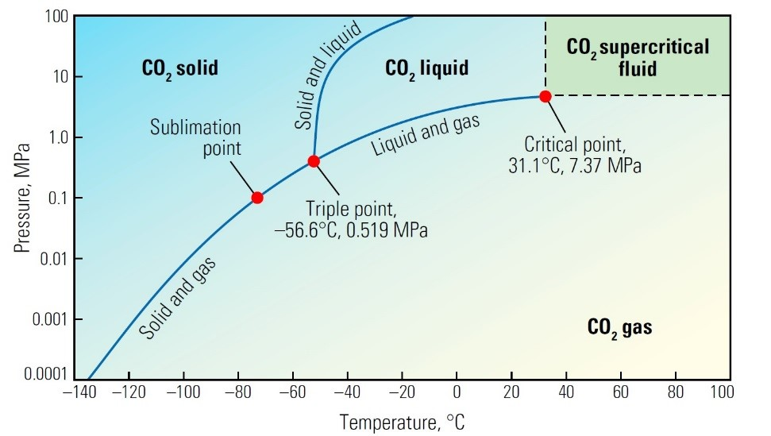
Include unique CO₂ phase behavior in well and piping design, operations and in well intervention
Low corrosion risk when injected stream is dry (CO₂ purity > 95%) and in supercritical stage
Long-term stability of wellbore materials is complex. Incorporate material and reservoir properties into well design/completion programs
CO₂ Phase Behavior (Oilfield Review September 2015)
7
Notes:
CO2 can exist as a solid, liquid or gas and at the Triple Point all 3 phases exist in thermodynamic equilibrium. Along the solid-gas line below the Triple point, CO2 sublimes directly from solid to gas without going through liquid phase, with sublimation point being 14.7 psi of CO2 vapor. Above the solid-liquid line above the Triple point, solid CO2 melts to a liquid. At the critical point, the liquid and gaseous states are indistinguishable, and phase boundaries no longer exist. These attributes at the critical point and at higher T and P characterize the area in which CO2 is a supercritical fluid (green). Storage depths are generally > 800 m (2,625 feet) since CO2 is more like a liquid than a gas, so it is denser and requires less pore space. Also, having a caprock/seal helps in restricting flow of fluids. Alberta regs require storage depths be > 1 km (0.621 mile).
1MPa = 145.038 psi – Triple Point – 70 deg F and 75.4 deg F, Critical Point – 88 deg F and 1069 psi.

Slide 8
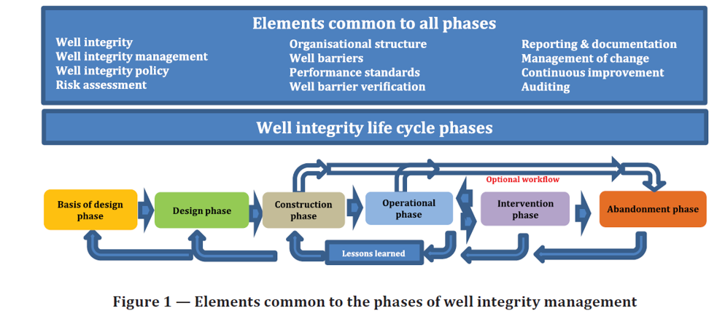
Well integrity – Life cycle governance (ISO 16530-1)
References: (1) ISO 16530-1-2017 – Well Integrity Part 1: Life cycle governance – www.iso.org;
(2) https://oilandgasuk.co.uk/product/well-life-cycle-integrity-guidelines; (3) www.hse.gov.uk/offshore/ed-well-integrity.pdf; (4) http://www.hse.gov.uk/offshore/wells.htm

Slide 9
Well Integrity
Complex loads/stresses on casing/tubing and cements from CO₂ injection handled with appropriate software
Impacts of CO₂ corrosion on well tubular and cements handled with appropriate selection of materials of construction (MOC)
Minimize thermal cycling (on-off injection and CO₂ supply disruption) to avoid potential cement debonding and injectivity effects
Annular pressure monitoring – primary concern is loss of well control (SCP etc.) (API RP-90, NORSOK D-010, ISO 16530-1)
Proper maintenance of CO₂ injection wells necessary – well integrity surveys, improved BOPE maintenance, crew training and awareness, contingency/emergency response
User-friendly, complete and up-to-date well data (including handovers)
Analyze data, audit losses due to well integrity
Monitoring – flowing and annular pressures; gas and fluid rates/composition

Slide 10
Well Integrity (Continued)
CO₂ transported and injected at a high pressure (above 1,100 psi)
- danger from its high coefficient of thermal expansion
Loss of well control (LWC)/blowouts during workovers is significant concern from CO₂ phase behavior and high pressure
- Failures from CO₂ – related corrosion of well materials can cause LWC
High injection pressures with low injection fluid temperatures can induce hydraulic fracturing – geo-mechanical models to determine in-situ stresses and fault activation hazard
Locate CO₂ storage wells far away from faults
Notes:
Even a small change in temperature leads to a large pressure change. CO2 normally transported as a liquid for economic/operational reasons. Under reservoir conditions, CO2 behaves as a low viscosity liquid and not a gas, affects injection performance (in tubing and near wellbore area). CO2 lighter than most oils- migrates to top of water and oil zones and interacts with wells at top of reservoir. Dense phase is 4th phase that cannot be described by the senses. Due to its unique properties, dense phase attractive for transport of CO2, natural gas, EOR, food processing and pharmaceuticals. With leakage, CO2 is not explosive (unlike hydrocarbons) – fires not a concern but asphyxiation is since CO2 is denser than air. Tremendous expansion of supercritical CO2 when pressure containment is lost is very significant from LWC perspective. Rapid cooling occurs due to the expansion that occurs leading to dry ice formation and hydrates that collects in various surface equipment areas.

Slide 11
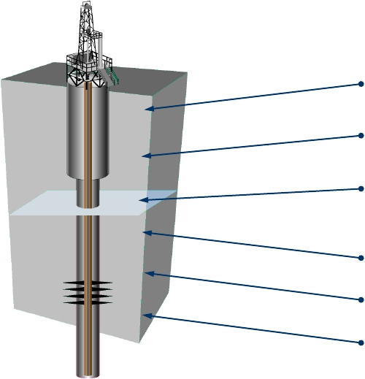
Why Mechanical Analysis?
A well is a stressful environment
Production/Injection
Temperature changes in upper
casings during production/injection
Pressure changes: drilling, production
injection
Permanent well abandonment
Formation changes/tectonic activity
Well completion/perforation/stimulation
(Kirksey, 2013)
11

Slide 12
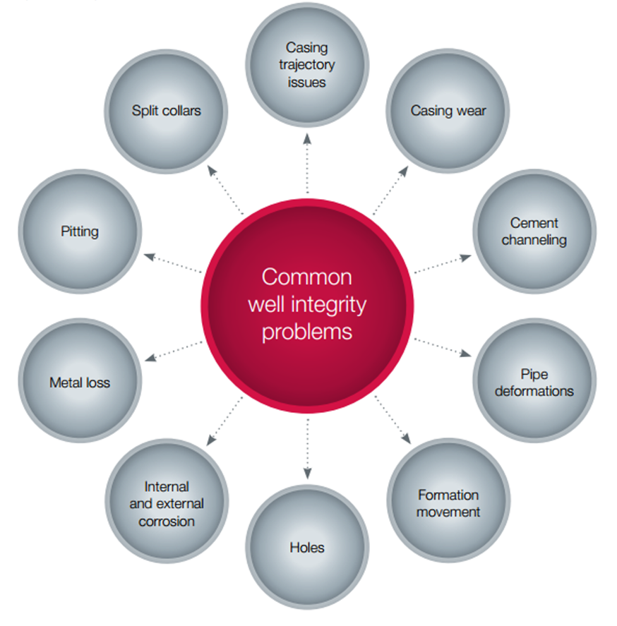
Common Well Integrity Challenges
Weatherford, 2014

Slide 13
Overview of State-of-Art Casing Design Software
Integrated Modules
Casing Design
Drill Design
Production Design
Tubing Design
Multi-string Design
Notes:
Casing Design/Tubing Design – comprehensive casing/tubing design and analysis - WellCAT and DrillPlan and other company proprietary software
Drill Design – simulates flow and heat transfer during drilling
Prod Design – simulates fluid and heat transfer during completion, production, stimulation, testing and well-servicing
Multistring Design – predicts pressure and volume changes due to trapped annular pressure and wellhead movement during life of well

Slide 14
Good Cementing Practices
Wellbore geometry
Centralization
Hole conditioning and mud displacement
Proper use of spacers and plugs
Casing movement
Accurate BHCT and downhole pressure
Cementing software - CemCADETM, OptiCemTM, IntegraStarTM
- Cover all potential flow zones. Uncemented zones may not flow in short-term but may lead
to SCP (sustained casing pressure) over long term
- Pressure tests – to confirm isolation at shoe (FIT/LOT)
- Post-job information: Cement top (TOC), evaluation of recorded job data – pressure, rate, density, other problems
- Data from logging tools
Notes:
WB geometry – straight annulus, no washouts, minimum 1.5” wide. Run caliper.
Centralization – Casing near middle of wellbore w/minimum 75% standoff.
Mud conditioning – Circulate mud before cement job. Avoid drilling fluid being static for extended period. Continue circulating until displacement begins.
Displacement – Complete displacement of cement slurry. Displacement ends when the top plug lands on the FC (bumping the plug). If plug does not bump after pumping the theoretical casing (nominal) displacement volume, and to avoid leaving a wet shoe (shoe surrounded by unset cement), pump additional half shoe track volume. Errors result from not using correct casing diameters (gauge significant number of casing joints); not accounting for compressibility of displacement OBMs fluids. QC and cement job monitoring.
Casing movement – reciprocation, rotation or both.
Accurate BHCT and downhole pressure for well control and cementing.

Slide 15
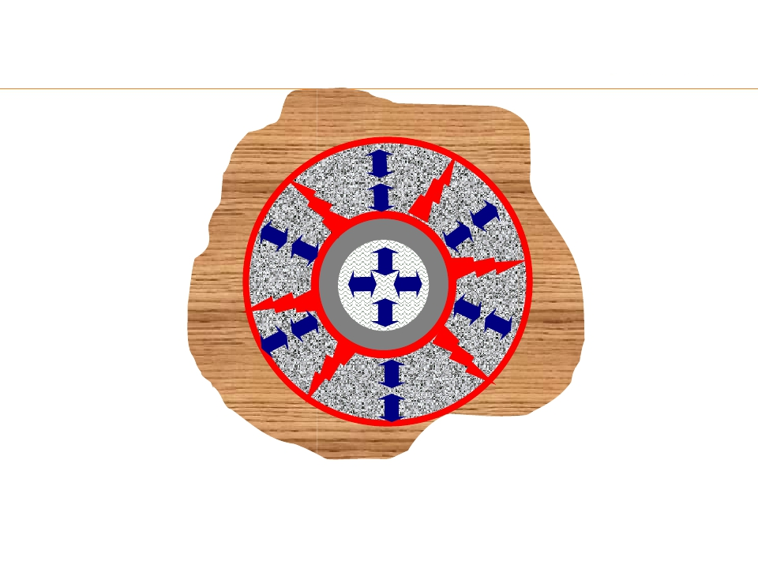
Stresses on the Cement Sheath
Tensile cracks
•Wellbore pressure
increase
•Wellbore
temperature
increase
•Cement shrinkage
De-bonding cement/
rock interface
•Formation stress
decrease
•Wellbore pressure
decrease
•Hydraulic fracturing
•Cement shrinkage
De-bonding steel/
cement interface
•Wellbore pressure
decrease
•Temperature
decrease
•Casing movement
•Cement expansion
Potential Results
•Loss of Well Integrity
•Sustained Casing
Pressures
•Collapsed Casing
(Kirksey, 2013)
15

Slide 16
Cement job evaluation – Indirect Methods
Since proper primary cementing is critical to well integrity, cement job evaluation is “indispensable”.
General indicators of success: full returns, lift pressure, and on-time plug landing
Full returns – volume of mud returns during cement job equals volume of fluids (spacer, cement and mud) pumped into well (if not lost returns or lost circulation)
Lift pressure – steady increase in pump pressure observed at appropriate time after cement is pumped. Indicates cement has “turned the corner” and is filling up annulus (and not being lost to formation)
Plug landed or bumped – pressure spikes on rig gauges when expected, indicates plugs landed properly and cement flowed out of shoe track into annulus (and not contaminated with mud)
Pressure and volume indicators will not show channeling or TOC (run CBL/USIT)
Notes:
Full returns – by monitoring mud tank volumes. Lift pressure – pressure increases since cement is generally heavier than mud.

Slide 17
Cement job evaluation techniques – Hydraulic Testing
Pressure testing - most common technique to confirm zonal isolation
Casing Integrity Test – performed first to verify mechanical integrity of casing. Straight line – good test, otherwise indicates poor cement job at shoe – requires remedial cementing
Leak Off Test (LOT) and Formation/Pressure Integrity Test (FIT/PIT) – Objectives: (1) verify cement seal around shoe and (2) determine wellbore capability to withstand pressures below the casing shoe to determine setting depth of next casing (include SF in case of kick). LOT and FIT are basically the same – former carries pressure increase to the formation fracture point – latter up to pressure required to drill ahead but not to fracture. If tests are not good, may require a squeeze job or drilling liner in extreme cases
Inflow testing (also known as dry testing) is a drill stem test (DST) to assess the isolation. Essentially opposite of a pressure test – the pressure inside casing is reduced and the well monitored to detect ingress of formation fluids. Successful dry test shows no downhole pressure change during the opening of the downhole valve or during the following shut-in period
Notes:
Casing integrity test – test csg to 2500 – 3000 psi for 30 minutes. Typical pump rates of ¼ to 1 bpm. Straight line – good test, otherwise indicates poor cement at shoe – requires remedial cementing. Prior to LOT/FIT test, must make decision whether to test until leakoff occurs (LOT) or stop at pre-determined pressure for a FIT.
Information from straight holes not applicable to deviated holes in same field and vice versa. If FIT is reqd, max. pumping pressure expressed in Equivalent Mud Weight EMW = P/(0.052xTVD) + MW. LOT – cement seal around shoe (must be at least as high as predicted fracture pressure in area

Slide 18
Cement Job Evaluation with Acoustic Logs – Current Techniques
Ultrasonic Imaging Tool (USIT), CAST-V (Circumferential Acoustic Scanning Tool – Visualization) and UltraView - continuously rotating pulse-echo type tool with nearly 100% coverage of the casing wall (acoustic impedance – Z).
The Segmented Bond Tool (SBT) measures quality of cement effectiveness, vertically and laterally around the circumference of the casing in 6 segment. Generally, run with VDL (variable density log)
The Isolation Scanner combines pulse-echo technology with ultrasonic technique of flexural wave imaging to evaluate cement job and casing condition. Covers a wide range of cements – heavy, traditional to light weight cements.
Other logs used to determine top of cement and channeling: Temperature, Radioactive tracer (RTS), Boron – Pulsed Neutron, Oxygen activation (OA)
Notes:
Z is product of density and acoustic velocity of a medium and is expressed in MRayl. CBL/VDL difficulty evaluating cements with low Z or cements contaminated with mud. Isolation scanner can differentiate between different cements e.g. between light weight cements and liquids and maps annulus material as solid, liquid or gas. Ensures confident squeeze/no squeeze decisions.

Slide 19
Cements for CO₂ - Rich Environments
Cements for CO₂ EOR and CO₂ GS
CO₂ -laden waters can degrade the structural integrity of set Portland cement and lead to a loss of casing corrosion protection and zonal isolation. Addition of pozzolans and latex can reduce the set cement permeability and lower the corrosion rate by as much as 50%.
Specialty CO₂ -resistant cements (EverCRETETM) are in increasing use for CO₂ GS wells (to demonstrate long-term well integrity) and can be used for both primary cementing as well as for P&A purposes
Self-healing cements for CO₂ service showing promise – engineered particle size distribution (EPSD) blend containing a reactive material that swells upon contact with CO_{2.} Swelling allows closures of micro-fissures, heals the cement sheath and reestablishes well integrity
Notes:
Note on Class G cores recovered from Permian basin after 50 years showed no degradation (also studies by Shell etc.). EverCRETE has proven effective to CO2 attack during lab tests, including wet supercritical CO2 and water saturated with CO2 environments under downhole conditions.

Slide 20
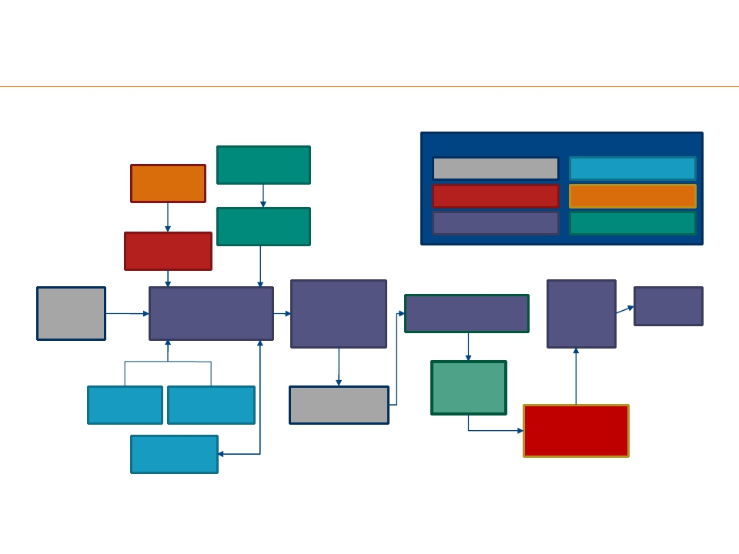
Cement Design Flow Path (Kirksey, 2013)
Roles:
Cementing Engineer
Petrophysicist
Project Coordinator
Conventional
Lab Testing
Contamination
Tests
Drlg Engineer
Wireline Engineer
Lab Engineer
WLLog
LWD Data
Caliper
Processing
Initial
Cement
Design
Real-Time (RT) Iterative
Updates to Cement Job
Design
Final Cement Job
Design and
Centralizer
Arrangement
Final
Results of
Cement
Isolation
Client
Review
Post job Evaluation of
Cement Execution
Cement
RTSurvey
RTCaliper
RT
Petrophysics
Cement Job
Execution
Properties
Report
CBL*/USI* or
Isolation Scanner*
Log
Drilling
Adjustments
20

Slide 21
Well Design & Construction (Drilling/Workovers)
CO₂ EOR and CO₂ storage well designs are similar, with latter more stringent in some cases (CO₂ -resistant tubular and cement)
Due to unique CO₂ phase behavior, be aware of potential for loss of well control (especially during well intervention/workovers)
CO₂ stored for a long period (decades). Specific requirements for well design and monitoring and abandonment (MMV – monitoring measurement and verification) depending on jurisdiction
Drilling in CO₂ injection environments results in complex loading conditions on casing/tubular/cements etc. Use casing design software such as WELLCATTM , DrillPlanTM and also appropriate materials of construction for CO₂ service (tubulars and cements)

Slide 22
Material Selection & Specifications
Material selection for CO₂ injection wells depends on high strength combined with high corrosion resistance. Use appropriate corrosion resistant metallurgy
Run chemical analysis of reservoir fluids; run temperature and pressure profiles and stresses on tubulars
Consider contact with wet CO₂ especially in deeper sections of well
Consider performance at low temperatures (brittle materials may not stop CO₂ leakage), and O₂ – related impacts
Use appropriate corrosion resistant metallurgy
Cementing is critical for mechanical performance and life cycle well integrity.
Use appropriate cements/specialty cements for zonal isolation and well integrity.
Use current industry best practices for successful cement design, execution and evaluation

Slide 23
Injectivity and Regularity
Injectivity and injection regularity critical for success of a CCS storage project (storage of millions of tons of CO₂ in a 50-year time frame)
For CO₂ EOR objective is to maximize oil recovery, while for storage wells is to maximize injection volumes/storage capacity with minimum number of wells
Large scale CO₂ storage requires good/sufficient capacity reservoirs with good petrophysical properties (dissipate pressure buildup and avoid interference with adjacent O&G operations, if present)
Injection can alter mechanical rock properties by inducing chemical reactions
CO₂ EOR project economics greatly impacted with injectivity loss and corresponding reservoir pressure loss
Injectivity loss factors: wettability, trapping, salt/halite precipitation, increased scaling, paraffin and asphaltene precipitation. Additional factors: fines migration, borehole deformation, fault intersection, facies variation and shale swelling
Notes:
Salt, halite precipitation can cause major near wellbore injectivity loss especially in low k saline intervals. Asphaltenes can plug up plungers, clog wellheads, tubulars, chokes and surface/production lines. Injection regularity – ability to actually inject CO2 at the desired rates or quantities needed for EOR or storage purposes) – affects project economics

Slide 24
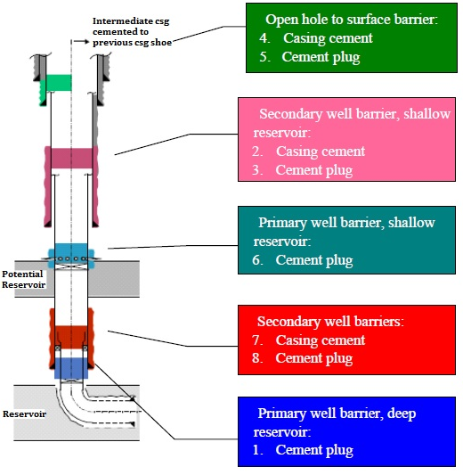
Typical Well Plugging & Abandonment
Quality of a P&A evaluated by type of plugging material and plug placement technique
Plugging materials: cements, formation, grouts, thermosetting polymers(resins), gels, metals (bismuth/thermite)
Placement techniques: Balanced plug, Dump-bailer, Two-plug and Jet grouting
Successful P&A protects
environment, with downhole integrity, regulatory compliance
Source: Randhol and Carlsen/SINTEF, 2001
24
Notes:
Lifetime legal liability – no time limit. CO2 storage wells – “1000 year” time frame.
Bismuth alloys/thermite – gas-tight seals – replacement for cements. Tested in OK, AK and North Sea.
Eutectic metal – converts from liquid to solid when cools and melts without going to gel phase.
Thermosetting polymers (resins) are particle-free fluids which solidify into an impermeable material upon curing (curing process is temp activated and occurs at a pre-determined temp) and viscosity/density can be tailored. Resins have been used in North Sea and GOM (can lose strength downhole). Also used for SCP/annulus seal/repairs.
Testing cement plugs – Run DP and locate top of plug by applying weight after plug has been allowed to set. A plug might be hard on top, but soft farther down, allowing fluids to migrate.

Slide 25
Summary
Imperatives for Success in Maintaining Life Cycle Well Integrity of CO₂ Storage Wells: Industry has the technology, knowledge, experience:
  To safely handle and manage CO₂ operations; to avoid potential catastrophic impacts to safety, human health, environment, economic loss; and maintain Social License to operate
  Original well design and conversions must meet critical casing and cementing requirements with appropriate materials of construction (tubular and cements)
  Implement best practices/sound engineering for well design/construction/injection
  Implement appropriate well integrity testing and monitoring procedures and compliance with stringent regulatory requirements
Notes:
Will also lower risks from legacy wellbores

