Slide 1

AADE Geothermal Meeting – October 21, 2021
Presentation of OTC-31090-MS
Repurposing Oil & Gas Wells, Facilities and Assets
for
Geothermal Energy Benefits
Robert Pilko, Blade Energy Partners
Pilko, Robert, N. Hart-Wagoner, A. Van Horn, J. Scherer, “Repurposing Oil & Gas Wells, Facilities and Assets for Geothermal Energy Benefits” OTC-31090-MS, 2021 Offshore Technology Conference, Houston, Texas, U.S.A. (2021).

Slide 2

OTC-31090-MS - Repurposing Oil & Gas Assets for Geothermal Energy Benefits
Overview
Basics of Geothermal Energy Wells & Fields Development
Closed-Loop Geothermal Systems & Downhole Heat Exchanger
Co-Production Geothermal Systems & Gravity Head Pump
Today, Natural Gas Fuels Wells, Fields and Facilities
Geothermal Repurposing & Extending Facilities’ Useful Lives
‘Start with the Rocks’
Key Differences Between Legacy Conventional Geothermal vs. Today’s Geothermal
Key Differences Between Drilling & Completing Geothermal Wells vs. Oil & Gas
OTC-31090-MS • Repurposing Oil & Gas Wells, Facilities and Assets for Geothermal Energy Benefits • Robert Pilko, Blade Energy Partners

Slide 3
OTC-31090-MS - Repurposing Oil & Gas Assets for Geothermal Energy Benefits
Geothermal Development Essentials That Oil & Gas Operators Have
Differences Between Geothermal Wells & Fields vs. Oil & Gas
Offshore Energy Needs & Costs – Comparability
Recommendations for Research & Development and Legislative/Permitting Changes
Conclusions.
Appendix – Considerations for Drilling Contractors to Provide Geothermal Drilling Services
OTC-31090-MS • Repurposing Oil & Gas Wells, Facilities and Assets for Geothermal Energy Benefits • Robert Pilko, Blade Energy Partners

Slide 4
OTC-31090-MS - Repurposing Oil & Gas Assets for Geothermal Energy Benefits
Basics of Geothermal Energy Wells & Fields Development
Geothermal is taking the natural heat energy within the Earth, and harvesting it for use at surface.
The amount of Geothermal Energy that is harvested and location of thermal energy users determine the type & economics of Geothermal applications.
OTC-31090-MS • Repurposing Oil & Gas Wells, Facilities and Assets for Geothermal Energy Benefits • Robert Pilko, Blade Energy Partners

Slide 5
OTC-31090-MS - Repurposing Oil & Gas Assets for Geothermal Energy Benefits
Closed-Loop Geothermal Systems & Downhole Heat Exchanger
Modern advances in Geothermal harvesting technologies provide more efficient uses
Closed-Loop Geothermal Systems contain subsurface fluids & solids production
Downhole Heat Exchangers harvest subsurface thermal energy at maximum temperature.
OTC-31090-MS • Repurposing Oil & Gas Wells, Facilities and Assets for Geothermal Energy Benefits • Robert Pilko, Blade Energy Partners

Slide 6
OTC-31090-MS - Repurposing Oil & Gas Assets for Geothermal Energy Benefits
Co-Production Geothermal Systems & Gravity Head Pump
Geothermal Closed-Loop systems may be combined with produced reservoir fluids to surface as Co-Production – enhancing economics
A Gravity Head Pump adapts the thermosiphon effect to power co-production
OTC-31090-MS • Repurposing Oil & Gas Wells, Facilities and Assets for Geothermal Energy Benefits • Robert Pilko, Blade Energy Partners

Slide 7
OTC-31090-MS - Repurposing Oil & Gas Assets for Geothermal Energy Benefits
Today, Natural Gas Fuels Wells, Fields and Facilities
Geothermal resource development easily complements & enhances oil, gas & mineral developments
Geothermal fits within most existing land rights, permitting, right-of-way, & infrastructure facilities of oil, gas & mineral developments.
OTC-31090-MS • Repurposing Oil & Gas Wells, Facilities and Assets for Geothermal Energy Benefits • Robert Pilko, Blade Energy Partners

Slide 8
OTC-31090-MS - Repurposing Oil & Gas Assets for Geothermal Energy Benefits
Geothermal Repurposing & Extending Facilities’ Useful Lives
Federal Waters – Lands
State Waters -- Lands
OTC-31090-MS • Repurposing Oil & Gas Wells, Facilities and Assets for Geothermal Energy Benefits • Robert Pilko, Blade Energy Partners

Slide 9
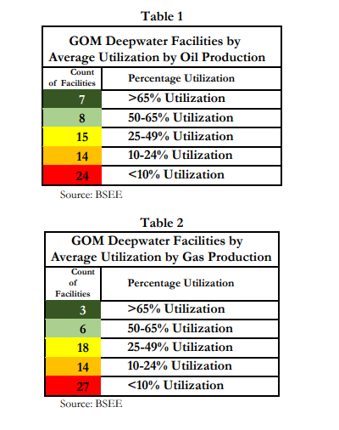
Figure 1 “BSEE’s analysis of recent production rates on existing deepwater GOM facilities revealed that a majority of the facilities were utilizing less than 50 percent of their average daily production capacity.
Tables 1 and 2 show the count of deepwater GOM facilities categorized by average utilization, which is calculated as average daily production rates over a 3-year period (2016-2019) divided by the nameplate capacity of each deepwater facility stated as a percentage” (BOEM Economics Division, 2020, p. 24).
OTC-31090-MS • Repurposing Oil & Gas Wells, Facilities and Assets for Geothermal Energy Benefits • Robert Pilko, Blade Energy Partners

Slide 10
OTC-31090-MS - Repurposing Oil & Gas Assets for Geothermal Energy Benefits
‘Start with the Rocks’
Identifying High Temperature Zones
              > South Texas Onshore
              > Gulf Coast & Offshore
OTC-31090-MS • Repurposing Oil & Gas Wells, Facilities and Assets for Geothermal Energy Benefits • Robert Pilko, Blade Energy Partners

Slide 11
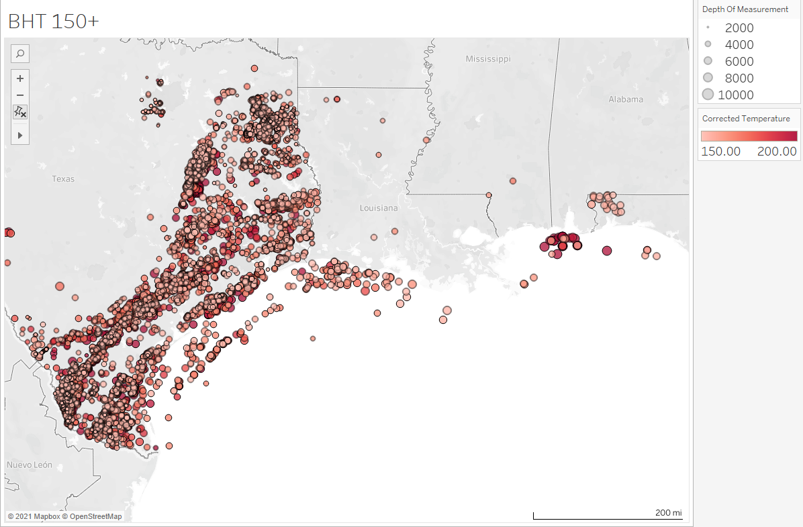
‘Start with the Rocks’
Figure 2 – Map of the Gulf of Mexico region wells from the Borehole Temperature Observation file from the National Geothermal Data System (NGDS) curated by SMU Geothermal Laboratory.
Each circle represents a corrected bottom hole temperatures in °C and depth of the measurement in meters.
OTC-31090-MS • Repurposing Oil & Gas Wells, Facilities and Assets for Geothermal Energy Benefits • Robert Pilko, Blade Energy Partners

Slide 12
OTC-31090-MS - Repurposing Oil & Gas Assets for Geothermal Energy Benefits
Key Differences Between
Legacy Conventional Geothermal vs. Today’s Geothermal
Historical & Legacy Hydrothermal and Fracturing EGS Geothermal
Today’s Closed-Loop Geothermal Energy Systems
Today’s Co-Production Geothermal Systems
OTC-31090-MS • Repurposing Oil & Gas Wells, Facilities and Assets for Geothermal Energy Benefits • Robert Pilko, Blade Energy Partners

Slide 13
OTC-31090-MS - Repurposing Oil & Gas Assets for Geothermal Energy Benefits
Key Differences & Challenges Between Drilling & Completing
Geothermal Wells vs. Oil & Gas Wells
High Temperature Electronics
High Temperature Cementing
Large Diameter Wellbores – Tubulars Expenses
VIT Sections to Retain Heat to Surface
Selection of Efficient Closed-Loop Working Fluids
(HP – high pressure not problem)
OTC-31090-MS • Repurposing Oil & Gas Wells, Facilities and Assets for Geothermal Energy Benefits • Robert Pilko, Blade Energy Partners

Slide 14
OTC-31090-MS - Repurposing Oil & Gas Assets for Geothermal Energy Benefits
Geothermal Development Essentials That Oil & Gas Operators Have
The initial and significant question is:
Do existing oil & gas lands contain hot enough geothermal resources at technologically reachable depths with sufficient heat that can be transferred to the surface by economically, environmentally and socially competitive projects?
If so, then these geothermal resources need to be tapped and exploited over the maximum useful lives of the land and its rights and infrastructure.
OTC-31090-MS • Repurposing Oil & Gas Wells, Facilities and Assets for Geothermal Energy Benefits • Robert Pilko, Blade Energy Partners

Slide 15
OTC-31090-MS - Repurposing Oil & Gas Assets for Geothermal Energy Benefits
Geothermal Development Essentials That Oil & Gas Operators Have
Land and Permit Rights
Permits Right-of-Ways, Paths to Markets & Supply, Infrastructure
Two key questions remain paramount for adopting geothermal use for widespread development:
What are the costs of geothermal wells, whether newly drilled and completed, or repurposed for underproducing geothermal and oil & gas wells?
What are the heat transfer losses (what is the thermal efficiency) of bringing geothermal heat from subsurface geologic formations to downhole heat exchangers or to the surface for use?
OTC-31090-MS • Repurposing Oil & Gas Wells, Facilities and Assets for Geothermal Energy Benefits • Robert Pilko, Blade Energy Partners

Slide 16
OTC-31090-MS - Repurposing Oil & Gas Assets for Geothermal Energy Benefits
Differences Between Geothermal Wells & Fields vs. Oil & Gas
Geothermal Wells are Critical / Complex Wells
Require –
    - Subsurface Understanding,
    - Strong Thermal Well Engineering,
    - Holistic Project Planning
Geothermal Project Economics Very Different, because Product Value Very Different
OTC-31090-MS • Repurposing Oil & Gas Wells, Facilities and Assets for Geothermal Energy Benefits • Robert Pilko, Blade Energy Partners

Slide 17
OTC-31090-MS - Repurposing Oil & Gas Assets for Geothermal Energy Benefits
Offshore Energy Needs & Costs – Comparability
Large & Deep Wellbores
Saves Unused, Watered-Out, or Underutilized Well Slots & Wellbores
Low, Constant Sea Temperatures for Maximum Carnot Efficiencies
Direct Use and/or Generated Electricity Use
OTC-31090-MS • Repurposing Oil & Gas Wells, Facilities and Assets for Geothermal Energy Benefits • Robert Pilko, Blade Energy Partners

Slide 18
OTC-31090-MS - Repurposing Oil & Gas Assets for Geothermal Energy Benefits
Research & Development and Legislative/Permitting
R&D –
    - G&G Advances Locating/Defining Resources
    - HT Cementing
    - HT Electronics – M/LWD
Legislative/Permitting –
    - Ensure Geothermal Permitting Similar to O&G
    - Allowing Licenses & Royalties Similar to O&G
What Geothermal Development Does Not Need –
  - Artificial Incentives
OTC-31090-MS • Repurposing Oil & Gas Wells, Facilities and Assets for Geothermal Energy Benefits • Robert Pilko, Blade Energy Partners

Slide 19
OTC-31090-MS - Repurposing Oil & Gas Assets for Geothermal Energy Benefits
Conclusions
Geothermal Energy must be elevated as a
primary consideration
for “All the Above” energies.
Needed today → and tomorrow.
OTC-31090-MS • Repurposing Oil & Gas Wells, Facilities and Assets for Geothermal Energy Benefits • Robert Pilko, Blade Energy Partners

Slide 20
OTC-31090-MS - Repurposing Oil & Gas Assets for Geothermal Energy Benefits
Considerations for Geothermal Drilling & Service Contractors
Torque & Hookload Capacity for large bits & casing
MPD Techniques that keep single-phase – minimizing drilling fluids flashing in wellbore
Ability to ‘drill blind’ when beyond high-temp range of M/LWDs & BHAs
HSE Surface Handling of Very Hot Return Fluids & Tubulars
Possibile Corrosive Well Fluids
OTC-31090-MS • Repurposing Oil & Gas Wells, Facilities and Assets for Geothermal Energy Benefits • Robert Pilko, Blade Energy Partners

Slide 21
AADE Geothermal Presentation
Thank You!
Questions?
Contact: Bob Pilko, Blade Energy Partners
bpilko@blade-energy.com
+1.832.202.7341

