Slide 1
Geothermal Opportunities in Geopressured Formations along the Gulf of Mexico
October 21, 2021
Cindy D. Taff, COO

Slide 2
Our Vision
Leverage oil and gas expertise to enable development and production of emission-free, baseload geothermal energy on a global scale by implementing efficient and cost-effective solutions.

Slide 3
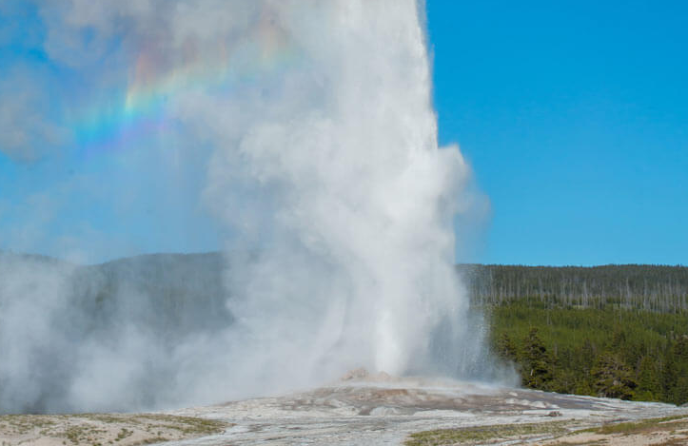
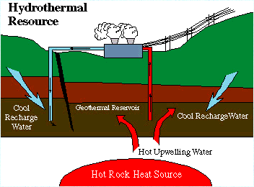
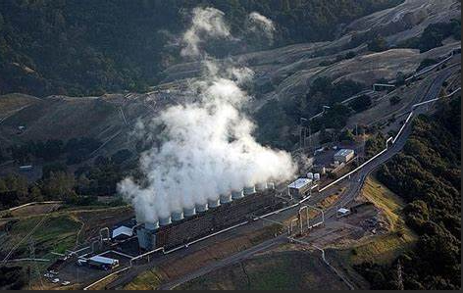
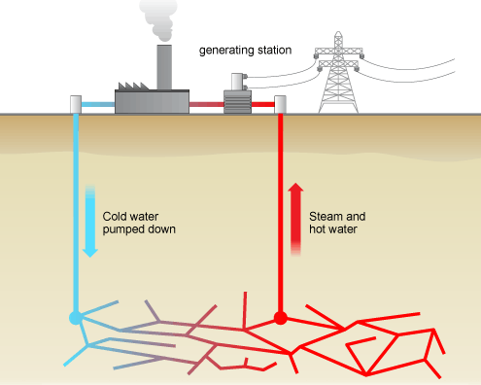
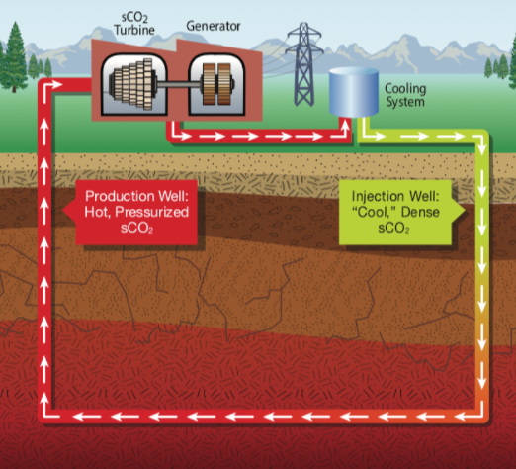
Geothermal System Types - Dependent on Geology
Current geothermal systems require two wells for adequate heat harvesting, which increases the upfront capital costs of geothermal
Hot Aquifer
Conventional Hydrothermal Systems (near volcanoes and the ‘Ring of Fire’)
Hot Dry Rock
2% of resources generate 99% of installed geothermal capacity
Enhanced Geothermal Systems (EGS) (in rocks that do not naturally flow water)
Fracturing is used to create man-made reservoir
Closed Loop

Slide 4
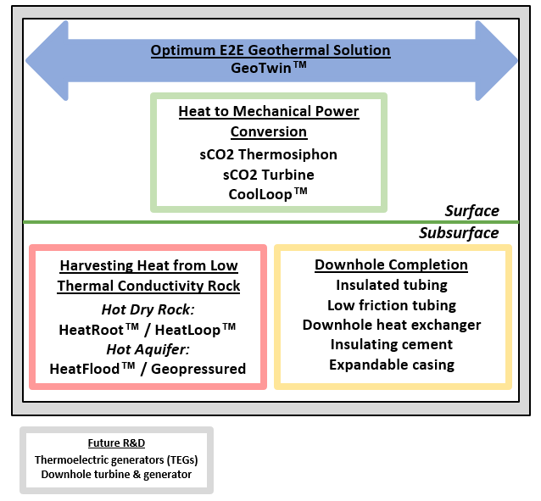
Business Strategy
Sage’s Unique Business Strategy
Integrated system approach - Optimize the design of both the power plant and well(s), used successfully in the oil and gas industry for years (e.g., Deepwater, Unconventionals, etc.).
Multiple geothermal design solutions - Recognize we must present geothermal design solutions for different subsurface environments.
Targeting lower temperatures - We are targeting lower subsurface temperatures (100-250°C) in sedimentary rock, widely available at depths of 3-6 km around the world. This allows application of
off-the-shelf oilfield technology and equipment that is field-proven.
Modeling informs design - In-house modeling tool, GeoTwin™, allows us to simulate output of geothermal system prior to design and installation.

Slide 5
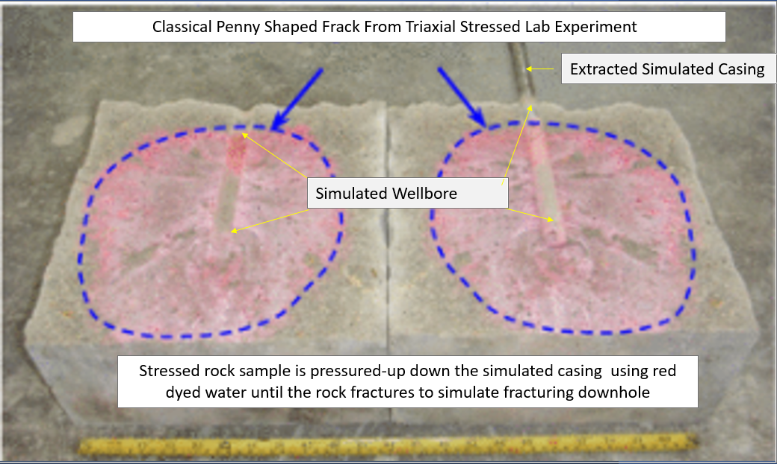

HeatRoot™
HeatRoot™
Acts as chimney for heat from deeper formations.
Equivalent to tens of kilometers of horizontal wellbores.
Boosts the heat harvesting and therefore power generated and ensures sustainable heat harvest over time.
Unlike conventional and Enhanced Geothermal Systems (EGS), the Sage closed loop system will have no:
            Discharge to air, including hydrogen sulfide or steam, during plant operations
            Fluid exchange/loss with
            the subsurface formations.
Natural convection
HeatRoot™

Slide 6
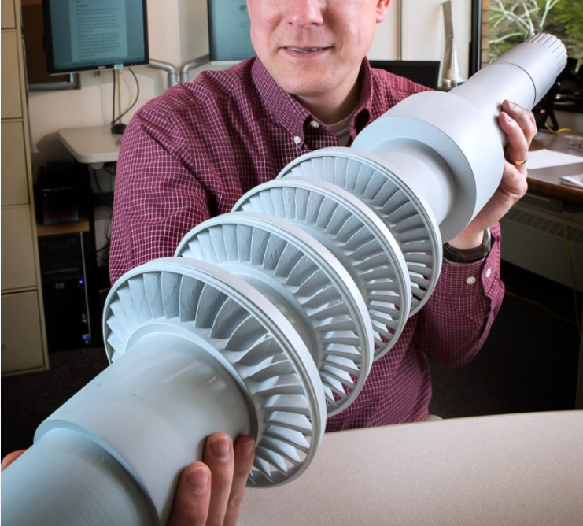

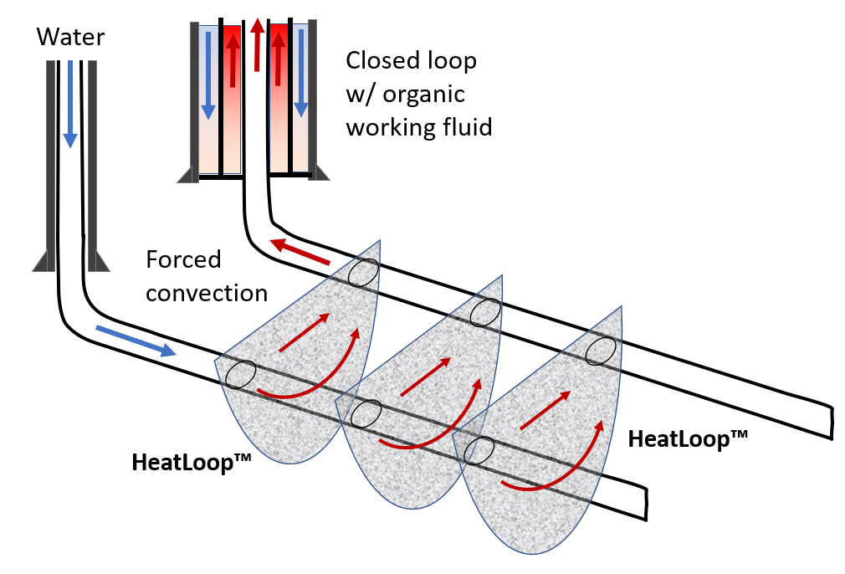
Hot Dry Rock - Opportunity for Unlimited Power
If Hot Dry Rock technology is proven, it provides UNLIMITED geothermal power opportunity!
Geothermal resources
Sage’s technologies
Sage’s sCO2 Turbine
2% of resources generate 99% of installed geothermal capacity
8%
30%
60%
HeatRoot™
Note: Above %s are estimates taken from various technical reports.

Slide 7
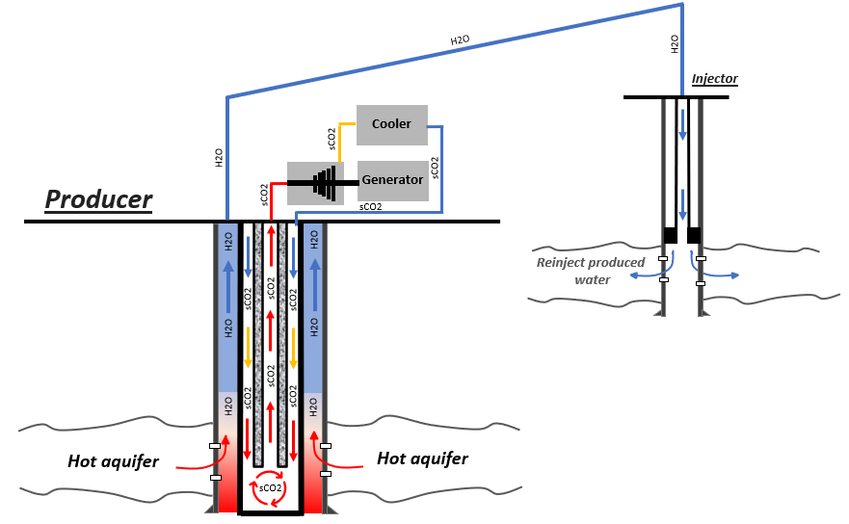
HeatFlood™
HeatFlood™
Hydrothermal-type well design at lower temperature range, 100-250°C.
Targeting hot aquifers with high flow rates.
High flow rates from either natural high permeability or via stimulation.
Opportunity for water desalination as produced water total dissolved solids (TDS) is typically much lower than ocean water.

Slide 8
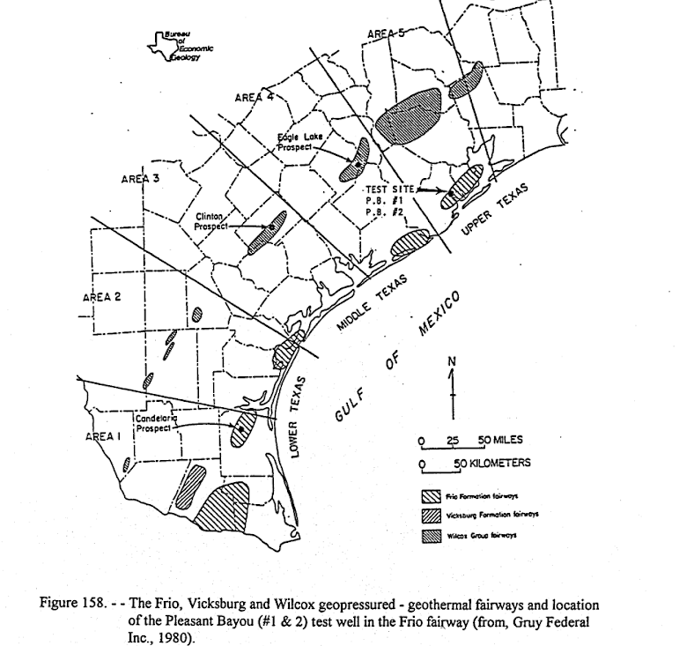
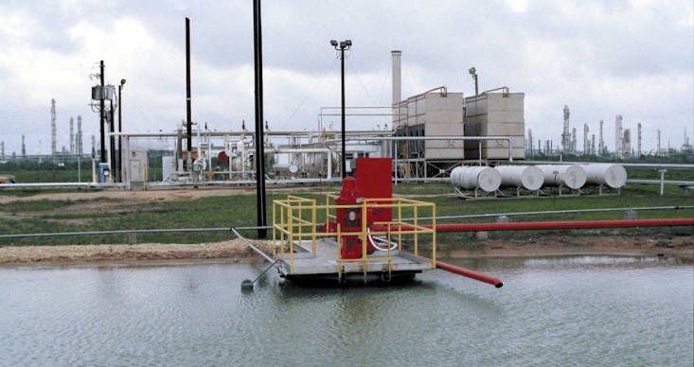
DOE Pleasant Bayou well in Brazoria County, TX
DOE geothermal project 30 miles south of Houston
The Pleasant Bayou well was drilled in the geopressured Frio formation and produced from 1989 to 1992.
Produced hot water and natural gas at high temperature/pressure.
Generated ~ 1.5MW, with half from the thermal energy of the water and half from the natural gas.
Two wells - Production and disposal (for produced water).

Slide 9
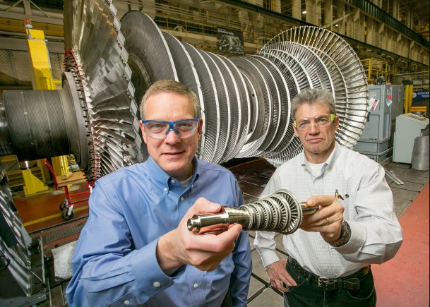
sCO2 Turbine
sCO2 Turbine benefits
Maintain sCO2 working fluid in supercritical state through the thermodynamic cycle:
  Doubles efficiency from < 10% to mid-20%
  Results in a doubling of power generation
CO2 has a low supercritical temperature (31°C) and pressure (1070 psi), a level of pressurization normal in industry.
Foreground: sCO2 10MW turbine (concentrated solar)
Background: 300MW steam turbine

Slide 10
First Commercial Installation / Scale-up Plan
Strategy: Continue to model with GeoTwin to prioritize Sage technologies and rapidly move to field testing to prove these technologies and calibrate the models.
Sage is currently working four potential commercial applications
    City of McAllen - PPA for 3MW plant (HeatFlood) / Opportunity to desalinate water for city
    McAllen Ranch Family - PPA for 3MW pilot (HeatFlood) / Opportunity to scale to 500MW
    Ellington Field - Feasibility study for 3MW plant (HeatRoot) / Opportunity to install microgrid across permanent military facilities
    Entergy Louisiana - PPA for 3-5MW plant (HeatFlood) / Opportunity to scale to 50MW

Slide 11
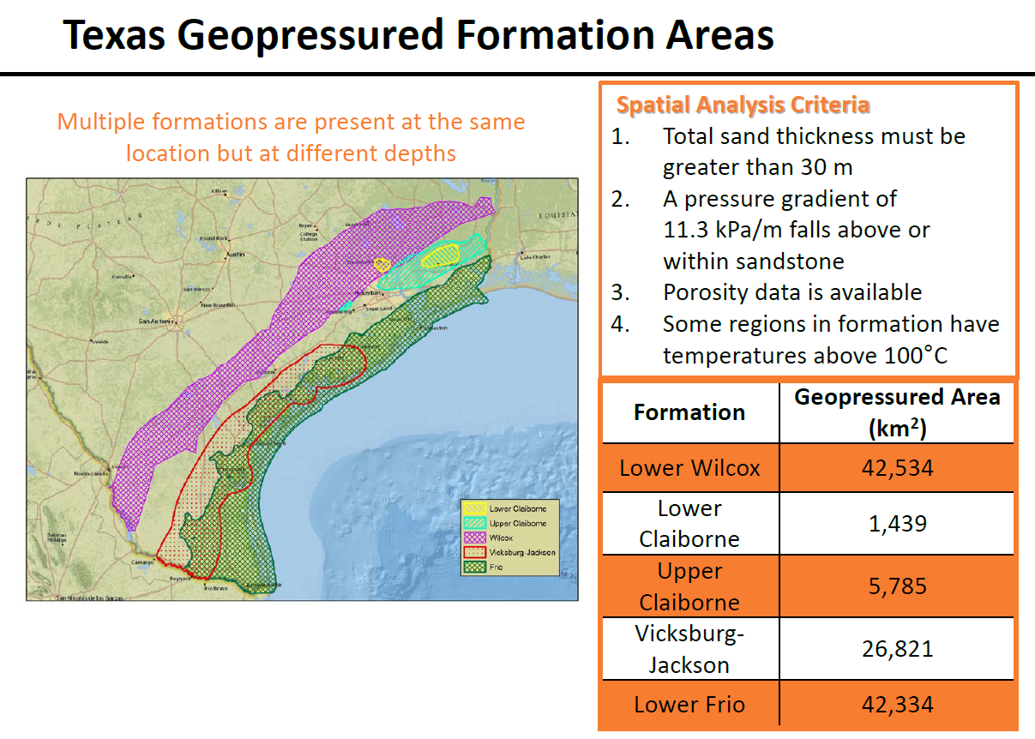
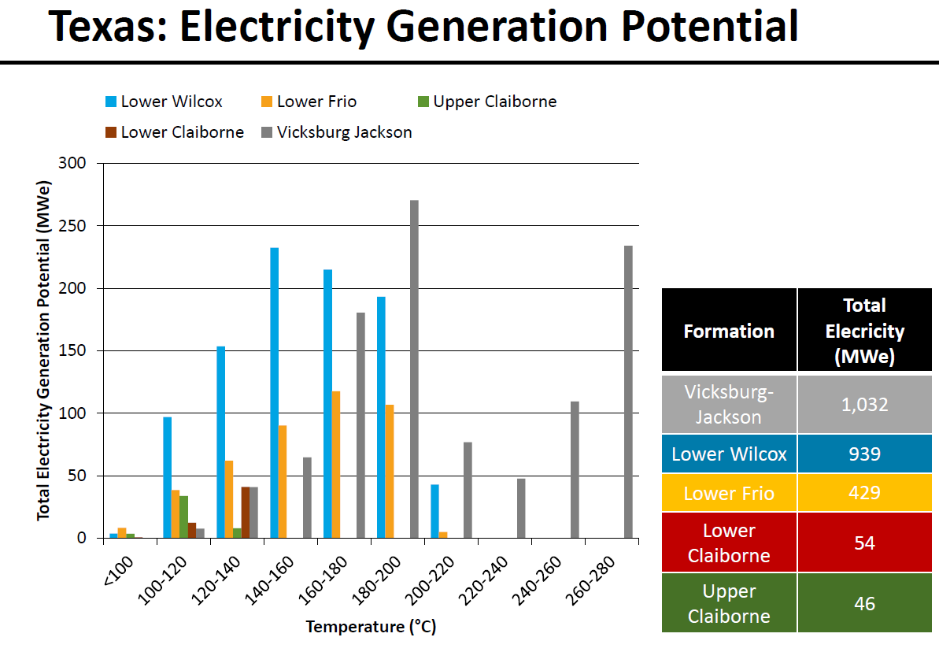
HeatFlood Target Initial Area - Gulf of Mexico Region

Slide 12
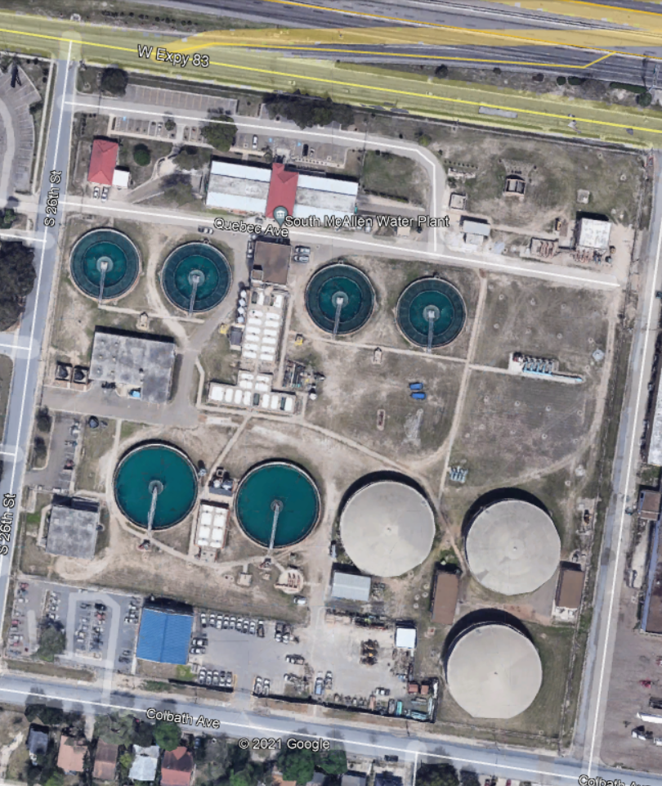
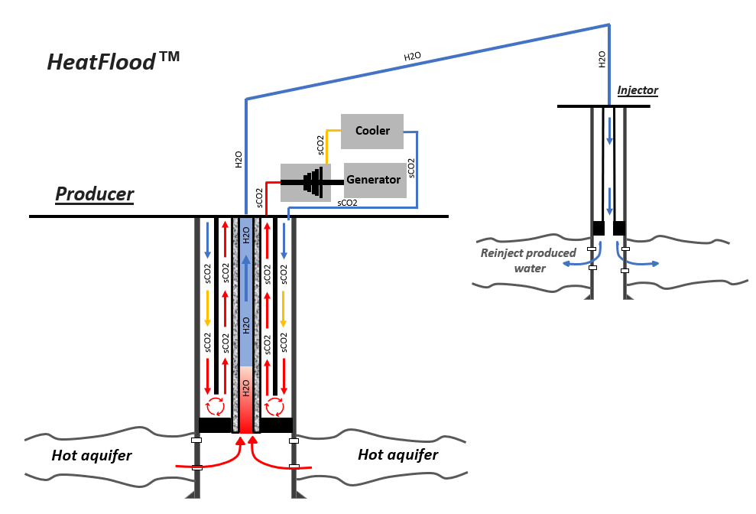
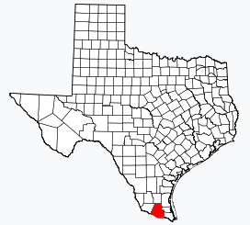
City of McAllen
3MW Geothermal Power Plant
Targeting a microgrid dedicated to the municipal water system.
Project will be 100% funded through either a Department of Commerce (DOC) grant or Sage Geosystems.
South Texas has the highest measured BHTs at depths of 10,000 to 12,000 ft.
McAllen is directly over a geopressured gas field called McAllen-Pharr, making geothermal an ideal renewable baseload energy source.
The City of McAllen would like to next leverage geothermal to power desalination of brackish groundwater produced from geopressured formations.
McAllen South Water Treatment Plant

Slide 13
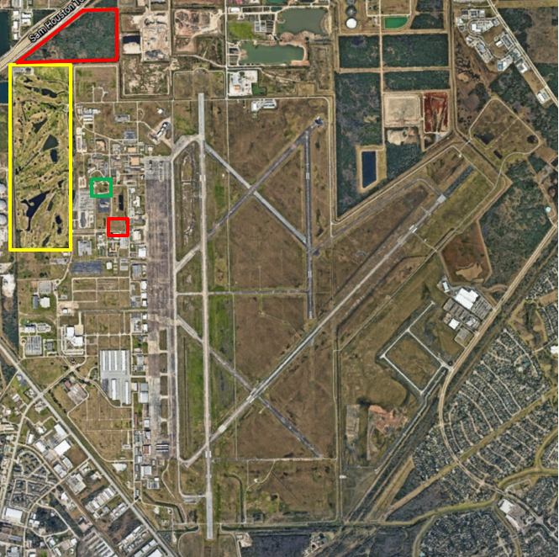


Air Force - Ellington Field in Houston, Texas
AFWERX STTR Phase II Contract
Sage Geosystems is partnering with the UT Bureau of Economic Geology (BEG) to finalize a feasibility study for a 3MW geothermal system for Ellington Field.
Awarded STTR Phase II contract for performance period Sep’21 to Aug’22.
Propose to solve the critical vulnerability of the Air Force facilities' reliance on
commercial power suppliers. Cyber and physical
attacks, technology malfunctions, and natural events
make power grids vulnerable to disruptions.
Work to be completed includes subsurface geologic study, identification of drilling site, geothermal system design modeling, well design, power plant design, and induced seismicity monitoring program.
The DIU (Defense Innovation Unit) wants to move to implementation of geothermal across all military services once the technology proves viable.
Potential Well Sites at Ellington Field

Slide 14
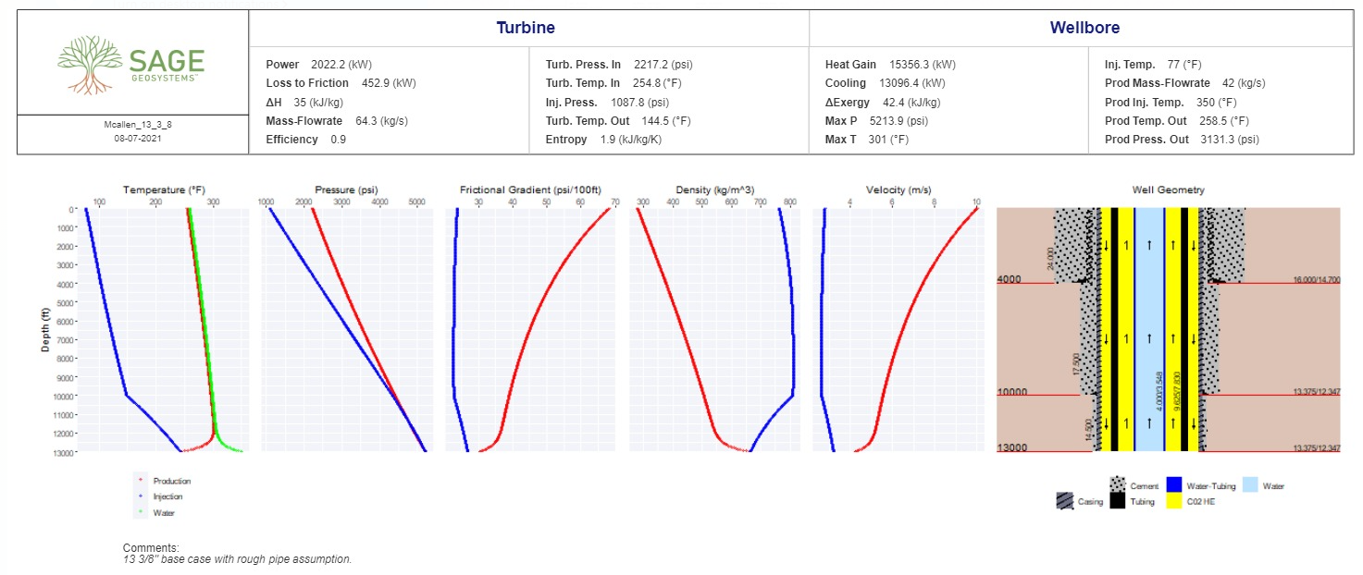
GeoTwin™ - Targeted first commercial project
Geopressured well in McAllen, Texas (HeatFlood)
Estimated power output
Estimated BHT

Slide 15
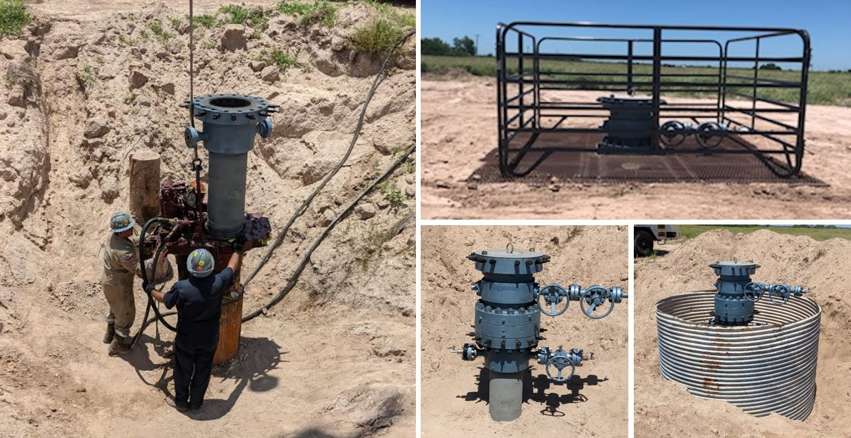
2021 Field Testing Program
Sage has been granted access to an abandoned exploratory gas well in Starr County, Texas
Single well EGS system - HeatRoot™
HeatRoot™

Slide 16
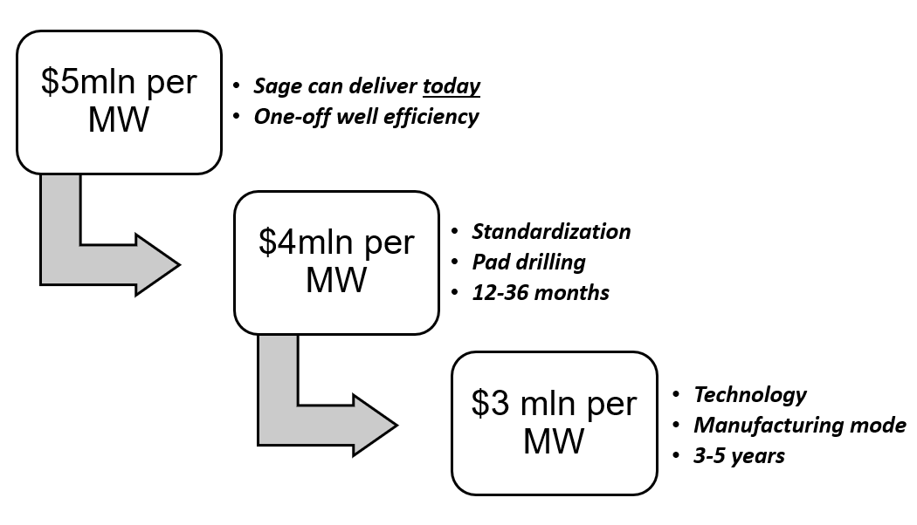
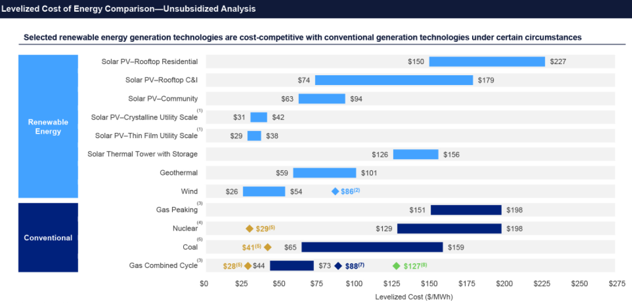
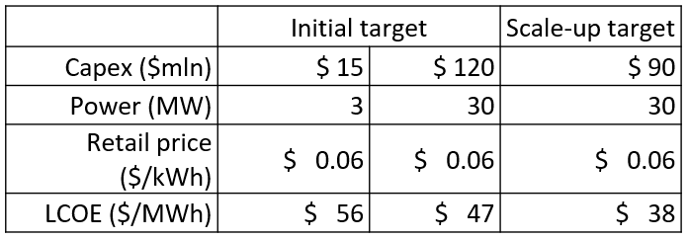

Performance path from $5mln/MW to $3mln/MW
Sage Geosystems performance path
Current Geothermal LCOE
$59-101/MWh
Sage Geosystems™ LCOE
$25-40/MWh
Financing Opportunities: (1) Energy Performance Contracting (EPC) can
provide > 30% ROI and (2) PPA-based financing of renewable projects

Slide 17









Benefits of Geothermal
Geothermal has numerous benefits for a totally green electric grid
HOSPITAL
Baseload energy
Not dependent on wind or sunshine
Below ground
Protected from weather
Below ground
Secure for critical infrastructure
Below ground
Small and low visible footprint
Environment
Zero emissions discharge
Few moving parts
Low maintenance
Modular
Built in small self-contained sections
Regulatory
Simpler path to regulatory approval

Slide 18


Investors / Sponsors
Investors
Virya, LLC Founder: Chris Anderson https://www.linkedin.com/in/chris-anderson-3b2a05bb/ | “Cheap and Clean Energy for the World: Virya, LLC invests nimbly in under-funded or new ventures with high potential impact on eliminating global greenhouse gas emissions.” https://virya.llc/
Nabors Industries Houston, Texas https://www.linkedin.com/company/nabors-industries/ | Automated Drilling Rigs, Software, Wellbore Services & Equipment (nabors.com)
Sponsors
Geothermal Entrepreneurship Organization (GEO) Executive Director: Jamie C. Beard https://www.linkedin.com/in/jamie-beard-7253a935/ | https://www.texasgeo.org/about

