Slide 1
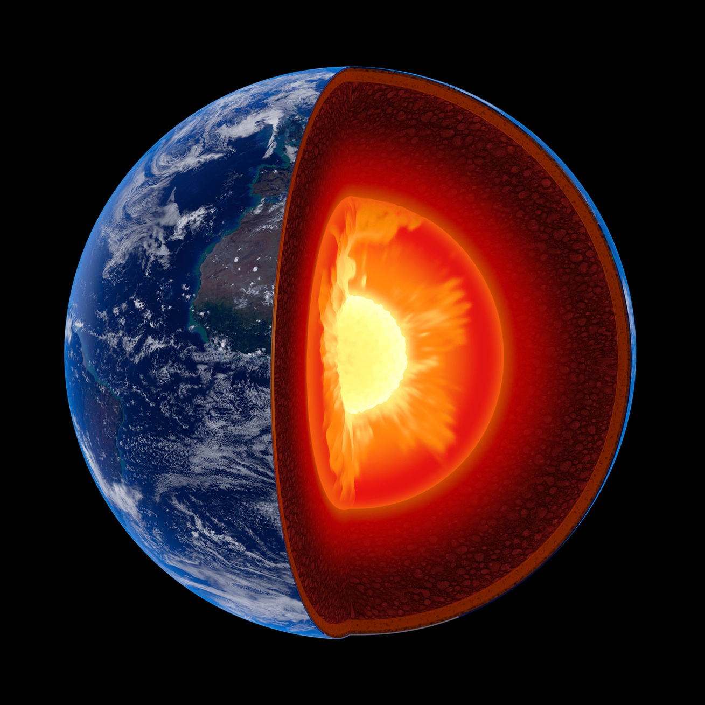
American Association of Drilling Engineers
Harvesting Geothermal Energy
via GeoHeat TM Technology
THE PATH TO THE GEOHEAT™ ENERGY REVOLUTION
2021 Geothermic Solution LLC. Confidential, for limited distribution only.

Slide 2
American Association of Drilling Engineers
“For geothermal to scale 100-fold “There is one and only one technology needed and that is deep drilling…. I’m very, very bullish on geothermal.” Vinod Khosla, Founder of Sun Microsystems and Khosla Ventures
“We believe that geothermal can play a much larger role in the energy transition” Anthony Petrello, Chairman and CEO of Nabors Industries
“So, what are you going to do with drill rigs and oil service workers if they aren’t drilling for oil? Geothermal is a near perfect fit here.” Lance Cook, former Chief Scientist for Well Engineering and Production Technology at Shell
“Geothermal energy offers an avenue for oil and gas companies to reinvent themselves as sustainable energy providers, while doing what they do best — drilling the most difficult wells in the world” Robert Metcalfe, Inventor of Ethernet, Founder of 3Com, Founder of TexasGeo.org
“This pivot (oil & gas to geothermal) necessarily recognizes that the product is now electricity and I would argue that fact not only makes the pivot realistic - it makes it obvious, even inevitable.”
Vik Rao, former Senior Vice-President and Chief Technology Officer at Halliburton
2021 Geothermic Solution LLC. Confidential, for limited distribution only.

Slide 3
Geothermic Solution, LLC
  Over a decade of pioneering work in Closed Loop heat harvesting
  40 team members in multiple disciplines
  Multiple patents and patents pending key to scalability
  Strategic investment and partnering from Oil & Gas Industry
  GeoHeatTM Technology ready to commercialize
2021 Geothermic Solution LLC. Confidential, for limited distribution only.

Slide 4
GeoHeatTM System Characteristics
  Eliminates interior pipe and turbine corrosion problems
  Eliminates odors associated with hot water harvesting
  Eliminates seismicity concerns from water removal & injection
  Eliminates above ground gathering lines
  Zero emissions, zero contaminants
  Smallest above ground footprint of any renewable power
  (for equivalent power GeoHeatTM - 25 acres, Solar - 5,000 acres, Wind – 50,000 acres)
2021 Geothermic Solution LLC. Confidential, for limited distribution only.

Slide 5
GeoHeatTM Design - Informed by our decade of Technical Leadership
GSL determined 5 basic design premises based upon years of research, study, and modeling work
Any system that harvests hot water or steam (e.g. conventional geothermal and EGS) will not scale
Any system that depends on the intrinsic thermal conductivity of the rock formation will not scale
Any system that operates at ≤ 200°C will not scale
Any system that lacks thermo-conductive grout penetrating into the formation will not scale
Any closed loop system w/o sufficient length in the target temperature zone will not scale
Each of these is a fatal flaw to scalable global exploitation of geothermal resources
2021 Geothermic Solution LLC. Confidential, for limited distribution only.

Slide 6
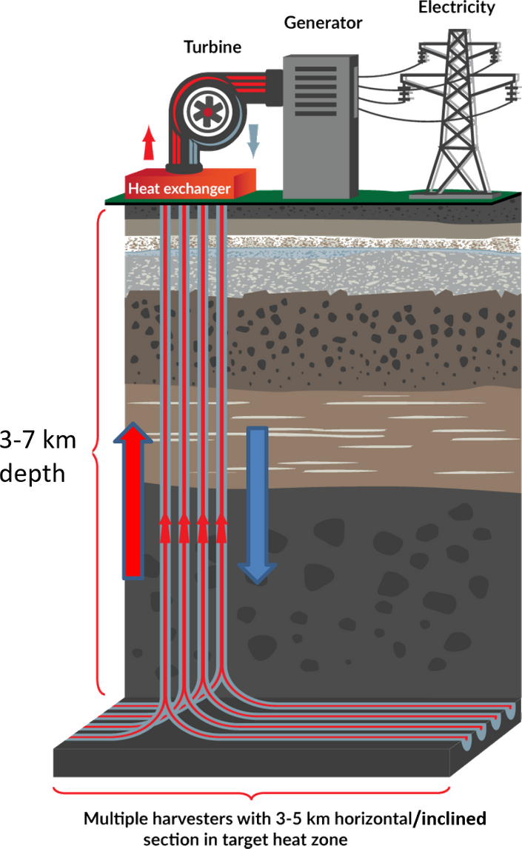
Harnessing GeoHeatTM
GEOTHERMIC PROPRIETARY HEAT HARVESTING SYSTEM
ABOVE GROUND
Conventional equipment for power and industrial processes
BELOW GROUND
Multiple closed loop “heat harvesters” absorb heat at depth and cycle 300°C+ water to a heat exchanger at the surface
At 3-7 km deep, the target rock temperature is about 350°C
2021 Geothermic Solution LLC. Confidential, for limited distribution only.

Slide 7
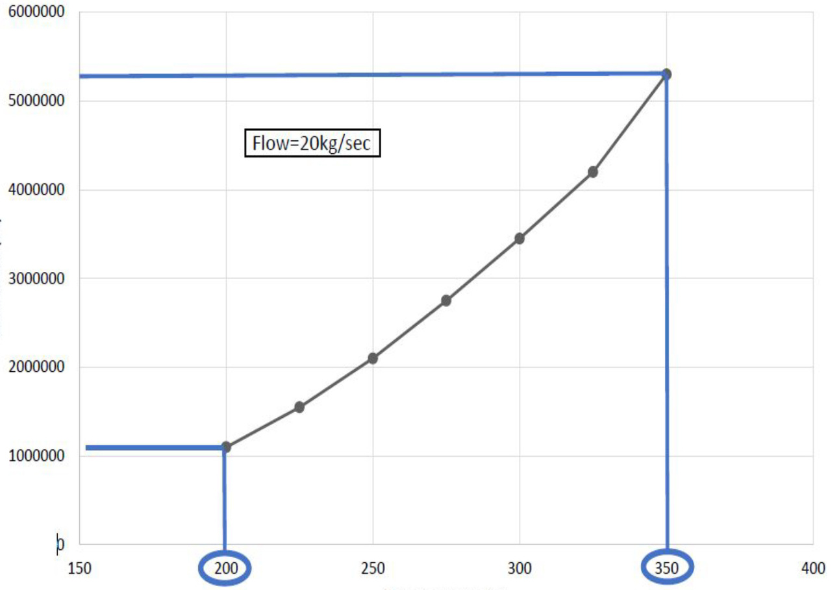
Power Output Increases & CapEx decreases with Temperature
5x the power output of conventional geothermal
Net Power (W)
o
o
150-200 C
CONVENTIONAL
300-350 C
GSL
Temperature (C)
Source: POWER Engineers Report to GSL 2017
2021 Geothermic Solution LLC. Confidential, for limited distribution only.

Slide 8
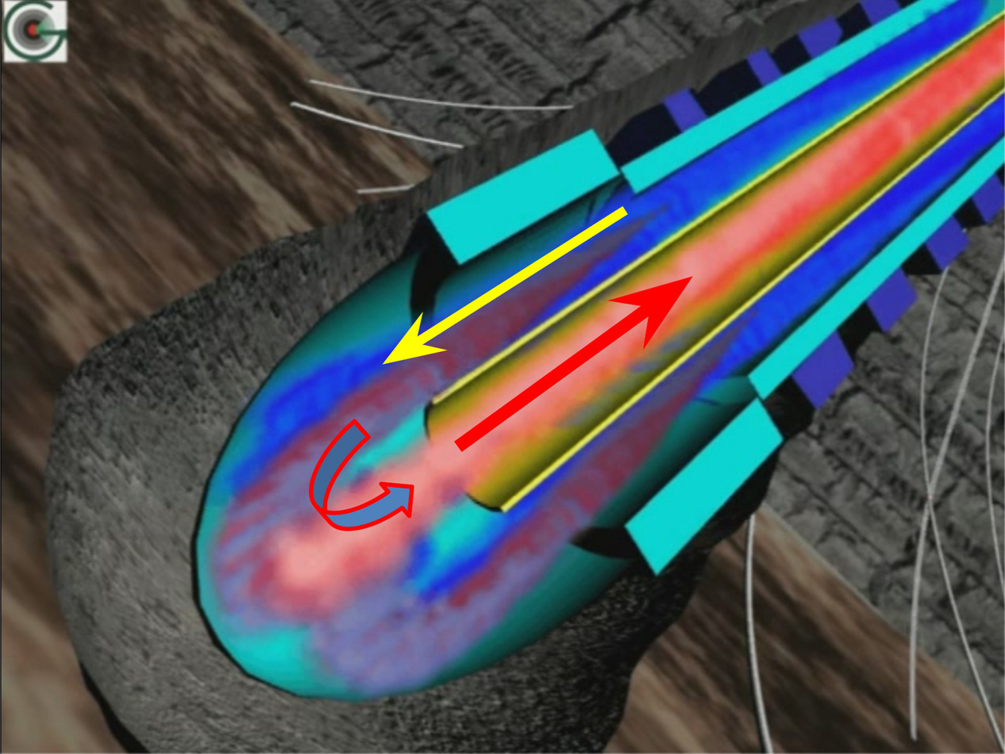
Functional Closed Loop System
Flow completely isolated from environment
HOT DRY ROCK
THERMAL CONDUCTIVE GROUT
o
Flowrate 20kg/s – 40 kg/s
Temp. loss on return < 15°C
2021 Geothermic Solution LLC. Confidential, for limited distribution only.

Slide 9
DRILLING
GSL got faster, deeper, cheaper, and is improving everyday
GSL uses advanced drilling technology unavailable 15 years ago
Only Now Possible
THERMAL CONDUCTIVITY ENHANCEMENT
GSL has grout more than10x conductive than rock
GSL has penetrant to enhance surrounding rock conductivity
GSL has world leading experts in heat transfer to the harvester
TUBE-IN-TUBE
Oil and gas insulated tube technology enables our proprietary harvester design
GSL is working with the world’s leading insulated tube manufacturer
INSULATION
GSL’s harvester uses new insulating materials developed and made commercially available only in recent years
SCIENTIFIC MODELLING
Supported by recent developments in state-of-the-art analytical tools
2021 Geothermic Solution LLC. Confidential, for limited distribution only.

Slide 10


GeoHeatTM – Excellent Economics
4.0
<3.0
2.0
kWh
kWh
kWh
LCOE for baseload energy – small plant
LCOE large plant without residual heat utilization
LCOE large plant with residual heat utilization
CALCULATIONS EXCLUDE VALUE OF RECS (1.0¢ - 2.0¢ PER kWh)
2021 Geothermic Solution LLC. Confidential, for limited distribution only.

Slide 11
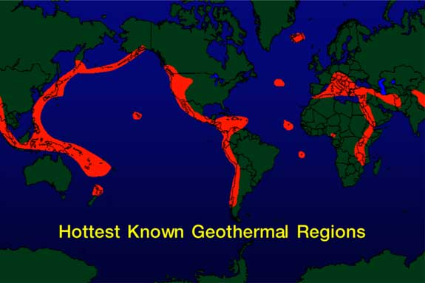
GeoHeatTM
is everywhere
INITIAL TARGETS
California (initially to provide additional heat to geothermal plants) and
countries like Saudi Arabia, Japan, Singapore, Taiwan (high electricity costs, land constraints)
2021 Geothermic Solution LLC. Confidential, for limited distribution only.

Slide 12
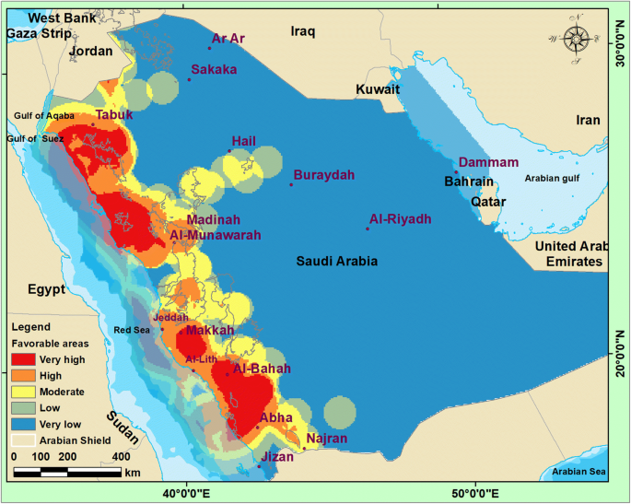
Saudi Arabian Geothermal Superpower
Excellent source for electricity, desalination, and air conditioning
2021 Geothermic Solution LLC. Confidential, for limited distribution only.

Slide 13
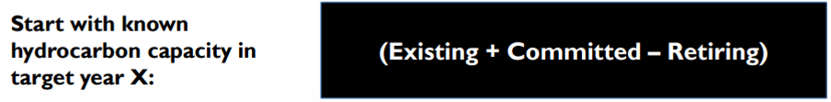
Saudi Arabian Future Requirement = 60.5 GW (source: Saudi Aramco)
Capacity Identification using Technology
Load Match Approach
+
Wind, Solar
Variable
121 – 60.5 = 60.5 GW
Geothermic Solution
Electricity, Industrial, Desalination
Base Load
2021 Geothermic Solution LLC. Confidential, for limited distribution only.

Slide 14
Saudi Arabian Renewable Roadmap
Saudi Arabian Plans
Aims to become the world’s foremost market for renewable energy By 2032, the country strives to generate as much as a third of the Kingdom’s energy demands using renewable energy (54 GW).
Some KSA plans have called for 40 GW of solar power.
Which KSA Renewable “Proven Reserves” should be utilized?
Solar would require at least 615,000 acres for 40 GW, GeoHeatTM would require 4,000 acres for the same amount of power
For solar to produce the same amount of kilowatt hours as GeoHeatTM would require a 123 GW installation with massive energy storage making solar more than 3 times more expensive than GeoHeatTM.
Were all fuel consumption replaced by exploitation of Saudi Arabia’s hot dry rock through GSL technology, the calculated savings on that cost of generation would be on the order of US$ 18.6 bn per year.
2021 Geothermic Solution LLC. Confidential, for limited distribution only.

Slide 15
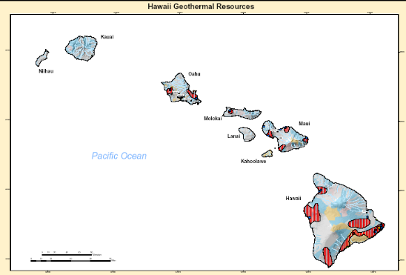
Hawaii All Electric Vehicle Opportunity
Planned proprietary charging stations
Known GeoHeat Resources
2021 Geothermic Solution LLC. Confidential, for limited distribution only.

Slide 16
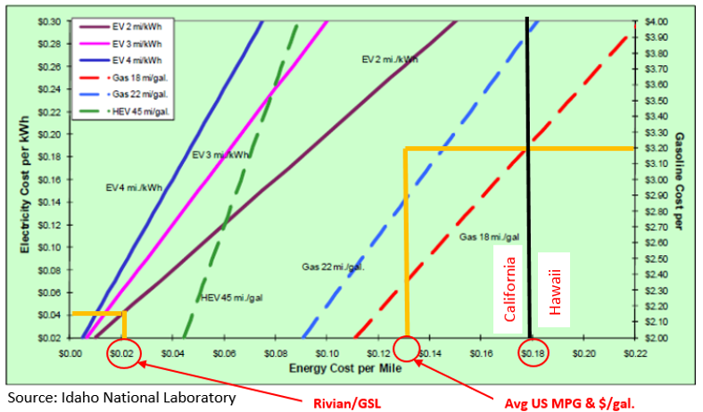
Electric Automaker Benefit – Significant Financial Advantage
Hawaiian Electric
10.9¢/kWh from 9 a.m. to 5 p.m.
39.8¢/kWh from 5 p.m. to 10 p.m.
31.6¢/kWh from 10 p.m. to 9 a.m.
At the times most vehicles would be charged the cost is >30¢/kWh
Electric Vehicle 2X more expensive per mile than a HEV.
Automaker/GSL
Hawaii has the highest share of petroleum use 62% in the U.S. for electricity generation
2021 Geothermic Solution LLC. Confidential, for limited distribution only.

Slide 17
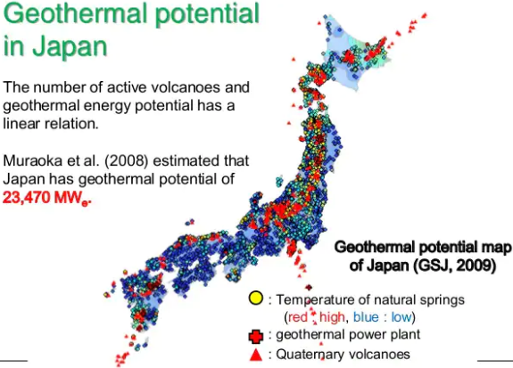
Enormous Japanese Resource
2021 Geothermic Solution LLC. Confidential, for limited distribution only.

Slide 18
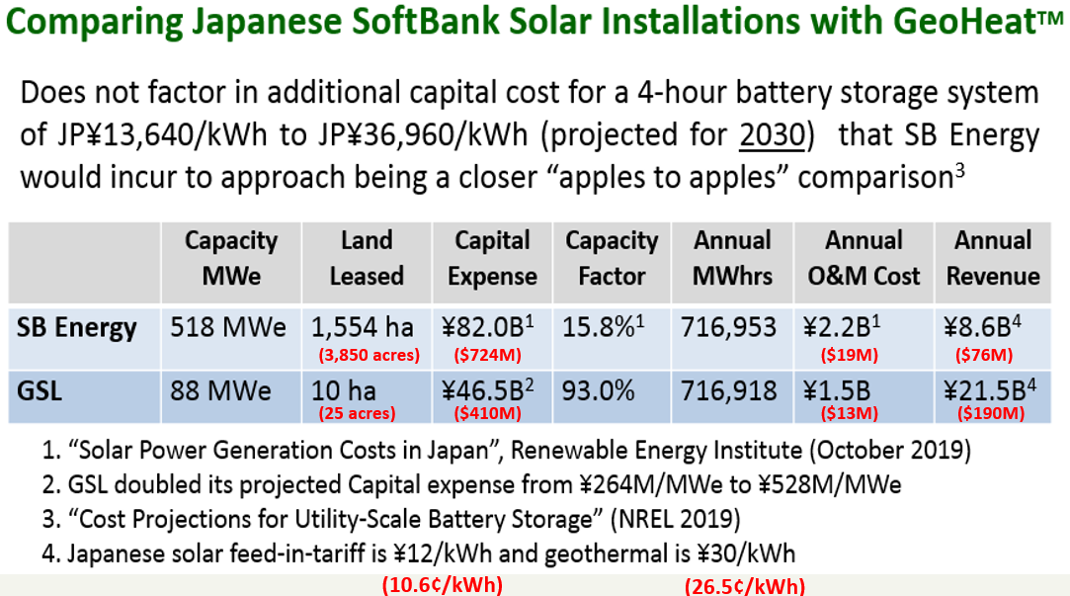
Japanese Benefits with GSL’s GeoHeatTM
2021 Geothermic Solution LLC. Confidential, for limited distribution only.

Slide 19
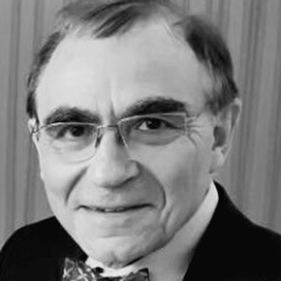

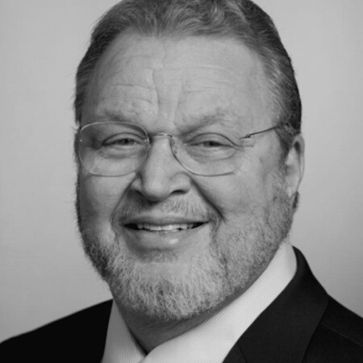
Executive Leadership
PIOTR D MONCARZ,
PH.D., P.E., NAE.
WALTER KOLBE,
M.SC., CEM
LOUIS CAPUANO JR,
B.SC.
CHIEF FINANCIAL OFFICER &
GENERAL MANAGER OF TECHNOLOGY COMMERCIALIZATION
CHIEF OF DRILLING &
WELL COMPLETION
CHIEF EXECUTIVE OFFICER
Industrial risk analysis; Adjunct Professor at Stanford University; Senior Fellow and former senior executive at Exponent, Inc.
World-leading authority in geothermal energy; led large-scale projects across the US, in Japan, Taiwan, & the Caribbean;
former President: Geothermal Resources Council
Serial entrepreneur and CEO; former Deputy Director at San Francisco Clean Water's $2 billion Program
2021 Geothermic Solution LLC. Confidential, for limited distribution only.

Slide 20
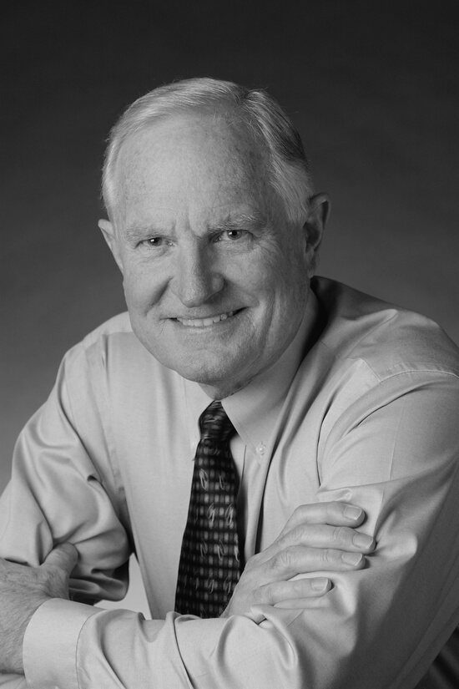

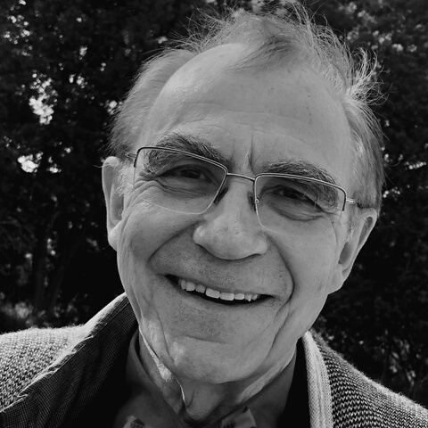
Board of Managers
CRAIG BARRETT,
PH.D., NAE
SHAWN DEVERSE
PIOTR MONCARZ,
PH.D., P.E., NAE
CEO
CHAIRMAN
Former H&P VP of Commercial Strategy
Former Intel Chairman and CEO
2021 Geothermic Solution LLC. Confidential, for limited distribution only.

Slide 21

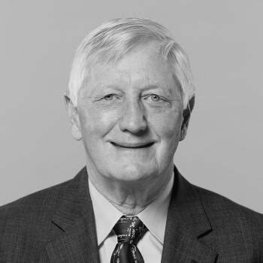
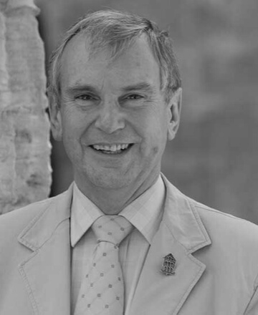
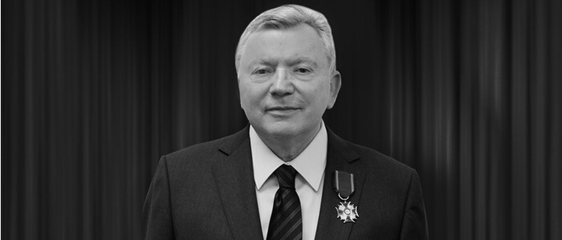
Board of Advisors
RUSS STROBEL,
J.D.
JAMES SWEENEY,
PH.D.
RICHARD MAUDSLAY,
CBE, FRENG
MICHEL KORWIN
Former Chairman of the Board, CEO and President of
Nicor Inc., He serves as a Director at MWH Global Inc., Economic Club of
Chicago and the Northern Illinois Gas Company
Professor, Stanford University; Senior Fellow,
Stanford Institute for Economic Policy Research; member, National
Research Council; advisor, National Renewable Energy Laboratory
Former Chairman of the UK National Nuclear Laboratory, Managing Director of the Rolls Royce Industrial Power
Group, and member, Board of Directors of Rolls Royce PLC
Founder and former President and Chief Executive Officer
of Nitrex Metal, Inc, one of the world’s leading experts in pipe treatment
2021 Geothermic Solution LLC. Confidential, for limited distribution only.

Slide 22
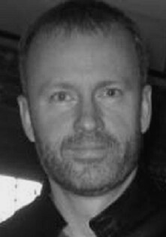
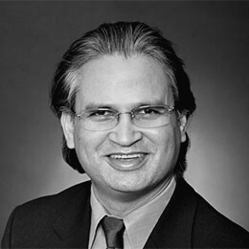
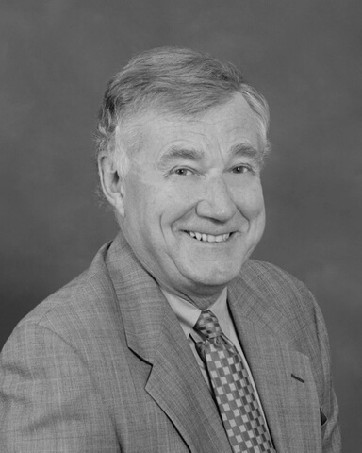
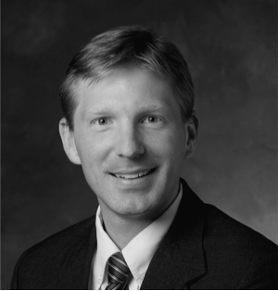
Technical Advisors
DOMINIK SCHMIDT,
PH.D.
P.V. SURYANARAYANA,
PH.D.
PAUL BROPHY,
M.SC.
MICHAEL LEPECH,
PH.D.
Dr. Schmidt heads QVT’s Palo Alto office. He focuses primarily on technological investments. Prior to joining QVT in May 2013, Dr. Schmidt was employed by Intel Corporation as Senior Director of Wireless Engineering from 2004 to 2010 and as Chief Technology Officer in the Intel Foundry from 2010 to 2013.
Chairman of Blade Energy Partners, a highly regarded Oil & Gas engineering firm. Blade clients include Anadarko, BP, Chesapeake Energy, Chevron, Conoco Phillips, ExxonMobil, Halliburton, Hess Corp., Hunt Oil, Marathon, Mitsubishi, Occidental Petroleum, Qatar Petroleum, Saudi Aramco, Shell, and Total
Mr. Brophy is considered one of the pre-eminent geothermal resource authority in the United States. Formerly President of the Geothermal Resources Council, and on the Board of Directors for the International Geothermal Association
Associate Professor of Civil and Environmental Engineering and Senior Fellow at the Woods Institute for the Environment. With an engineering background in civil & environmental engineering and material science (BSE, MSE, PhD), and business training in strategy and finance (MBA)
2021 Geothermic Solution LLC. Confidential, for limited distribution only.

Slide 23





Tapping into World-Class Domain Experts
DRILLING
Helmerich & Payne, a GSL investor, is the leading U.S. unconventional driller, and the largest on-shore driller in the U.S.
GEOLOGY
Paul Brophy, our Chief Geologist; pre-eminent U.S. geothermal resource authority; past president of the Geothermal Resource Council; Board member, International Geothermal Association.
ABOVE GROUND ENGINEERING
POWER Engineers is one of the U.S. top-ranked engineering design firms in the power industry.
BELOW GROUND ENGINEERING
RESOURCE ANALYTICS
Blade Energy provides engineering services for the world’s largest oil & gas companies, including BP, Chevron ExxonMobil, SaudiAramco, and Shell.
Itasca Consulting Group, who provided the thermal modeling studies validating GSLs design, is a leader in geomechanical & hydrogeological modeling.
2021 Geothermic Solution LLC. Confidential, for limited distribution only.

Slide 24

Ready to Serve
PIOTR MONCARZ, PH.D., P.E., SPCM
WALTER KOLBE, M.SC., CEM
(650) 208-8249
(650) 515-9995
MONCARZ@GEOTHERMICSOLUTION.COM
KOLBE@GEOTHERMICSOLUTION.COM
2021 Geothermic Solution LLC. Confidential, for limited distribution only.

