Slide 1
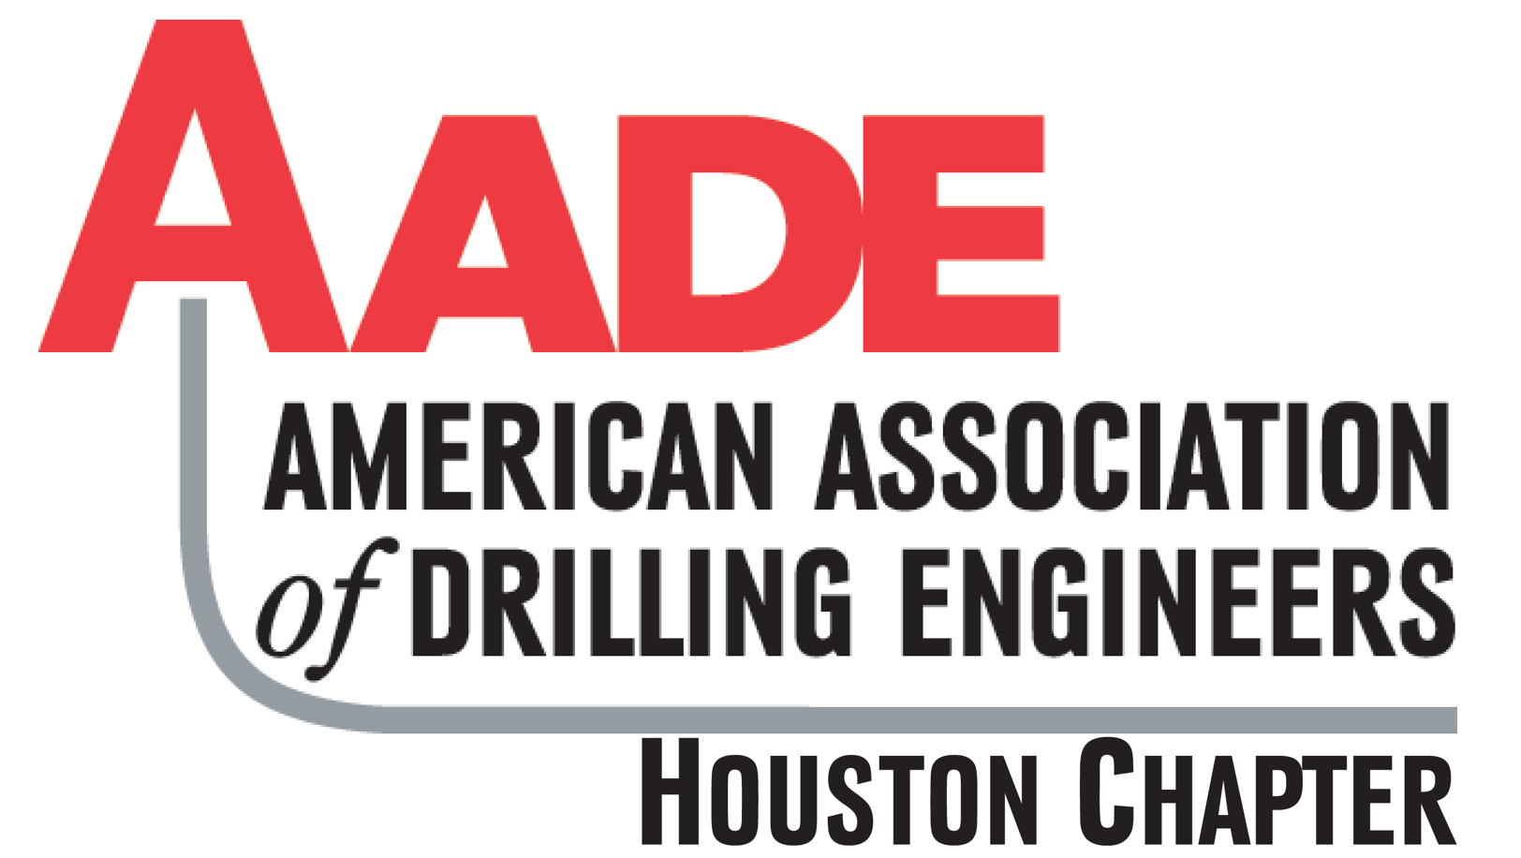

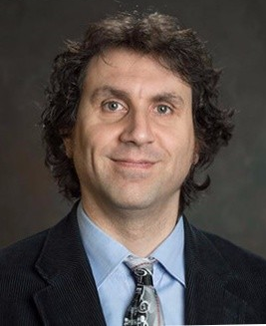
SPE-GCS DSG / AADE JOINT EVENT
Cuttings Transport: Mechanistic Models, Data Driven Models, and More
Petroleum Club of Houston (1201 Louisiana St, 35th Floor, Houston, Texas 77002)
May 5th, 2022 / 11:30 am to 1:00 pm US CST (Webinar 12:00 pm to 1:00 pm)
Q&A session will follow the presentation. We encourage you to ask questions using the chat feature.
Dr. Evren M. Ozbayoglu
Professor and Director of
Drilling Research Projects
University of Tulsa

Slide 2
Agenda
Introduction
Programs Highlight & Announcements
Presentation:
“Cuttings Transport: Mechanistic Models, Data Driven Models, and More”
Q&A
Survey & Wrap Up

Slide 3
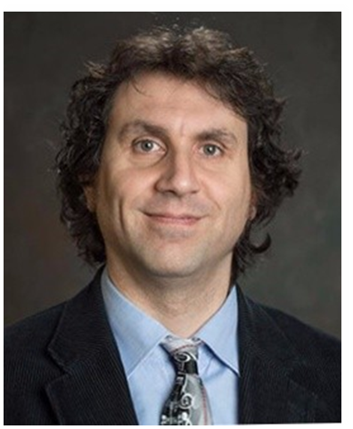
Dr. Evren M. Ozbayoglu
Evren M. Ozbayoglu is currently a “Jonathan Detwiler Chair” full Professor of The University of Tulsa (TU), Petroleum Engineering Department, and the Director of The University of Tulsa, Drilling Research Projects (TUDRP).
He has earned his BSc in 1996 and MSc in 1998 from METU. He earned his PhD degree from The University of Tulsa in 2002 where he has been a full-time faculty member since August 2009.
Dr. Ozbayoglu has numerous publications and has participated in several industry projects on major drilling engineering topics. His research interests include non-Newtonian fluid flow, multiphase fluid flow, underbalanced drilling, hole cleaning, tubular mechanics, horizontal & directional drilling, data analytics, optimization, automation and computational fluid dynamics.
He is an SPE member since 1994, and ASME member since 2015. He was awarded for “Outstanding Technical Editor Award” for SPE Journal, SPE Reservoir Application & Engineering, and SPE Drilling & Completion for years 2012, 2013, 2015, 2018, 2019, and 2021, “SPE Regional Distinguished Faculty Award – Mid-Continent Region – 2013” within 2012-2013 academic year, SPE Regional Drilling Engineer Award in 2019, and SPE Distinguished Membership Award in 2020.

Slide 4
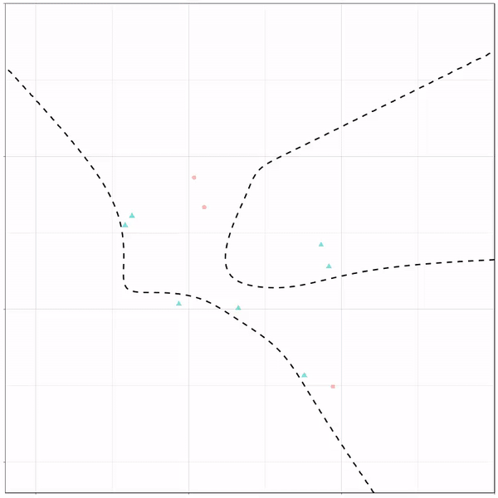
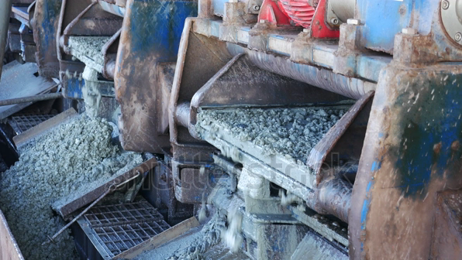
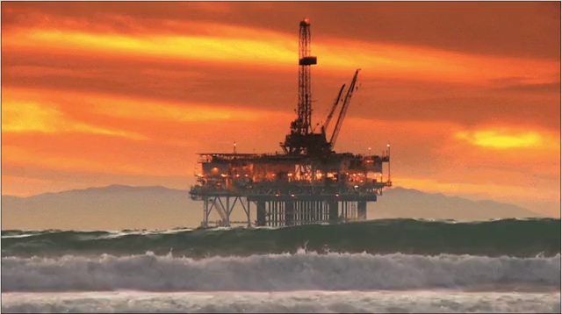
Outline
Potential applications
Cuttings transport
Physical + Data Driven Models

Slide 5
Take-Away
Mechanistic models
  Provides insight information
  Understanding physical aspects
  Assumptions required
Data driven models
  Provides good estimates for difficult cases to model
  No assumptions required
  Accuracy is reasonable
  Extrapolation not suggested
Hybrid models
  Promising results
  Decent accuracy
  Provides some insight information

Slide 6
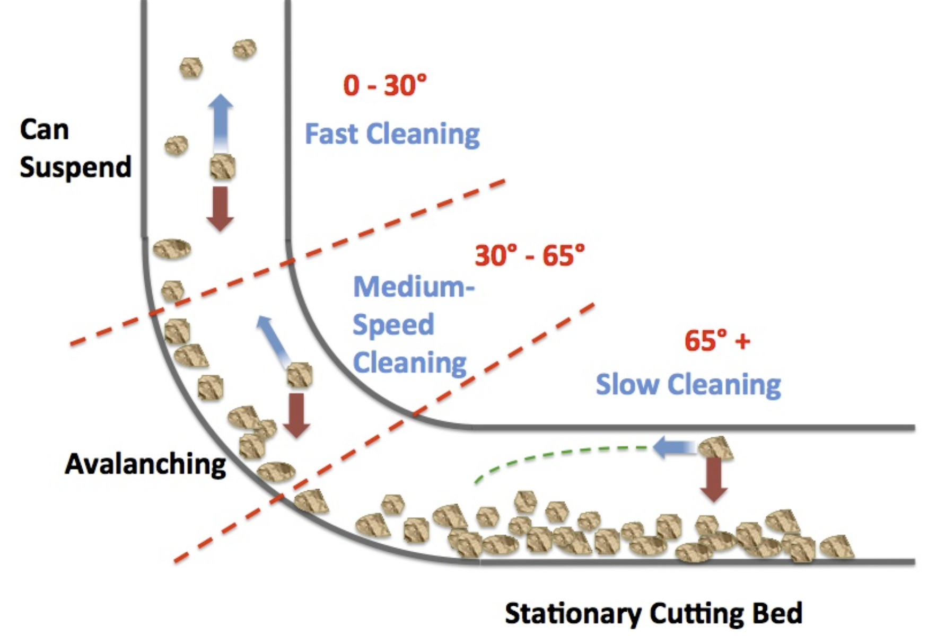
Cuttings Transport
https://agushoe.wordpress.com/2013/10/08/horizontal-extended-reach-well-hole-cleaning-part1/

Slide 7
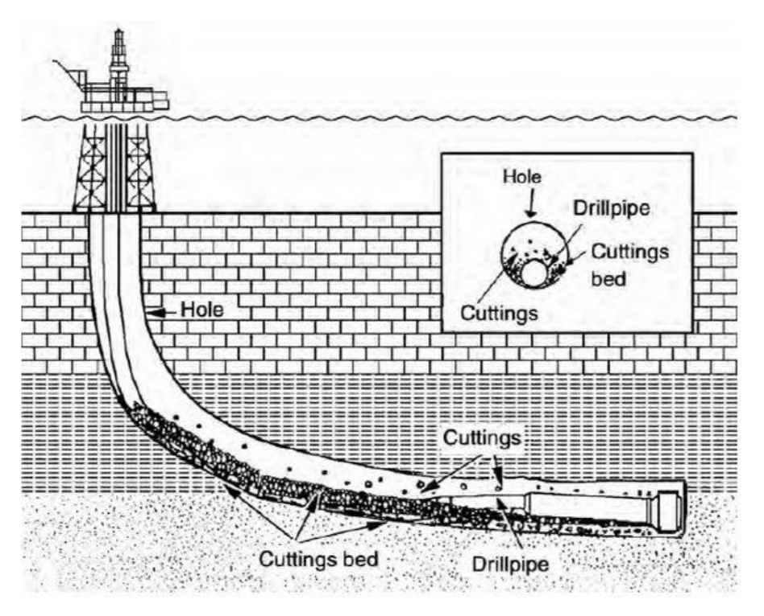
Cuttings Transport
Formation of stationary cuttings bed deposits inevitable when drilling long horizontal and extended reach wells
Operational problems arise such as
  low ROP, excessive torque and drag, bridging, pack-off, hole fill and pipe stuck
Occasionally drilling must stop to clean the well, this costs time and money
Lake, 2007

Slide 8
History of Research on Cuttings Transport
Advanced Studies
1980 – 1990
1990 – 2000
2000 – Present
1950 - 1980
Awakening years²
Pioneering Studies²
Settling Days¹
1- J.J. Azar 1997, SPE 39020
2- A.A. Pilehvari 1999, SPE 57716

Slide 9
History of Research on Cuttings Transport
Settling Days
  Hall et al. (1950), Zeidler (1974), Sifferman (1973), Moore (1974), Chien (1994) …
Pioneering Studies
  Tomren (1979), Iyoho (1980), Okranji (1981), Hareland (1985), Becker (1987), Gavignet and Sobey (1989) …
Awakening Years
  Larsen (1990), Jalukar (1993), Bassal (1995), Campos (1995), Nguyen and Rahman (1996), Adari (1999), Sapru (2001) …
Advanced Studies
  Okpobiri (1982), Martins, et al (2001), Zhou (2004), Li (2004), Duan (2007) …

Slide 10
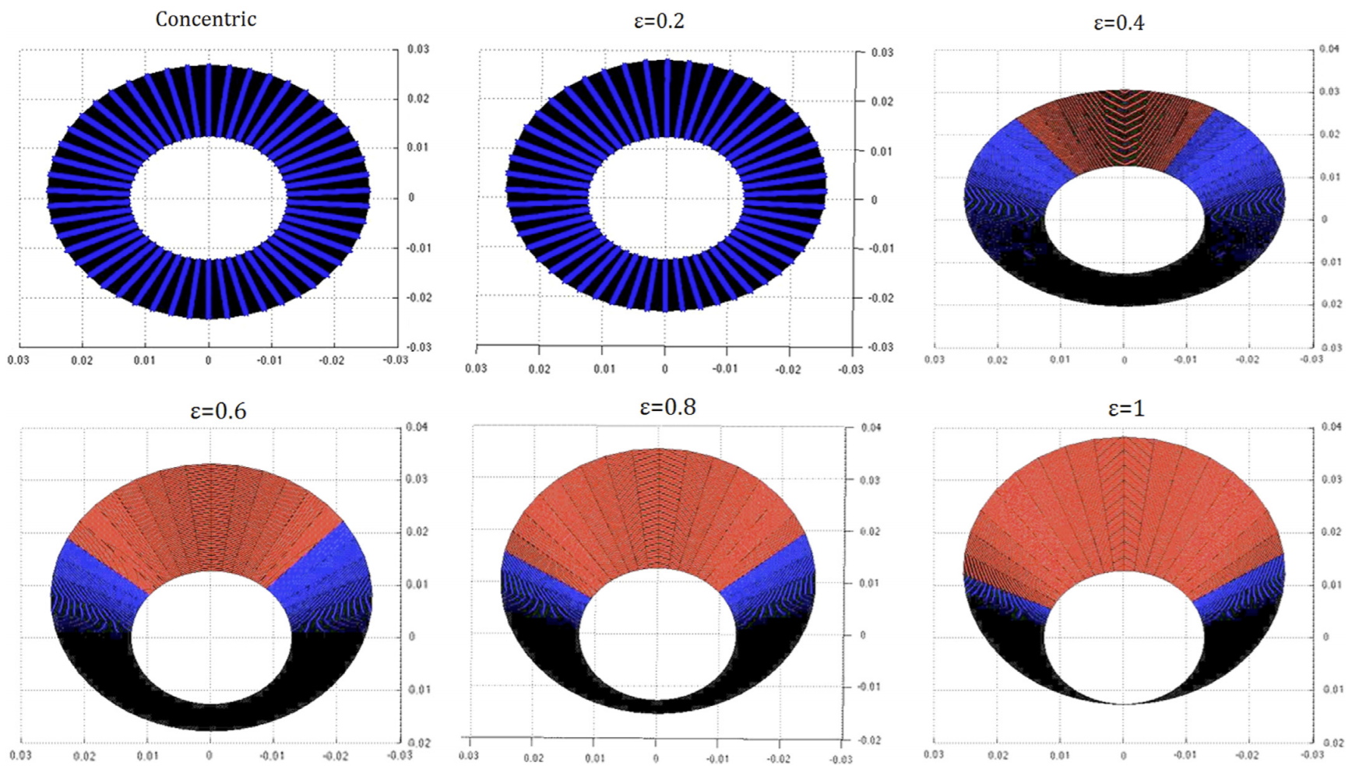
Current Studies
Local Velocity Determination
Erge et al, 2015

Slide 11
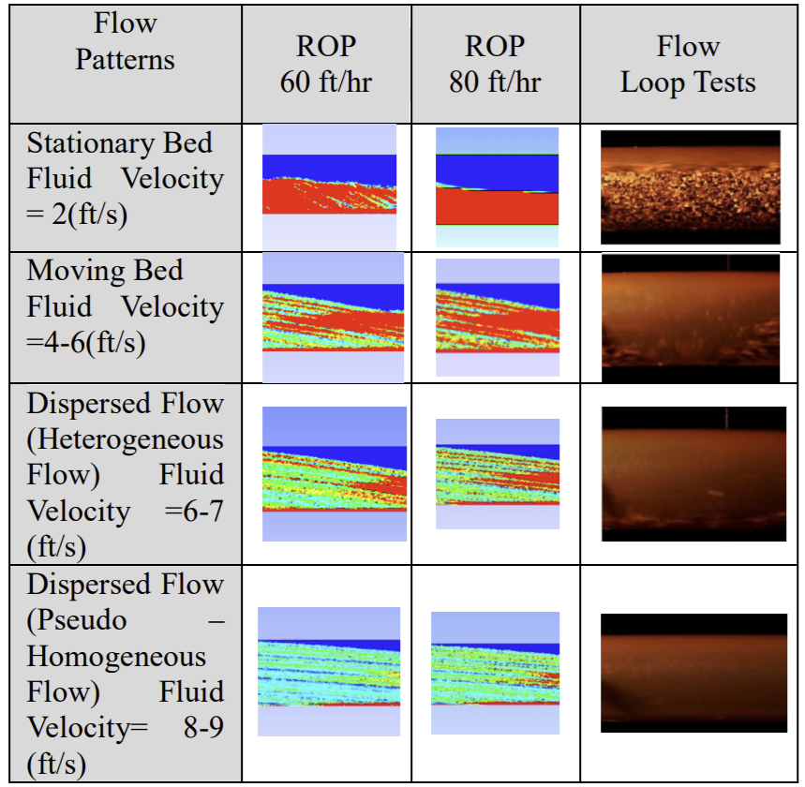
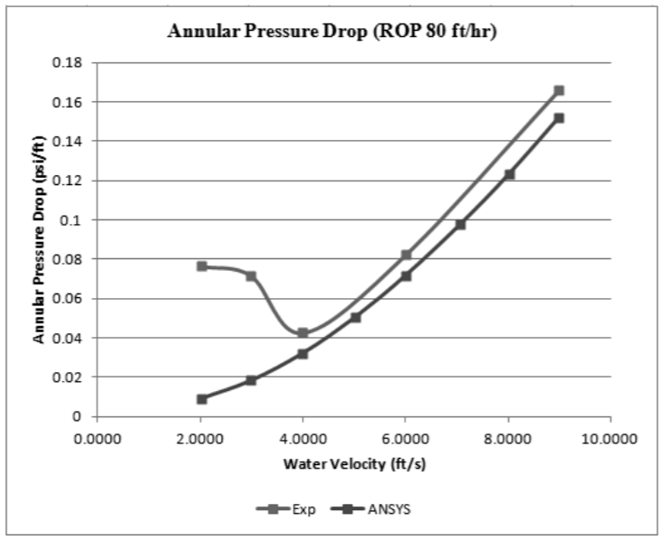
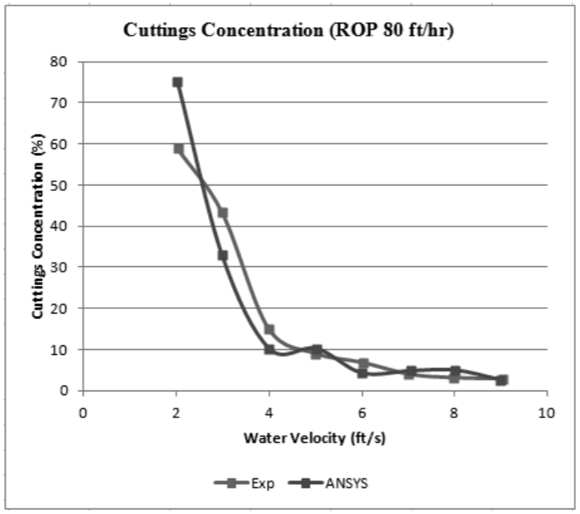
Current Studies
CFD Multiphase
Fu et al, 2013

Slide 12
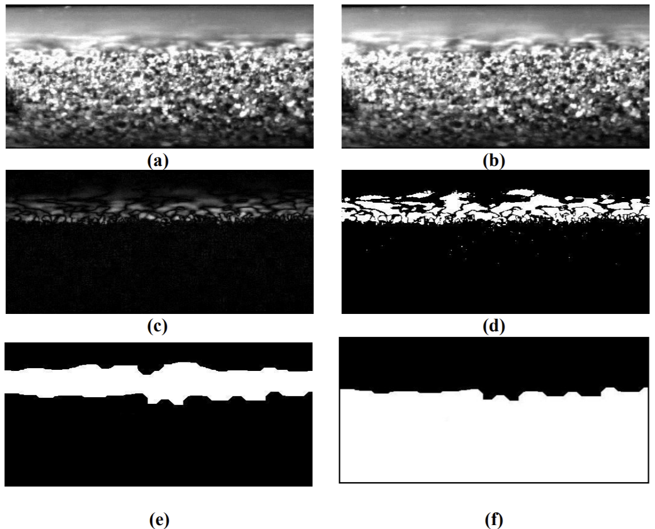
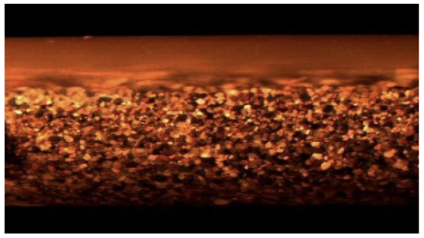
Current Studies
Image Processing
Ozbayoglu et al, 2010

Slide 13
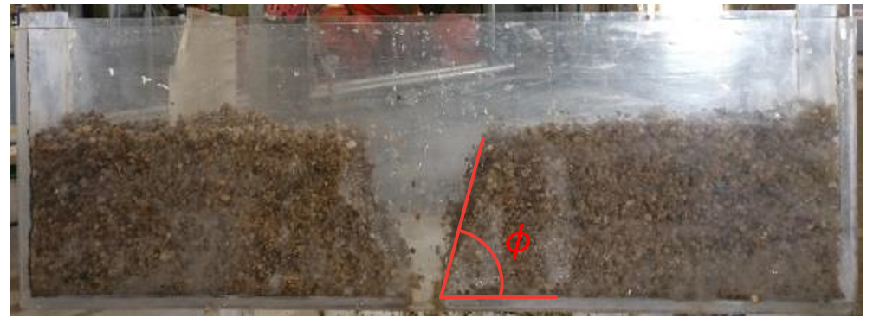
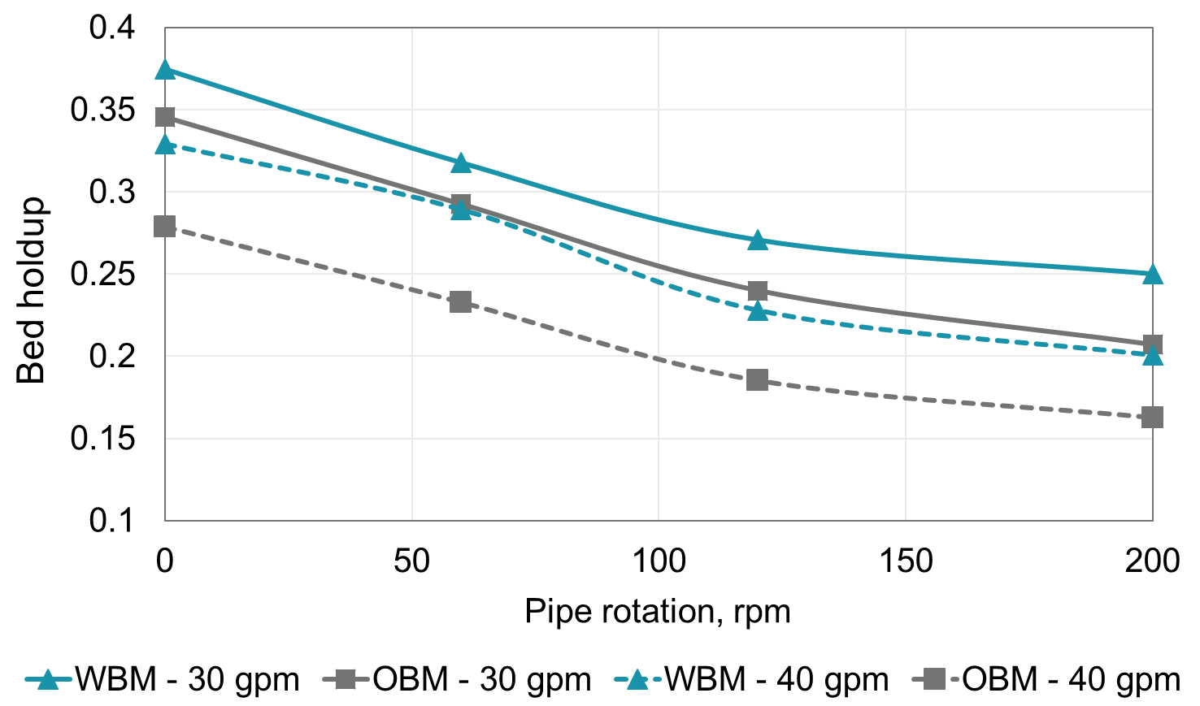
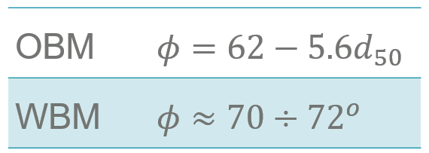
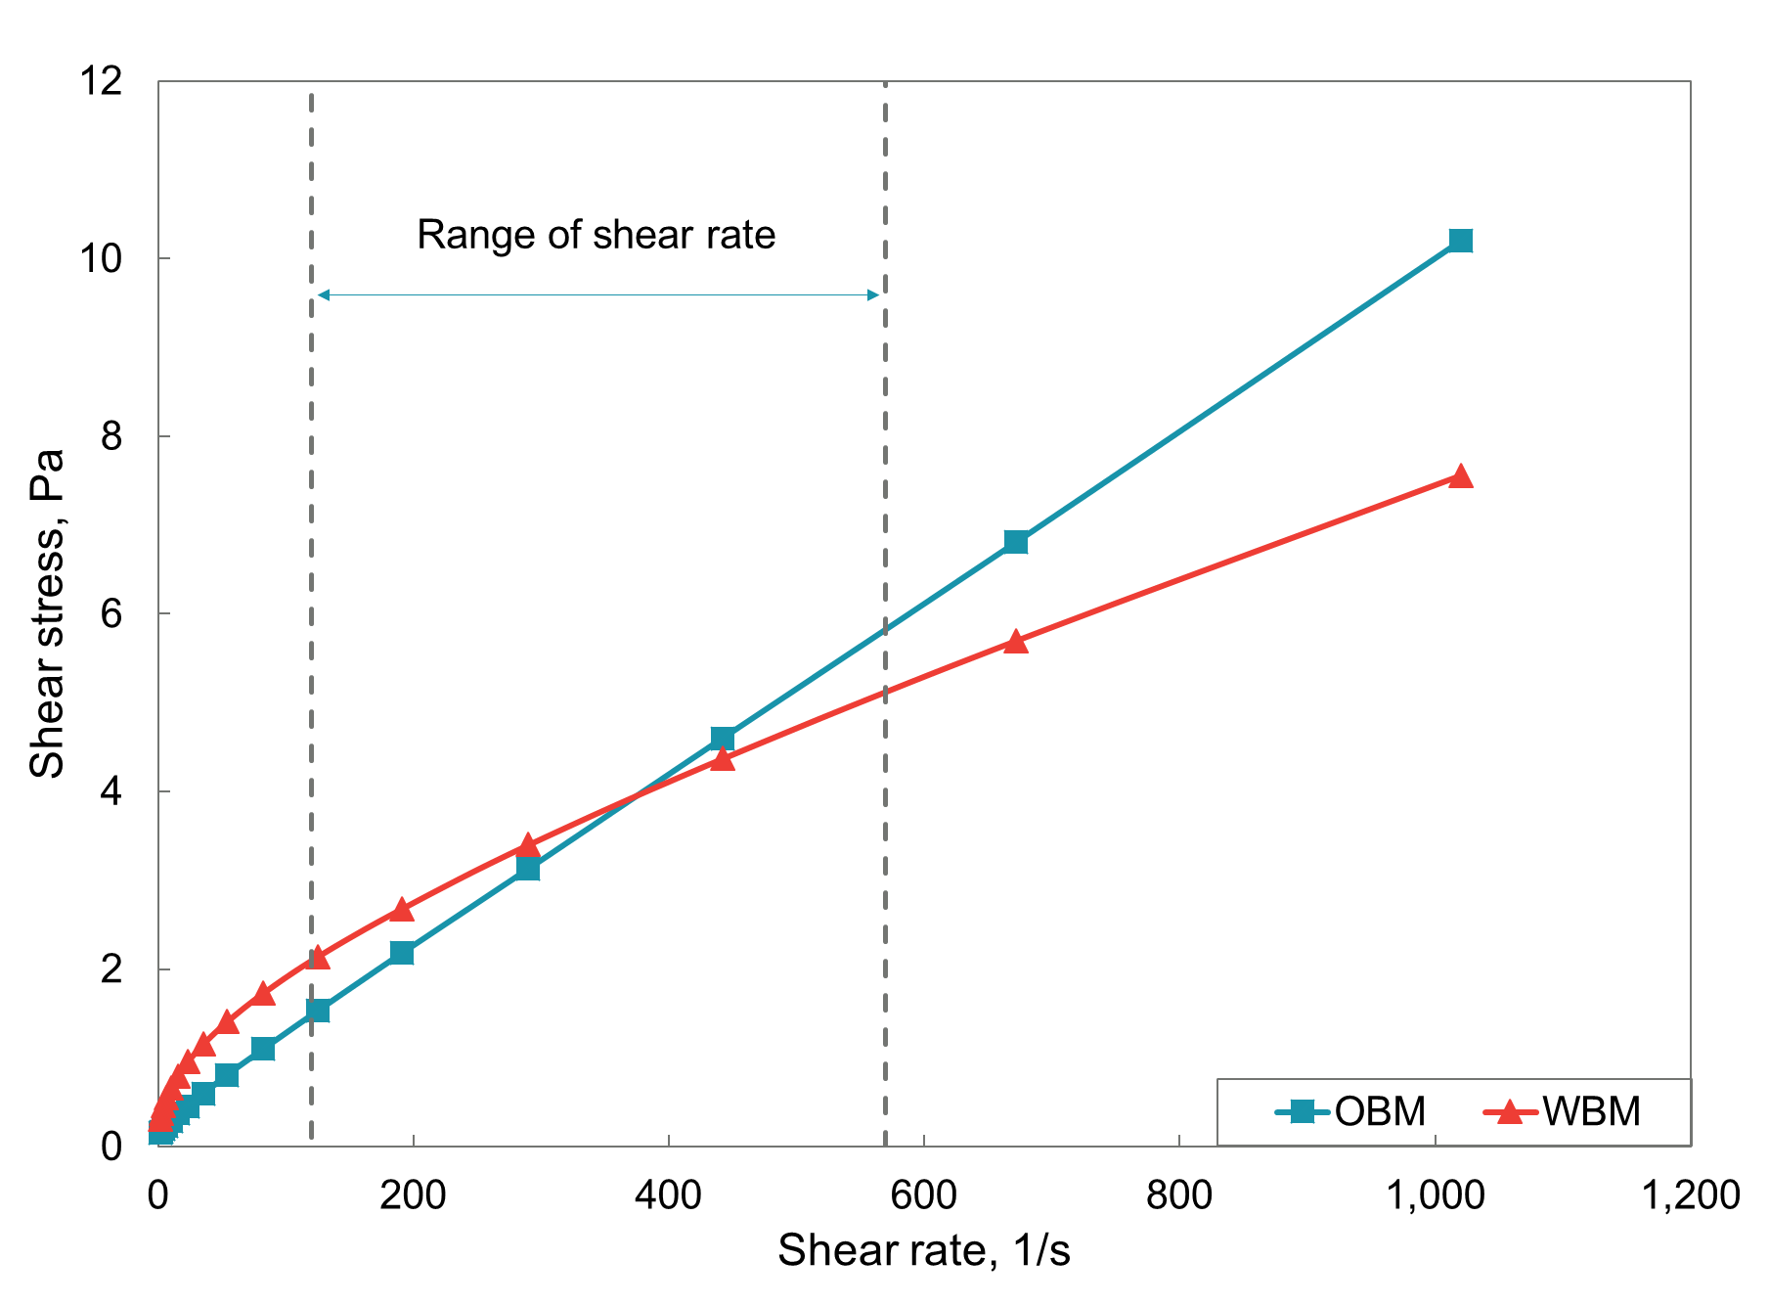
Current Studies
Similar Rheology – Different Base
Tong et al, 2020

Slide 14
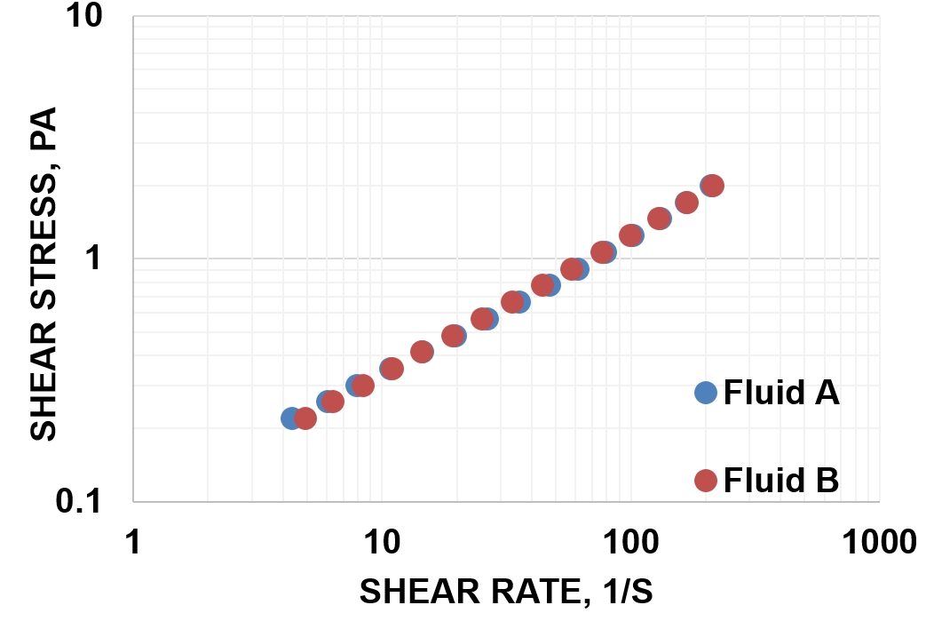
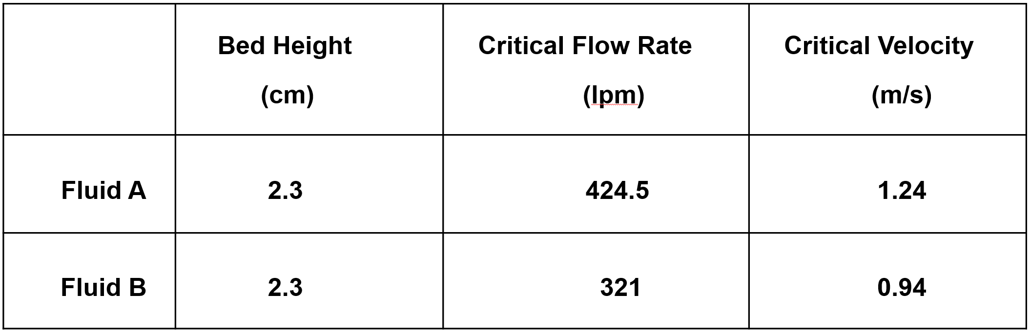
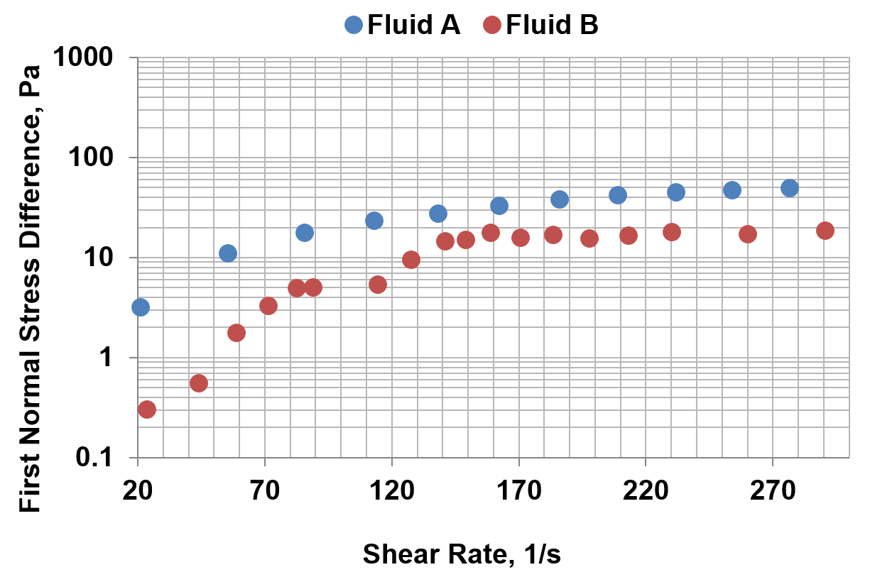
Current Studies
Kuru et al, 2020

Slide 15
Particle Settling
Free Settling
  A single particle in a fluid (Stoke’s Law)
Dynamic Slippage
  Difference in upward velocity and slip velocity
  Increased slip component in highly deviated wells
Hindered Settling
  At high concentrations, particles tend to support themselves
Boycott Settling
  Settling occurs more rapidly in inclined wellbores
  Occurs in static or low velocity conditions only

Slide 16
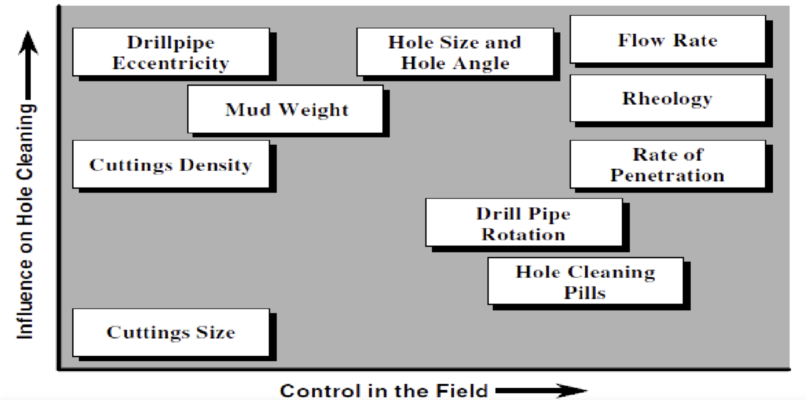
Key Variables Influencing Cuttings Transport
Luo et al, 1992

Slide 17
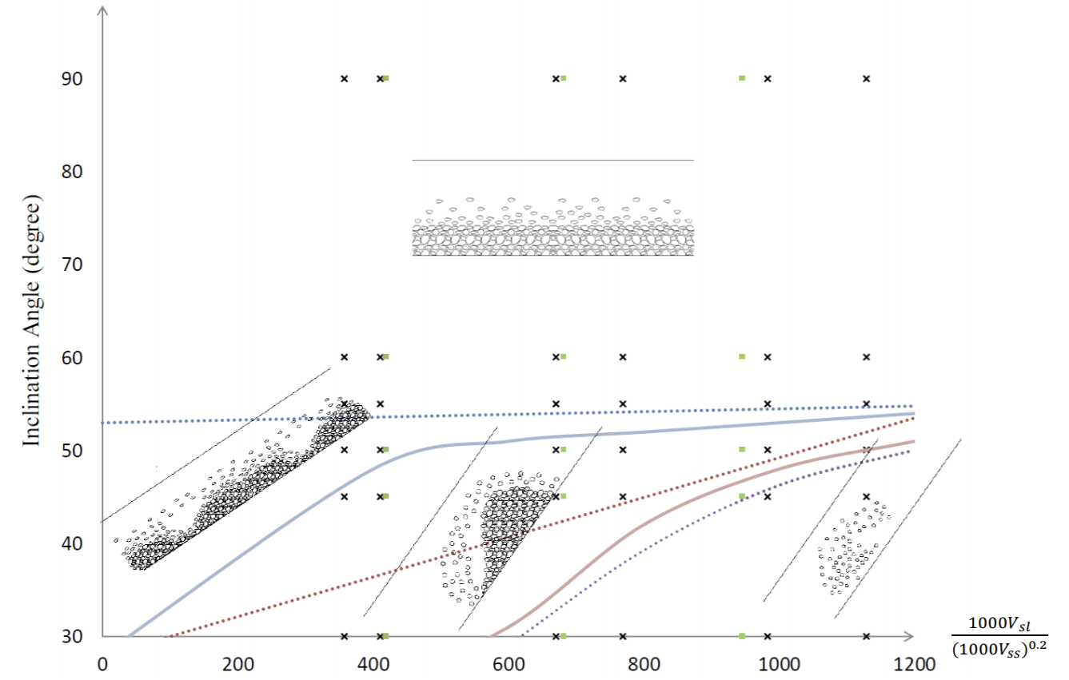
Flow Patterns
Zhang et al, 2014

Slide 18
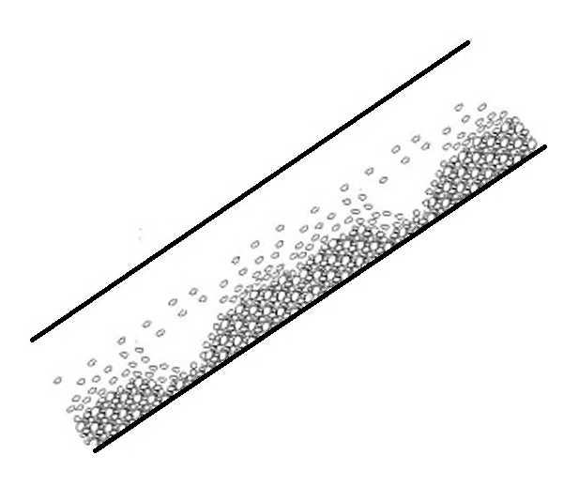
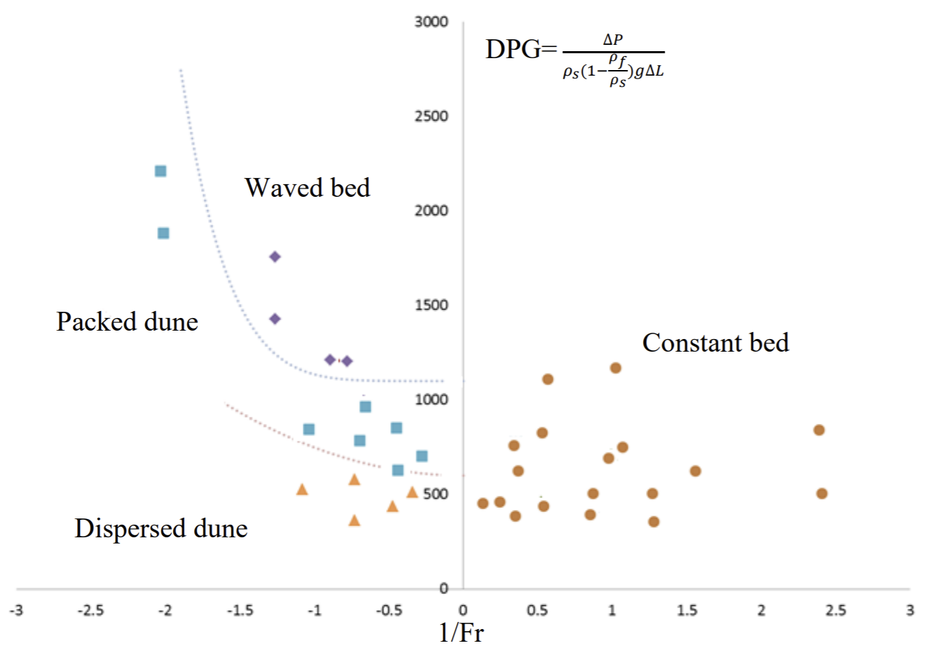
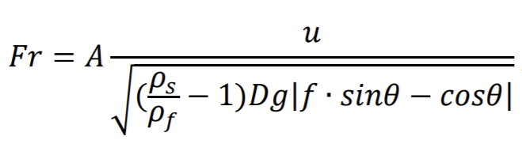

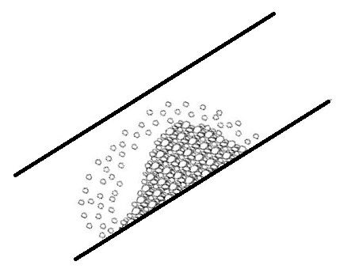
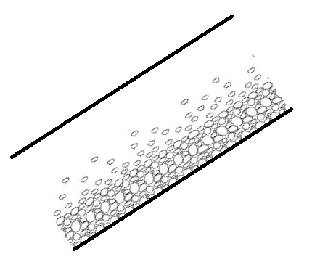
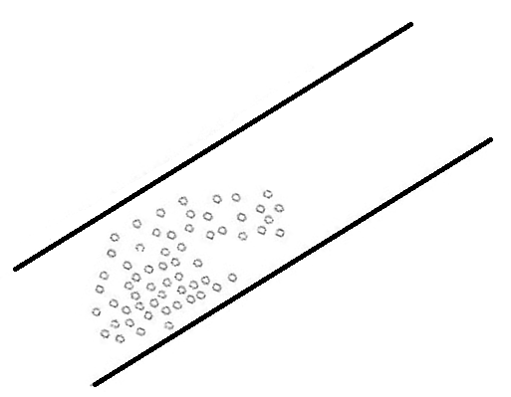
Flow Patterns
Zhang, 2015

Slide 19
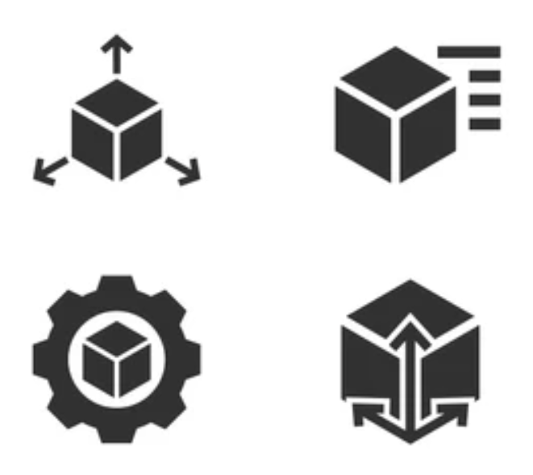
Modeling
Physical based mechanistic models
Empirical correlations
Dimensional analysis
Conformal mapping
Boundary layer
Computational Fluid Dynamics
Machine learning methodology
Hybrid models
https://www.shutterstock.com/

Slide 20
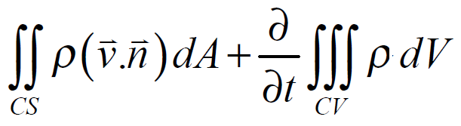

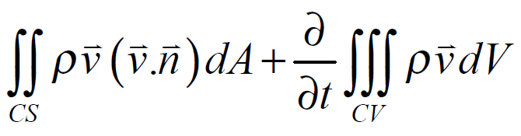
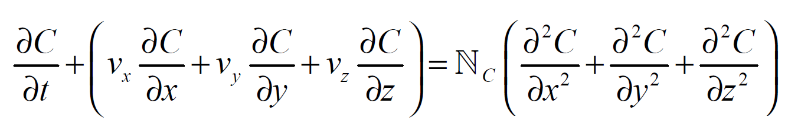
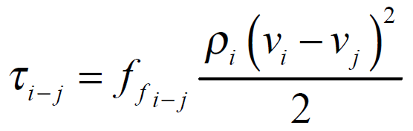
Mechanistic Model
Mass Conservation
Momentum Conservation
Concentration Between Layers
Constitutive

Slide 21
Mechanistic Model

Slide 22
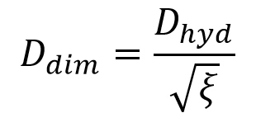
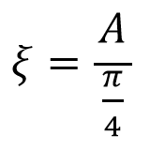
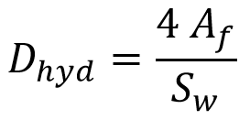
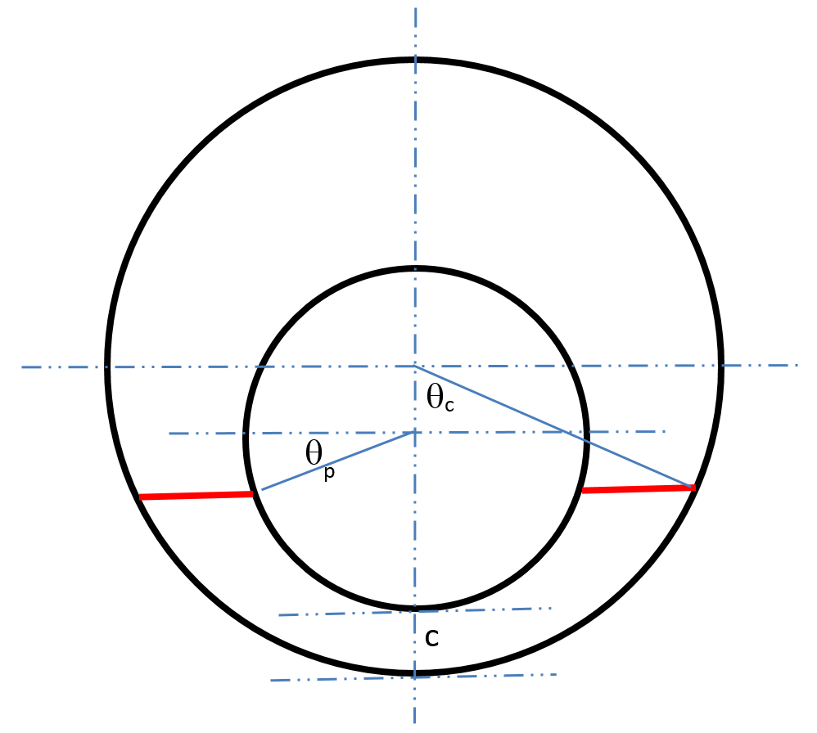
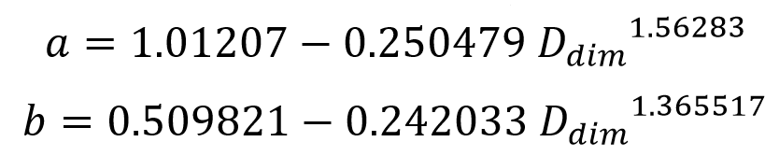
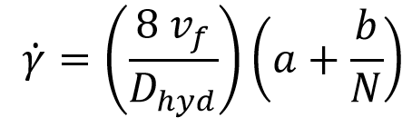
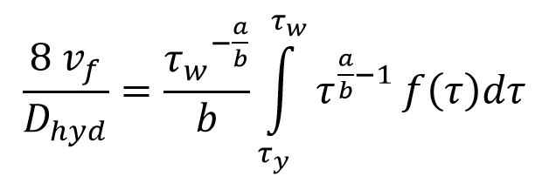
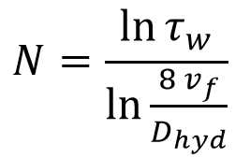
Frictional Pressure Loss
Physical Model
Geometry

Slide 23
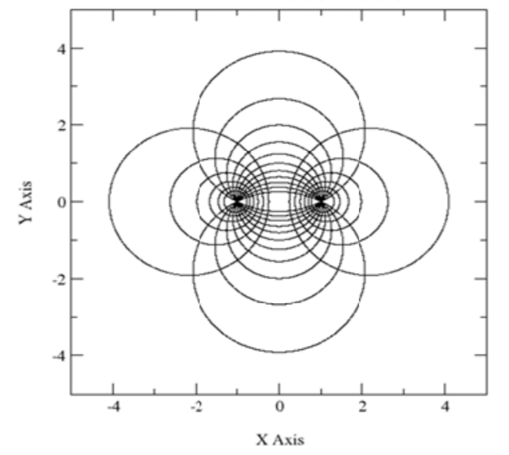
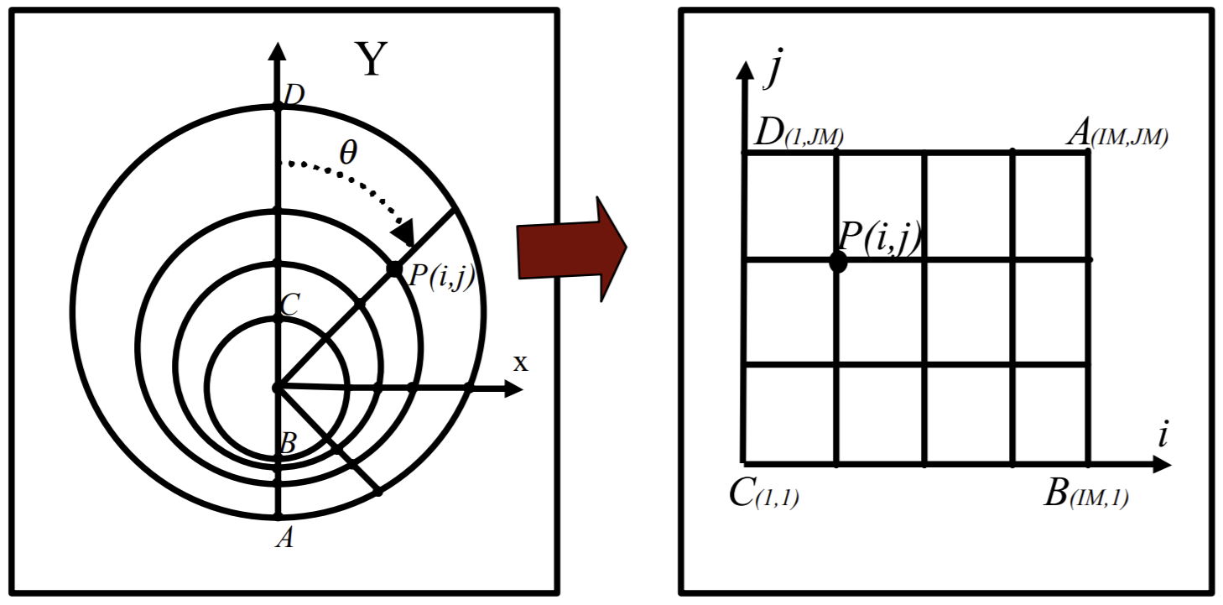
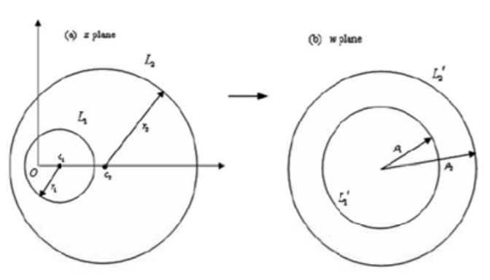
Geometrical Transformation
Hashemian, 2005
Chen et al, 2009

Slide 24
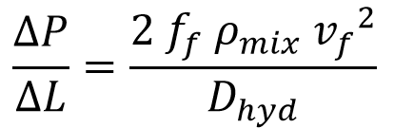
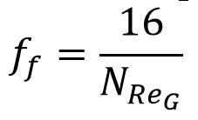
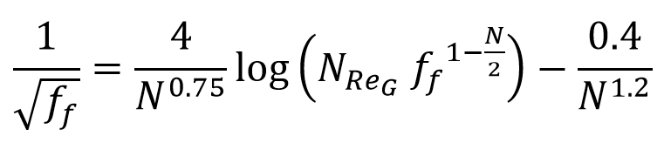
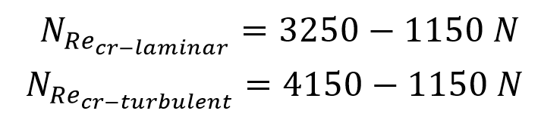
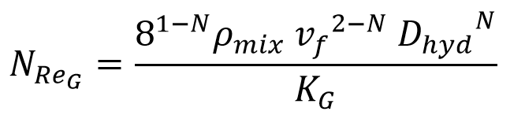
Frictional Pressure Loss
Physical Model
Pressure loss
Laminar
Turbulent
Transition

Slide 25

Frictional Pressure Loss
Physical Model
Effect of Moving Cuttings on Rheology and Density

Slide 26


Pipe Rotation
Dependents on:
Well geometry
Pipe rotation speed
Inclination
Cuttings properties
Fluid properties
Q & ROP
https://www.merlinerd.com/annular-velocity-vs-hole-cleaning/

Slide 27
Semi-Mechanistic Modeling Approach
Layered model
Dune model
Dispersed model
  ⇒ Flow patterns
  Function of:
    Critical fluid velocity
    Inclination
    Fluid rheology
    Reynolds number
    Froude number

Slide 28
Modeling Challenges
High inclinations → Cuttings bed
Lower inclinations → Unstable cases
  Backsliding, avalanching
Bond interconnecting bed particles
  Function of fluid properties
Drill string axis unpredictable
Fluid properties not stable, hard to predict
Cuttings size distribution and shape not known
Steady state vs transient

Slide 29


Results
Semi-Mechanistic Model

Slide 30

The University of Tulsa
Drilling Research Projects

Slide 31

The University of Tulsa
Drilling Research Projects - Experimental Facilities
www.tudrp.utulsa.edu
◎

Slide 32

Typical Experimental Data

Slide 33
Summary of Cuttings Transport Experimental Data

Slide 34







Experimental Results
Zhang, 2015

Slide 35


Machine Learning Approach
Notes:
.

Slide 36




Machine Learning
Cost function
Hypothesis
Weight function

Slide 37

Matlab - Fitnet
Backpropagation
Support vector
Random forest
Adaptive boosting

Slide 38
Input Data
Dimensional Analysis
Reynolds number
Froude number
Taylor number
Stokes number
Shields number
Archimedes number
…
Raw Data
Wellbore geometry
Fluid properties
Cuttings properties
Operational conditions

Slide 39

Dimensionless Groups

Slide 40






Comparison
Raw Data Input vs Dimensionless Group Input

Slide 41


Artificial Neural Networks

Slide 42

Applications
Design & operation stages
Automation & optimization
Drilling dysfunction detection
Minimizing user judgement calls
Improved accuracy
http://pngkey.com

Slide 43


“Measured” Frictional
Pressure Loss

Slide 44
“Measured” Frictional
Pressure Loss
Can be used as an expert system
Accurate cuttings concentration estimation
dP/dL discrepancy may indicate “other” problems
  Lost circulation, hole enlargement, poor hole cleaning, etc
Future Work:
  Automation tool for drilling dysfunction detection

Slide 45


Flow Rate and Pipe Rotation Speed Optimization

Slide 46







Optimization
Optimization Criteria
Ozbayoglu et al, 2021

Slide 47

Flow Rate and Pipe Rotation Speed Optimization
Ozbayoglu et al 2021

Slide 48



Flow Rate and Pipe Rotation Speed Optimization
Different cases considered

Slide 49
Flow Rate and Pipe Rotation Speed Optimization
Quantification and automation of the optimization process
Data driven algorithm provides user independent results
Mechanistic models require user judgement calls with subjective decisions
Future Work:
  Consideration of “other” hydraulic related aspects

Slide 50
Remarks
Mechanistic models provide
  Detailed information about process and physics
  Extrapolation is possible
  Several assumptions required
ANN estimated more accurate than mechanistic model
  More accurate than mechanistic models
  No assumptions required
  Heavily depends on training data quality, range and domain
  Extrapolation is limited
Potential use as a tool for drilling automation & at design stages
Real time monitoring

Slide 51
Q&A
If attending on Zoom, we encourage you to ask questions using the Chat feature.

