Slide 1
Greater Power, Greater Responsibility
Houston AADE
Aron Deen
21-Mar-2022

Slide 2

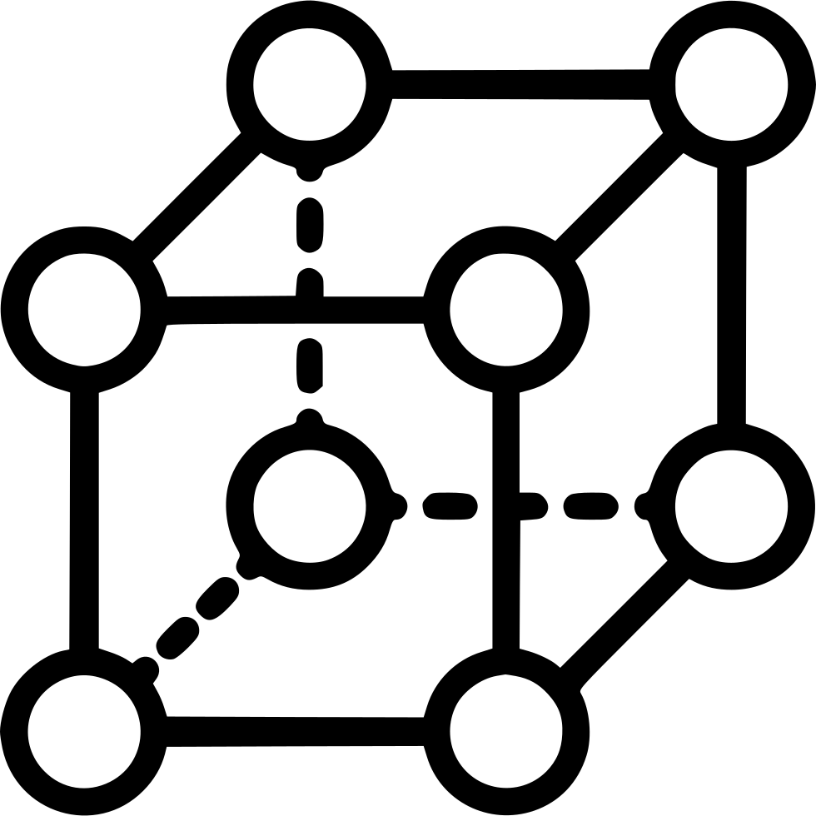
Important Definitions
Innovation = anything new and useful¹
Technology = anything that helps us produce things better, faster, or cheaper²
Design Engineering
Manufacturing Technology
Materials Technology
Design
¹ Collective Genius, Hill
² ECNMY.org

Slide 3
The Method – 4 Important Questions
What has been improved?
What new capabilities does that bring?
What problems do I have?
Pumps, Rigs, Motors, Pipe
HHP, WOB, Torque
ROP, durability, reliability
  Cleaning, cooling, evacuation, energy transfer, dysfunction avoidance, etc.
How have others used these tools to solve these problems?

Slide 4
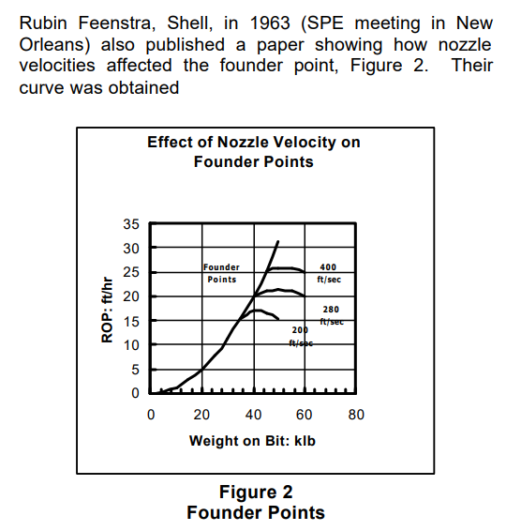
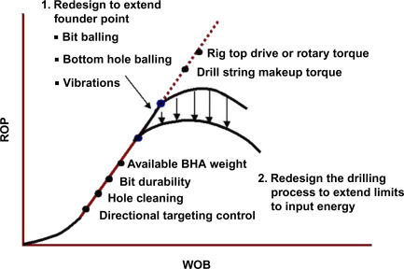





Better Pumps → More Hydraulics…
¹ Robinson, AADE
² Dupriest, SPE

Slide 5
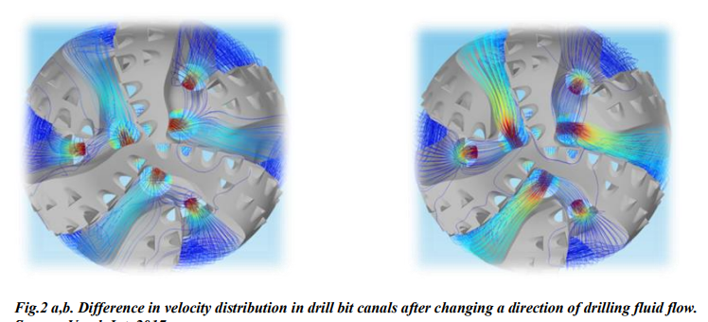
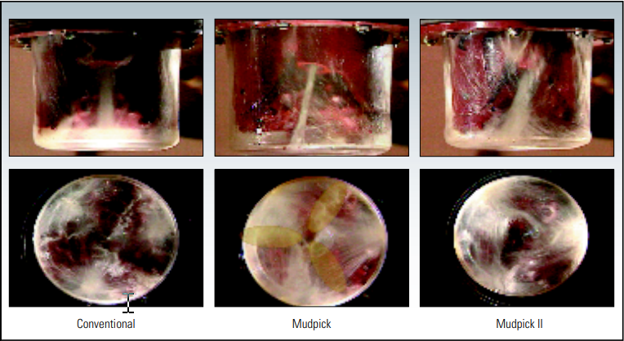
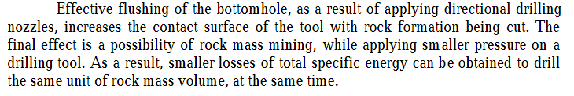
What has been done?
¹ SLB, Oilfield Review
² Toczek, TSE

Slide 6
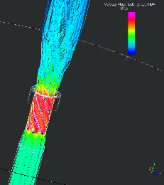
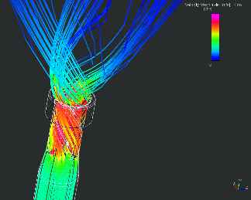
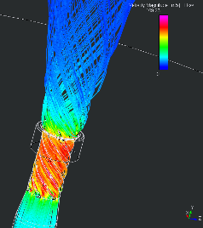
What other advances?

Slide 7
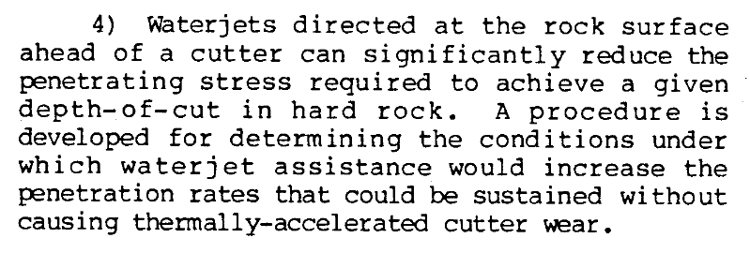
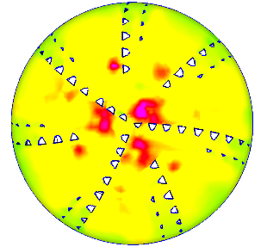
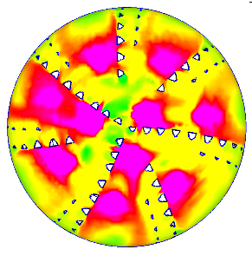

Hydraulics
Pumps → Hydaulic Energy → ???
¹ Glowka, SPE

Slide 8
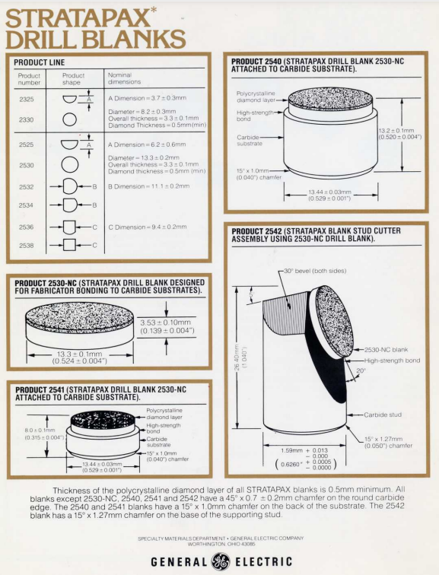
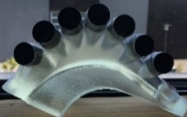
More WOB, Torque?
¹ Scott, IADC

Slide 9
Q&A and Closing Remarks
Don’t go easy!

