Slide 1
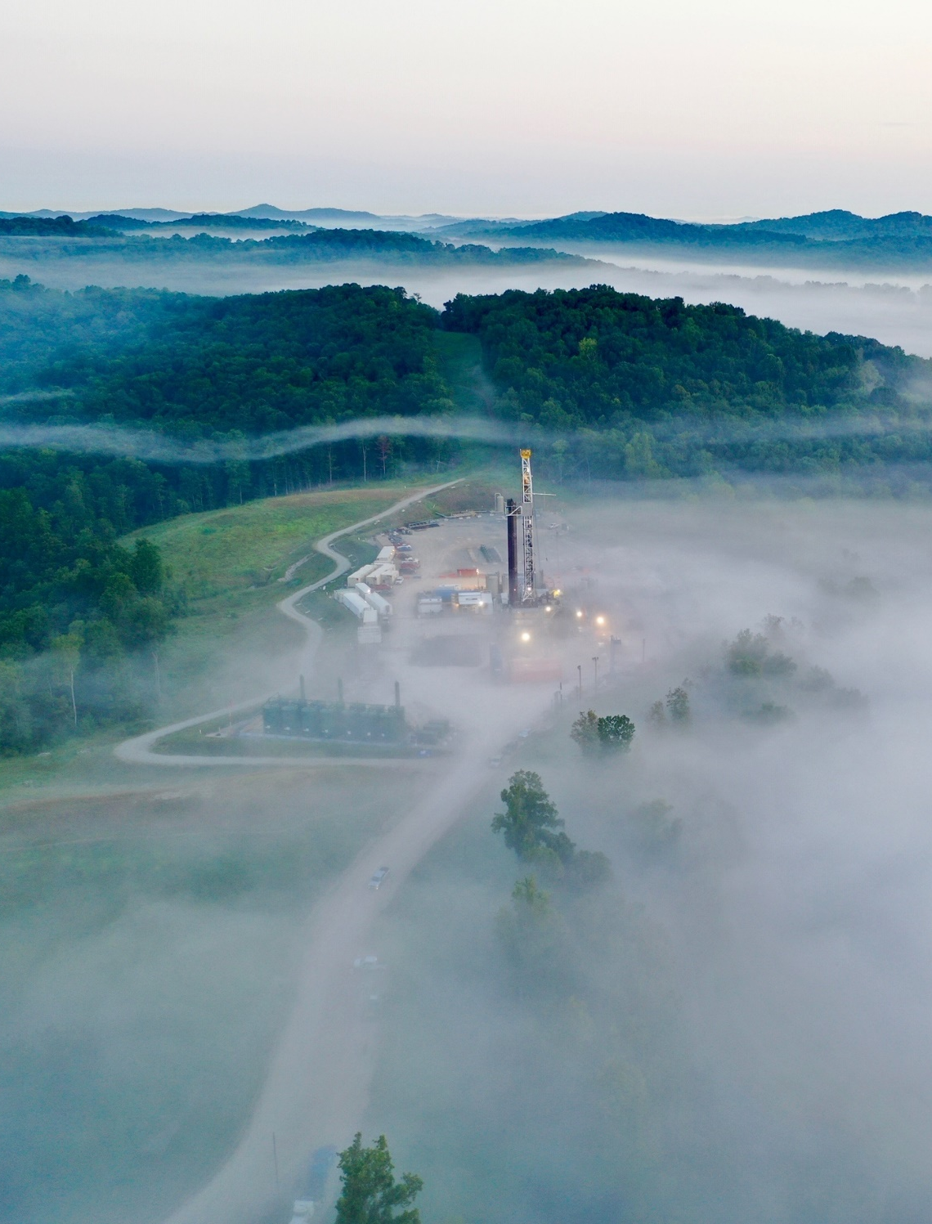

Jon McEvers
VP Completions
American Association of Drilling Engineers Forum
February 10, 2022

Slide 2
Legal Disclaimer
This presentation includes “forward-looking statements.” Such forward-looking statements are subject to a number of risks and uncertainties, many of which are not under AR’s control. All statements, except for statements of historical fact, made in this presentation regarding activities, events or developments AR expects, believes or anticipates will or may occur in the future, such as those regarding expected results, future commodity prices, future production targets, completion of natural gas or natural gas liquids transportation projects, future earnings, future capital spending plans, improved and/or increasing capital efficiency, continued utilization of existing infrastructure, gas marketability, estimated realized natural gas, natural gas liquids and oil prices, acreage quality, access to multiple gas markets, expected drilling and development plans (including the number, type, lateral length and location of wells to be drilled, the number and type of drilling rigs and the number of wells per pad), projected well costs and cost savings initiatives, future financial position, future technical improvements, future marketing and asset monetization opportunities, the amount and timing of any contingent payments, the participation level of our drilling partner and the financial and operational results to be achieved as a result of the drilling partnership, estimated Free Cash Flow and the key assumptions underlying its projection and AR’s environmental goals are forward-looking statements within the meaning of Section 27A of the Securities Act of 1933 and Section 21E of the Securities Exchange Act of 1934. All forward-looking statements speak only as of the date of this presentation. Although AR believes that the plans, intentions and expectations reflected in or suggested by the forward-looking statements are reasonable, there is no assurance that these plans, intentions or expectations will be achieved. Therefore, actual outcomes and results could materially differ from what is expressed, implied or forecast in such statements. Except as required by law, AR expressly disclaims any obligation to and does not intend to publicly update or revise any forward-looking statements.
In addition, many of the standards and metrics used in preparing this presentation and the ESG Report continue to evolve and are based on management expectations and assumptions believed to be reasonable at the time of preparation but should not be considered guarantees. The standards and metrics used, and the expectations and assumptions they are based on, have not been verified by any third party. In addition, while we seek to align these disclosures with the recommendations of various third-party frameworks, such as the Task Force on Climate-Related Financial Disclosures ("TCFD"), we cannot guarantee strict adherence to these framework recommendations. Additionally, our disclosures based on these frameworks may change due to revisions in framework requirements, availability of information, changes in our business or applicable governmental policy, or other factors, some of which may be beyond our control. The calculation of methane leak loss rate disclosed in this release conforms with ONE Future protocol, which is based on the EPA Greenhouse Gas Reporting Program. With respect to its Scope 1 emissions goal, Antero Resources anticipates achieving Net Zero Scope 1 emissions by 2025 through operational efficiencies and the purchase of carbon offsets.
AR cautions you that these forward-looking statements are subject to all of the risks and uncertainties incident to the exploration for and the development, production, gathering and sale of natural gas, NGLs and oil, most of which are difficult to predict and many of which are beyond AR’s control. These risks include, but are not limited to, commodity price volatility, inflation, lack of availability of drilling and production equipment and services, environmental risks, drilling and other operating risks, regulatory changes, the uncertainty inherent in estimating natural gas and oil reserves and in projecting future rates of production, cash flow and access to capital, the timing of development expenditures, impacts of world health events, including the COVID-19 pandemic, cybersecurity risks and the other risks described under the heading "Item 1A. Risk Factors" in AR’s Annual Report on Form 10-K for the year ended December 31, 2020.
Any forward looking statement speaks only as of the date on which such statement is made and AR undertakes no obligation to correct or update any forward looking statement whether as a result of new information, future events or otherwise, except as required by applicable law.
This presentation and the ESG Report contain statements based on hypothetical or severely adverse scenarios and assumptions, and these statements should not necessarily be viewed as being representative of current or actual risk or forecasts of expected risk. These scenarios cannot account for the entire realm of possible risks and have been selected based on what we believe to be a reasonable range of possible circumstances based on information currently available to us and the reasonableness of assumptions inherent in certain scenarios; however, our selection of scenarios may change over time as circumstances change. While future events discussed in this presentation or the report may be significant, any significance should not be read as necessarily rising to the level of materiality of certain disclosures included in Antero Resources' SEC filings
This presentation also includes (i) Free Cash Flow, (ii) Adjusted EBITDAX, (iii) Net Debt and (iv) leverage which are a financial measures that are not calculated in accordance with U.S. generally accepted accounting principles (“GAAP”). Please see “Antero Non-GAAP Measures” for definitions of these measures as well as certain additional information regarding these measures.
Antero Resources Corporation is denoted as “AR” in the presentation and Antero Midstream Corporation is denoted
as “AM”, which are their respective New York Stock Exchange ticker symbols.
Antero Resources | May 2019 Presentation

Slide 3

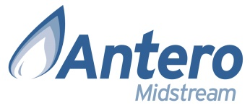

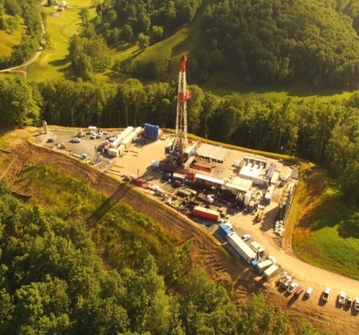
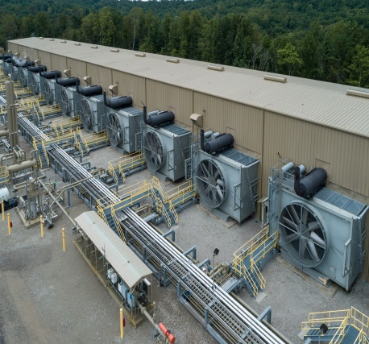
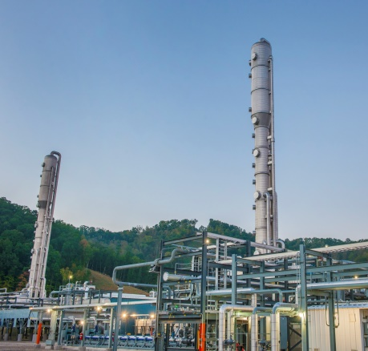
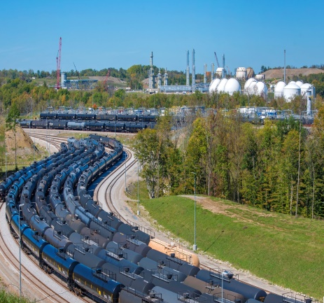
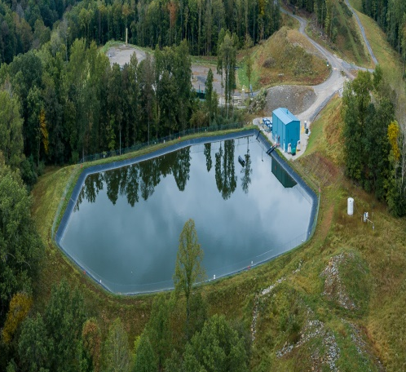
Antero Family Today
50/50 JV
Exploration & Production
Gathering & Compression
Natural Gas Processing
C3+ NGL Fractionation
Water Delivery & Blending

Slide 4

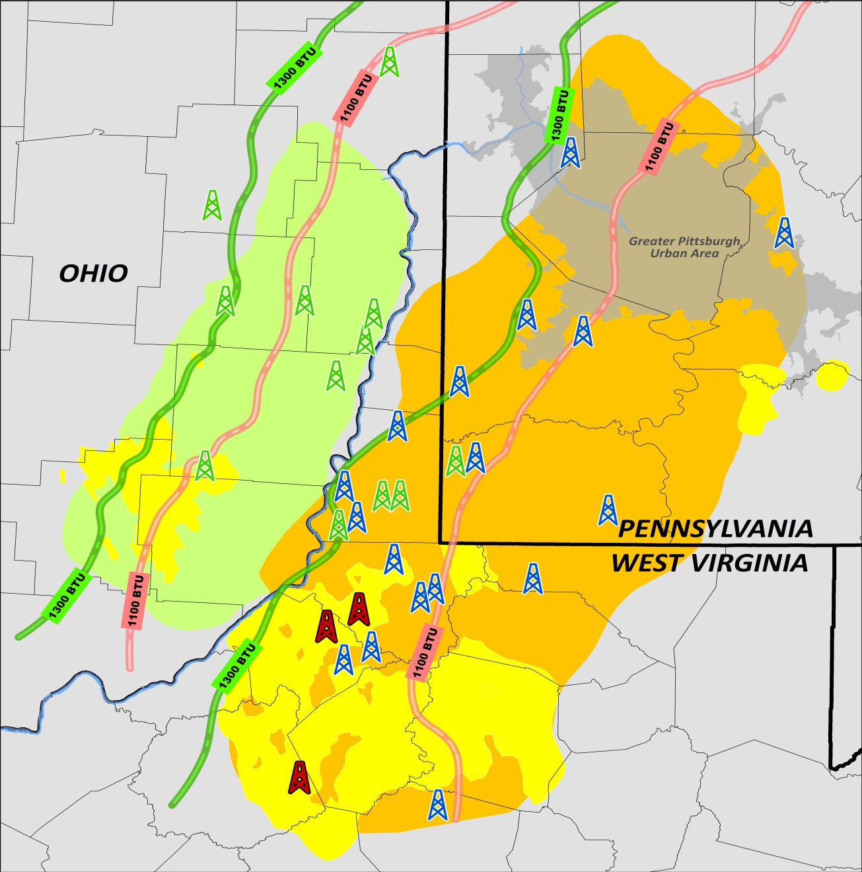


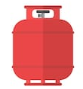


Antero Resources Snapshot
Denver, CO
HEADQUARTERS
Antero Resources Acreage Map
$8.7 B
ENTERPRISE VALUE ⁽¹⁾
Antero Marcellus Rig
Industry Marcellus Rig
Industry Utica Rig
Antero Acreage
5th Largest
U.S. GAS PRODUCER ⁽²⁾
SW Marcellus Core
Ohio Utica Core
2nd Largest
U.S. NGL PRODUCER ⁽²⁾
Own 38%
OF CORE LIQUIDS-RICH UNDRILLED LOCATIONS IN APPALACHIA⁽³⁾
~950
ADDITIONAL DRY GAS LOCATIONS IN DRILLING INVENTORY ⁽³⁾
$900 MM+
Forecast Free Cash Flow in 2021 ⁽⁴⁾
⁾
Core Liquids-Rich Appalachian
Undrilled Locations⁽³⁾
29% Midstream
AM VALUE HELD BY AR $1.4 B
Note: Rigs on map as of 2/4/22, per Rig data. AM value based on 2/4/22 share price.
AR share price as of 2/4/2022 and indebtedness as of 9/30/2021.
Natural gas and NGL rankings based on 3Q21 reported production.
AR drilling inventory as of 12/31/2020. Industry location count based on Antero technical analysis of undeveloped acreage in the core of the Marcellus and Ohio Utica Shales.
Free Cash Flow is a Non-GAAP metric. Please see appendix for additional disclosures, definitions, and assumptions.

Slide 5
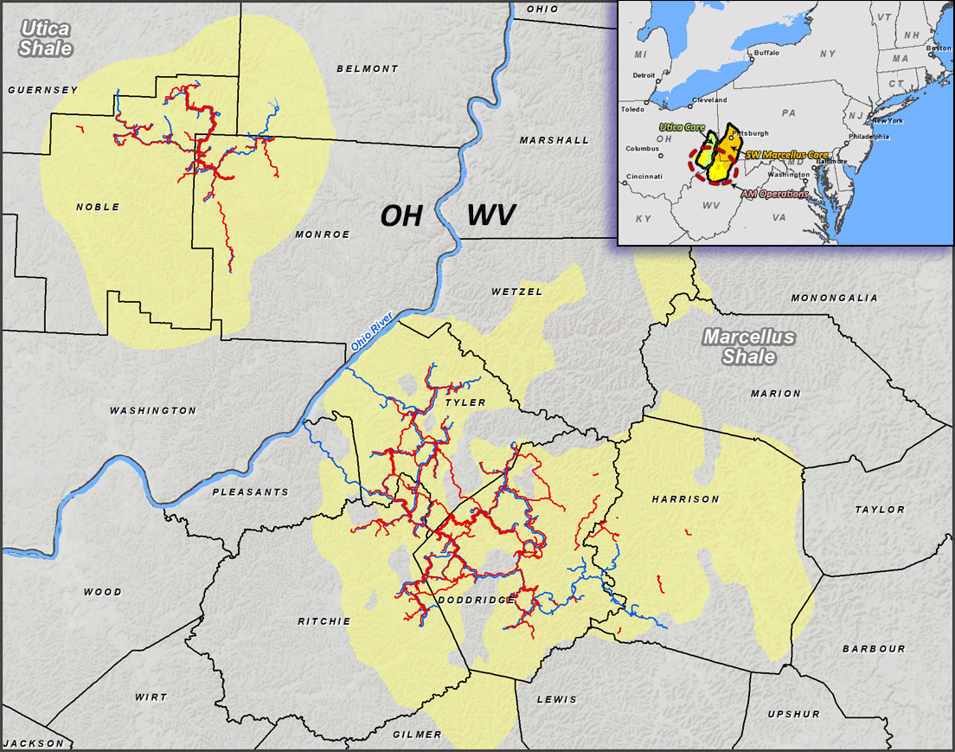
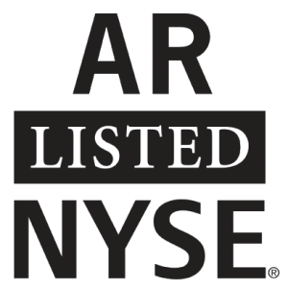





Antero Midstream Corporation at a Glance
Denver, CO
HEADQUARTERS
Antero Midstream Asset Map
S&P 400
CONSTITUENT
$8.2 Bn
ENTERPRISE VALUE ⁽¹⁾
14% ROIC
AVERAGE FROM 2015-2020
3.2 Bcf/d
COMPRESSION CAPACITY ⁽²⁾
90% UTILIZATION RATE IN 2020
Sherwood and Smithburg Processing Facilities
Water Withdrawals
AM Compressor Station
AM Gathering Pipelines
Water Pipelines
468 Miles
OF PIPELINES ⁽²⁾
Adjusted EBITDA Mix (2021)⁽³⁾
Fresh Water Delivery & Wastewater Handling
Gathering,
Compression and Processing
1.6 Bcf/d
JV PROCESSING CAPACITY ⁽²⁾
96% UTILIZATION RATE IN 3Q21
Fixed Fee
AM market value as of 2/4/2021 and balance sheet as of 9/30/2021.
Pipeline mileage as of 12/31/2020 and 50/50 MPLX JV processing capacity as of 11/1/2021.
Adjusted EBITDA and ROIC are Non-GAAP financial measures. Please see appendix for more information.

Slide 6
Antero Strategy Evolution
Antero’s business strategy has evolved to match the U.S. shale industry life cycle
AR Net Production (Right Axis) & Capital Investment (Left Axis)
($MMs)
We are
here
(MMcfe/d)
⁽¹⁾
Shale 1.0
Shale 2.0
Shale 3.0
Acquire acreage
Support infrastructure through long-term commitments
Delineate resource
Grow production
Aggressively hedge
Consolidate acreage
Innovate through drilling and completion techniques
Access low cost capital
Maintain production
Generate Free Cash Flow
Reduce debt & commitments
Sustain low leverage
Maintain commodity exposure
Optimize FT
Return capital
Prioritize ESG
Represents drilling and completion + leasehold capital expenditures.
Growth
Mature
Emerging

Slide 7
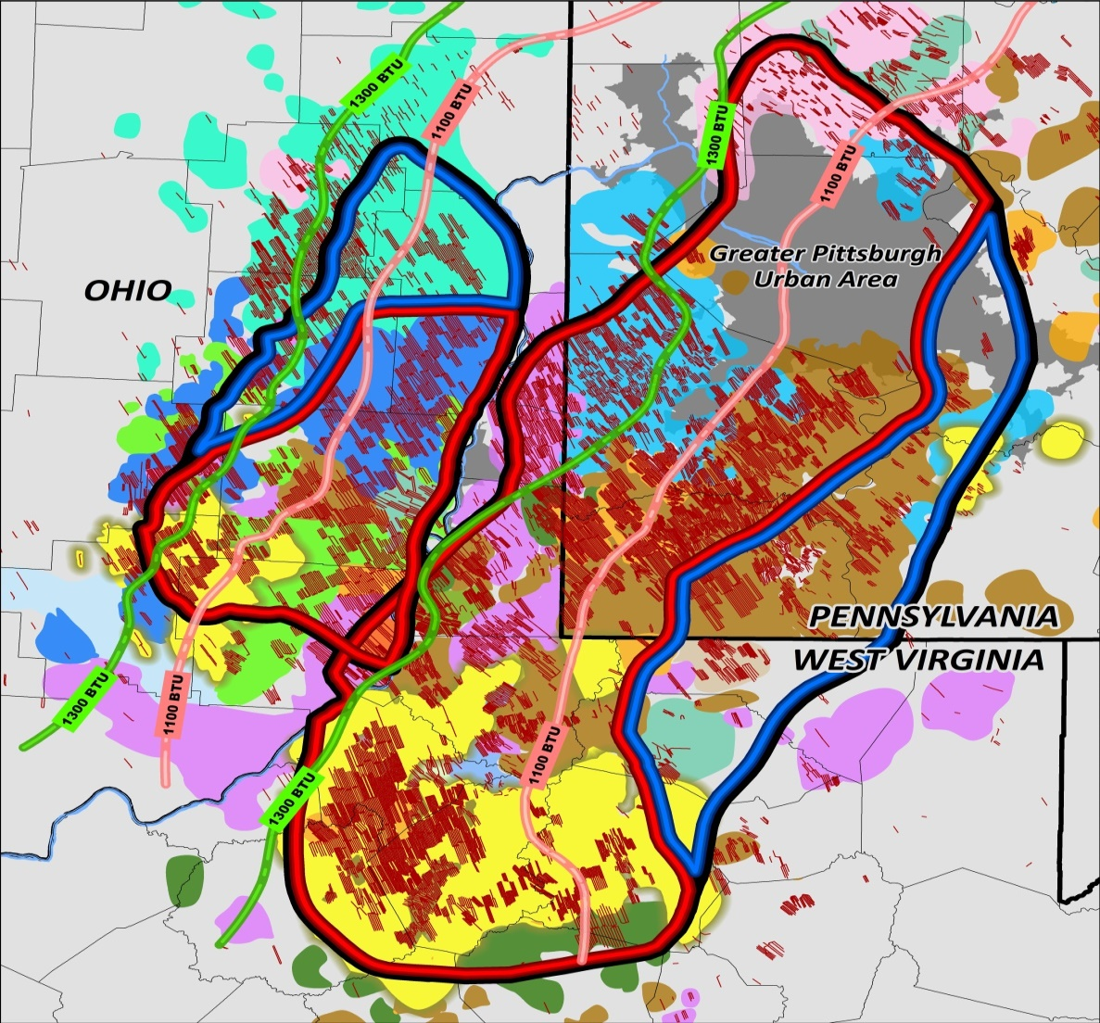
Peer Leading Premium Core Drilling Inventory
  Antero’s technical and management teams have performed an extensive update on acreage positions, undrilled locations, well performance and EURs across the basin
  Led to division of the SW Marcellus and Ohio Utica into Premium Core and Tier 2 Core acres
Premium Core Marcellus Inventory:
~5,200 undeveloped locations
AR holds ~1,865 locations, or 36%
Premium Core Utica Inventory:
~1,100 undeveloped locations
AR holds ~210 locations, or 19%
SW Appalachia Core
Utica Core
Tier 2
Premium Liquids-Rich
Core Undrilled Locations
Premium
Premium
Antero
Ascent
Tier 2
Encino
CNX
EQT
Exxon
Gulfport
Tier 2 Core Marcellus Inventory:
~1,600 undeveloped locations
AR holds ~150 locations, or 9%
HG
SW Marcellus Core
SWN
PennEnergy
Range
Antero Leasehold & Minerals
Drilled Wells
Notes: AR drilling inventory as of 12/31/2020. Industry location count based on Antero technical analysis of undeveloped acreage in the core of the Marcellus and Ohio Utica Shales.

Slide 8
Diversity of Product & Destination
Antero’s liquids-rich strategy and diversified firm transportation portfolio allows it to capture commodity price upside both domestically and internationally
Leader in Liquids Production
and Realized Pricing
Leader in Premium Natural Gas Takeaway and Realized Pricing ⁽²⁾
Liquids Production (MBbl/d) ⁽¹⁾
Percent Sold Out of Basin
AR leaves ~150 MBbl/d of incremental ethane in the gas stream
C2+ NGL Price as % of WTI ⁽¹⁾
Price Differential to NYMEX ⁽³⁾
Source: Company presentation and filings.
Represents YTD 2021 results as of 9/30/2021. Liquids production includes C2+ NGLs and oil.
Based on company disclosure of firm transportation commitments.
Represents YTD 2021 results as of 9/30/2021. AR price differential excludes $0.13/Mcf positive impact from 1Q21 WGL settlement.

Slide 9
Drilling and Completions Progress
Lateral Length per Well
Lateral Feet Drilled per Day
U.S.
Record
Completed Lateral Feet per Day
Drill Out Feet per Day
Notes:
Average lateral length per well represents average drilled lateral length.

Slide 10
Drilling Efficiency Gains Continued in 2021
  2021 Drilling Yielded Improvement Across Most Key Record Categories
Phase | Measure | Prior Record | 2021 YTD Record | % Change vs. Prior
Drilling | 10,000+ foot lateral drilling days YTD – Marcellus | 5 | 11 | +120%
  250’ Stage Lengths and SimulFrac Pilots Drove Completions Performance
Completions | Average completed stages per day YTD – Marcellus* | 8.1 | 9.5 | +17%
 | Average completed stages per day YTD – Utica | 5.3 | 8.2 | +55%
 | Record pad average stages per day – Marcellus* | 9.6 | 10.8 | +12%
Drill Out | Average drill out feet per day YTD - Marcellus | 3,771’ | 4,120’ | +10%
 | Longest one trip drill out - Marcellus | 16,321’ | 18,998’ | +16%
*Normalized to account for 250’ stages

Slide 11
Replaced 50% of AR Top 20 Marcellus Records YTD
80% of top 20 Marcellus drilling days greater than 10,000’
Highlights
H&P 317 drilled 10,000’ in 24 hours on three consecutive wells in 3Q
H&P 519 drilled 11,000’ in 24 hours on three consecutive wells in 2Q

Slide 12
Every Utica Lateral YTD Surpassed 2018 Record Footage
Early 2021 lessons translate to continued performance gains
Keys to Success - Utica
Improved mud system
Better use of managed pressure drilling system

Slide 13





ESG Momentum Continues
Antero’s peer-leading ESG ranking reflects the internal efforts
to prioritize ESG performance and disclosures
2025 Goals Progress
World Bank Zero Routine Flaring Initiative ⁽¹⁾:
Commitment to no routine flaring in 2021
MSCI UPGRADE
(August 2021):
BBB ESG Rating
2020 ESG Report (October 2021):
Report is expected to drive further ratings upside
Project Canary (July 2021):
Announced Pilot to Pursue Responsibly sourced gas certification
Antero has not flared produced natural gas since the infancy of the Marcellus and Utica shale projects in West Virginia and Ohio.

Slide 14


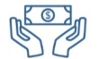


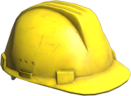
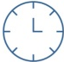
Social Responsibility and Safety
  Exported approximately 60,000 Bbls/d of LPG in 2020, including approximately one-third to developing nations
  Paid approximately $375 million in lease and royalty payments to Ohio and West Virginia land owners
  Generated and paid property and severance taxes of $112 million in Ohio and West Virginia
  Invested $26 million on community road improvements
  Antero Foundation contributed over $682,000 in direct community donations in 2020
  Reduced Total Recordable Incident Rate (TRIR) by 35% from 2016 to 2020 Reduced Lost Time Incident Rate (LTIR) by 68% from 2016 to 2020
LPG Export by Destination
Community Relations Inquiries
Tickets Created: 3,006
98%
RESOLUTION
RATE
Other
Developing
Nations
Tickets Closed: 2,959

