Slide 1
Commodity Update
January 13, 2022

Slide 2
Disclaimer
This presentation is intended for educational purposes only and does not replace independent professional judgment. Statements and opinions expressed are those of the presenter and do not represent the opinion of Schneider Downs.

Slide 3
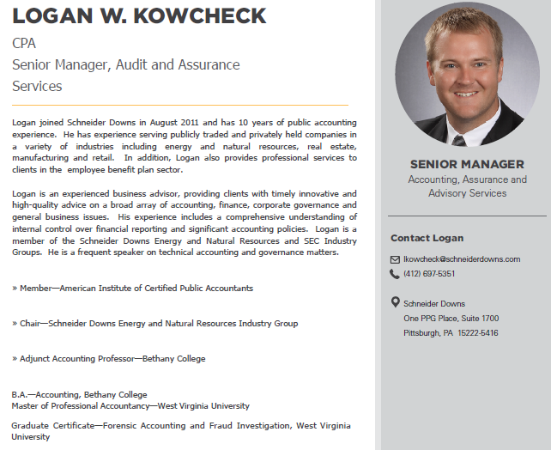
Bio

Slide 4
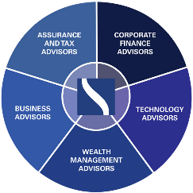



Schneider Downs Firm Profile
SCHNEIDER DOWNS
GROUP OF COMPANIES
Headquartered in Pittsburgh, Schneider Downs’ dominant position in the industry and region is evidenced by our ranking among the 60 largest accounting and advisory firms in the U.S.
Largest locally owned and managed public accounting firm, with offices in Pittsburgh, Columbus and Washington DC.
Comprised of five business units, including assurance and tax, corporate finance, technology, wealth management and business advisory, providing more than 80 unique service offerings.
Nearly 500 employees
Serving clients throughout Pennsylvania, Ohio, West Virginia, Virginia, Maryland, Colorado and Texas, as well as nationally and internationally.
Serving clients in the oil and gas industry including upstream, midstream, downstream, oilfield services, power and utilities and renewables.
Across energy segments, our practice areas include traditional audit and tax, complex financial reporting, disputes and litigations, enterprise risk, investment banking, outsourcing, process and technology, restructuring, strategy and organizational design, and due diligence and valuation.
SCHNEIDER DOWNS’ AWARDS
Recipient of ClearlyRated’s Best of Accounting™ Award for providing superior service to our clients
Recognized by Inside Public Accounting in receiving a Top 100 Firms Award

Slide 5
Oil & Gas Update
Key Trends
Production and Pricing Outlook
Drilling Activity

Slide 6
Key Trends
COVID-19 and Uncertainty
Commodity Price Lookback
Throughout 2021, oil demand rebounded from the 2020 price devastation caused by COVID-19
OPEC+ oil supply cuts have been maintained through 2021 and are expected to continue into 2022
Natural gas prices rallied in 2021 as market fundamentals tightened on strong demand and unexpected supply bottlenecks.
Current Condition
Price increases bailed out the industry
Strong performance of energy companys’ Q3’21 operating results
Oil- $75.99/BBL
Natural Gas- $3.76/mmbtu
Oil storage numbers are still high
Drilling and production remained flat in 2021
U.S. producers are showing financial discipline
Industry is in “DUC” mode
LNG export facilities
Notes:
COVID-19
The energy sector remains subject to heightened levels of uncertainty related to the ongoing recovery from the COVID-19 pandemic most notably the emergence of the Omicron variant which raises uncertainty about the level of energy consumption throughout the world. Close to 50% of the world’s population has received at least one dose of the COVID-19 vaccine.
Natural Gas Prices
Gas year 2021/22 opened 10/1 with record high spot prices and lower than avg storage inventory levels for the upcoming heating season. The tightening of gas markets over the past month results from a combination of demand growth as economies recover from 2020 lockdowns, a succession of extreme weather episodes that have generated additional gas consumption.

Slide 7
Key Trends (Continued)
2022 Opportunities and Focus
  “Free cash flow”
  ROI
  Strategic drilling
  Attract, train and retain employees
  Environmental, Social and Governance (ESG) requirements
  Rising energy prices help energy transition plan
  ESG playing a role in M&A transactions
  Oilfield services business models shifting to enable a new energy era
Notes:
Heading into 2022, free cash flow, along with liquidity, will be the most important factors. Hedge positions at higher pricing will be heavily relied upon, either to stabilize cash flows or provide liquidity by monetization. I think there will be a more disciplined approach to operating cost and development expenditure plans to the extent that they don’t lose their best leases as well as continued pressure on G&A reductions to reduce overhead.
High oil prices boost energy transition plans, challenging conventional wisdom
With the expectation that these higher prices are here to say, that helps companies manage cash flow from those high-quality assets and companies feel they can continue to make money even during a pivot toward cleaner forms of energy which have typically shown lower returns.
ESG playing a role in M&A transactions
Oil prices have been rising since the start of 2021, bolstered by recovering demand and capped supply from OPEC.9 However, upstream M&A activity, which typically follows oil prices, remains well below prepandemic levels. The total count and value of US upstream deals during the first eight months of 2021 were 30% and 46%, respectively, down from the same period in 2019.10 While the ongoing capital discipline of O&G companies is the primary reason behind the lull in upstream M&A activity, limited visibility of buyers (especially large companies) into the carbon profile of sellers or their assets is a growing factor.
Oilfield services business models shifting to enable a new energy era
The oilfield service (OFS) sector had slashed costs and optimized operations to stay afloat even before the pandemic. Being traditionally dependent on upstream cycles, the sector is now likely to see a permanent structural shift as rapid energy transition shifts the scales of O&G revenues and spending. Not surprisingly, spending in OFS, which declined during the pandemic, is expected to remain about 25% below 2019 levels until 2025.15 With margins at the mercy of another price cycle and reduced spending, many OFS companies are crafting a new strategy for the future of energy. About 30% of executives surveyed believe that building capabilities in adjacent areas such as hydrogen and carbon capture usage and storage will help them thrive the most in the future.18 Suppliers already have an advantage in leveraging subsurface and reservoir geology expertise and applying it to new emission abatement techniques like carbon capture, usage and storage.

Slide 8
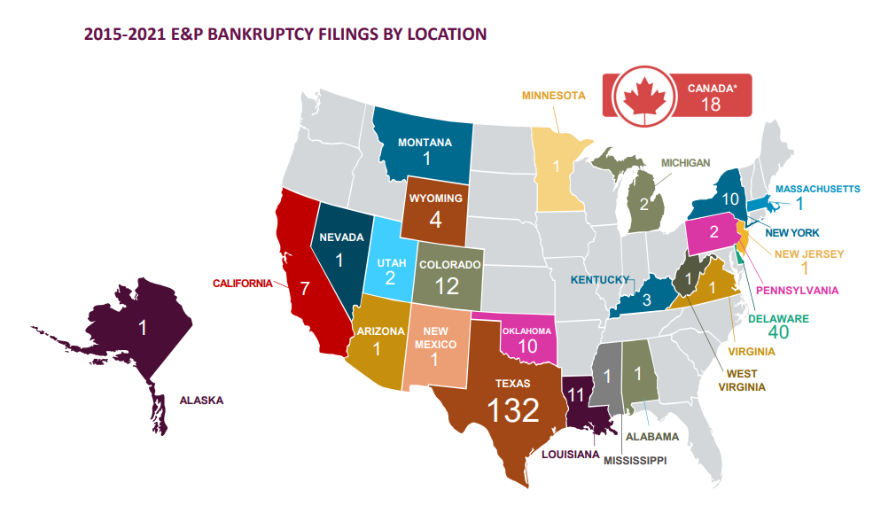
Key Trends (Continued)
2015-2021 Bankruptcy Filings by Location
Notes:
Key Takeaways for Q1-Q2 2021
12 producers filed in Q1-Q2 2021, which is the lowest Q1-Q2 total since 2015 when 13 producers filed.
The aggregate debt for producers that filed in Q1-Q2 2021 is just over $1.8 billion, which is the lowest since 2015 of $3.6 billion
There were no producers with billion dollar bankruptcies in Q2 2021, which has not happened since Q3’2018
Texas accounted for 58% of the total producer filings in 2021, with seven in total
Restructurings
Over the last handful of years, there have been a significant number of restructurings that have occurred which has been making a significant difference. We have seen a lot of over extended operators go through the restructuring process to reduce pressure on the balance sheets.
Financially distressed firms
There still remain a lot of financially distressed firms in the United States. Occidental petroleum’s acquisition of Anadarko petroleum
Seeing a lot of selling off of non-core assets to pay debt obligations or increase “free cash flow” for future drilling

Slide 9
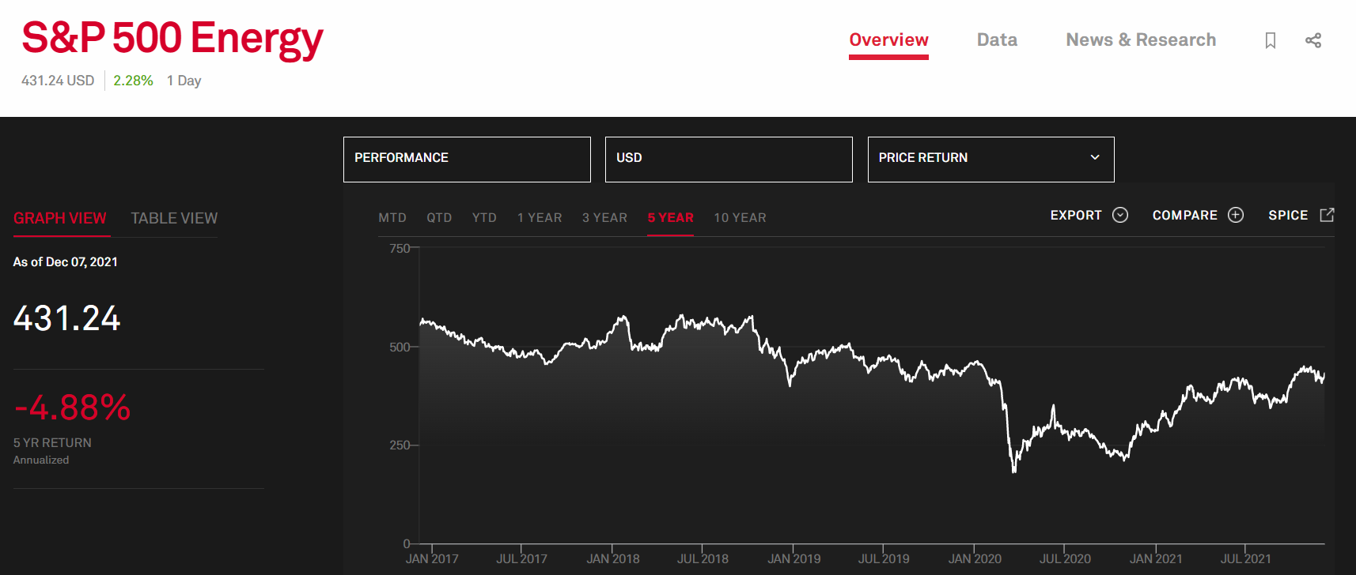
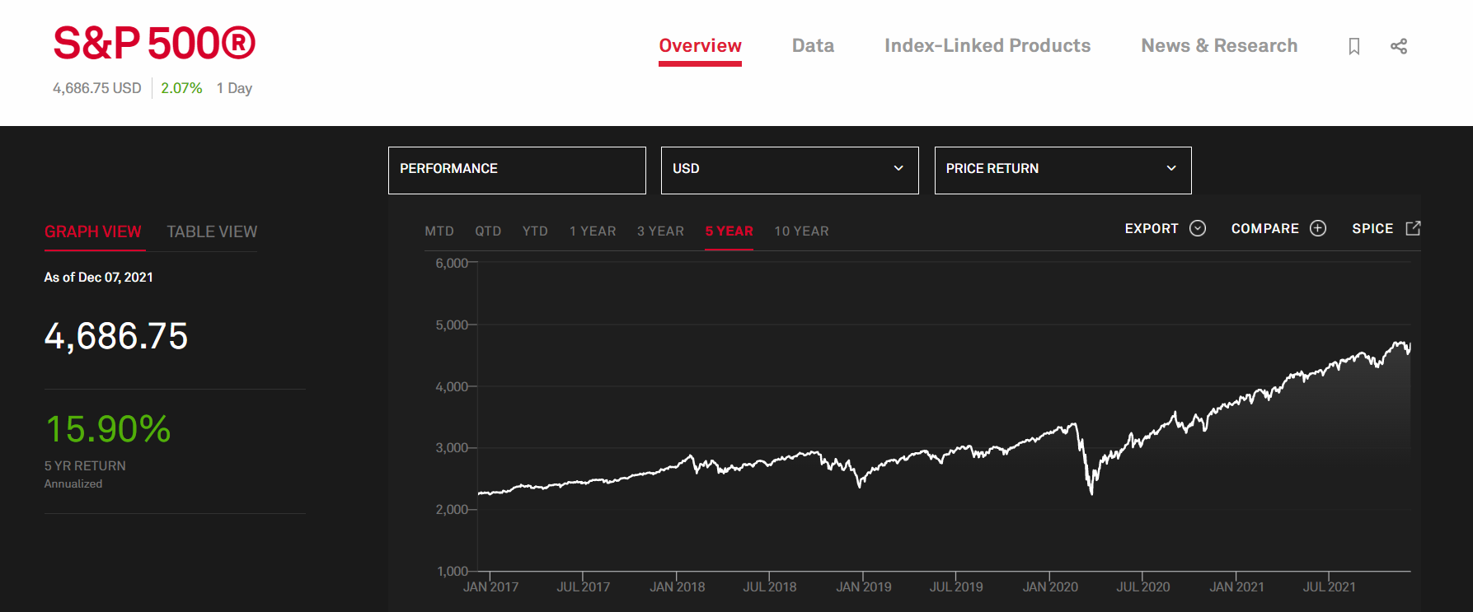
Key Trends- Capital Markets

Slide 10
Oil and Gasoline

Slide 11
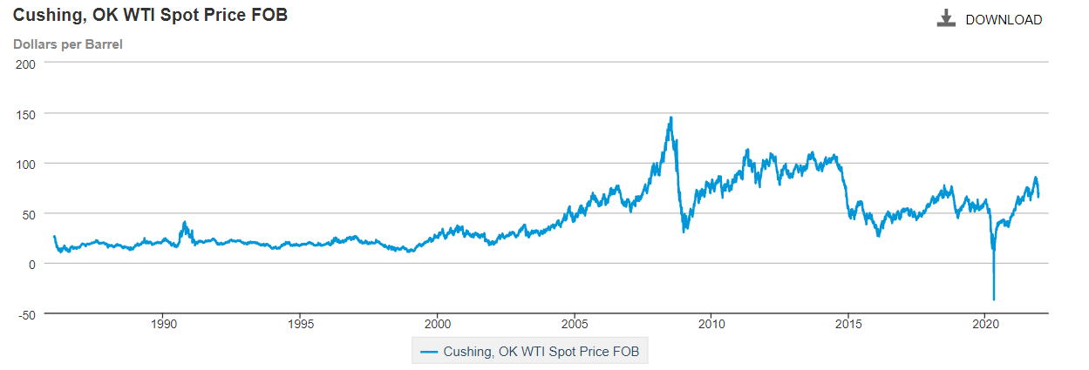
Oil Prices
Notes:
Crude oil spot prices averaged $70.61/bbl in Q3’21 up from $40.89/bbl in Q3’20.

Slide 12
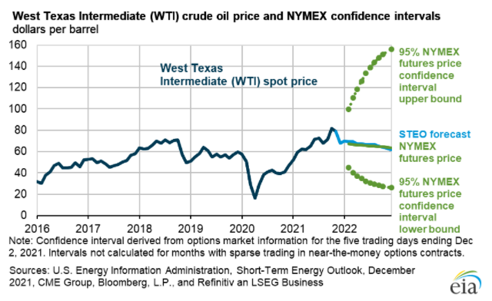
Oil Prices (Continued)
Notes:
There is a 95% confidence interval that the price of crude/bbl will be between $30-$150.
spot prices avg’d $81/bbl in November, a $3/bbl decrease from October 2021 but a $38/bbl increase from November 2020.
Crude prices are expected to average $71/bbl in the first quarter of 2022. For 2022 as a whole, the EIA expects that growth in production from OPEC+, of US tight oil and from other non-OPEC countries will outpace slowing rowth in global oil consumption, especially in light of renewed concerns about COVID-19 variants. Crude prices will remain near current levels in 2022 averaging approx. $70/bbl.
I personally think that the prices will remain in the “goldie locks” zone of $60-$80/bbl where it is profitable for companies to operate and continue to plan strategic drilling plans.

Slide 13
Oil Prices – NYMEX Futures Closing Prices
Month | Price
Feb-22 | $ 82.450
Mar-22 | $ 81.740
Apr-22 | $ 80.890
May-22 | $ 79.820
Jun-22 | $ 78.980
Jul-22 | $ 78.500
Aug-22 | $ 77.370
Sep-22 | $ 76.340
Oct-22 | $ 75.610
Nov-22 | $ 74.920
Dec-22 | $ 74.830

Slide 14
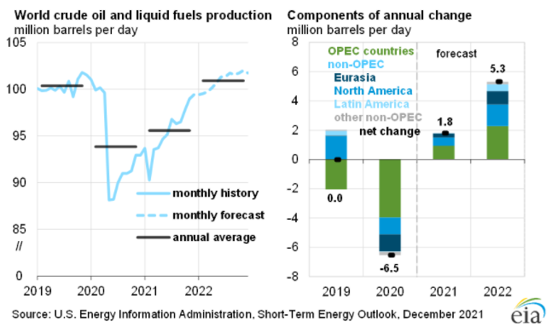
World Crude Oil Production
Notes:
An estimate of 99.7 million b/d of petroleum and liquid fuels was consumed globally in November, a 4.9 million b/d increase from November 2020 but 1.1 million b/d less than in November 2019. Q1’22 forecasted consumption is now expected to be less than originally anticipated due to the new travel restrictions due to the Omicron variant of COVID-19. The potential effects of the spread of this variant are uncertain which introduces downside risks to the global oil consumption forecast, particularly for jet fuel. We forecast that global consumption of petroleum and liquid fuels will increase by 3.5 million b/d in 2022 to average 100.5 million b/d.

Slide 15
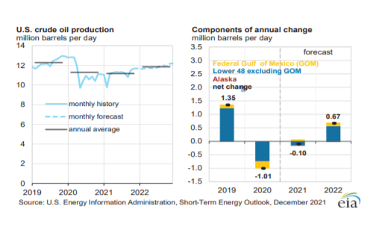
U.S. Crude Oil Production

Slide 16
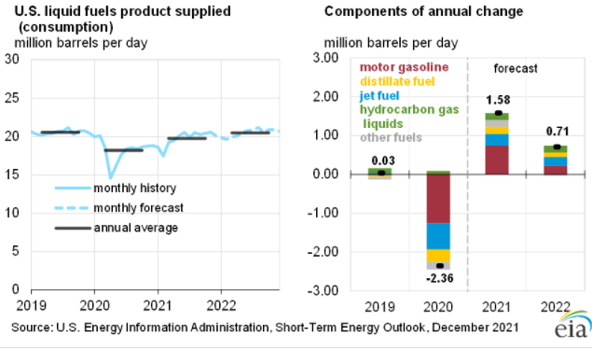
U.S. Crude Oil Consumption
Notes:
U.S. regular gasoline retail prices averaged $3.39 per gallon (gal) in November, a 10 cents/gal increase from October and $1.29/gal higher than in November 2020. The November monthly average was the highest since September 2014. We forecast that retail gasoline prices will average $3.13/gal in December before falling to $3.01/gal in January and $2.88/gal on average in 2022.
Total U.S. crude oil production was an estimated 11.7 million b/d in November. We forecast that it will rise to an average of 11.8 million b/d in 2022 and to an average of 12.1 million b/d in 4Q22.

Slide 17
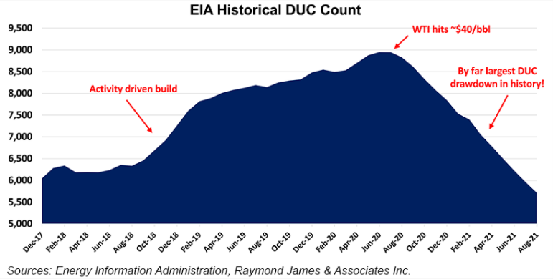
Drawing Down Ducs
Notes:
U.S. exploration and production (E&P) companies are completing wells at record rates, outpacing new wells by nearly 250 a month, according to Raymond James & Associates Inc.
Analyst John Freeman in a note to clients Monday said the domestic count of drilled but uncompleted wells, aka DUCs, has dropped by nearly 3,300 from nearly 9,000 strong in July 2020.
In the “largest (and quickest) drawdown to date,” the current DUC inventory is crossing the critical “normal level,” Freeman said. “Over the last year, completions have outpaced new drills by nearly 250 wells/month, an unsustainable delta of which has never occurred.”
E&Ps since July 2020 have maintained production levels mostly “by tapping their vast supply of DUCs, opting to forego costlier new drills in favor of cheaper completions.”

Slide 18
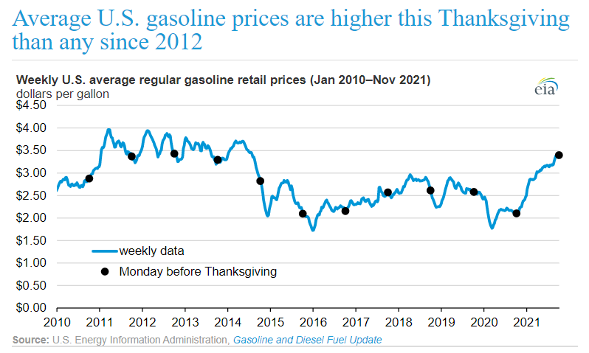
Gasoline Prices
Notes:
The average price that consumers paid at the pump for U.S. regular gasoline on the Monday before Thanksgiving this year was $3.40 per gallon (gal). This price is $1.29/gal (62%) higher than last year and is the highest pre-Thanksgiving price since 2012 (in nominal terms), according to our latest Gasoline and Diesel Fuel Update. U.S. gasoline prices are 82 cents/gal (32%) higher than at the same time in 2019, before the COVID-19 pandemic. October 2021 had the largest recorded year-over-year increase in gasoline prices, at $1.13/gal, since we began collecting gasoline prices in 1990.
Typically, U.S. retail gasoline prices follow a seasonal trend: prices increase in late summer when people drive more frequently and then decline going into the winter months. This year, gasoline prices did not increase in September but instead rose 20 cents/gal in October before leveling off in November. Our November Short-Term Energy Outlook forecasts that gasoline prices will fall 5% in December and remain close to $3.00/gal through the first half of 2022.

Slide 19
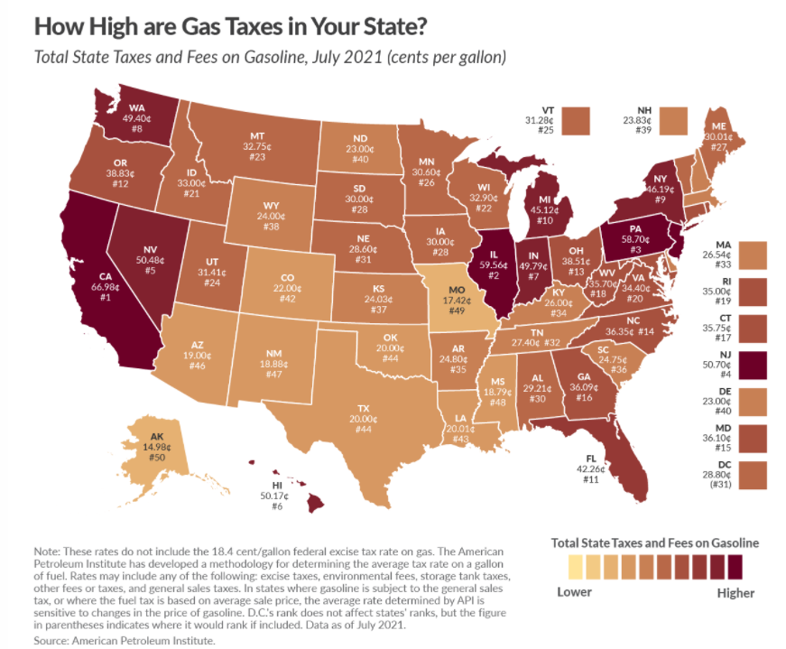
Gasoline Taxes by State

Slide 20
Natural Gas

Slide 21
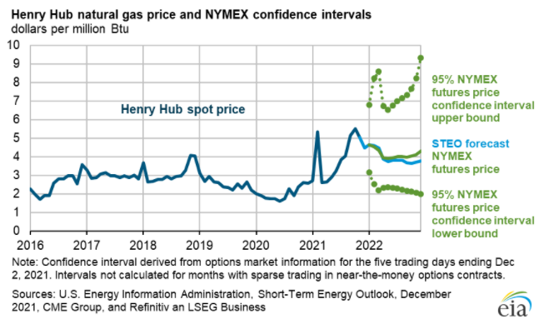
Gas Prices
Notes:
There is a 95% confidence interval that the price/mmbtu will be between $2-$9.
spot prices avg’d $5.05/mmbtu in November, a $.50/mmbtu decrease from October 2021 but a $1.80/mmbtu increase from November 2020.
Henry Hub spot prices averages $4.58/mmbtu from December 2021 through February 2022 and then generally declines through 2022 averaging $3.98/mmbtu in 2022 amid rising US natural gas production and slowing growth in LNG exports. We are expecting the US inventory draws will be similar to the five-year average this winter and we expect that factor, along with rising US natural gas exports and relatively flat production through March will keep US natural gas prices near recent levels before downward price pressures emerge. Because the uncertainty around seasonal demand, we expect natural gas prices to remain volatile over the coming months and winter temperatures will be a key driver of natural gas consumption and prices.

Slide 22
Gas Prices – Natural Gas futures Closing Prices
Month | Price
Feb-22 | $ 4.418
Mar-22 | $ 4.072
Apr-22 | $ 3.967
May-22 | $ 3.974
Jun-22 | $ 4.020
Jul-22 | $ 4.077
Aug-22 | $ 4.084
Sep-22 | $ 4.063
Oct-22 | $ 4.090
Nov-22 | $ 4.167
Dec-22 | $ 4.338
Jan-23 | $ 4.439
Feb-23 | $ 4.314
Mar-23 | $ 3.972
Apr-23 | $ 3.299
May-23 | $ 3.219
Jun-23 | $ 3.248
Jul-23 | $ 3.284
Aug-23 | $ 3.291
Sep-23 | $ 3.276
Oct-23 | $ 3.306
Nov-23 | $ 3.401
Dec-23 | $ 3.591
Jan-24 | $ 3.724
Mar-24 | $ 3.400
Apr-24 | $ 3.021
May-24 | $ 2.933
Jun-24 | $ 2.989
Jul-24 | $ 3.039
Sep-24 | $ 3.042
Oct-24 | $ 3.078
Jan-25 | $ 3.603
Feb-25 | $ 3.534
Apr-25 | $ 2.904

Slide 23
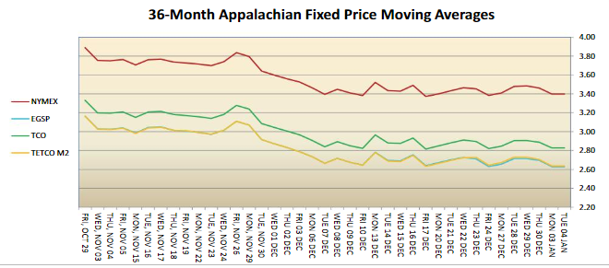
Gas Prices

Slide 24
PA Gas Price Basis Differential (November 2021)

Slide 25
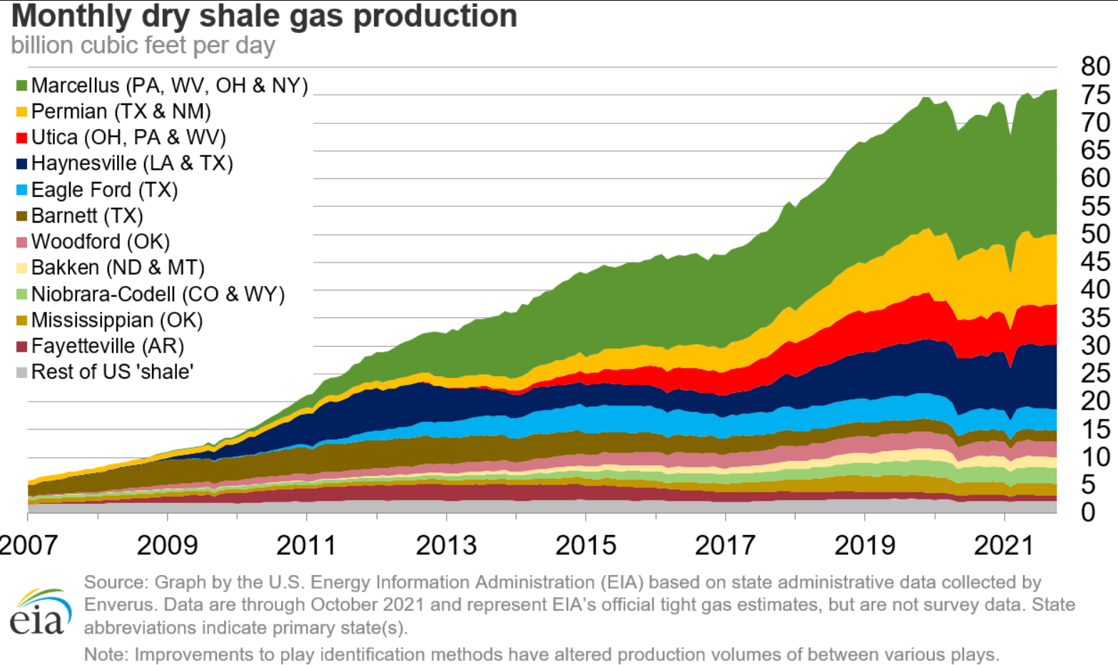
Gas Production

Slide 26
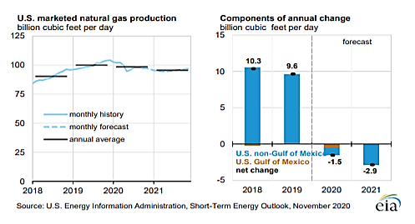
Gas Production (Continued)

Slide 27
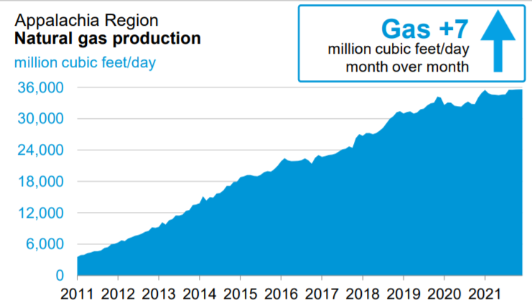
Appalachia Region Production

Slide 28
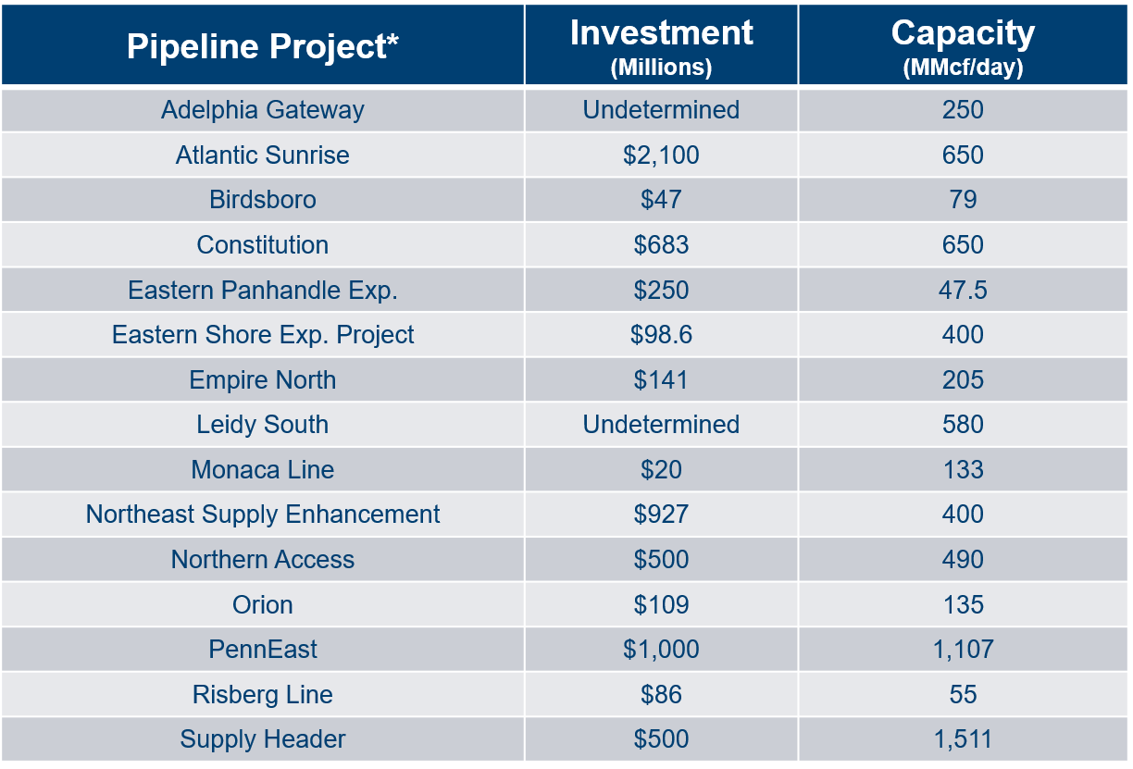
Moving Gas to Market
Notes:
Source: Energy in Depth- Appalachian Basin
*FERC Project- approved or under review

Slide 29
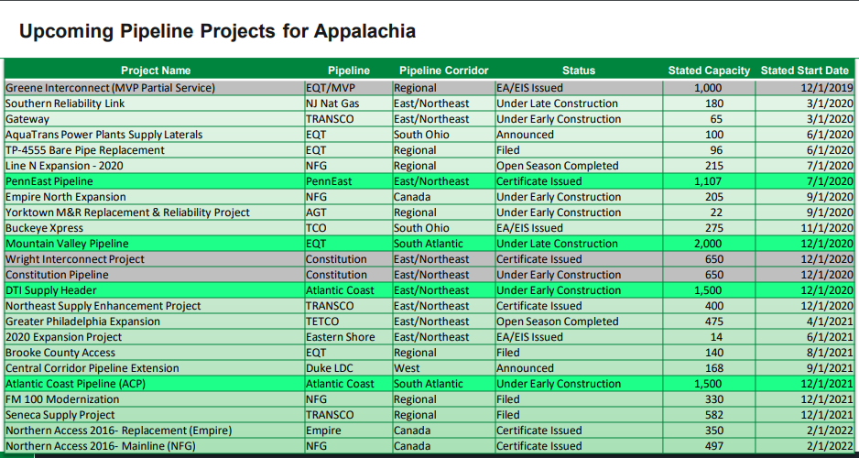
Moving Gas to Market (Continued)

Slide 30
Rig Counts

Slide 31
Pennsylvania Rig Count

Slide 32
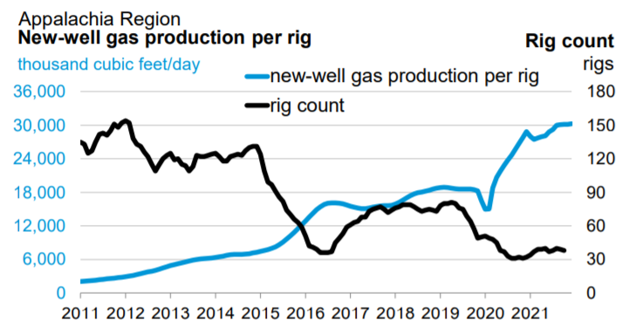
New-Well Gas Production Per Rig

Slide 33
QUESTIONS?

