Slide 1

Geothermal Overview: Drilling Fluids and Performance
Fred Dupriest
Presented at AADE Fluids Management Group
September 21, 2022
Based on SPE 208798 written by Fred Dupriest and Sam Noynaert
Notes:
:50

Slide 2
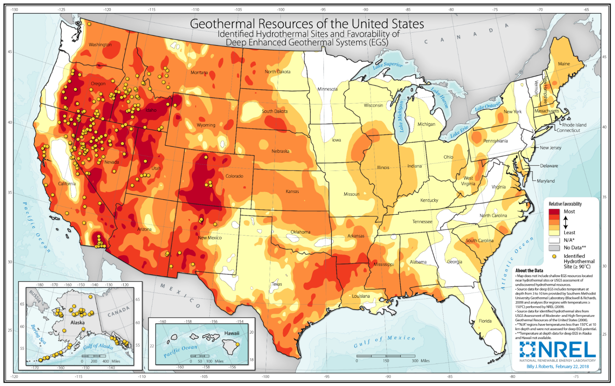

Slide 3
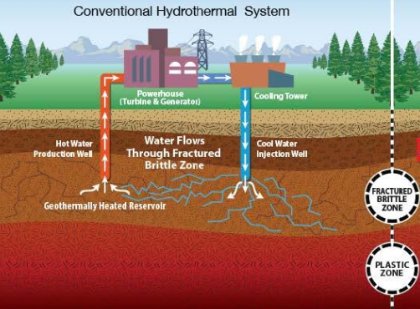
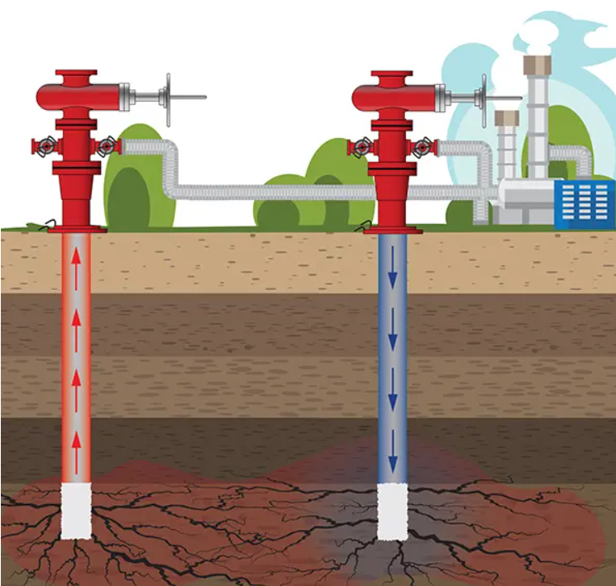
Types of Geothermal
Hydrothermal
Enhanced Geothermal System(RGS)
Wet rock with mobile hot aquifer
Injection, cross flow heating, and production
Natural conductive fractures or permeability
Lost Returns while drilling is a good sign
Dry rock. Water circulation required
Limited or no natural conductivity
Fracture simulation require

Slide 4
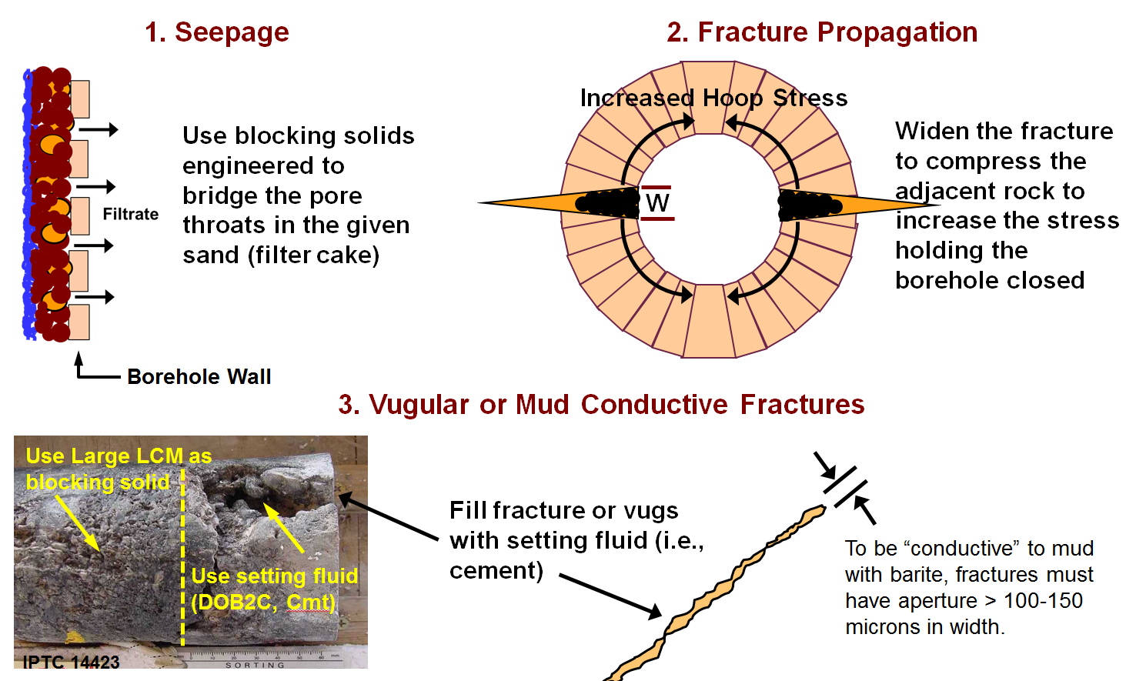
Teach How to Identify the Mechanism: Treat specifically for that mechanism

Slide 5
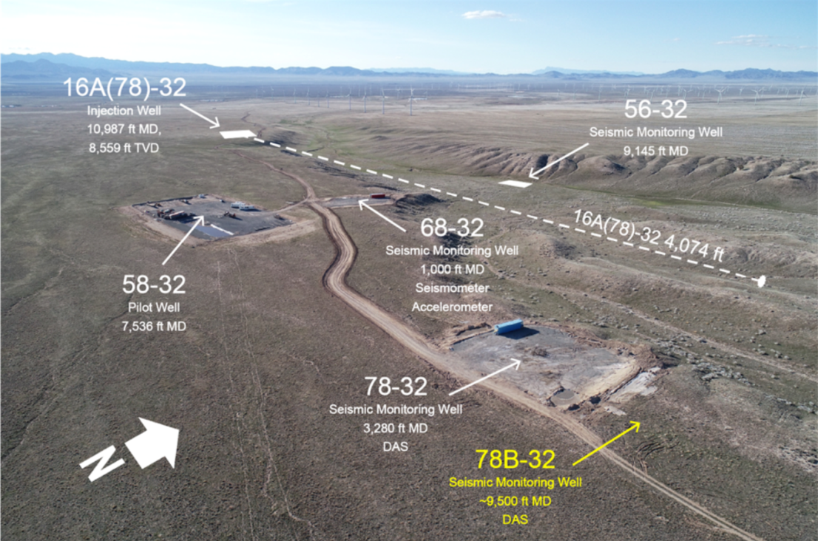
DOE Funded FORGE Research Field, Milford Utah
FORGE allowed Noynaert/Dupriest to use DOE grant to implement Physics-Based, Limiter-Redesign workflow similar to that used in oil and gas. Knowledge transfer, not technology transfer. Published in SPE 208798, 2022.

Slide 6
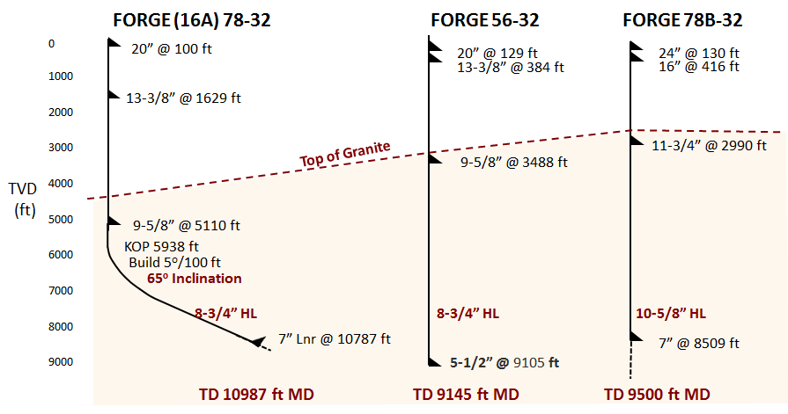
FORGE EGS Program
435º F BHT is manageable with mud coolers

Slide 7
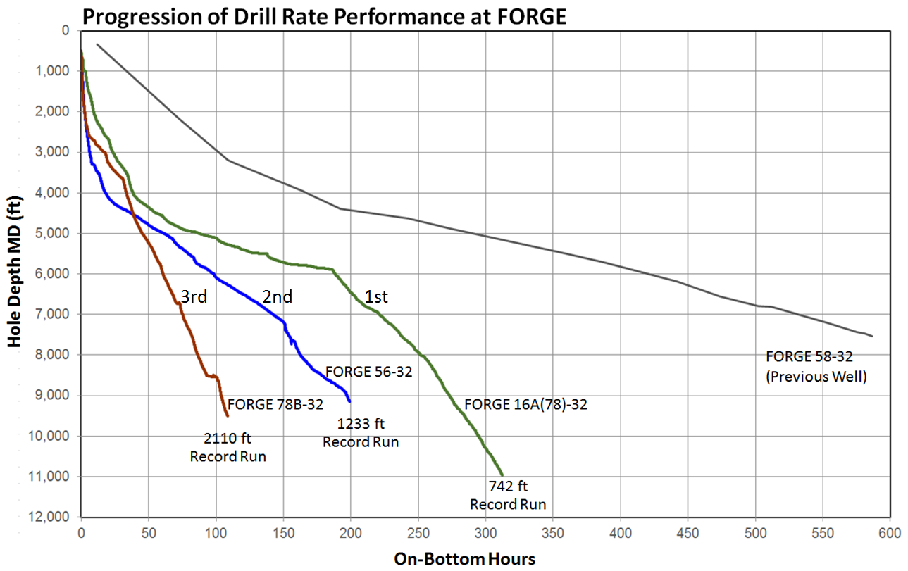
SPE-208798-MS describes the training, workflow, design and physical practices that resulted in large gains in drilling performance at FORGE

Slide 8
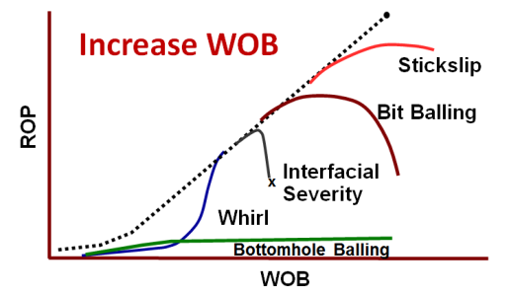
Physics-Based, Limiter-Redesign Practices (knowledge not technology)
  Belief granite would damage PDC Bits. Training
  Belief higher WOB would damage PDC bits. Training
  Belief high WOB would wear the bit faster. Training
  Belief thermal cutter failure was due to bit speed. Training
  Use of vendor “recommended” WOB (use “structural limit” instead). Training
  Implemented WOB and RPM step tests to maximize WOB in every foot
  Increased WOB to suppress whirl to reduce wear and extend cutter life
  Increased WOB to increase run length by reducing cutter sliding distance per foot drilled
  Increased Bit Aggressiveness to increase DOC to reduce cutter sliding distance per foot
  Used High Spurt Fluid (i.e., Water) to reduce Bottom Hole Balling (BHB)

Slide 9
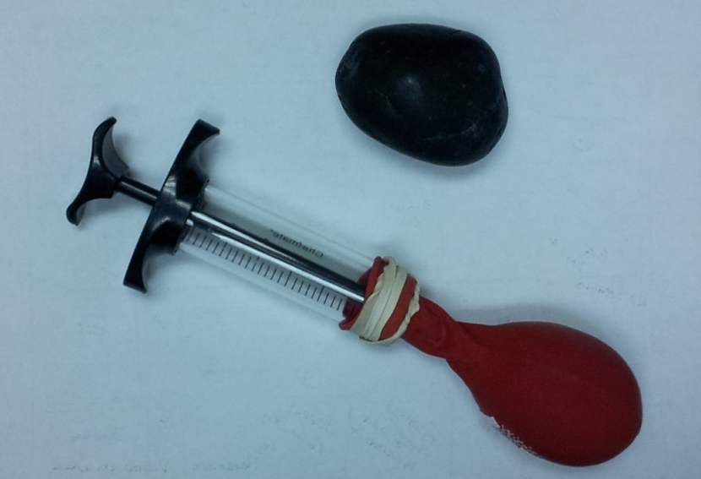
Bottom Hole Balling (BHB)
BHB: Granular cuttings material that has already failed but has high resistance to excavation by the cutter due to strength created by high effective stress from dilatant expansion

Slide 10
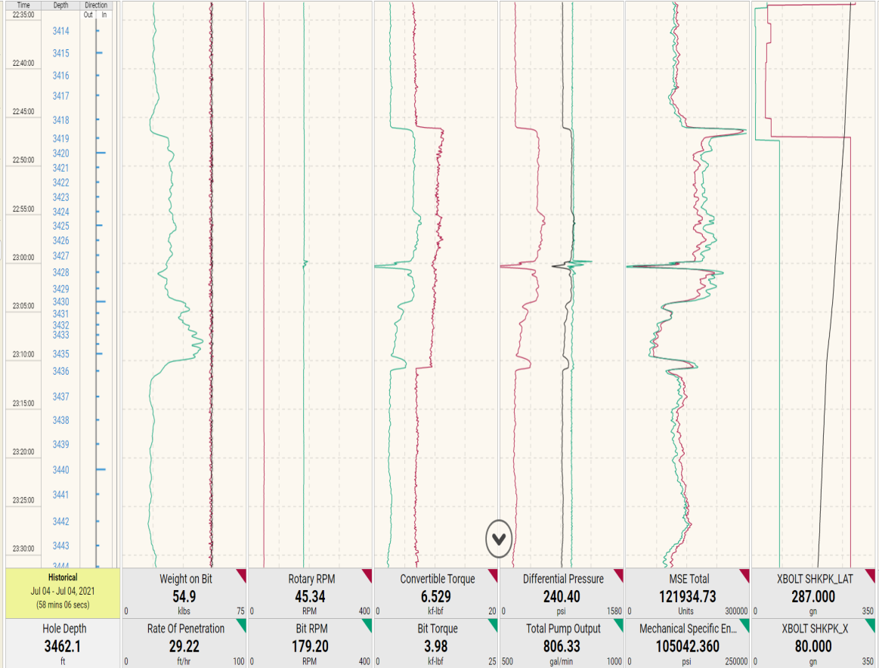
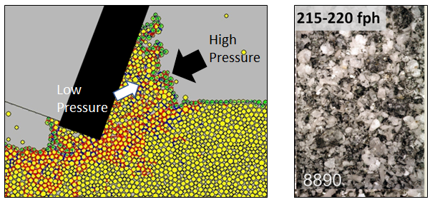
  High Spurt Drilling Fluid (i.e., Water) to Reduce Strengthening of Failed Granular Material
85 ksi MSE Baseline
Circulated 100 bbl of water and observe MSE and ROP
3420
3420
30 fph
Rock is exhibited strength (85ksi) due to “ductile” failure (SPE 124870)
High spurt loss filtrate (i.e., water) pressurizes the spaces between the failed granular material, eliminating effective stress and strength
3430
60 fph
100 bbls water
45 ksi MSE
24 fph
3440
3440
Forge 78B-32
Weight on Bit
Top Drv RPM
Top Drv Tq
Differential
MSE Total
Lateral Vib
ROP
Bit RPM
Bit Torque
Flow Rate
MSE Downhole
Depth of Cut
Notes:
0:00

Slide 11
Ductile Strengthening (Bottom Hole Balling) is Top Priority
Water (MSE 43 ksi)
Stickslip
Bit Balling
ROP
MSE 85 ksi
Interfacial Severity
x
Whirl
Bottomhole Balling
WOB

Slide 12
Key Takeaways
The technology available to the geothermal industry is identical to oil and gas. They differ in the knowledge available. That’s changing fast.
You are responsible for teaching the entire team how your products physically work
Formations are stable, holes are gauge, and water is adequate for hole cleaning
Lost returns are the major fluids issue. Ensure you diagnose the physical mechanism correctly and treat based on the specific mechanism
There is an enormous global performance opportunity in high spurt loss. Geothermal is likely to be an easy and productive place to do it on most wells. Pump 100 bbls of water and find out.
Actually, go do that every where and tell me what happens.

