Slide 1
A Detailed Look at the Challenges of Geothermal Drilling Fluids
David Horton
Wellbore Construction Fluids, Technology Delivery Group
AADE Fluids Management Group Meeting – Sept. 22, 2022

Slide 2

Agenda
Geothermal Background
Drilling Fluids Challenges (summary)
Drilling Fluids Challenges (details)
Case Study
Summary

Slide 3
Geothermal Challenges, Drilling Fluids
Types of Geothermal wells requiring drilling fluid:
  Direct Use: Shallow geothermal heat pump
  Conventional Hydrothermal: Naturally occurring dry steam
  Enhanced Geothermal Systems: Require stimulation / hydro-shearing
  Advanced Geothermal Systems: Closed loop

Slide 4
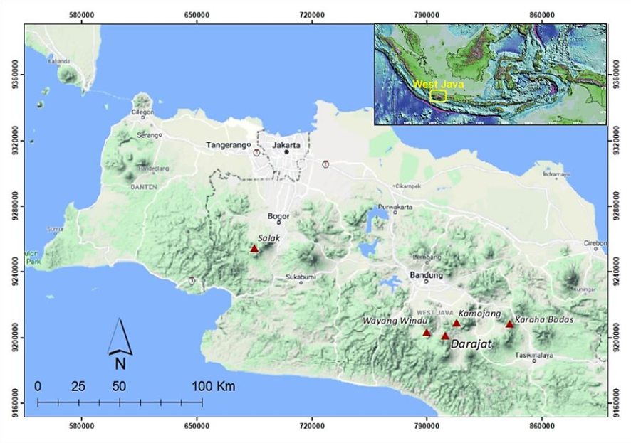
Geothermal Challenges, Drilling Fluids
It’s estimated Indonesia has up to 40% of the world’s potential geothermal resources*
Indonesia is the second largest geothermal producing country (based on power generation capacity, 2020)**
The Dry Steam Field X, is currently the largest steam dominated geothermal resource in Indonesia***
  Volcano hosted geothermal system
  Reservoir temperature range 240-280ºC (464-536ºF)
  Permeability through faults and fractures
  Produces dry stream
  Reservoir Sections only
Internal study: 251 wells
Source: Rindu Grahabhakti Intani et al 2021 IOP Conf. Ser.: Earth Environ. Sci. 732 012012
*Source: Wikepedia, “Geothermal power in Indinesia”
https://en.wikipedia.org/wiki/Geothermal_power_in_Indonesia#:~:text=Geothermal%20power%20in%20Indonesia%20is,at%2028%2C000%20megawatts%20(MW).
**Source: ThinkGeoEnergy, “Top 10 Geothermal Countries – year-end 2020”
https://www.thinkgeoenergy.com/thinkgeoenergys-top-10-geothermal-countries-2020-installed-power-generation-capacity-mwe/
***Source: Rindu Grahabhakti Intani et al 2021 IOP Conf. Ser.: Earth Environ. Sci. 732 012012

Slide 5
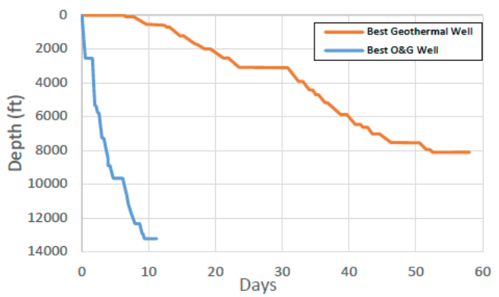
Geothermal Challenges, Drilling Fluids
Drilling Fluid Challenges:
  Lost Circulation
  Stuck pipe / wellbore stability
  Acid gas / corrosion / contamination
  Formation damage
  Remote locations; limited pad size; limited water source
  Geothermal economics
Source: GRC Transactions, Vol. 44, 2020; “Challenges and Opportunities of Geothermal Drilling for Renewable Energy Generation” Vivas, Salehi, Tuttle, & Rickard; (modified from Denninger et al., 2015)

Slide 6
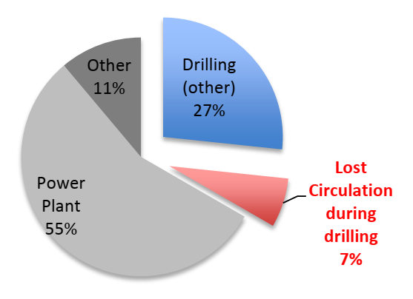
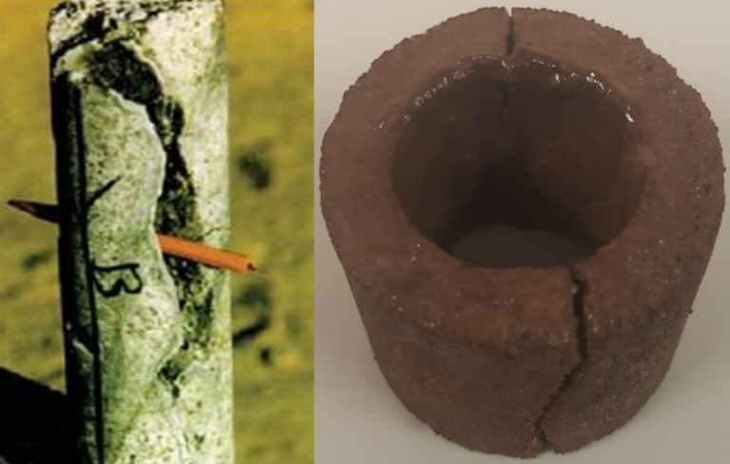
Geothermal Challenges, Drilling Fluids
Lost Circulation
  “Drilling for fractures”
    “Lost circulation represents an average of 10 percent of total well costs in mature geothermal areas, and often accounts for more than 20 percent of the costs in exploratory wells and developing fields.”*
  Cavernous hard rock; under-pressurized, with multiple zones of highly fractured and altered material*
  Pump rates up to 1,000 gpm in 12 ¼” and 900 gpm in 9 7/8”
  Severe and total lost circulation
    Upwards of 650,000 bbl is the typical amount of water needed to drill a single geothermal well in this area.**
  Internal data show avg. Reservoir losses: 120,501 bbl / well
    Maintain reservoir permeability
Source: “Geothermal Drilling: A Baseline Study of Nonproductive Time Related to Lost Circulation”, Cole, Young, Doke, Duncan, Eustes, 2017
Above: A typical fracture in a geothermal well (courtesy of US DOE) and a core sample after a fracture-wellbore strengthening test at the University of Oklahoma
* Source: Sandia Report, SAND2010-6048, “Handbook of Best Practices for Geothermal Drilling”
Finger and Blankenship, Dec. 2010
**Source: SPE-186922-MS “Drilling Problems Mitigation in Geothermal Environment, Case Studies of Stuck Pipe and Lost Circulation”
W. A. Nugroho, S. Hermawan, B. H. Lazuardi, R. Mirza, PT., 2017

Slide 7
Geothermal Challenges, Drilling Fluids
Stuck Pipe / Wellbore Stability
  “Data from 46 wells drilled in a geothermal field in West Java, Indonesia, show an average stuck pipe occurrence of ~1.9 incidents per well.”*
  Volcanic, intrusive, metamorphic formation
  High matrix strength, yet highly fractured
    Hard rock (above 240 MPa compressive strength)**
  Working pipe to break ledges is common
  Limitations for spotting or circulating (during lost circulation)
*Source: IADC/SPE-191074-MS
“Using Drill Pipe Connection Continuous Circulation Technology on a Geothermal Drilling Project in Indonesia to Reduce Stuck Pipe Events”
Wahyudin, S., Scagliarini, S., Napitupulu, G. et al, 2018
**Source: GRC Transactions, Vol. 44, 2020
“Challenges and Opportunities of Geothermal Drilling for Renewable Energy Generation”
Vivas, Salehi1, Tuttle, Rickard

Slide 8
Geothermal Challenges, Drilling Fluids
High Corrosion Rates:
  Internal Data Average 156.98 MPY (Avg. run time 85.15hr) (on AISI 4130 alloy steel)
    (Highest rate: 644 MPY; Lowest rate: 16.4 MPY)
Aerated fluid the likely key factor; exacerbated by temperature (and KCl, if used)
Steam charged with CO₂ / H₂S / NH₃ gas
Drill pipe inspected after every well (often requiring re-dress & re-fabricate)
Fluid often pumped but not circulated (during lost circulation)

Slide 9
Geothermal Challenges, Drilling Fluids
Typical Drilling Fluids Utilized:
  WBM Gel / Polymer
  Viscous Water + Corrosion inhibition
  Aerated Mud
  Sweeps (hole cleaning)
    Small vol.; Frequent (YP = ~5)
      Avoid induced pack-off
Primary Fluid Formulation:
Potassium Hydroxide (KOH) Alkalinity / pH Buffer
Xanthan Gum Low Range Viscosifier
PAC Fluid Loss Control
Note: Assume 4 day’s drilling with TLC at 1,000gpm
Contingency (necessity) Materials:
De-foam
Lubricant
Corrosion inhibitor
H2S Scavenger
Sweeps (KOH, Xanthan Gum, Corrosion inhibitor)
Stuck pipe treatment

Slide 10
Geothermal Challenges, Drilling Fluids
Geothermal Economics:
  “Lost circulation represents an average of 10 percent of total well costs in mature geothermal areas, and often accounts for more than 20 percent of the costs in exploratory wells and developing fields. Well costs, in turn, represent 35 percent to 50 percent of the total capital costs of a typical geothermal project. Therefore, roughly 3.5 - 10 percent of the total costs of a geothermal project can be attributable to lost circulation.”*
  ROI for geothermal is based on years of power plant’s service vs. 4-6 months for O&G***
  Analysis of ~4,500 lost circulation zones found:
    Cement used 65%; LCM used 30%
    Proportion of success is about 15% with cement and 10% with LCM**
  Customer objective: Lowest possible cost per barrel fluids used
*Source: Sandia Report, SAND2010-6048, “Handbook of Best Practices for Geothermal Drilling”
Finger and Blankenship, Dec. 2010
**Source: “Development of Database System for Lost Circulation and analysis of the Data”
Hyodo, Kitao, and Furukawa, 2000
***Source: GRC Transactions, Vol. 44, 2020
“Challenges and Opportunities of Geothermal Drilling for Renewable Energy Generation”
Vivas, Salehi1, Tuttle, Rickard

Slide 11
Geothermal Challenges, Drilling Fluids
Case Study: Indonesia; Dry Steam Field X, April, 2022
Section Summary:
  12 ¼” Section 3,151 - 5,488 ft MD (2,337 ft)
  Interval days: 13
        Drilled out with Gel Polymer (adjust Rheology; add inhibitors)
        full returns (flow rate 900-920 gpm, aerate fluid 500 scfm)
        4,582’ – 4,900’ partial lost circulation (dynamic loss rate 10-15 bph)
        4,900’ Lost complete returns – increased air up to 3,000 scfm
        Drilled remainder of Section Blind with 900-1,000 gpm
        Pumped hole-cleaning sweeps (10bbl every 10min)
        During blind drilling – pumped viscous water (xanthan gum + KOH + filming amine corrosion inhibitor)
        Ran 10 ¾” perforated liner – pump backside 1,100 gpm, no return
        General and pitted corrosion (avg. 269.85 MPY)
        Total fluid lost: 33,243 bbl

Slide 12
Geothermal Challenges, Drilling Fluids
Case Study: Indonesia; Dry Steam Field X, April, 2022
Section Summary:
  9 7/8” Section 5,488-5,749 ftMD (261 ft)
  Interval days: 5
    Drilled out shoe 10’ to 5,498’, lost complete returns
    Erratic torque 6-24 Klbf-ft & Pipe stall at 5,498’
    Polished shoe and drilled ahead Blind to 5,749’ (pumping 900 gpm; air up to 3,000 scfm)
    Stuck pipe at 5,749’ – applied torque while P/U and slack off 5 times – pipe free
    backreamed to 5,613’& Circulate Hole clean
    Reamed down to 5,743’ - stuck pipe – similar procedure as before – pipe free
    Called TD @ 5,749’
    Backreamed to 5,418’; pulled out on elevators
    General corrosion (16.4889 MPY)
    Total fluid lost: 128,225 bbl

Slide 13
Geothermal Challenges, Drilling Fluids
Case Study: Indonesia; Dry Steam Field X, April, 2022
Section Summary:
  Drilled 2,598’ in 18 days (overall avg. 144 ft/day)
  Maximum Angle 36°
  Experienced:
        Partial and total lost circulation
        High / erratic torque & pipe stall
        Stuck pipe
        Severe corrosion rates
        Total fluid lost 161,468 bbl

Slide 14
Geothermal Challenges, Drilling Fluids
Summary and Conclusions:
  Lost Circulation, Corrosion, Stuck pipe, High Temperature
    Likely to occur simultaneously
  Geothermal economics – low-cost fluids
  Fit for purpose drilling fluids
  Operational excellence (plan & process) a must
  Safe and economic delivery of the well

Slide 15


Geothermal Challenges, Drilling Fluids
  Questions?
Special thanks to:

