Slide 1
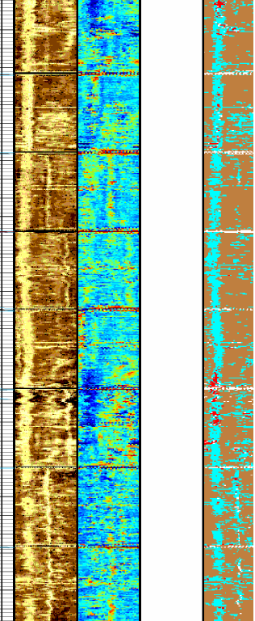
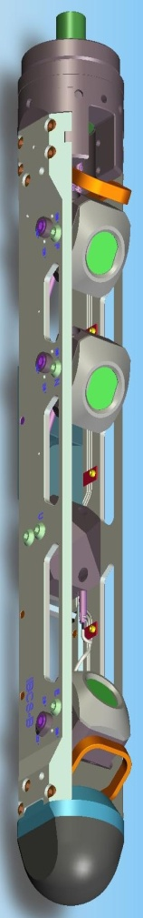
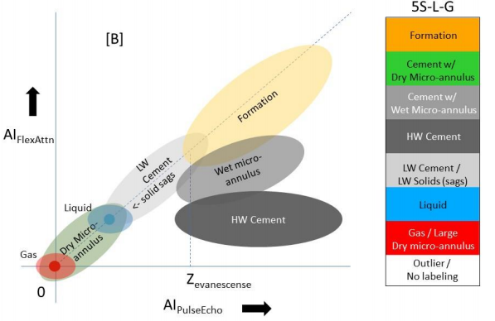
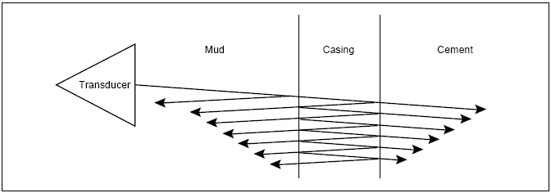
Dirk Valstar
Ultrasonics to help understanding annular content
Well Integrity Engineer Domain Champion
Houston, 20 October 2020

Slide 2
AGENDA
  Annulus contents
  Different interactions with casing
  Combining different measurements
  Case History
  Second string cement evaluation
  Summary

Slide 3
What can we find in the annulus?
  Gas (air or hydro-carbon)
  Liquid: Mud (OBM/WBM), brine, formation fluid (…), spacer
    Dehydrated mud
    Settled solids
  Solids
    Good cement
    Poorly bonded cement / micro annulus
    Formation/casing collapse

Slide 4
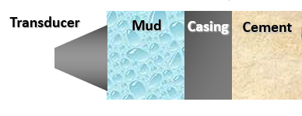
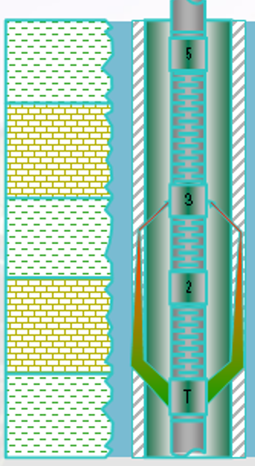
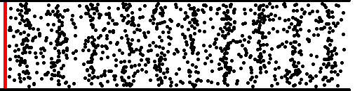
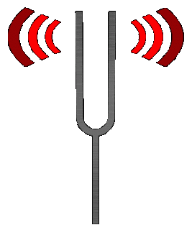
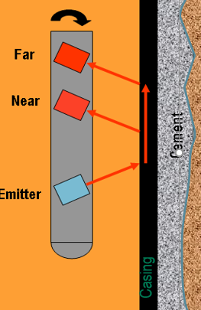

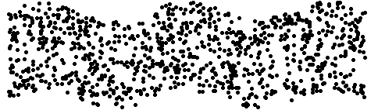
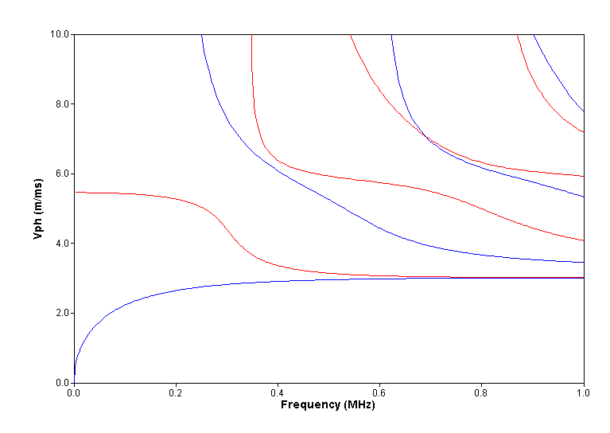
Cement Evaluation Tools - Different casing interactions
USIT
S1
CBL
S0
A0
Isolation Scanner Flexural wave
Notes:
Acoustic propagation in steel pipes is controlled by modes
At a given frequency, a mode is defined by its velocity (phase or group velocity, angle of incidence) and attenuation.
Mode attenuation is generally sensitive to materials inside/outside casing.
Cement evaluation tools measure modal attenuation (CBL, USIT, FWI)
Realize there are not tools which see cement directly, just like there are no tools which measure porosity directly. We introduce energy into the casing and watch how it decays and relate that decay to the properties of the annular material. The physics of each measurement CBL and USI are different from each other in frequency and type of pipe motion created. When the Flex ATT is added with IBC you have yet another set of physics and pipe motion/energy created to watch the decay with.
CBL sends a compression wave up the casing with a low frequency 20 KHZ – longer wavelength – energy source. Think of the 5 balls on strings and you drop one and the one on the other end moves out but the three in the middle don’t move. That is CBL physics.
USI is more like a tuning fork with each pulse exciting the thickness mode of the casing as the energy bounces back and forth 7 times inside the casing wall. We use Snells law to see how much energy is refracted and lost into the material at the outer wall of the casing.
With IBC we add Flexural which sends a flexural wave up the casing ( ie think guitar string) and we measure the energy drop of that wave between 2 receivers close together. TIE adds another set of physics, to send signal to the next change in impedance, typically the cement ( or annular liquid) and formation ( or outer casing).
Due to the different physics they respond differently to dry and wet microannulii. Also due to very thin coatings of oil/varnish etc. CBL’s with lower frequency tend to be less affected by narrow dry microannulii than the USI, but more affected by wet microannulii. USI are highly affected by dry microannulii due to the snells law concept as more energy is reflected the higher the contrast is between the casing AI and the material at that interface which in the case of a dry microannulii is essentially void/gas. An analogy is in a gas filled rock a density porosity tool and a Neutron porosity tool read completely different from each other, but in liquid filled rock they read pretty much the same.
Unless the cement is attached to the outside of the casing over the entire 1.1 “ USI spot size of the pulse at each firing then we do not record accurate AI data for the slurry as we see what is in the gap as well. Not until the full coupling/shear bond between casing and cement is reestablished, can we measure the accurate AI.

Slide 5



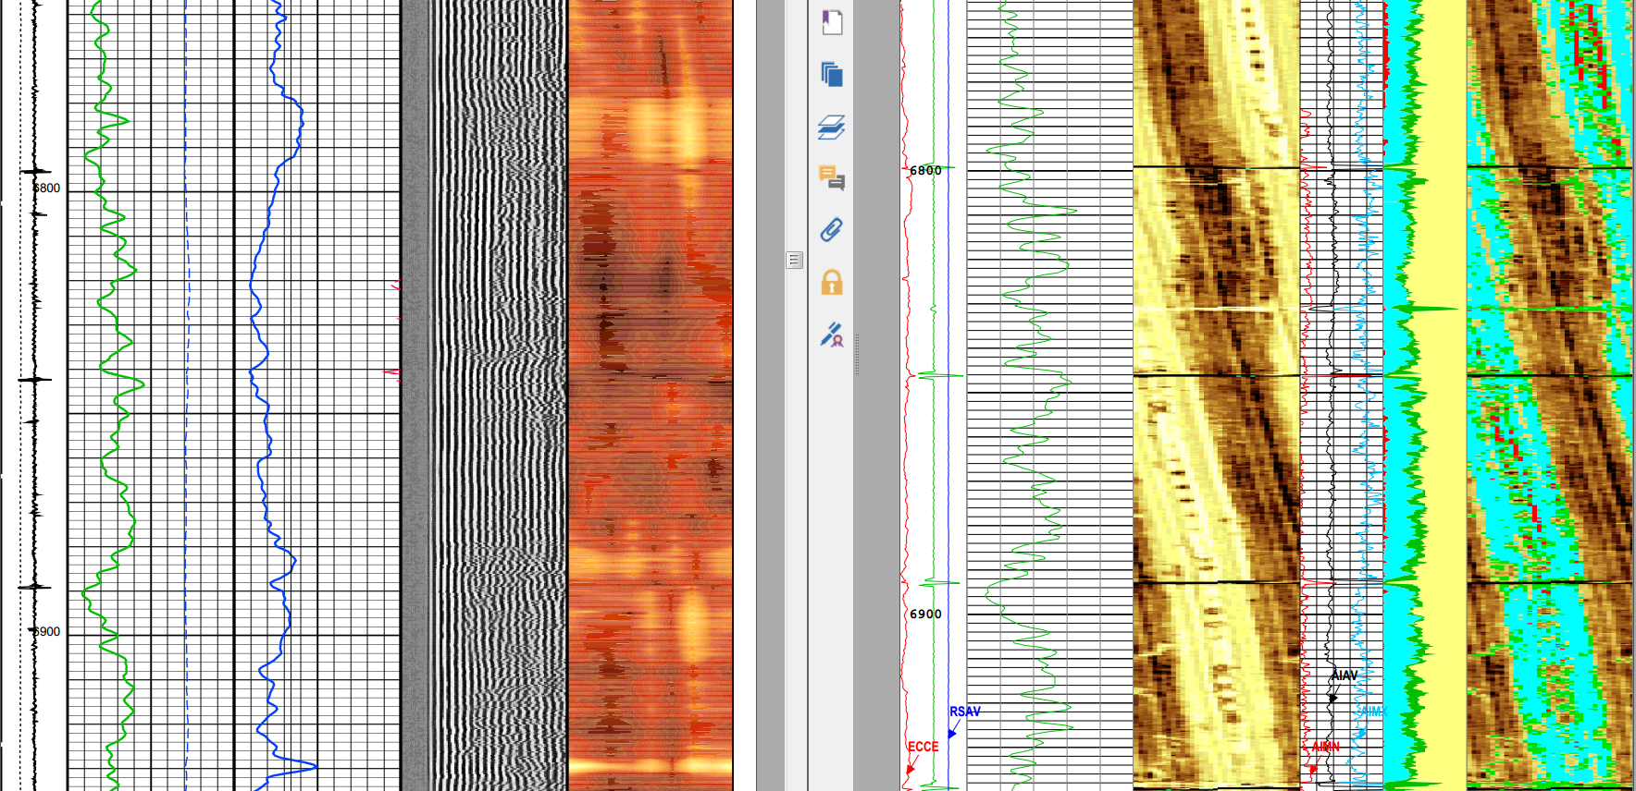
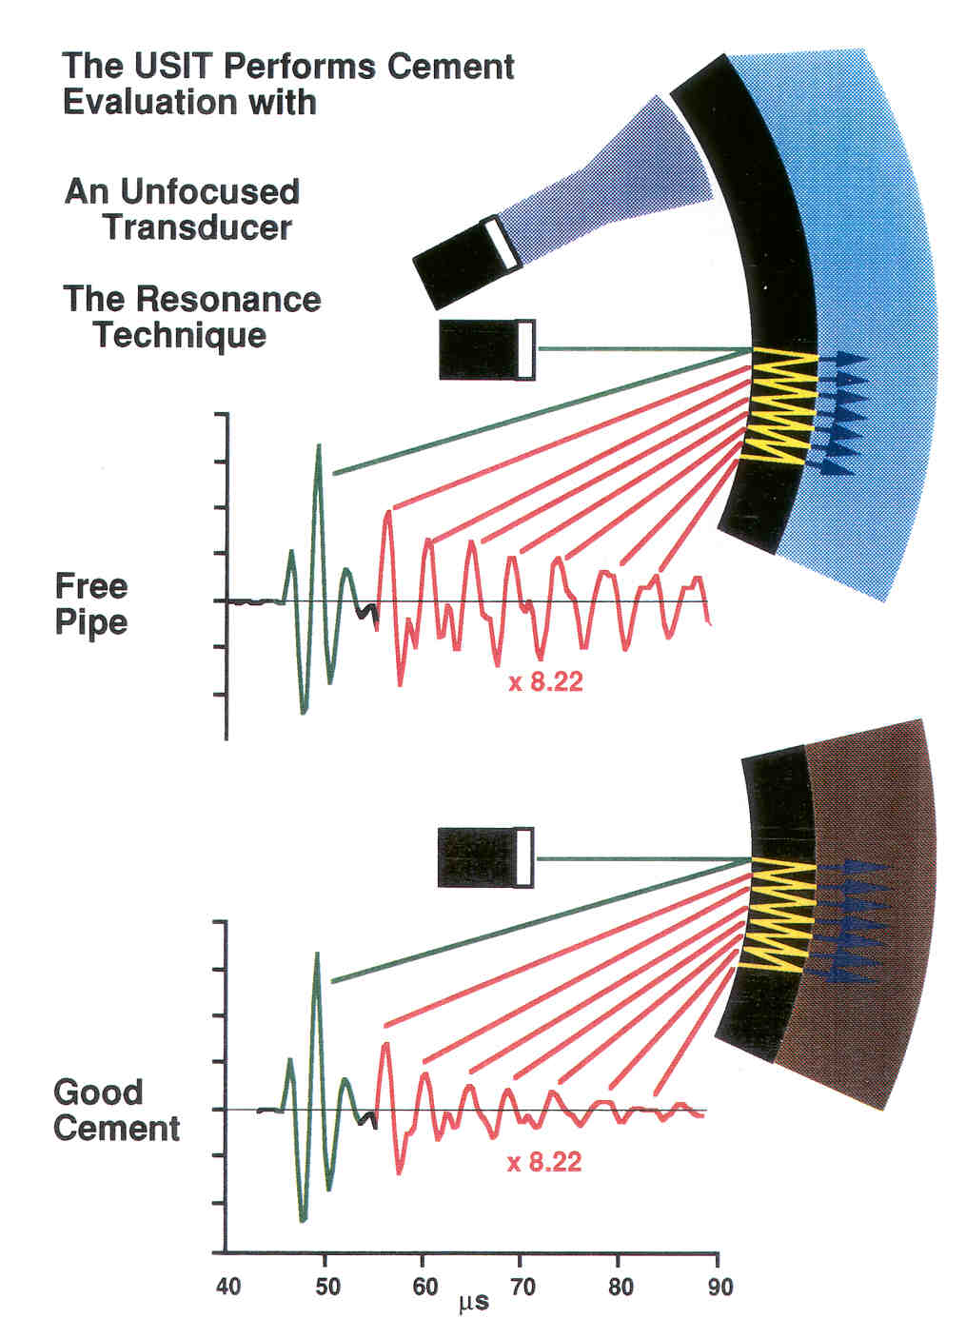

Ultrasonic Measurement – Pulse Echo (USI)
Transducer
Mud
Casing
Cement
Formation
Raw and interpreted image:
Analyze decay of returned signal
Notes:
The “CBL” or cement bond log has been around since the 1960’s. It is based on the principle that a signal transmitted through a casing unsupported by cement will ring strongly and attenuate slowly while that same signal will ring weakly and attenuate quickly when transmitted through a casing well supported by cement. The measurement is omni-directional, responding to the average of contributions from around the circumference of the casing, and is made at a relatively low frequency of ~ 20 kHz at a transmitter-to-receiver spacing of 1 to 3 feet. The measurement is normally accompanied by a variable density log (VDL) that is made at a longer transmitter-to-receiver spacing of 5 feet. This VDL may yield an indication of cement bond to the formation.

Slide 6
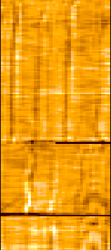
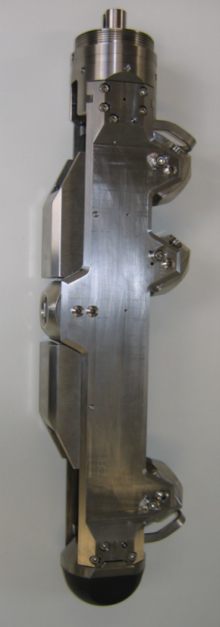

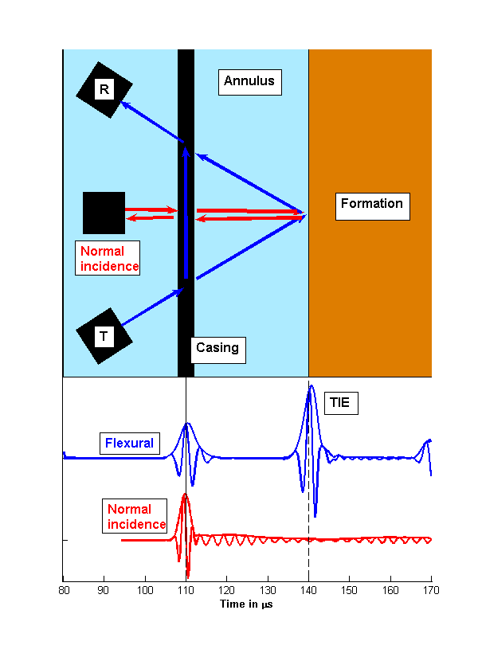
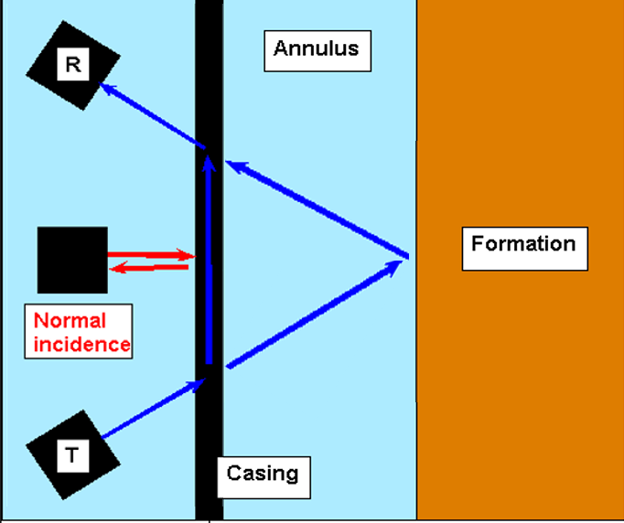

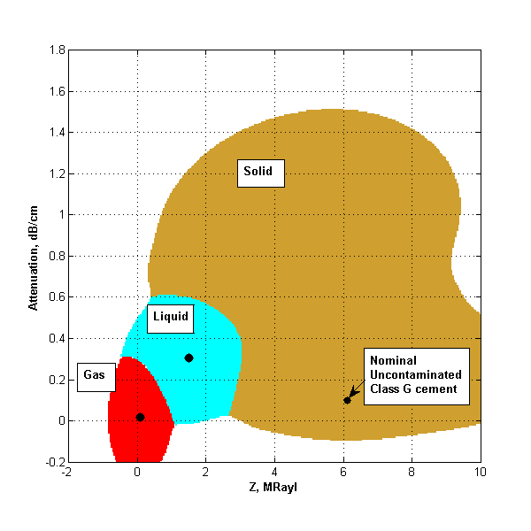
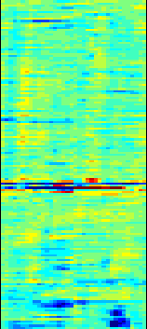
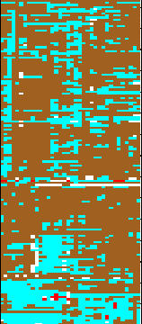
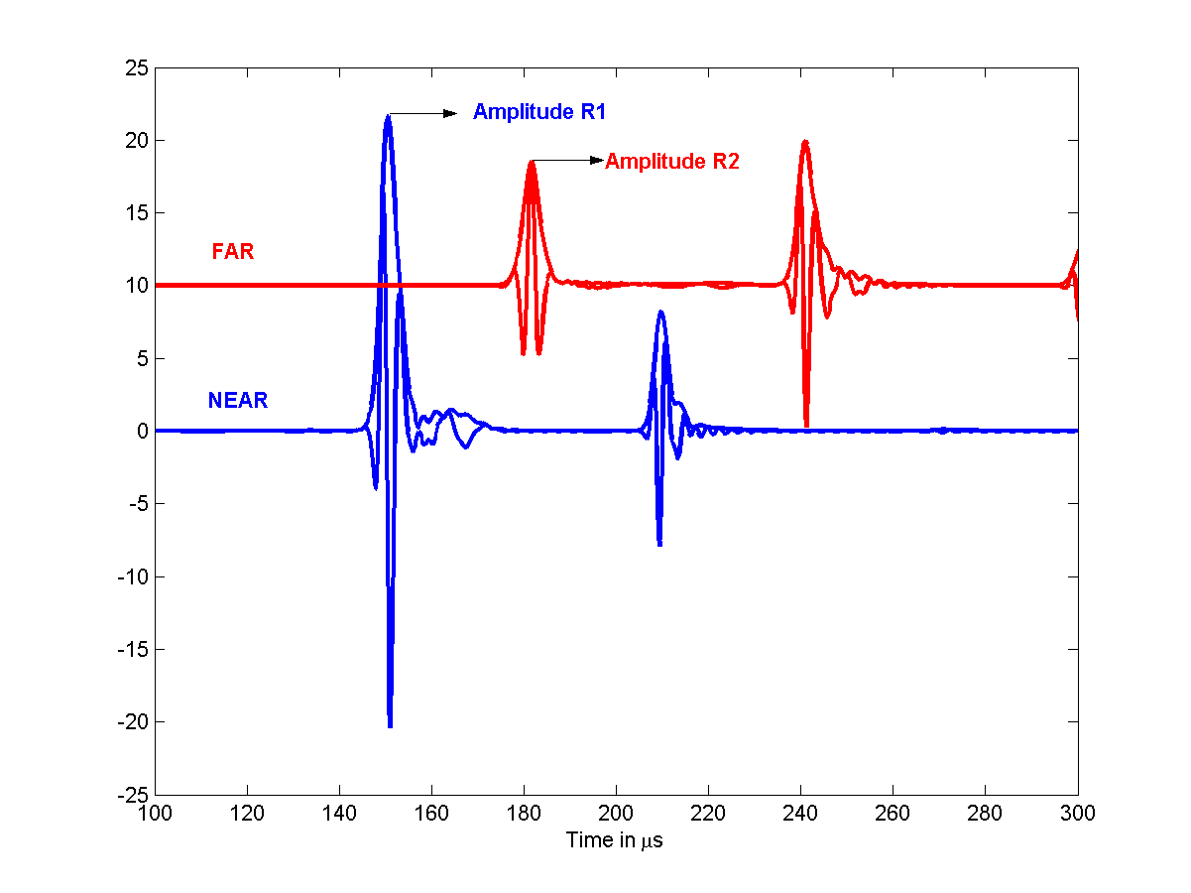
Flexural wave principle
Notes:
The Isolation Scanner maintains the measurement provide by the USIT and incorporates it in the new answer. It replaces the current USIT measuring device consisting of a single rotating transducer (click to change sub picture and add text) with a new rotating device comprised of 4 separate transducers. The additional 3 transducers are comprised of a transmitter and 2 receivers acting in a pitch-catch manner to excite and record a flexural measurement. The amplitude of the flexural wave is measured at each receive, and an attenuation is calculated based on the known distance between the receivers with the knowledge of the relative sensitivities gained thru a master calibration.
As previously mentioned, the propagation characteristics of the flexural energy allow for capturing information from the 3rd interface.

Slide 7
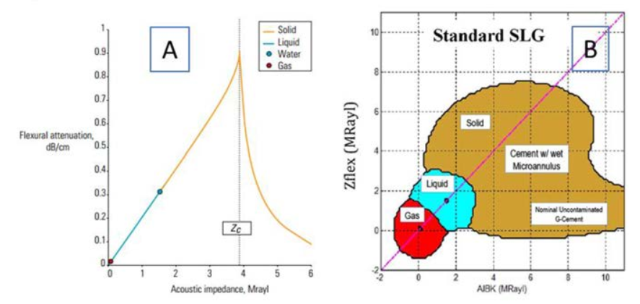
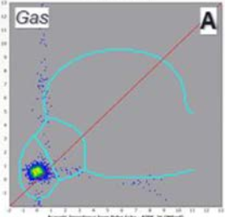
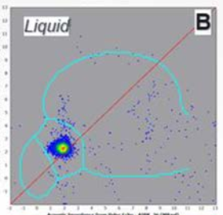
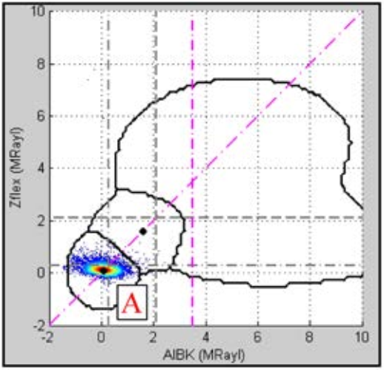
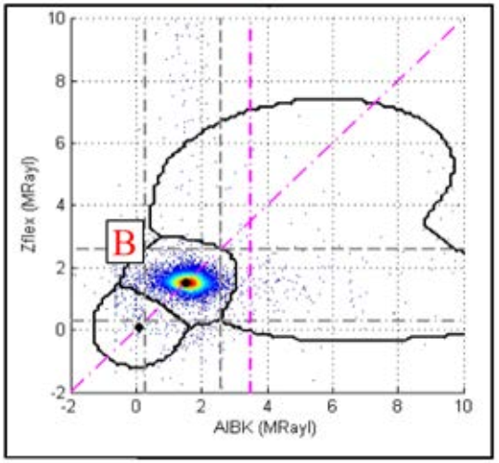
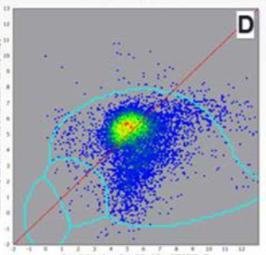
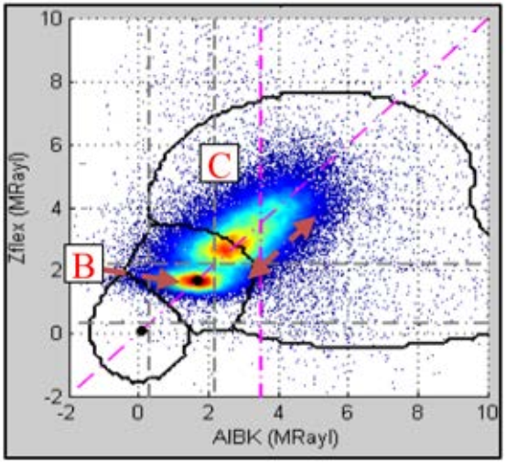
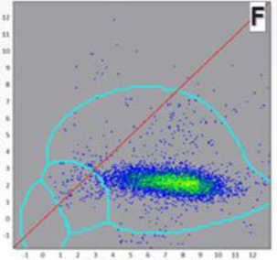
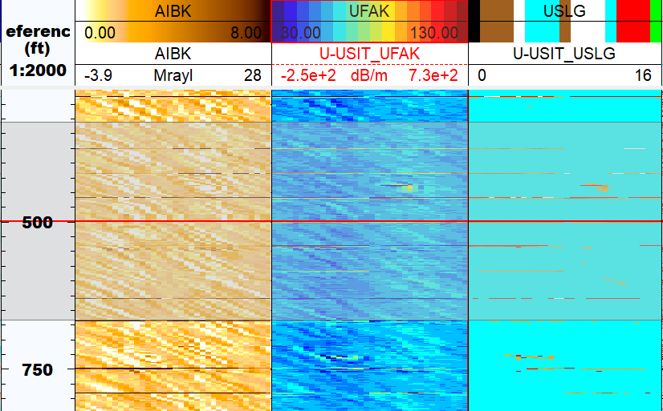
Closer look at model

Slide 8
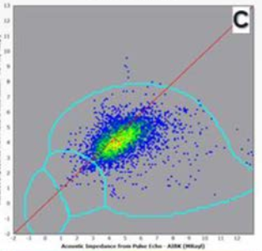
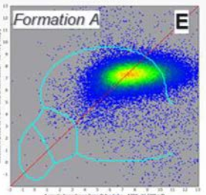
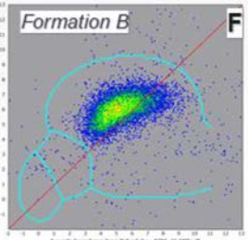
Other responses
  Formation (SPE/IADC 204040)
  Norsok D-010 has verification acceptance listed for formation creep involving bond logs.

Slide 9
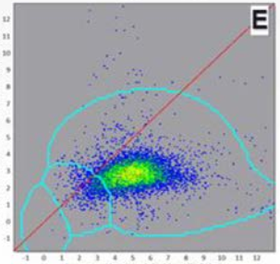
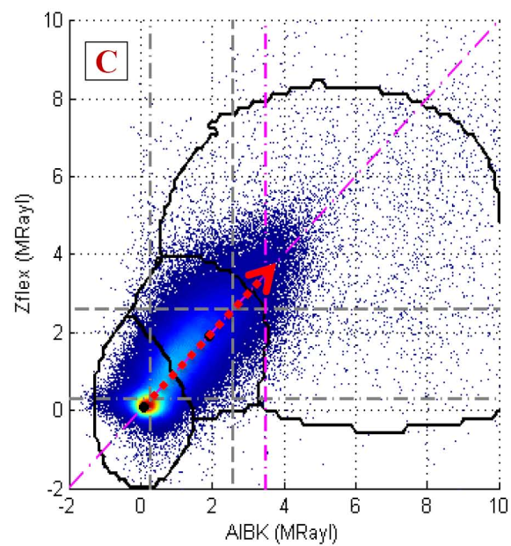
Other responses
  Micro annulus Wet vs Dry (SPE paper 185731)
  Wet: Dry:

Slide 10
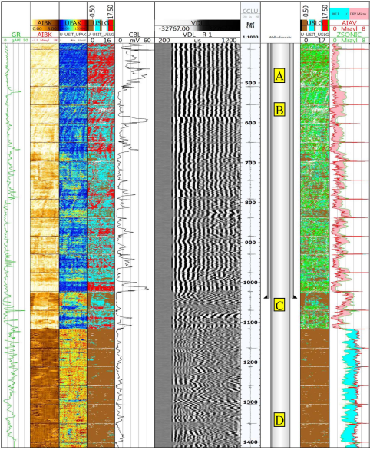
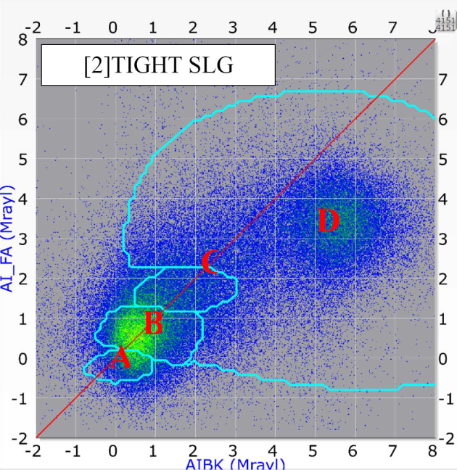
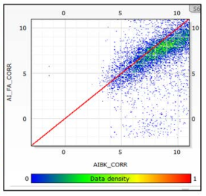
Dry Micro annulus
  Use different model
  Bla
  Add Cement Bond Log
Ultrasonics in Cut and Pull Operations
10

Slide 11
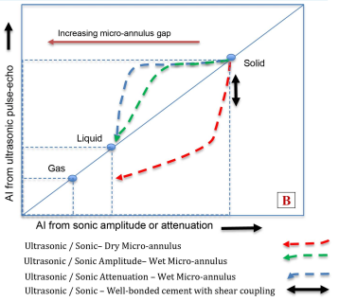
Dry Micro annulus
  Add Cement Bond Log
    Less susceptible to dry micro annulus than ultrasonics

Slide 12
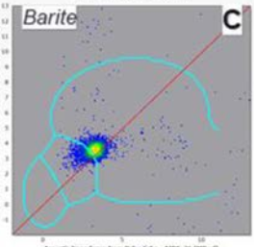
Other responses
  Barite Sag or other mud solids
              or different fluid
              or very light cement
              or ….

Slide 13
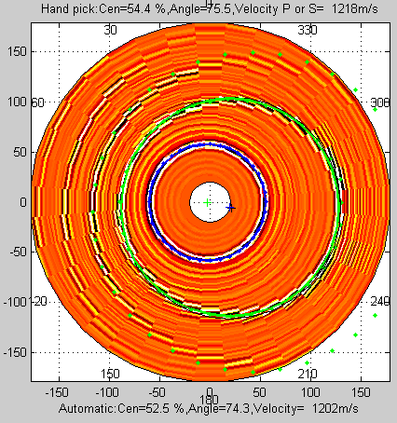
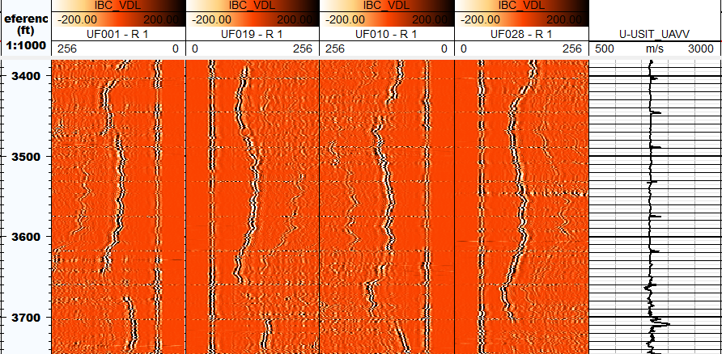
Flexural wave: outer casing reflection
Notes:
The Isolation Scanner maintains the measurement provide by the USIT and incorporates it in the new answer. It replaces the current USIT measuring device consisting of a single rotating transducer (click to change sub picture and add text) with a new rotating device comprised of 4 separate transducers. The additional 3 transducers are comprised of a transmitter and 2 receivers acting in a pitch-catch manner to excite and record a flexural measurement. The amplitude of the flexural wave is measured at each receive, and an attenuation is calculated based on the known distance between the receivers with the knowledge of the relative sensitivities gained thru a master calibration.
As previously mentioned, the propagation characteristics of the flexural energy allow for capturing information from the 3rd interface.

Slide 14
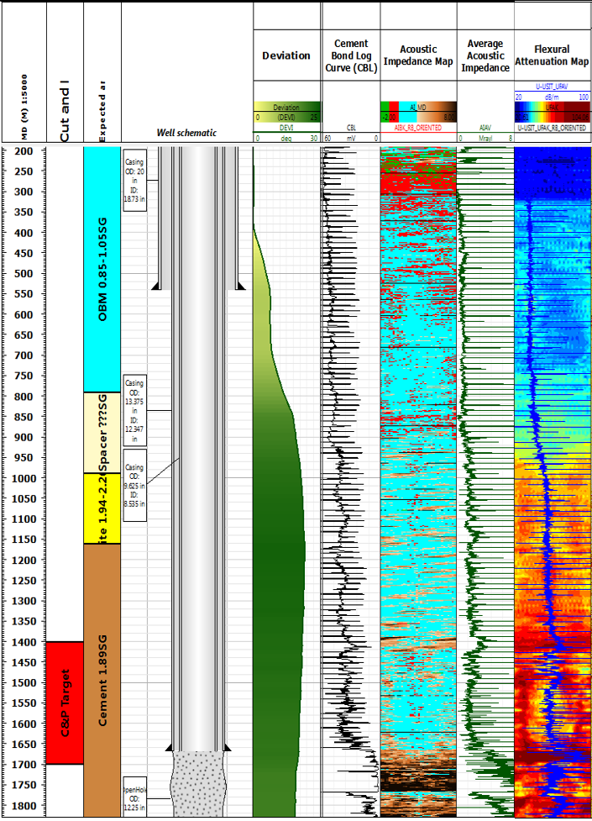
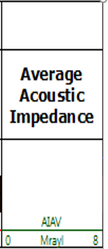
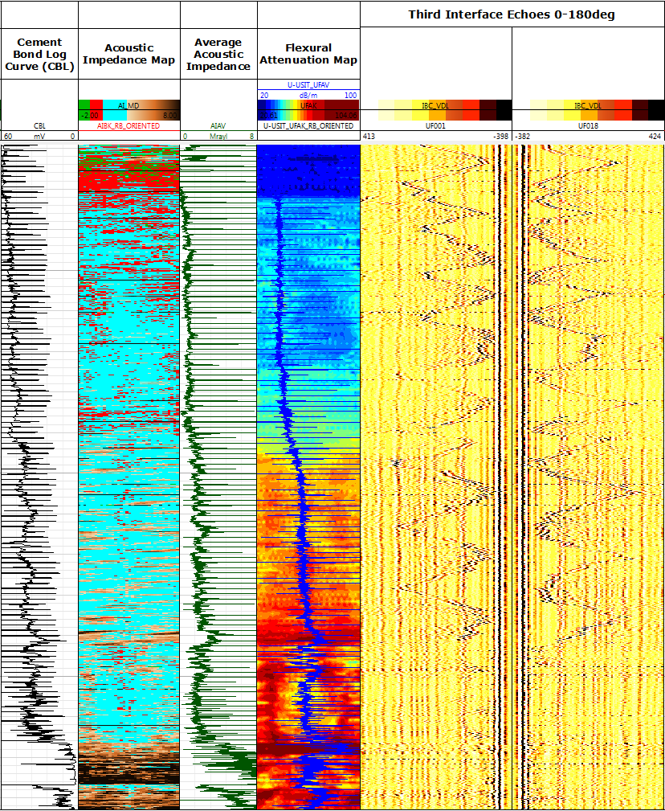
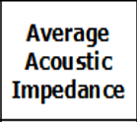


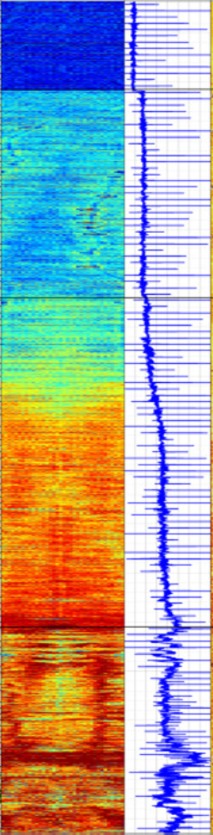

Case History: North Sea
Ultrasonics in Cut and Pull Operations
14

Slide 15
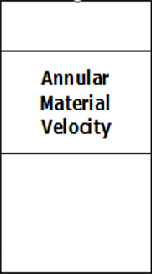
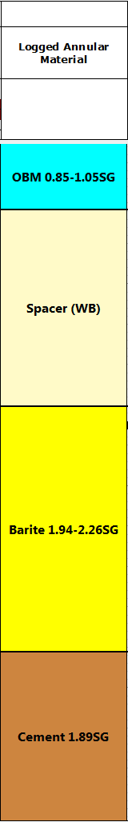
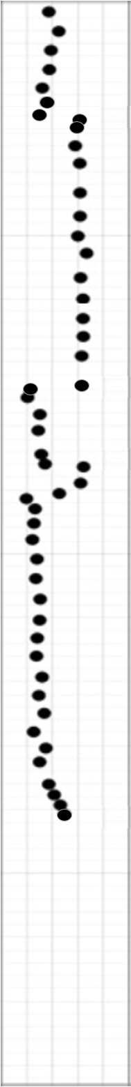

Case History: North Sea
Ultrasonics in Cut and Pull Operations
15

Slide 16

Dual String Cement Evaluation

Slide 17

Dual String Cement Evaluation
Details in paper OTC-31302

Slide 18

Conclusion
  Ultrasonics can be powerful
    Analyse your well history
      Logs only tell you so much
    Combine different measurements
    Analyse full range of measurements
  Isolation in annulus
    Regulators have final say on acceptance criteria

Slide 19


Casing with 9.5 ppg resin and with external coating
Steel casing
CRA casing

