Slide 1

20+ Years and Still a “Novel” Product
Importance of Epoxy Exotherm and Delivery Systems
P Martial Burguieres
AADE IETC Houston
October 20, 2022

Slide 2
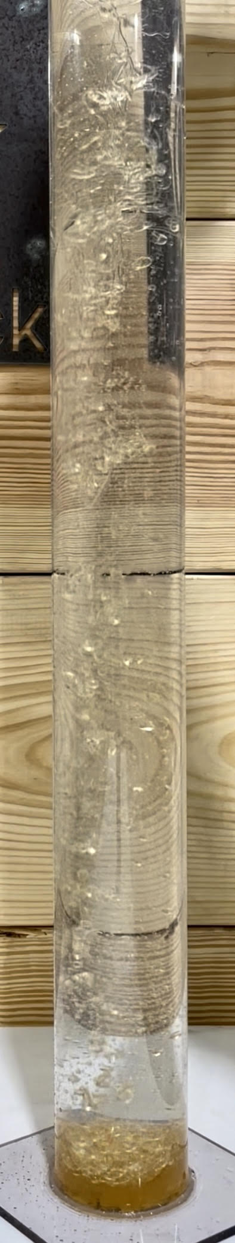
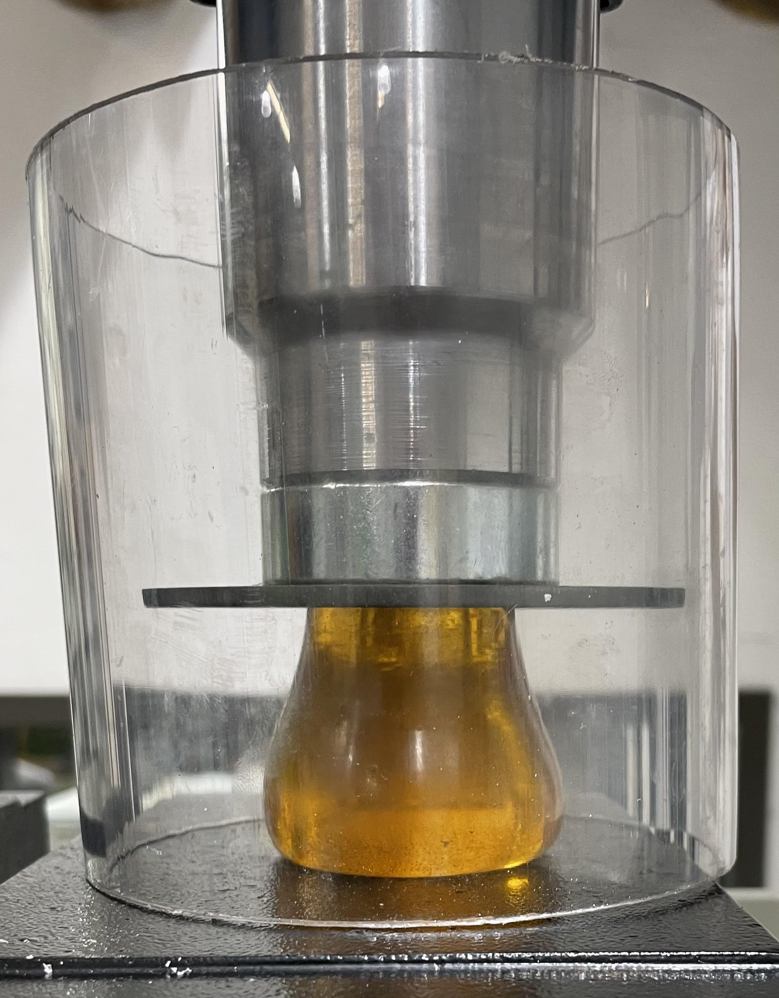
Multi-Component Thermoset Epoxy
Nothing new…
-epoxy first used in wellbores circa 1960s
-several different vendors, and one Major have developed products
-significant successes… and failures…
Pros of Epoxy:
-Immiscible in water
-Resistant to hydrocarbons, acids, chlorides, C02, H2S…
-Far greater compressive and tensional strength compared to cements
-Resistant to channeling and debonding
-Non-permeable
And cons:
-Highly temperature dependent (curing time)
-heat is a catalyst, but epoxy can also exotherm significantly
-Handling issues:
-Large volumes can exotherm violently
-Handling times vary with temperatures (pot life)
-Impossible to pump once it begins to gel (potentially catastrophic)
-It’s a mess… High cleanup costs and solvents involved are not environmentally friendly
10,000# press test on 1.44” dia. cylinder
H20 immiscibility demonstration

Slide 3
It’s all about the exotherm…
Epoxy has very high success rates when attempting to squeeze micro-annuli and porous formations
Epoxy has very low success rates when attempting to plug ID of tubulars…
-EFFECT OF THERMAL MASS!-
We have recorded epoxy resin exotherm to 288°F over ambient!
-Commonly believed epoxy “shrinks” once cured (partially true)
-Thermal mass and associated exotherm causes epoxy to expand significantly as it solidifies
-As epoxy cools to ambient, the strain from shrinkage causes bond failure
In testing, performance (bonding) of epoxy begins to degrade when exotherm temperatures surpass 180°F above ambient
Adding micro-fine solids can assist in controlling exotherm and has been practiced for decades
Yes, less aggressive chemistry can be deployed, but setting times increase significantly
-Two hours is believed to be operationally ideal time for cure and testing

Slide 4
It’s all about the exotherm… continued…
Current methods involve mixing epoxy on surface
-exotherm begins and temperatures must be monitored
-increasing temperatures = decreased cP until polymer chains begin to form then cP dramatically increases (gel time)
-Retardants are employed to slow the reaction and increase pot life, but they can then result in long cure times
-Pumping/Bailing a catalyzing epoxy resin is a very high risk operation!
It is critical to completely understand the exotherm of the epoxy
1.From inception of catalyzation to displacement
2. Additional heat from “thermal mass” effect

Slide 5
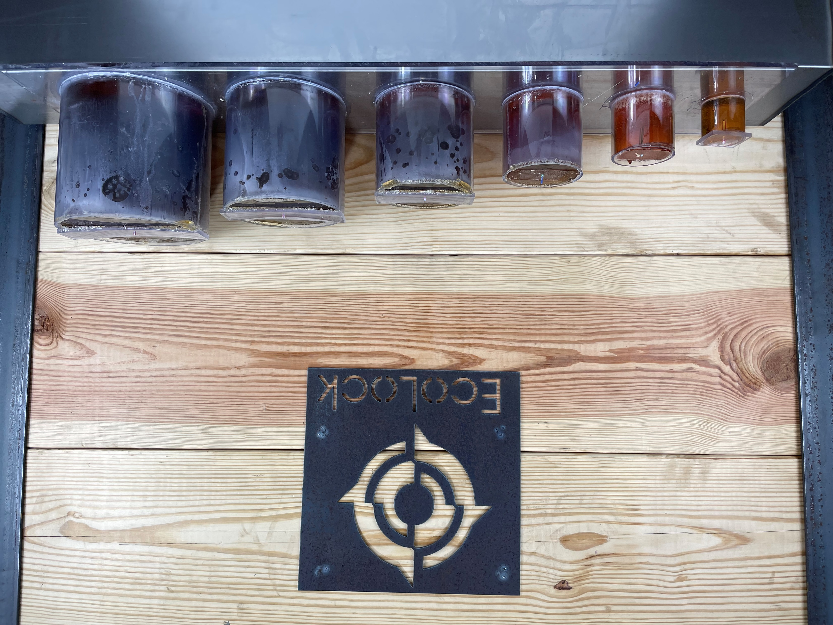
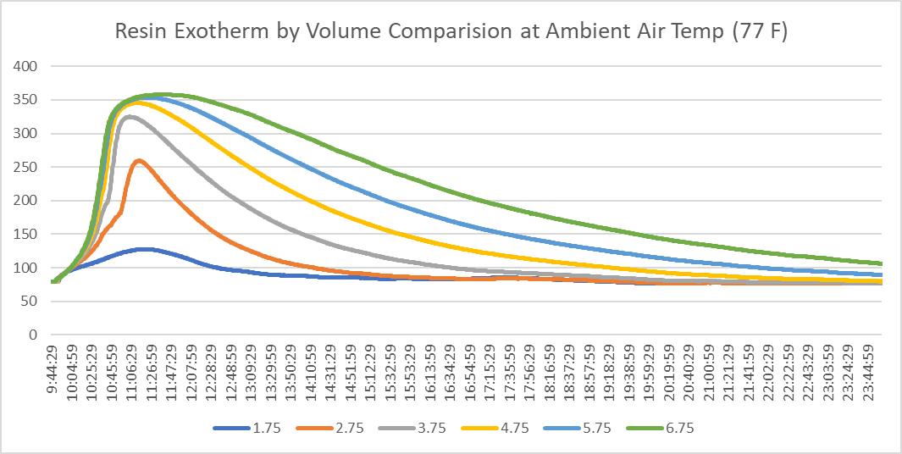
Thermal Mass
Tests were conducted to begin “mapping” the thermal mass effect of gradually increasing volumes of epoxy resin
Tests were done at select ambient temperatures (77°, 100°, 125° and 150°F)
Centralized temperature probes recorded temperatures

Slide 6
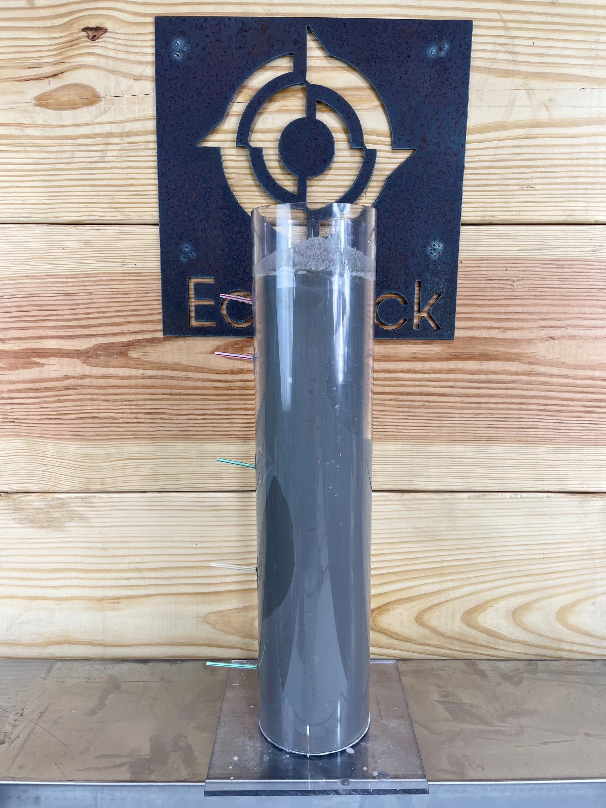
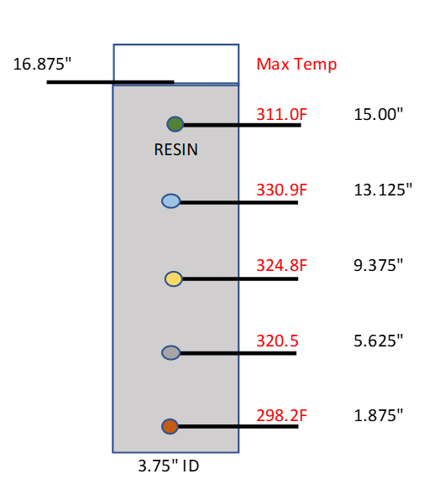
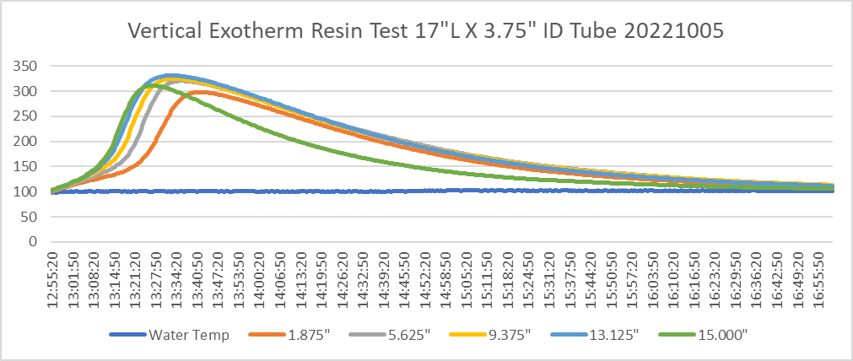
Thermal Mass
After mapping the thermal mass, tests were conducted to ascertain the effect of “thermal rise” through a cylindrical column
Temperature probes were inserted to record exotherm along the length of the “plug”
Currently conducting identical test on a 48” cylinder

Slide 7

Thermal Mass
After mapping the thermal mass, tests were conducted to ascertain the effect of “thermal rise” through a cylindrical column
Temperature probes were inserted to record exotherm along the length of the “plug”
Currently conducting identical test on a 48” cylinder

Slide 8
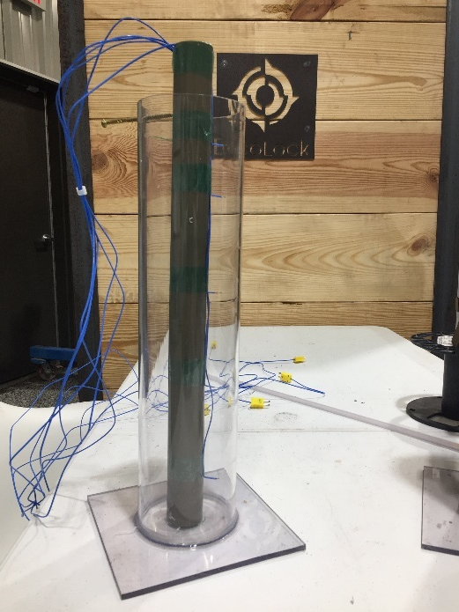
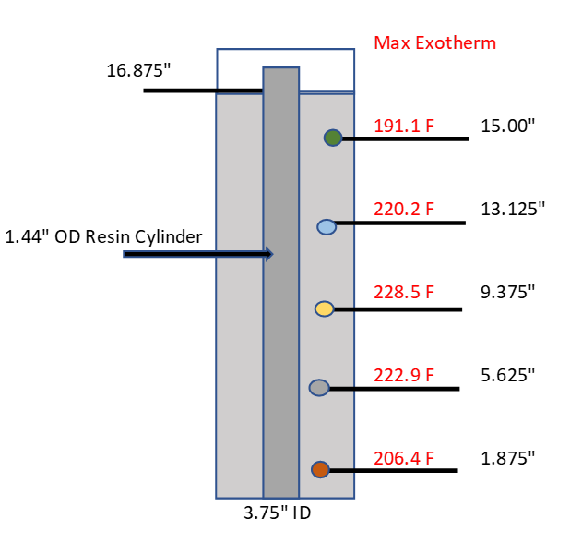
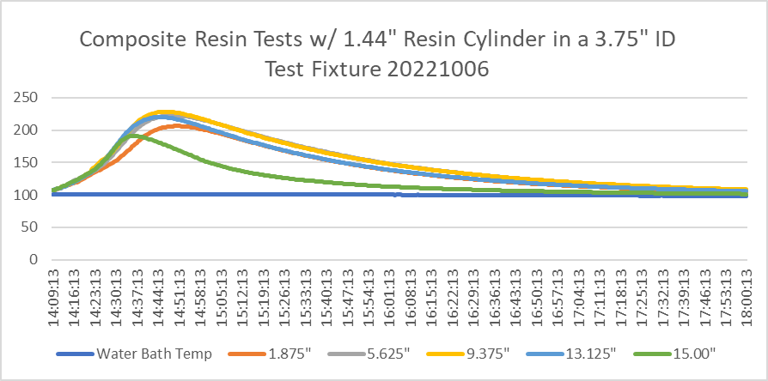
Thermal Mass
Pre-Cured epoxy cylinder is inserted into another test fixture
The cylinder reduces volume and controls the exotherm to a predetermined temperature
Cylinders can be made to whatever length and diameter is deemed necessary
Spheres have also been molded for occasions when cylinders are not ideal
The cylinders can be deposited in the well via slickline, wireline or freefall
Enables control of exotherm in very large diameter pipe

Slide 9

Thermal Mass
Catalyzing epoxy exhibits extreme bonding to pre-cured components
When compressed to failure (>10,000#) test articles reacted identically to homogenous articles
Cylinders can be machine and threaded
    Bullnose profiles
    Threaded connectors and fish necks

Slide 10
Application Methodology
Much of the resistance to using epoxy stems from handling issues
  Pumping
  Pump vendors don’t want to pump epoxy (liability issues)
  Volatile solvents used to flush equipment and clean residual epoxy
  Sudden changes in cP can severely effect pumping pressures
  Wireline Bailing
  Operational delays can cause compromised sealing ability or ruin bailer

Slide 11
Improved Application Methodology
Current developments will increase the efficacy and efficiency of epoxy use in wellbores…
Mix “on the fly” method
-Ability to pressure pump epoxy that is only catalyzed the instant it leaves the high pressure side of a piston pump
-Any rate and pressure needed for the particular job
-Can bullhead initial epoxy dose, then be displaced with rig pumps
-Greatly reduced cleanup with a small footprint
Hybrid Bailer
-Epoxy components are stored inside the bailer disparately
-The components are dispensed and catalyzed only upon actuation of the tool
-Aggressive chemistry can be used
-Unaffected by temperature variations with unlimited operational window

Slide 12
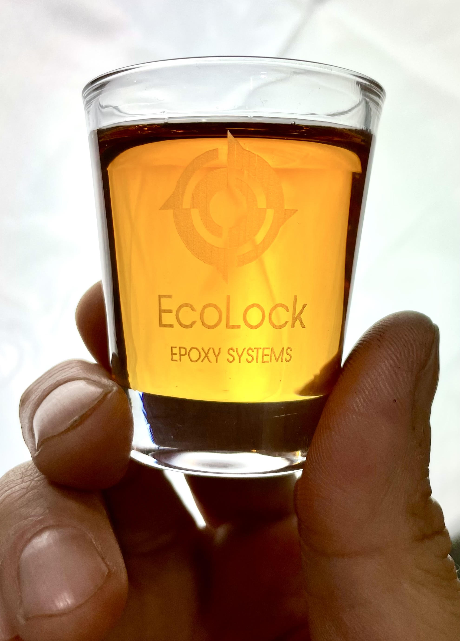
mburguieres@ecolockusa.com

