Slide 1

Mitigating C Annulus Sustained Casing Pressure With a Permanent Epoxy Resin Barrier
Presented by Jeff Everage
Tactical Oilfield Products

Slide 2
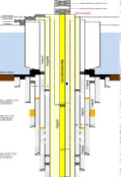
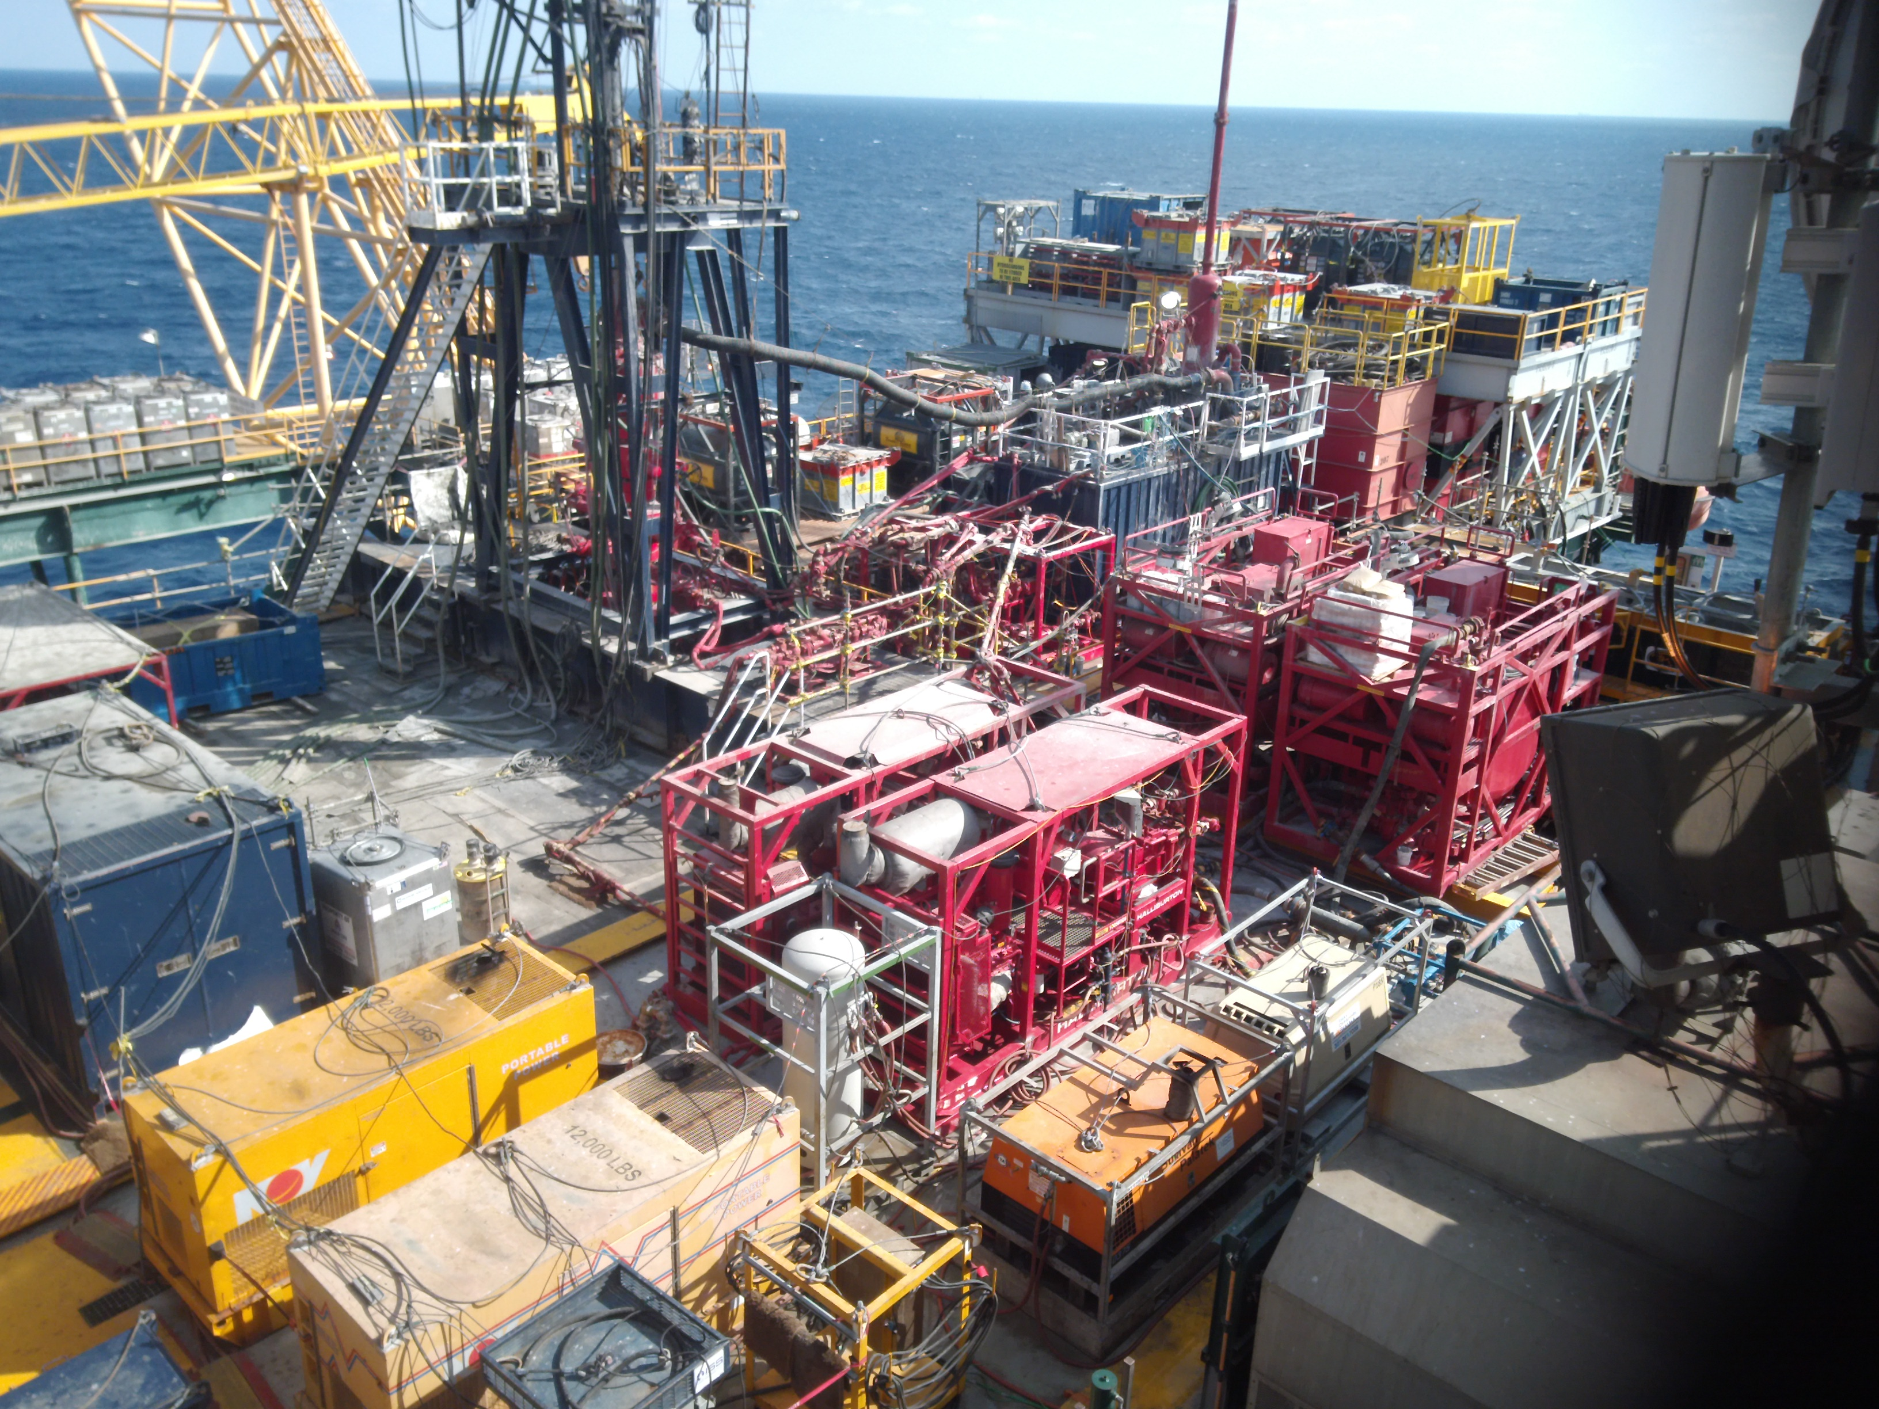
Case History Overview
Sustained Casing Pressure (SCP) issue was threatening to shut down a producing platform in the GoM.
Multiple cement jobs had failed to isolate the reservoir gas pressure.
Flow restrictions that were created compromised conventional annular treatment options.
Notes:
Live producing offshore platform
1,700’ WD
Options: 1. Hydraulic Work Over (HWO Unit and rig-up pictured here). Modified snubbing unit that gave us the ability to run light tubulars. 2. Shut in all producing wells and bring in a workover rig for full abandonment.

Slide 3
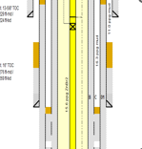
Operator Objective
Isolate C annulus from pressure source.
Perforate through 7-5/8” and 9-7/8” casing to access C annulus (9-7/8” X 13-5/8”)
Shoot second set of perforations if circulation or injection to the 13-5/8” shoe was not achievable.
Place 30 bbls of EPOX-Я™ through perforations.
C Annulus
Notes:
Not that we will get into the details, but the ballistic optimization that went into accessing the C Annulus was extensive and impressive.
Were not sure if were going to be able to breakdown the shoe or circular. Fortunately, the shoe was accessible.

Slide 4
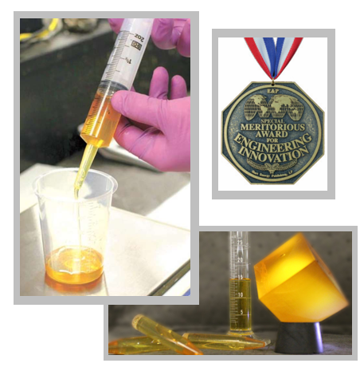
Resin Design
13.2 ppg density.
Resin chemistry design was based on an 80ºF target temperature.
Six (6) hours of handling time.
48 hour curing time.

Slide 5
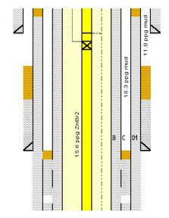
Operations
The CR was set at 5029’ with a 3-1/2” workstring.
Perforations were made through the 7-5/8” and 9-7/8” casings to access the C annulus (5,064’ – 5,078’).
Shot details: .25” diameter, 16 SPF, 60º phasing.
Injection was achieved with first phase of perforations at 3 bpm and 550 psi.
The 30 bbls of EPOX-Я™ was bull-head squeezed below the perfs.
Notes:
16 shots per foot over a 14’ foot interval.
Understand that our starting point for a resin application is less than 1 bpm and greater than 1,000psi.
Operator chose to move to a

Slide 6
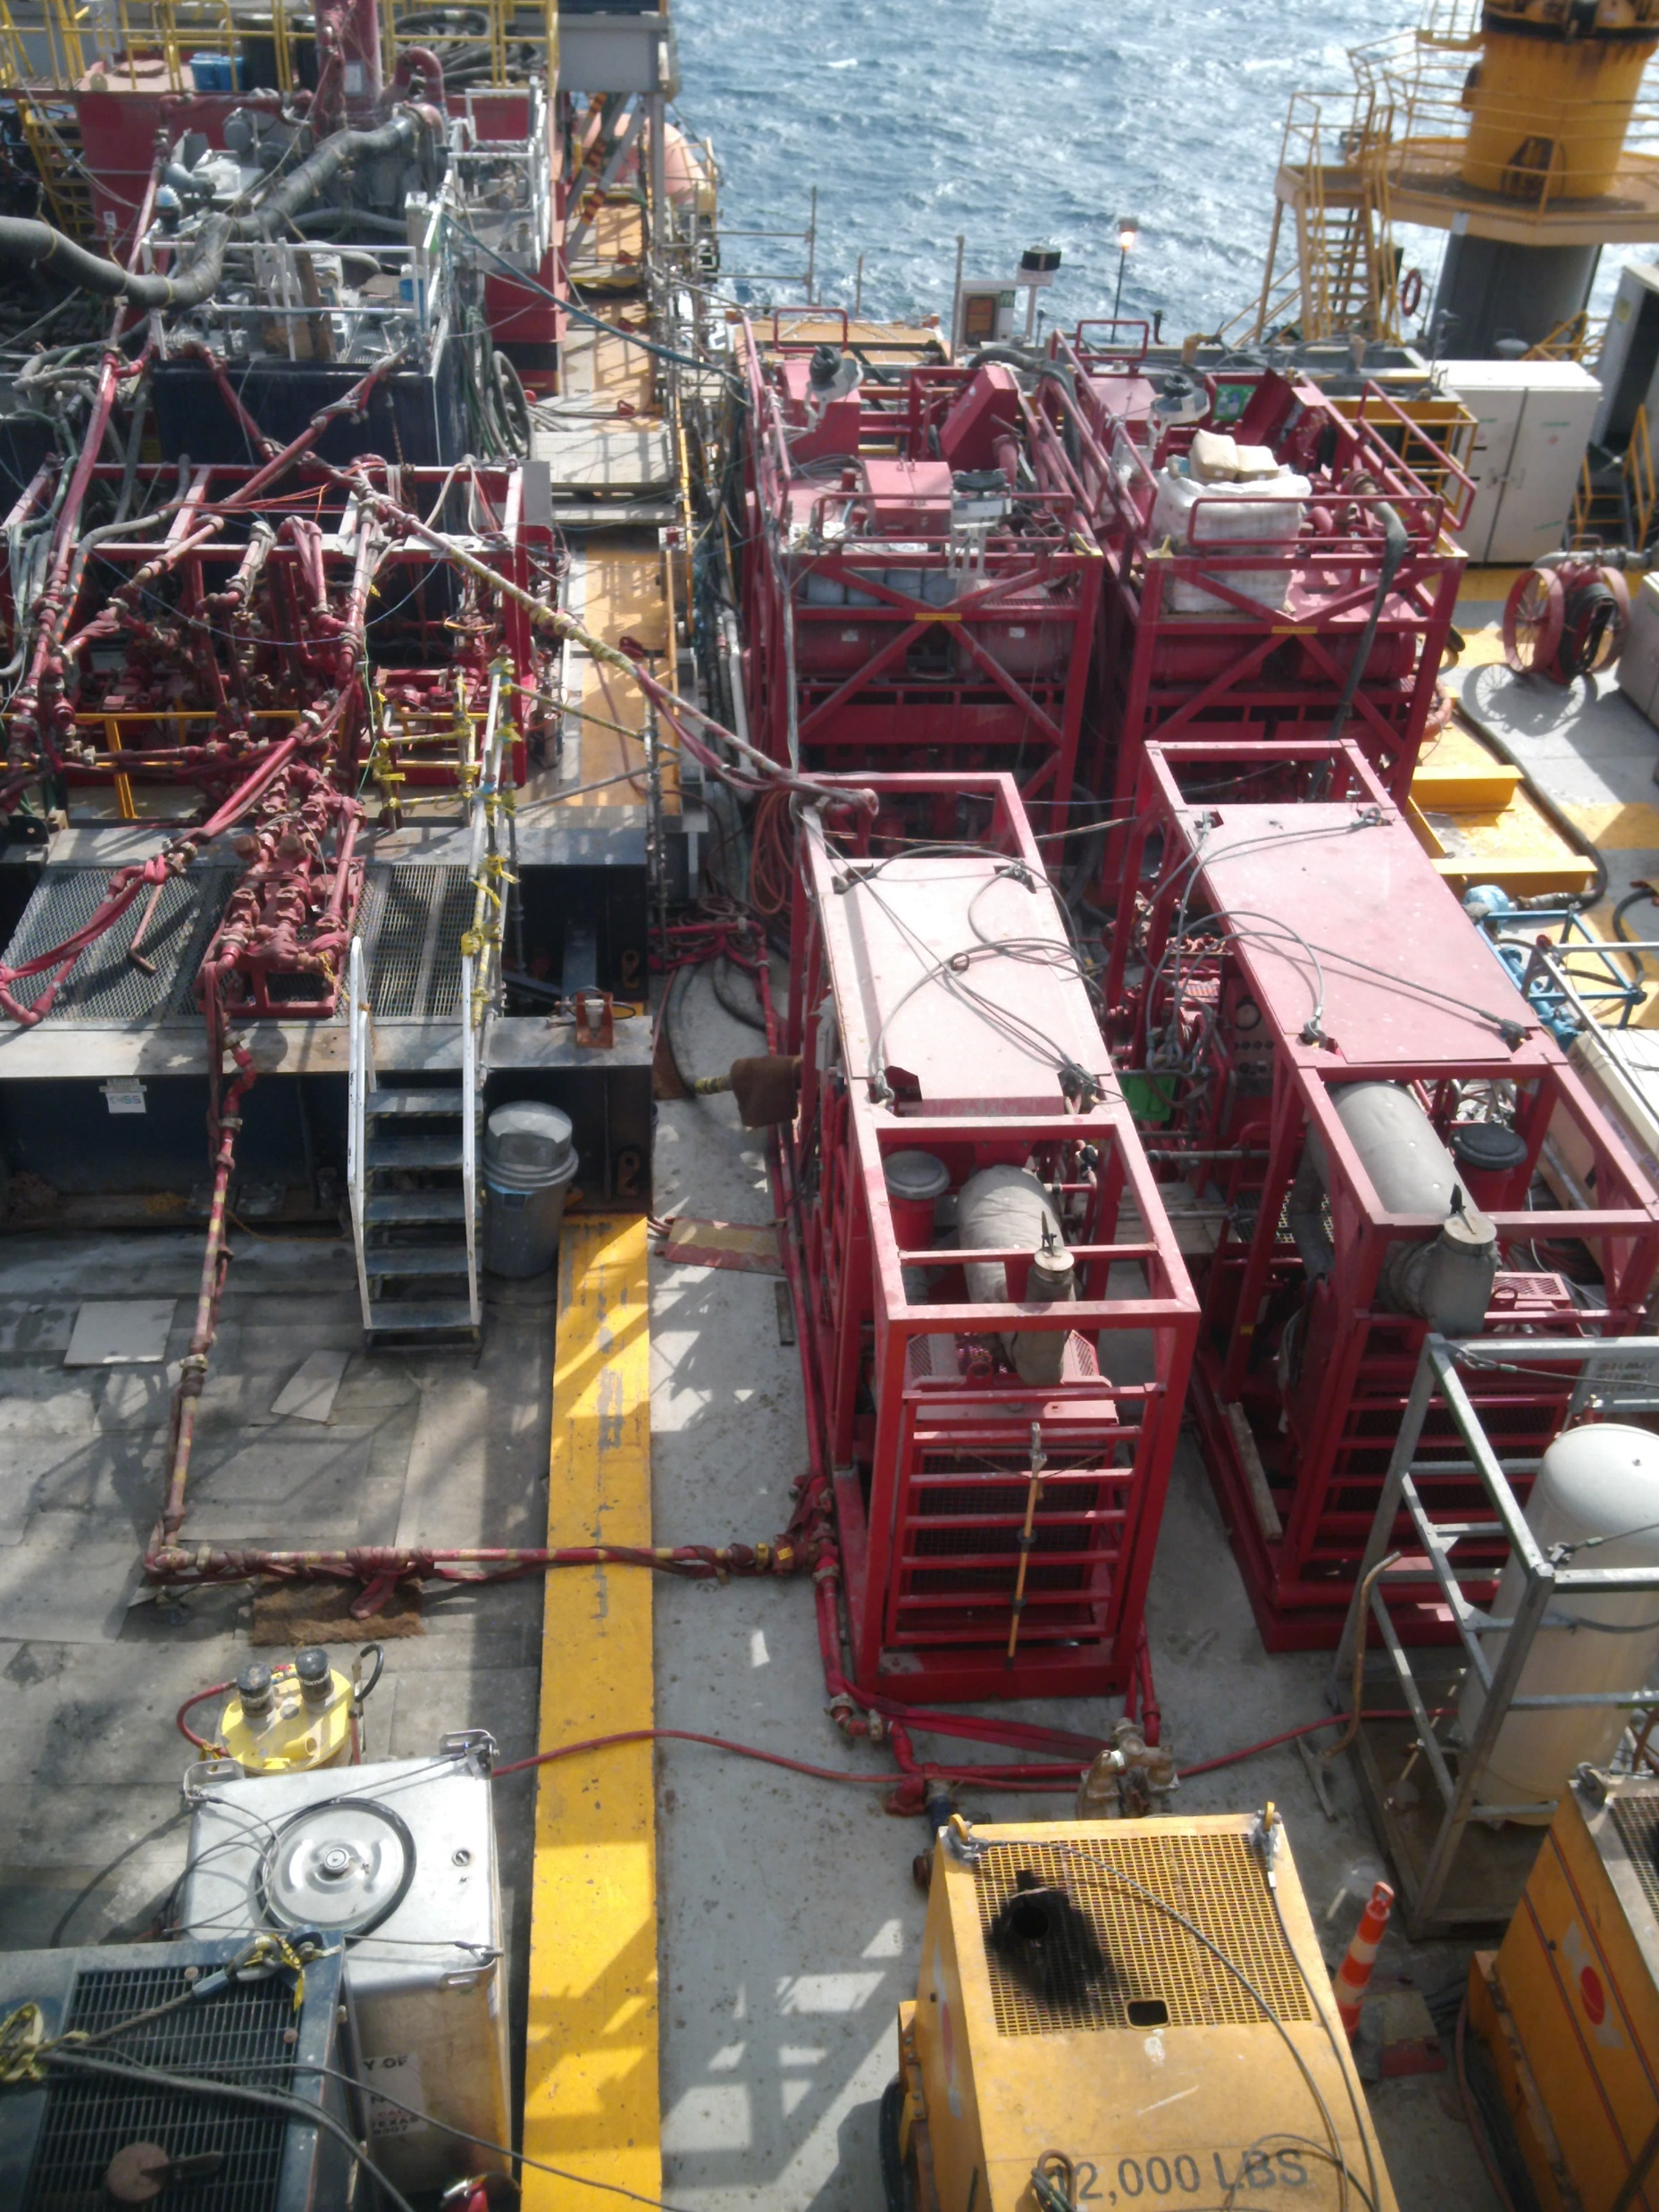
Mixing Logistics
Resin was prepared in a single batch with a conventional (cementing) 50-barrel batch mixer.
Resin components (base resin, weighting material, and hardener) were gravity fed into the mixing package.
Resin was displaced with 8.6ppg SW @ 3bpm.
Total pump time: 43 min
Cleaned surface equipment with vendor cleaning solution (provided).
Well was shut in for 48 hours for EPOX-Я™ to cure.

Slide 7
Post Treatment
After work string was circulated through to verify no residual resin remained, stung back into CR.
Pressured up on resin plug to 1,300 psi (39 psi bleed off over 30 min).
Operator agreed to a successful positive test.
Proceed to build-up test…

Slide 8
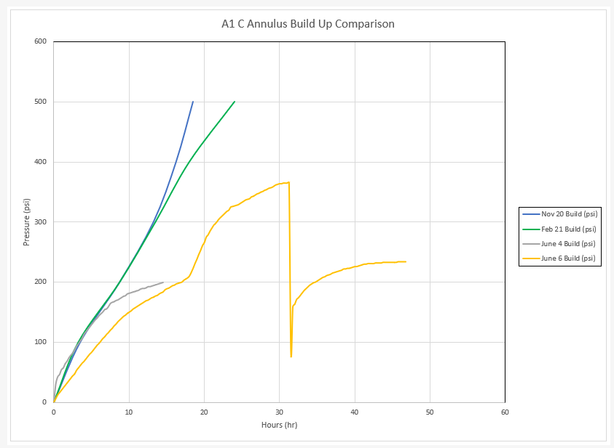
Pressure Anomaly expected to be from a migrating gas bubble.
Inadvertent Bleed Off during BOP Testing
12 psi pressure build in last 8 hours prior to bleed off.
First Build Up Test. Stopped at 13 hours
Notes:
The blue and green lines were historic build up rates.
The first 7 hours it appeared the resin plug was not success (similar to previous test)
Then we see an anomaly where the pressures looks to flatline. The first test was stopped at that point.
Operator decided to commit to a 48 hour build up test…the theory was that there was residual gas trapped in the C Annulus above the resin plug.
Continued to see favorable response.

Slide 9
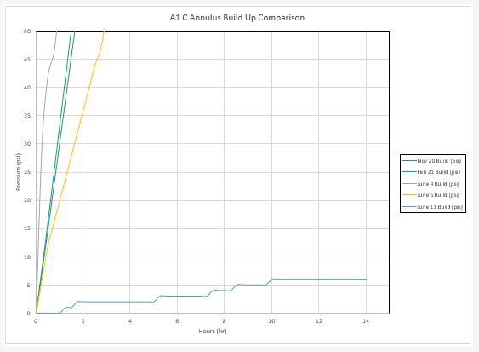
Notes:
After final venting of the well to atmospheric pressure, a third and final build up test was performed as is shown in this graph.
Notice the previous tests graphed to the left.
There was less 10 psi build up over a 14 period…I’ll let that sink in for a minute.

Slide 10
Summary
Prior to the resin treatment, the well built 500 psi annular gas pressure in less than 24 hours. (And continued to climb over a 2-3 day period to achieve ±1,800 psi).
Initially following resin treatment, pressure response reduced by 50% and flat-lined in the 200 – 300 psi range.
After extended bleed down and build up cycles, used to vent annular trapped gas above the newly installed resin barrier, pressure was effectively eliminated from the annular all together (<10 psi in 24 hours, and zero (0) gas bubble in 30 min.).

Slide 11
Conclusion
The annular resin plug was determined to have achieved all operational objectives and with BSEE approval, the C-Annulus intervention was considered successful.
Over one year after treatment the well continues to show negligible SCP.

Slide 12
Questions?

