Slide 1

CARBON TRANSITION
TOOLBOX
WILLIAM BARRETT | 01.19.2023

Slide 2
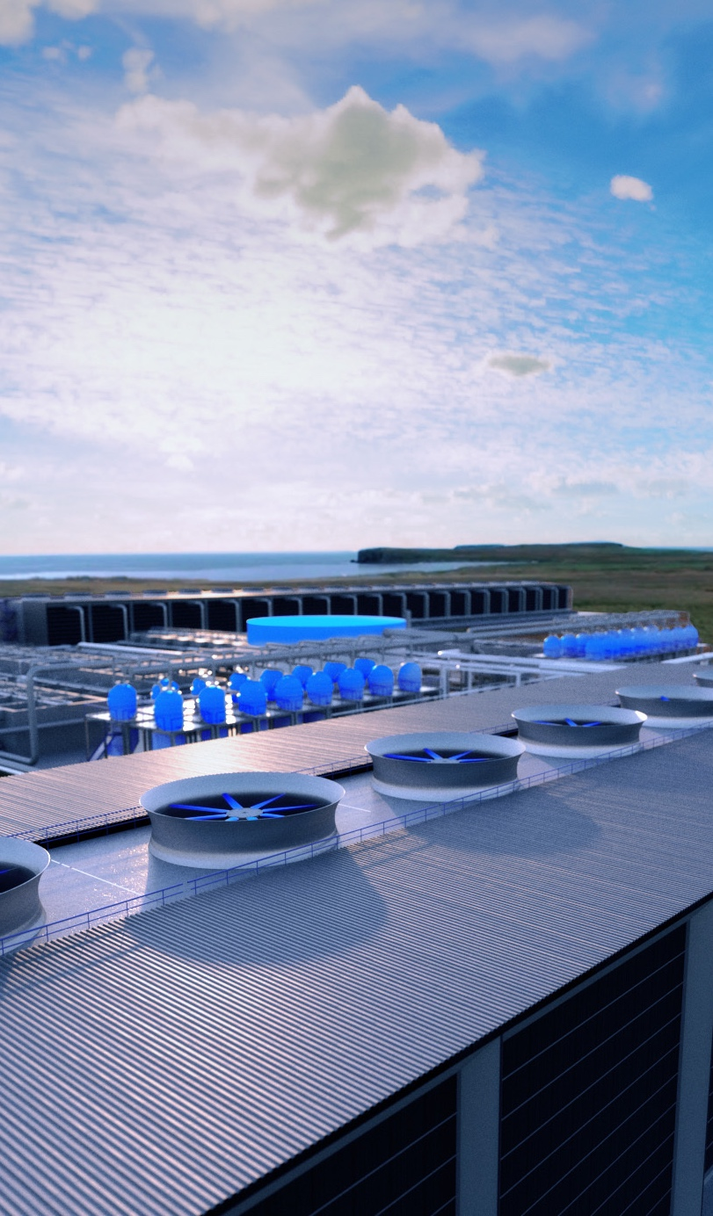
AGENDA
01
INTRO
02
DIRECT AIR CAPTURE
03
SEQUESTRATION
04
POINT-SOURCE CAPTURE
05
AIR TO FUELS™

Slide 3


3
Notes:
At 1PointFive, we're on a mission to help curb global temperature rise to 1.5°C by 2050.

Slide 4






FROM CAPTURE TO LOW-CARBON PRODUCTS
ZERO-EMISSION POWER
CO₂ TO FUEL SYNTHESIS
LOW-CARBON DIESEL AND JET FUELS MADE FROM ATMOSPHERIC CO₂
1PointFive plans to bolt on fuel synthesis processes to Direct Air Capture facilities and use the captured CO₂ to create low-carbon diesel and jet fuels. This process creates a synthetic fuel with an up to an estimated 90 percent emissions reduction factor (ERF) when compared to conventional diesel and jet fuels.
PRACTICAL SOLUTIONS TO HELP MEET CLIMATE OBJECTIVES
CARBON AS A FEEDSTOCK
The DAC technology utilized by 1PointFive inherently enables a high-purity CO₂ stream without additional high-energy, high-cost processing. This means our DAC CO₂ streams will be ready for use as a feedstock in CO₂ product manufacturing.
POINT-SOURCE CAPTURE
DIRECT AIR CAPTURE
GEOLOGIC SEQUESTRATION
This solution captures CO₂ before it enters the atmosphere. 1PointFive will engineer carbon capture equipment at industrial and manufacturing facilities such as those producing ethanol, steel, cement and biofuels. This CO₂ will be transported from the emitter's location and securely stored in CO₂ sequestration hubs.
Direct Air Capture (DAC) is the process of removing CO₂ directly from the air. DAC is expected to remove large volumes with a relatively small footprint very quickly—up to one million tonnes per year (MTPA), per facility. The CO₂ can then be securely stored in 1PointFive’s geologic sequestration hubs to generate a carbon removal credit, or be utilized for fuel synthesis or other purposes.
CO₂ sequestration hubs will be dedicated to underground CO₂ storage in saline formations. The sequestration process is supported by leading experts with decades of reservoir engineering experience. Globally recognized sequestration protocols will be in place to oversee monitoring, reporting and verification and the ongoing safety of the CO₂ storage.
Notes:
1PointFive is a Carbon Capture, Utilization and Sequestration (CCUS) platform.
By commercializing numerous decarbonization solutions, 1PointFive expects to provide practical options for organizations to reduce their carbon impact.
Currently, 1PointFive is developing solutions that include Direct Air Capture, point-source capture, geologic sequestration hubs and AIR TO FUELS™ facilities.

Slide 5



A HISTORY OF INNOVATION
AND EXECUTION
5
50 years carbon management experience
Experts in CO₂ separation, transportation, utilization and storage
Investing across the carbon capture value chain
Developing integrated solutions to address climate change
OXY FORMED 1POINTFIVE TO DEVELOP AND DEPLOY INTEGRATED CCUS SOLUTIONS.
Notes:
Though 1PointFive is a new force in the battle to meet global climate targets, we have a legacy of innovation and execution.
We are experts in managing the carbon lifecycle with skills and experience in CO₂ separation, transportation, utilization and storage.
We are part of the business unit within Oxy that is investing across the carbon capture value chain in emerging carbon markets.
We are an integrated CCUS platform, developed from combining technologies to create solutions for emitters to reduce their CO₂ impact through point-source capture and Direct Air Capture.
1PointFive's products and services can be contracted and purchased today.

Slide 6
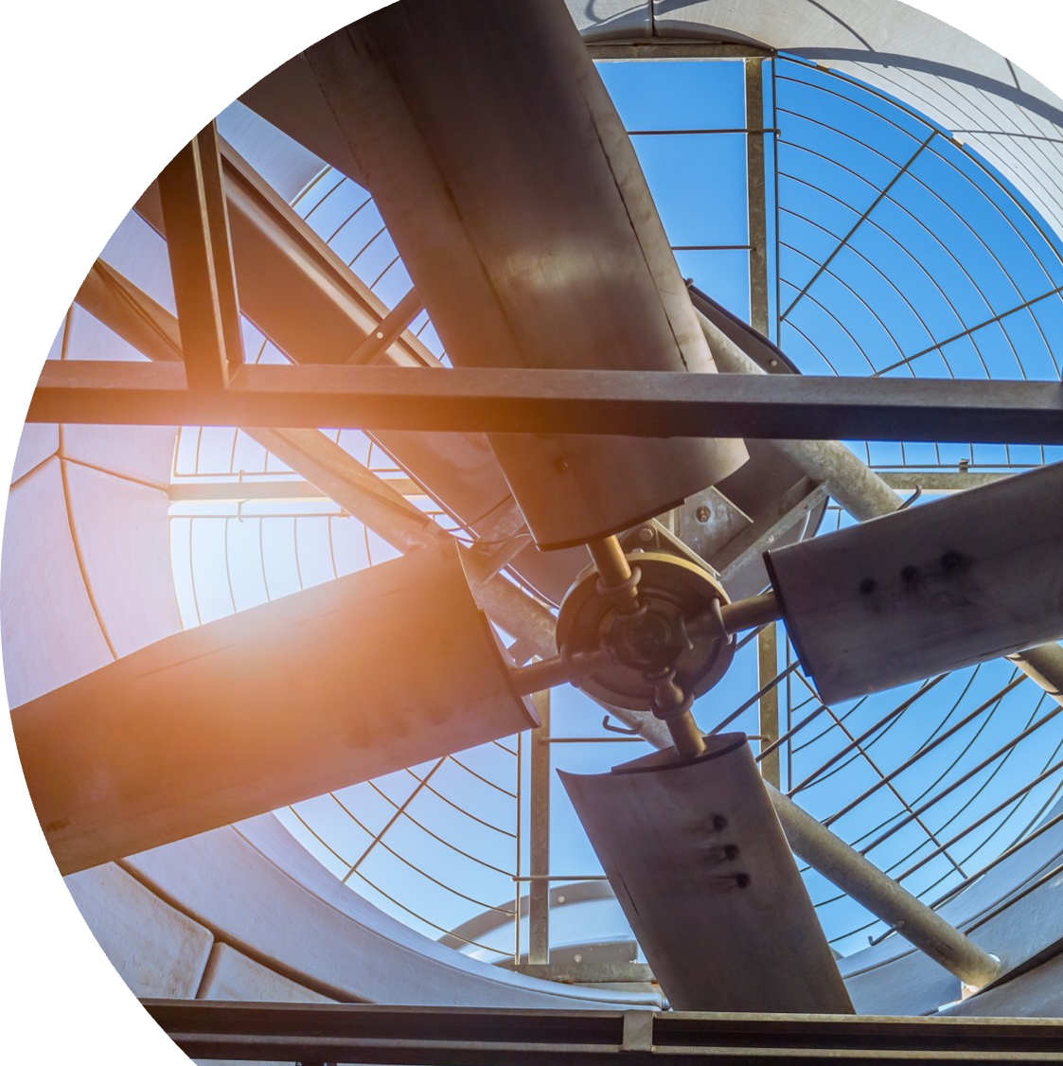
DIRECT AIR
CAPTURE
Notes:
1PointFive has teamed up with Carbon Engineering to deploy technologies to remove CO₂ from the atmosphere at scale.
What does that include?
First commercial DAC facility—the world's largest—to be built in the Permian Basin
Expected to remove up to one million tonnes of CO₂ annually
Expected operational in late 2024

Slide 7
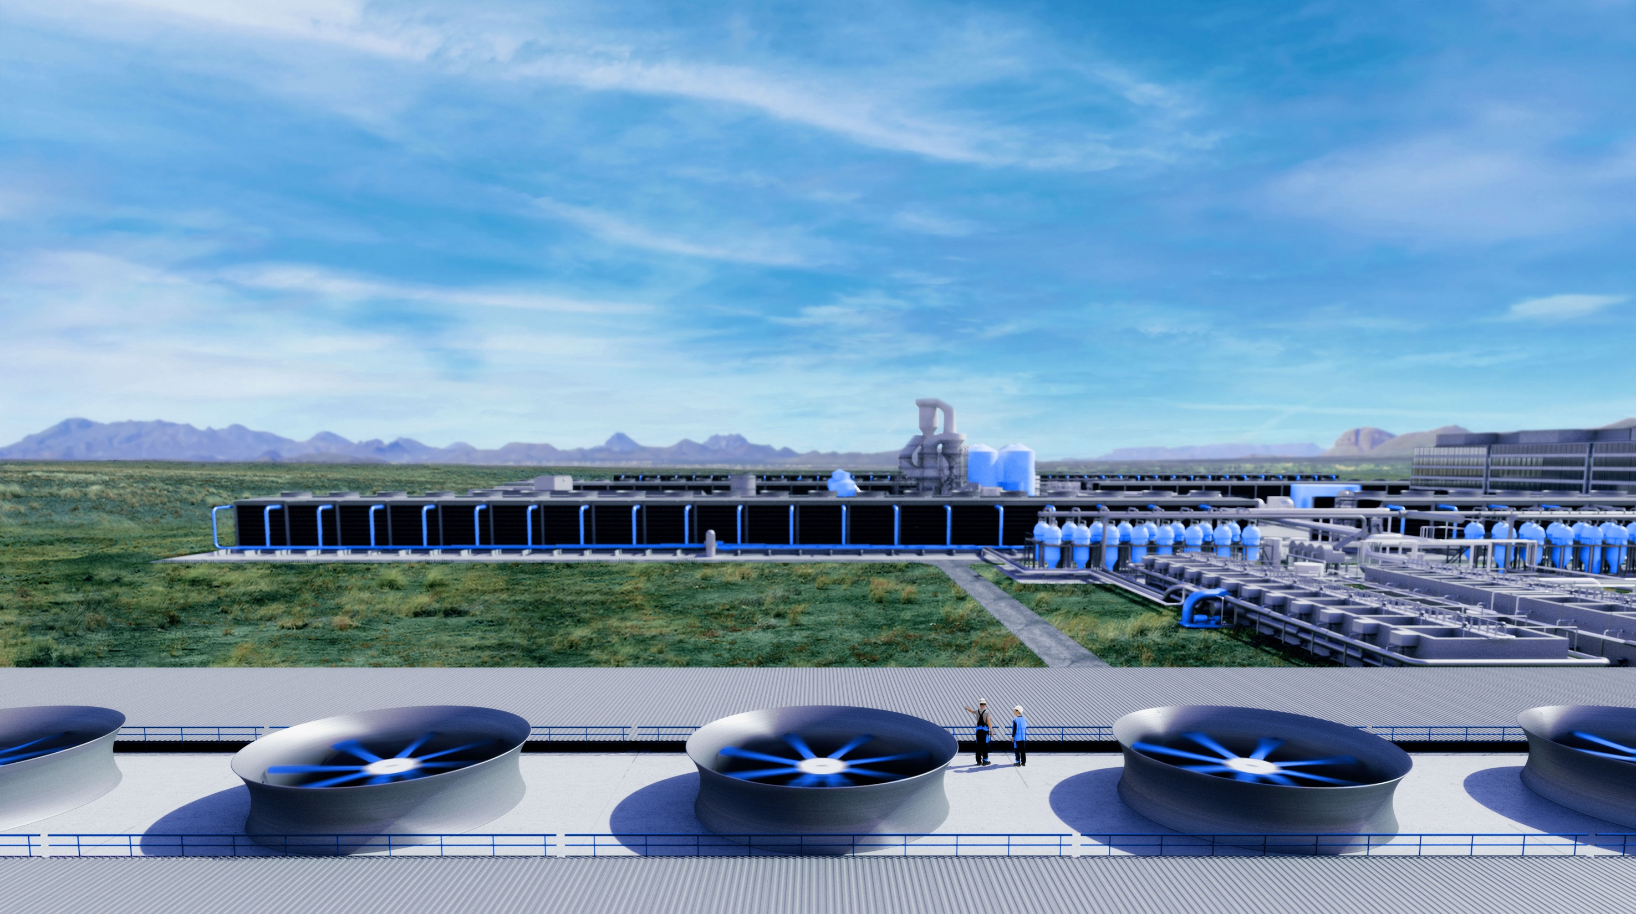

7
DIRECT AIR CAPTURE
Direct Air Capture uses mechanical means to extract CO₂ straight from the air, where it can be safely and securely stored underground or used to make products.
Notes:
Direct Air Capture uses mechanical means to extract CO₂ straight from the air, where it can be safely and permanently stored underground or used to make products.
DAC facilities using Carbon Engineering technology draw in CO₂-laden air and then remove the CO₂.
EPA-regulated 1PointFive sequestration sites bury that CO₂ deep underground.

Slide 8





CARBON REMOVAL
IS CRITICAL
8
~36,400 MTPA
280-418 PPM
ESTIMATED HUMAN-GENERATED CO₂ EMISSIONS PER YEAR
INCREASE IN ATMOSPHERIC CO₂ SINCE PRE-INDUSTRIAL TIMES
Even if we eliminated all emissions right now, it would not be enough to meet our collective climate goals.
LIMITING GLOBAL WARMING
TO 1.5°C
UP TO 15,000
MILLION
TONNES
WILL REQUIRE THAT ATMOSPHERIC CO₂ CONCENTRATIONS BE NO GREATER THAN 430 PARTS PER MILLION (PPM) BY 2050.
OF UNABATABLE EMISSIONS MUST BE REMOVED FROM THE ATMOSPHERE ANNUALLY BY 2050.
Notes:
We're responsible for more than 36 thousand megatonnes of CO₂ emissions per year.
Since pre-industrial times, the increase has been staggering... up to approximately 420 parts per million.
To avoid the worst impacts, we cannot allow it to exceed 430 ppm.
According to the IPCC's sixth Assessment, we will need to remove approximately 15,000 million tonnes of unabatable emissions from the atmosphere, annually through 2050.
To achieve such goals, carbon removals will be necessary.
Why is DAC a preferred method? We can measure how much CO₂ we capture and store. And it's permanent. We can track it and monitor it per United States EPA-approved programs.

Slide 9
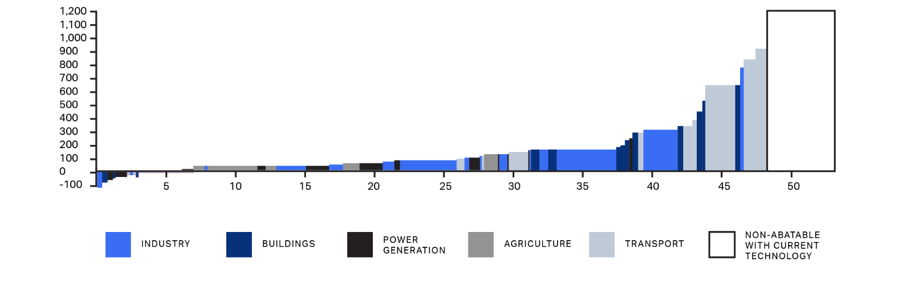
DAC ECONOMICS
9
A COMPETITIVE SOLUTION FOR THE
HARDEST-TO-DECARBONIZE INDUSTRIES
$/MT
3
4
DAC+S @ $450/t
DAC+S @ $250/t
DAC+S @ $125/t
GIGATONNES OF CO_{2e}
Abatement costs based on data from Goldman Sachs’ Carbonomics 2020
Notes:
Direct Air Capture is expected to provide a competitive solution for the hardest-to-decarbonize industries. Collectively that represents approximately 5,000 MTPA. The cost to abate for these industries is up to $1,000/tonne today.

Slide 10
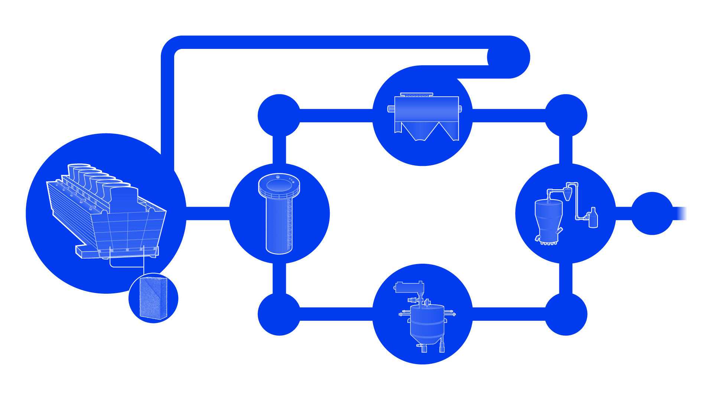

DAC
PROCESS
10
Refreshed
KOH
Pellet/Liquid
Solution
Calcium
Carbonate
Pellets
CENTRIFUGE
AIR OUT
The pellet/liquid solution is pumped into a centrifuge where the pellets are separated from the refreshed potassium hydroxide.
PELLET
REACTOR
CO₂
is transported for underground storage or product use.
AIR IN
The solution is pumped into a pellet reactor where calcium hydroxide is added, forming small pellets of calcium carbonate that hold the captured carbon.
CALCINER
SLAKER
The calcium carbonate pellets are moved to a calciner, exposed to high temperatures and converted into calcium oxide and CO₂.
The calcium oxide pellets are mixed with water in a Slaker forming calcium hydroxide which can be recycled back into the process.
AIR CONTACTOR
Large fans draw air into each unit where it is absorbed into a chemical solution of potassium hydroxide (KOH) and water, which bonds to the CO₂.
Calcium
Hydroxide
Calcium
Oxide
Pellets
KOH + H₂O
Notes:
Air is pulled into the facility with dozens of high-powered fans and sent through a series of processes that separate the carbon dioxide from other atmospheric molecules.
The isolated CO₂ is then converted into a liquid, which can be pumped underground to be safely and permanently stored or used as a feedstock from products that improve our quality of life.
A DAC facility will have large fans that draw air into each unit where it is absorbed into a chemical solution of potassium hydroxide and water, which bonds to the CO₂.
This bonding happens as the potassium hydroxide flows across a highly engineered PVC packing system designed to increase the surface area and amount of CO₂ captured.
Once the liquid solution reaches the unit's outlet, the process of concentrating the captured CO₂ begins.
First, the solution is pumped into a pellet reactor. Calcium hydroxide is added, forming small pellets of calcium carbonate that hold the captured carbon.
The pellet/liquid solution is pumped into a centrifuge where the pellets are separated from the refreshed potassium hydroxide.
The pellets are then dried while the potassium hydroxide liquid is filtered and recycled back to the air contactors to capture more CO₂.
From the centrifuge, the calcium carbonate pellets are moved to a calciner where they are exposed to high temperatures and converted into calcium oxide and carbon dioxide.
The captured carbon dioxide is sent off to be compressed, and either stored or utilized.
The calcium oxide pellets are recycled back into the process. They are first sent to a slaker, where, mixed with water, calcium hydroxide is formed and ready to go back into the pellet reactor, where it will be used again to create new calcium carbonate pellets.
With the CO₂ captured, separated, purified and compressed, it can be permanently stored deep underground or used as a feedstock for new products such as cement, plastics or even low-carbon fuels.

Slide 11
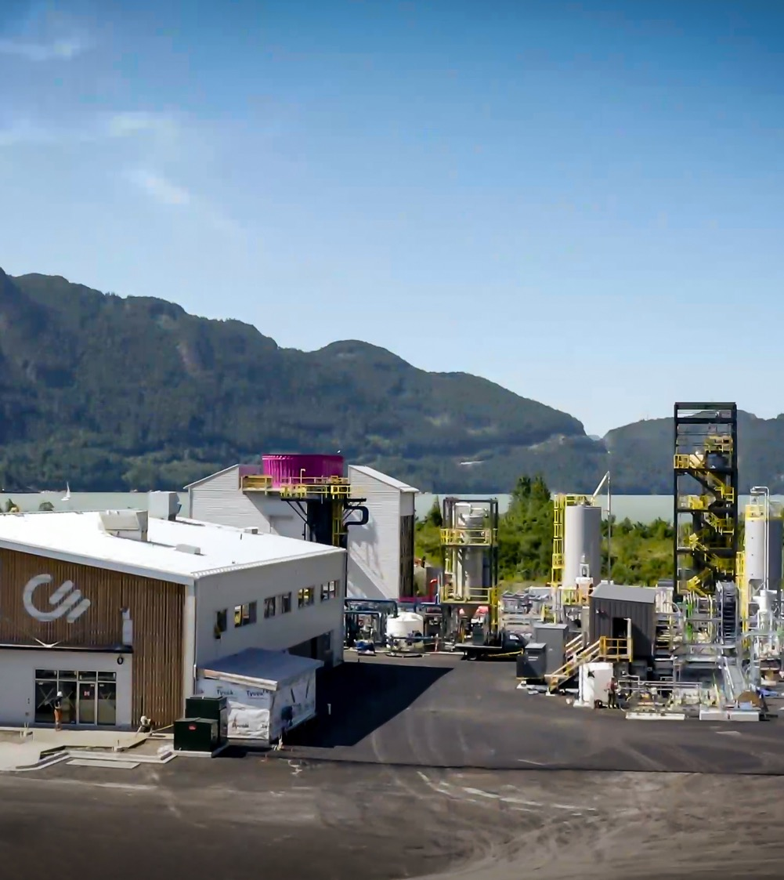
CARBON ENGINEERING’S
DAC TECHNOLOGY
11
GLOBAL DEPLOYMENT
PROVEN EQUIPMENT
& PROCESSES
Economic advantage
Supply chain strength
Improved scalability
Location agnostic
Decoupled from emitter
Strategic locations
CONTINUOUS OPERATION
CLOSED-LOOP
Enables megaton scale
Resource efficient
Minimal waste
Notes:
The advantages of Carbon Engineering’s DAC technology are significant.
Utilizes proven industrial-scale equipment and processes, served by known supply chains
Closed-loop process recycles chemical reactants
Continuous cycle enables megaton scale DAC – 24/7 operation
DAC technologies can be located in many areas around the globe

Slide 12
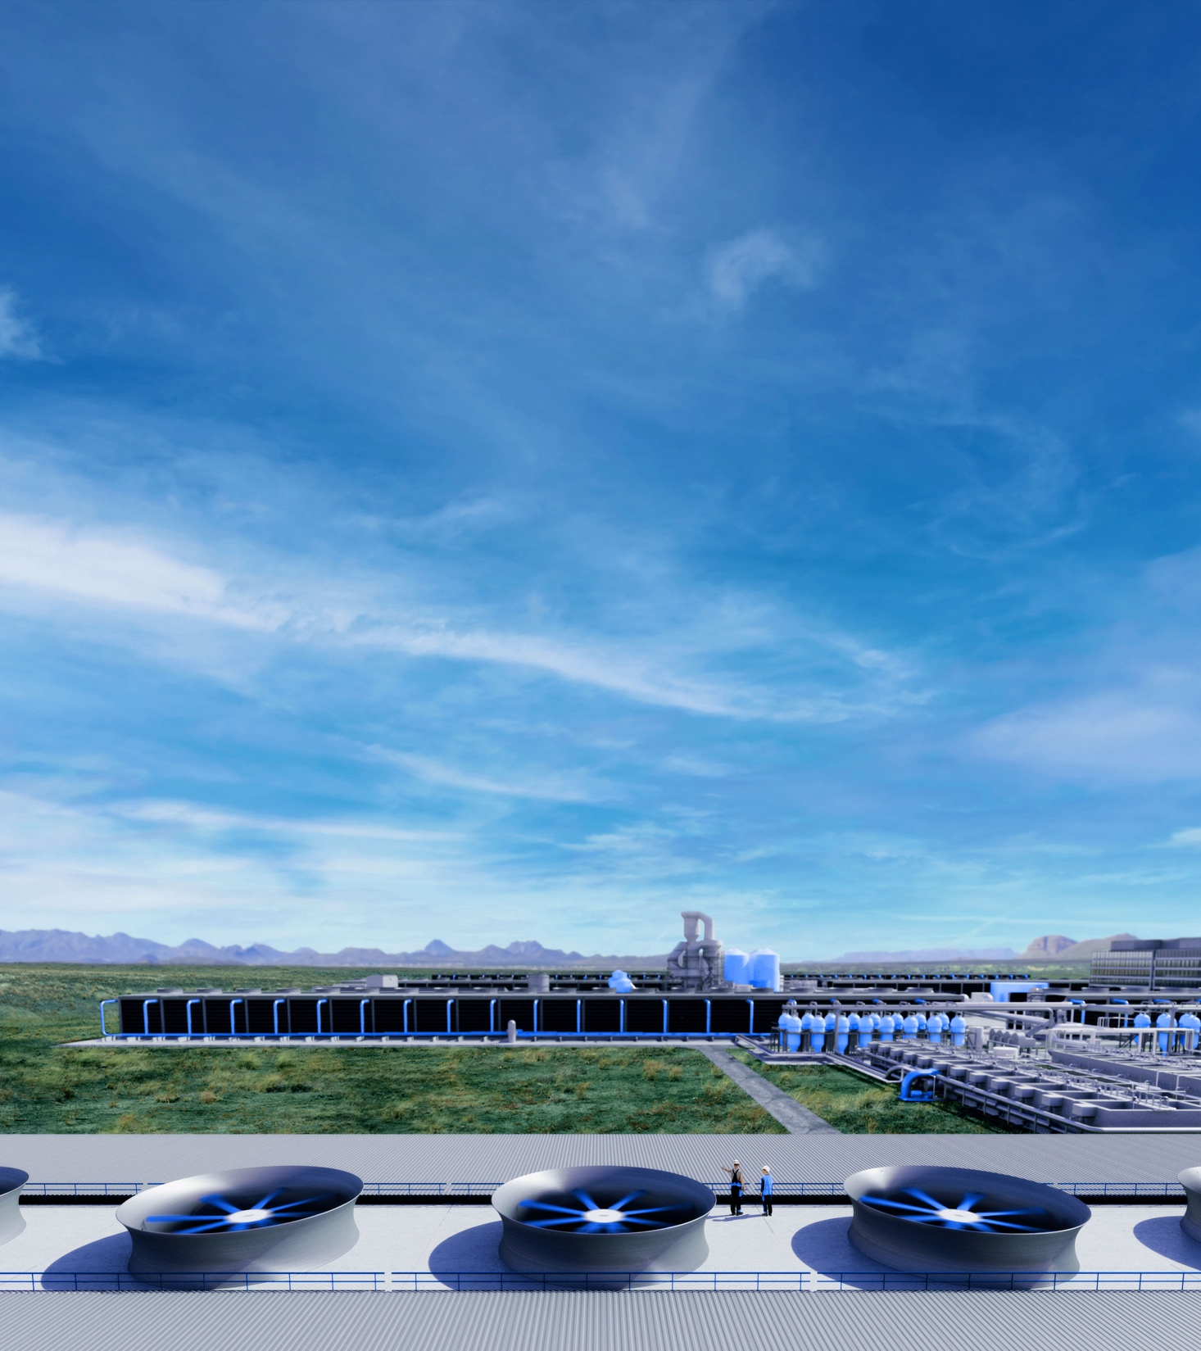
DAC 1: CURRENTLY
IN DEVELOPMENT
12
LICENSE TO BUILD
Exclusive DAC and AIR TO FUELS™ license for U.S. deployment and a worldwide agreement as the execution partner for all DAC and AIR TO FUELS™ deployments
INNOVATION CENTRE
Carbon Engineering Innovation Centre was built to develop and test technology advancements so improvements can be incorporated into commercial facilities worldwide
FEED COMPLETED
FEED was successfully completed this summer with a definitive agreement for the EPC contract expected by the end of 2022
CONSTRUCTION UNDERWAY FOR DAC 1
Site preparation and roadwork at the DAC 1 site in Ector County, Texas began in Q3 2022
Notes:
Already, we are taking important strides toward broad development and commercialization.
This now includes holding an exclusive license for Direct Air Capture and Air-to-Fuels development in the United States. Additionally, OLCV has an agreement to be execution partner for all Carbon Engineering DAC and Air-to-Fuels technologies worldwide.
Oxy Low Carbon Ventures is working with Carbon Engineering in their new innovation center which provides large-scale process capability to advance improvements not only for DAC plant 1, but importantly for future generations of plants.
With Worley, we are nearing completion of Front-End Engineering and Design for 1PointFive’s first Direct Air Capture facility, which is anticipated to be in the Permian Basin — Startup is expected late 2024.

Slide 13

CCUS PROTOCOLS AND METHODOLOGIES
1PointFive is working with the CCS+ initiative to establish a globally recognized methodology for monitoring, tracking and verifying carbon removals and secure geologic sequestration.
FOUNDING MEMBER OF CCS+ INITIATIVE
To ensure environmental integrity through proper carbon accounting and independent verification of climate benefits, CCS+ will develop a comprehensive methodological framework under the Verified Carbon Standard (VCS), which is managed by Verra.
Notes:
High-integrity, internationally recognized CCUS protocols and methodologies for generating tax and carbon credits are paramount for scaling the CCUS industry.
We are very familiar with these protocols and methodologies, as well as the governing bodies and industry institutions involved.
We secured the first two monitoring, reporting and verification (MRV) plans approved by the United States Environmental Protection Association, and we've been reporting under these for over a decade to generate 45Q tax credits.
We filed the first California Air Resources Board (CARB) reservoir permanence certification for EOR to generate LCFS credits.
And we are a founding member of the CCS+ Initiative, which is developing an expansive set of CCS methodologies for use in the voluntary and international (Article 6) carbon markets.

Slide 14

DAC CARBON REMOVAL CREDITS
CO₂ MONITORING
AND REPORTING VERIFIED BY VVB
CREDITS ISSUED
TO 1POINTFIVE
1POINTFIVE
SELLS CREDITS
CREDITS RETIRED
FROM REGISTRY
Our credits will comply with globally recognized methodologies and standards for carbon removal and sequestration.
Each project will be validated by an independent validation and verification body (VVB).
Notes:
This is the process for generating carbon removal credits with DAC facilities by removing CO2 from the atmosphere.
1. 1PointFive monitors CO₂ capture and sequestration and submits validation, monitoring and verification reports to the Carbon Standard and Registry, in accordance with the approved methodology.
2. Credits are issued to 1PointFive by the Carbon Standard and listed on the registry.
3. 1PointFive sells issued carbon removal credits to end users.
4. The end user removes carbon liability, and the credit is retired from the carbon registry.
Our credits will comply with the approved methodology of the Carbon Standard and Registry.
This reporting process happens every quarter.

Slide 15
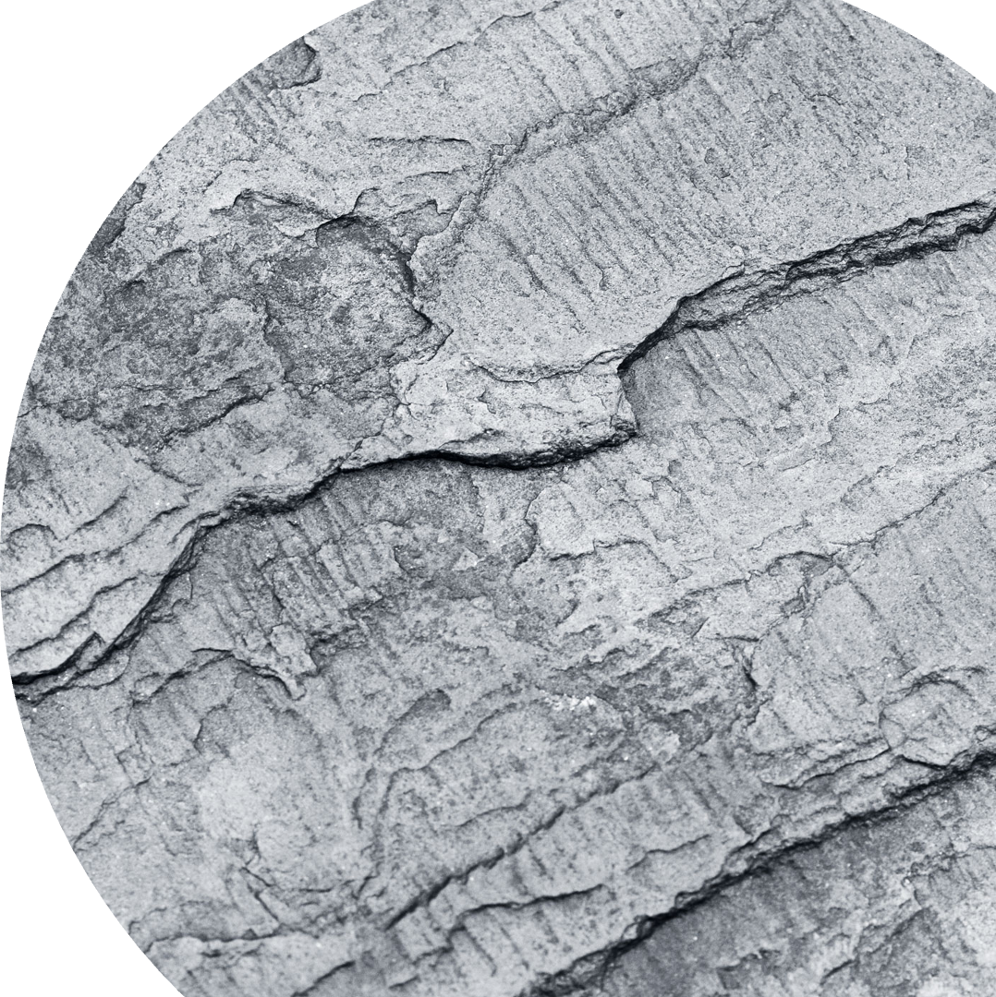
SEQUESTRATION
Notes:
1PointFive is developing CO₂ sequestration hubs that will be dedicated to underground CO₂ storage in saline formations. These hubs will aggregate CO₂ from multiple point source emitters and may also be anchored by Direct Air Capture facilities for permanent CO₂ storage.

Slide 16
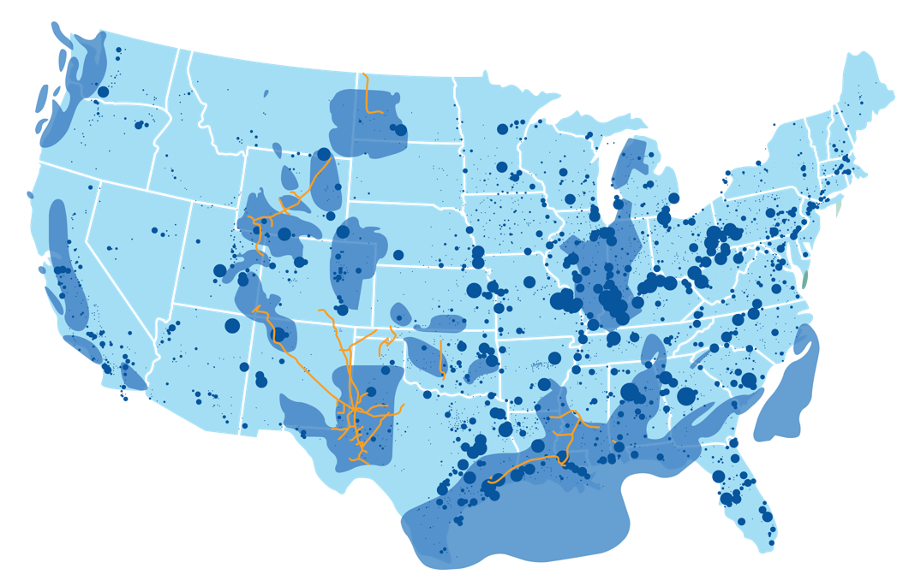

MAJOR U.S. EMISSION SOURCES
Strategically located CO₂ transportation and storage infrastructure can help provide decarbonization solutions for industrial emitters
Existing CO₂ Pipelines
CO₂ Sources
Suitable CO₂ Storage Geology
Source: DOE’s public NATCARB database
Notes:
The plan is to establish sequestration hubs in regions where emitters are concentrated. Here is glimpse of the location of major emission sources as well as potential storage area.
There are currently ___ gigatons of storage capacity available in the U.S.
Globally, the total geologic CO₂ storage capacity has been estimated to be as large as 55 gigatons.

Slide 17



TYPICAL
SEQUESTRATION
WELL DEPTH
17
Sequestration sites will have multiple monitoring wells for every CO₂ injection well to monitor the CO₂ trapped in the storage reservoir deep below the surface
IMPERMEABLE
CAPROCK
5,000 FT –
7,500 FT
> 100 FT
THICK
INJECTION WELLS
IMPERMEABLE CAPROCK
Notes:
Injection wells, which are used to get the CO₂ deep underground, will typically run between 5,000 and 7,500 feet below the surface. Primary storage of CO₂ usually be between 6,000 and 7,500 feet underground, below a primary seal, or caprock, that is greater than 100 feet thick.
These storage reservoirs will be several thousand feet below the deepest underground source of drinking water (USDW).

Slide 18
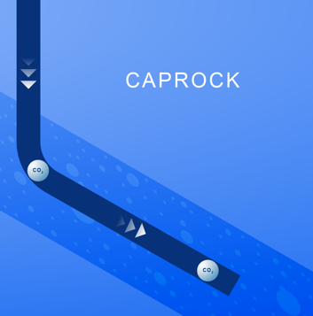

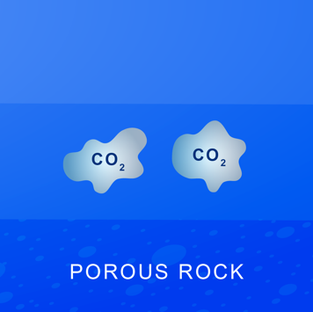

SAFELY, SECURELY STORED CO₂
18
NATURALLY OCCURRING TRAPPING MECHANISMS
STRATIGRAPHIC
Impermeable caprock
isolates the CO₂
RESIDUAL
CO₂ is immobilized and contained in tiny pores
SOLUBILITY
CO₂ dissolves into naturally occurring salty brines
MINERAL
CO₂ becomes part of the rock
Notes:
Once underground, the CO₂ is trapped by a variety of naturally occurring mechanisms.
Stratigraphic trapping
A non-porous, impermeable caprock serves as a giant lid, isolating any CO₂ that is injected below it. This rock can be hundreds of feet thick. These barriers can store hydrocarbons for millions of years.
Residual trapping
These reservoirs are not large, hollow spaces. They’re composed of huge strata of porous rock, more like a sponge than a cave. When residual trapping occurs, the CO₂ is contained within the tiny pores of the rock itself and rendered immobile.
Solubility trapping
Injected CO₂ can also dissolve into the salty brines that naturally occur within the reservoir. This process of molecular diffusion is caused by varying concentration gradients. This dissolution increases the density of brines, causing them to sink even lower in the formation—reducing upward migration of CO₂ and increasing reservoir storage capacity.
Mineral trapping
With this form of trapping, the liquid CO₂ interacts with minerals present in the rock formation at the molecular level via a series of geochemical reactions. These reactions result in the formation of new, solid and stable carbonate minerals which are practically immobile. The CO₂ actually becomes part of the rock.

Slide 19
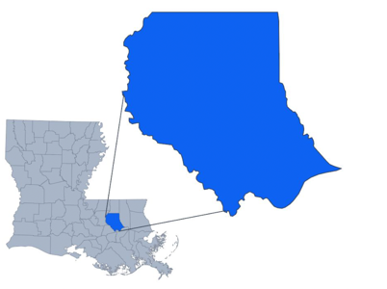
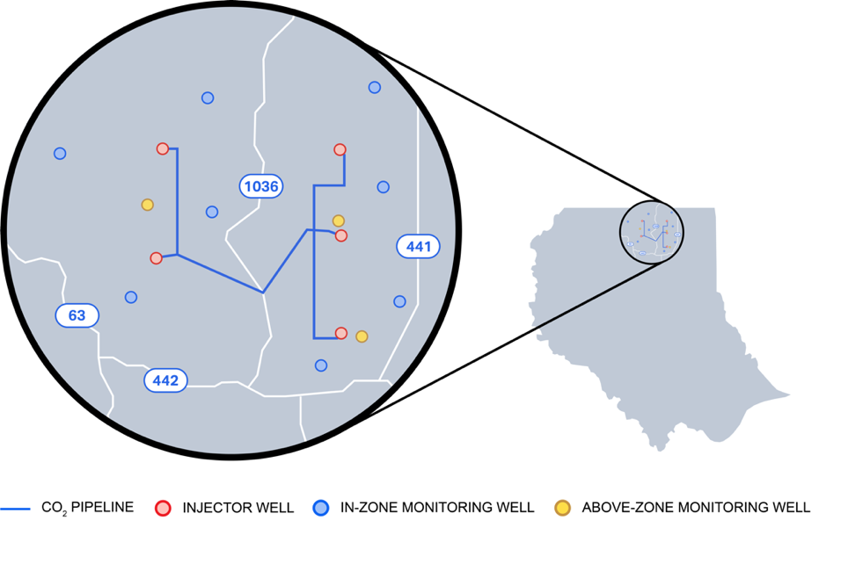
~6 MTPA
OF CO₂ STORAGE CAPACITY
EXPECTED IN 2025
19
HUB 1
LIVINGSTON PARISH, LA
5 to 6 CO₂ injection wells
8 to 10 monitoring wells
Leased land from Weyerhaeuser Company
Surface will remain working forest (minimal wellpad footprint)
Notes:
1PointFive has leased land from Weyerhaeuser Company to develop a carbon sequestration hub in Livingston Parish in Louisiana. Plans are for the hub to store six million tonnes of CO₂ per year starting in 2025.

Slide 20



CLASS VI WELLS AND
MONITORING PROGRAMS
20
MONITORING PRESSURE, TEMPERATURE, CORROSION, WATER AND SOIL
Reviewed and permitted by the U.S. Environmental Protection Agency (EPA)
Highly engineered wells featuring multiple layers of steel casing and cement
Designed specifically to protect underground sources of drinking water
Notes:
The geologic sequestration of CO₂ employs highly engineered wells that feature multiple layers of steel casing and cement. In the United States, these are known as Class VI wells and are rigorously reviewed and permitted by the United States Environmental Protection Agency (EPA). These structures are designed and engineered specifically to protect underground sources of drinking water and ensure safe long-term CO₂ storage.
We will have EPA-approved programs in place to monitor pressure, temperature, corrosion, water and soil. The programs will remain in place throughout construction and during ongoing operations. In-zone and above-zone monitoring wells enable us to keep an eye on subsurface fluid movement and make sure the CO₂ remains in the storage area, safely beneath the caprock.

Slide 21
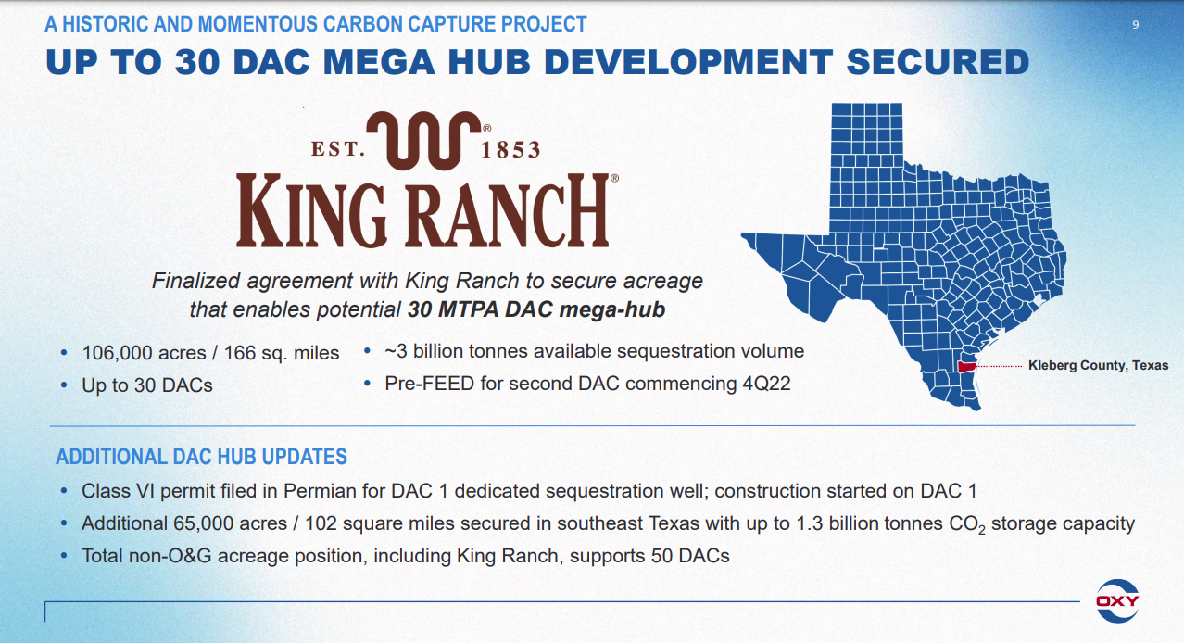
21
Notes:
The geologic sequestration of CO₂ employs highly engineered wells that feature multiple layers of steel casing and cement. In the United States, these are known as Class VI wells and are rigorously reviewed and permitted by the United States Environmental Protection Agency (EPA). These structures are designed and engineered specifically to protect underground sources of drinking water and ensure safe long-term CO₂ storage.
We will have EPA-approved programs in place to monitor pressure, temperature, corrosion, water and soil. The programs will remain in place throughout construction and during ongoing operations. In-zone and above-zone monitoring wells enable us to keep an eye on subsurface fluid movement and make sure the CO₂ remains in the storage area, safely beneath the caprock.

Slide 22
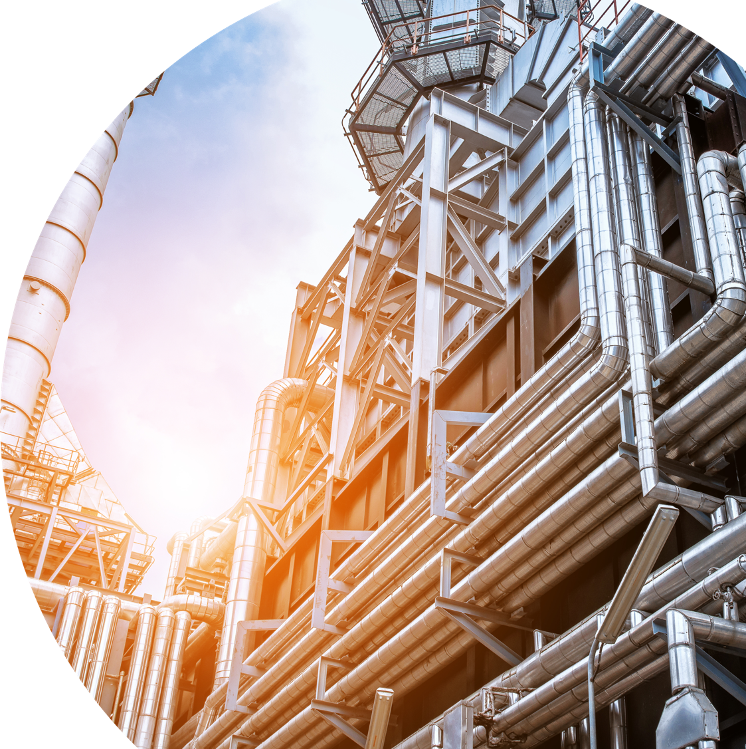
POINT-SOURCE
CAPTURE
Notes:
This process captures CO₂ from industrial facility processes before it enters the atmosphere.

Slide 23
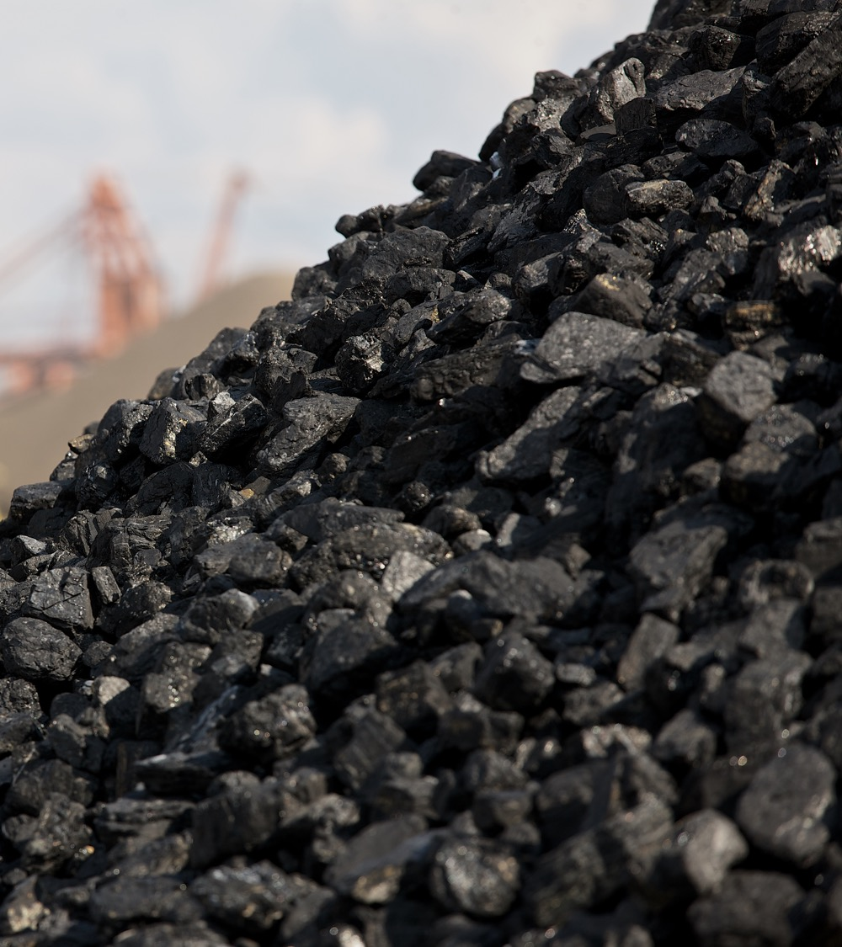
POINT-SOURCE CAPTURE
Notes:
1PointFive supports industrial and manufacturing facilities such as ethanol, steel, cement, biofuels and LNG, by engineering and developing capture plants at their facilities.
This CO₂ is transported and permanently stored in CO₂ sequestration hubs. This enables production of end products with a lower carbon intensity because they were produced without adding CO₂ to the atmosphere.
Whatever business or industry you're in, if you have emissions challenges, we can work with you to solve them.

Slide 24

COMPREHENSIVE PROJECT SUPPORT
PROVIDING CAPTURE EXPERTISE ACROSS THE ENTIRE PROJECT LIFECYCLE
FEASIBILITY
ANALYSIS
CAPTURE FACILITY
ENGINEERING, CONSTRUCTION AND COMMERCIAL & FINANCING AGREEMENTS
CO₂
TRANSPORTATION
CO₂
SEQUESTRATION
Notes:
We provide capture expertise across the entire project lifecycle. From feasibility analysis to the engineering and construction of the capture facility. As well as the CO₂ transportation to a hub and, ultimately, the sequestration itself.
We can come in and do analysis to see if you can make money
Determine where the best capture points in your facility are
Help decide what to do with the CO₂

Slide 25





SUPPORTING POINT SOURCE CAPTURE PROJECTS ACROSS INDUSTRY SECTORS
ETHANOL
Carbon capture and transportation of CO₂ from two ethanol plants in Texas expected in 2024
BIOFUELS
Providing offtake, transportation and sequestration for biomass-to-fuels project in Natchez, Mississippi
COAL-FIRED POWER
Providing consulting services for world's largest CO₂ capture facility for power plant in North Dakota
CEMENT
Assessing viability and design of commercial-scale capture facility at a cement facility in Florence, Colorado
LNG
Plans to offtake and securely store CO₂ captured from planned LNG project in Brownsville, Texas
Notes:
We have been actively engaged in CCS project development and advisory services for several years, leveraging our experience to support projects across the United States.
Ethanol
Carbon capture and transportation of CO₂ from White Energy’s two ethanol plants in Texas
Expect to capture up to 700,000 TPA CO₂
CO₂ to be sequestered in CARB/MRV field in the Permian Basin
Biofuels
CO₂ offtake, transportation and sequestration of CO₂ captured from planned Velocys’ Bayou Fuels biomass-to-fuels project in Natchez, Mississippi
This project is expected to make Velocys’ facility a net-negative emitter of CO₂, enabling zero-carbon transportation fuels
Coal-fired power
Led by the Minnkota Power Cooperative, this project is to build the world’s largest CO₂ capture facility at the Milton R. Young Station, a coal-fired power plant in North Dakota
LCV is providing carbon storage consulting services and recently supported with Class VI permitting
Cement
LCV is engaged on a joint pre-FEED study to assess the viability and design of a commercial scale CO₂ capture facility at the Holcim Portland Cement Plant in Florence, Colorado
The capture project would be designed to capture 725,000 TPA CO₂ to be stored in geologic sequestration
LNG
Plans to offtake and permanently store CO₂ captured from NextDecade’s planned Rio Grande LNG project in the Port of Brownsville, Texas
Expected to enable the capture and permanent sequestration of more than
5 MTPA CO₂

Slide 26
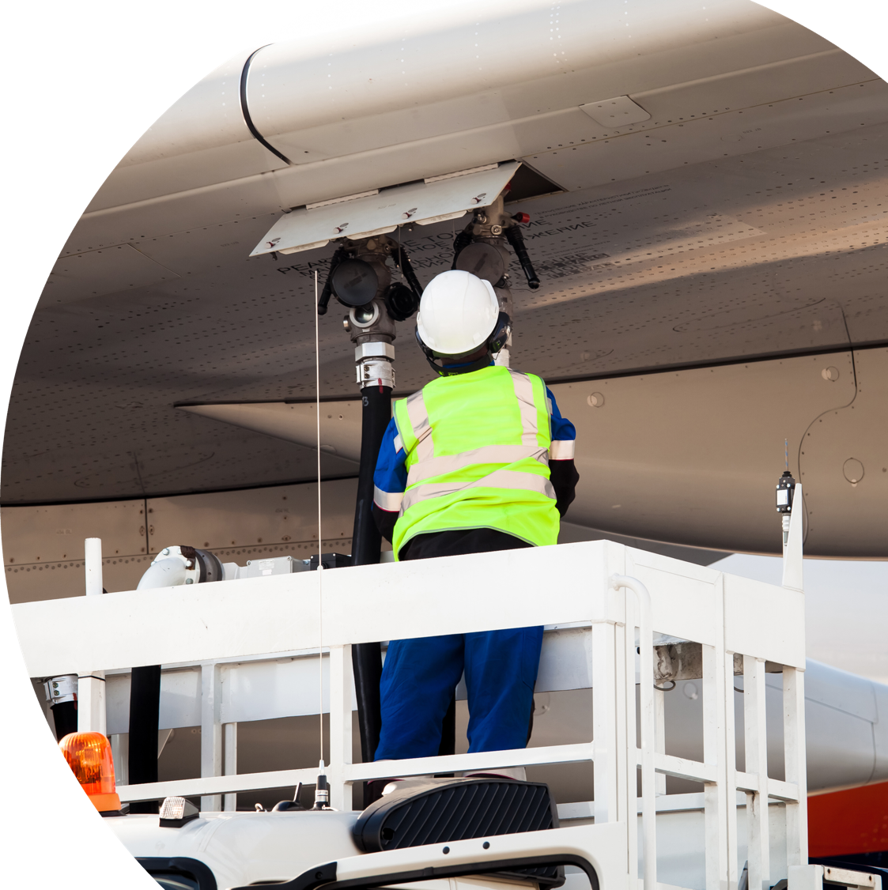
AIR TO FUELS™
Notes:
Utilizing CO₂ captured from the air, 1PointFive plans to attach fuel synthesis processes to Direct Air Capture facilities in order to create low-carbon diesel and jet fuels.

Slide 27
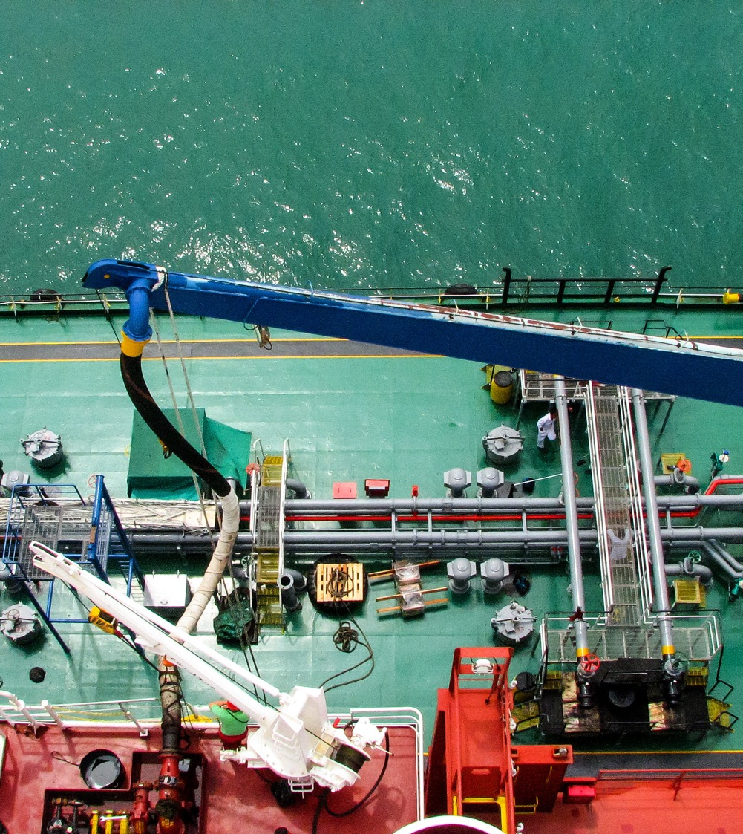
SYNTHETIC
LOW-CARBON FUELS
27
THE FUTURE OF TRANSPORTATION
Up to estimated 90% emissions reduction factor (ERF)
Highly competitive carbon intensity vs. renewables fuels
Requires no change in diesel of jet engines
Can be blended with conventional fuels
Meets ASTM standards
Creates drop-in fuels
Uses proven processes and equipment
Notes:
AIR TO FUELSTM facilities can be co-located with Direct Air Capture sites. Pure CO₂ captured from DAC will feed into the process to synthesize diesel or jet fuel. The benefits are significant.
Produces low-carbon fuels with up to ~90% emissions reduction factor (ERF) when compared to conventional diesel and jet fuels
Provides highly competitive carbon intensity versus competing renewable fuels that are capable of scale to large volumes
Requires no change in diesel or jet engines to operate and can be blended up to 50% with conventional fuels
Meets American Society for Testing and Materials (ASTM) standards
Creates drop-in fuels, keeping costs competitive
Uses proven processes and equipment

Slide 28

AIR TO FUELS™ PROCESS
28
Eliminating feedstock constraints for large-scale production
Fuels can be produced via several fuel synthesis processes
Diesel, jet-fuel, LNG, methanol
ILLUSTRATIVE FISCHER-TROPSCH (FT) PROCESS
O₂
H₂
H₂ + CO₂
H₂ + CO
DAC
ELECTROLYZER
SYNGAS REACTOR
FT REACTOR
LOW-CARBON FUEL
Notes:
Using CO₂ eliminates feedstock constraints for large-scale fuel production.
This can be achieved through a multiple of fuel synthesis processes and 1PointFive and Carbon Engineering are exploring all of them.

Slide 29
SCALE WITH LOWER CARBON IMPACT
29
AIR TO FUELS™ SAFs represent a new class of fuel that has lower carbon intensity than most biofuels and is more scalable.
HIGH PRODUCTION VOLUME
conventional FUELS
AIR TO FUELS™
PRODUCTION SCALE
BIOFUELS*
CI RANGE
15–45, AVG 30
LOW PRODUCTION VOLUME
100
50
25
0
CARBON INTENSITY (CI), gCO₂e/MJ
Notes:
AIR TO FUELSTM SAFs represent a new class of fuel that has lower carbon intensity than most biofuels and is more scalable.
Up to 90% emissions reduction factor (ERF) when compared to conventional jet fuels¹
Carbon intensity as low as <10 gCO₂e/MJ¹
Fully scalable
Proven technologies and processes
No technological blending limits
Location flexibility
Small footprint for production facilities
¹Company data

Slide 30
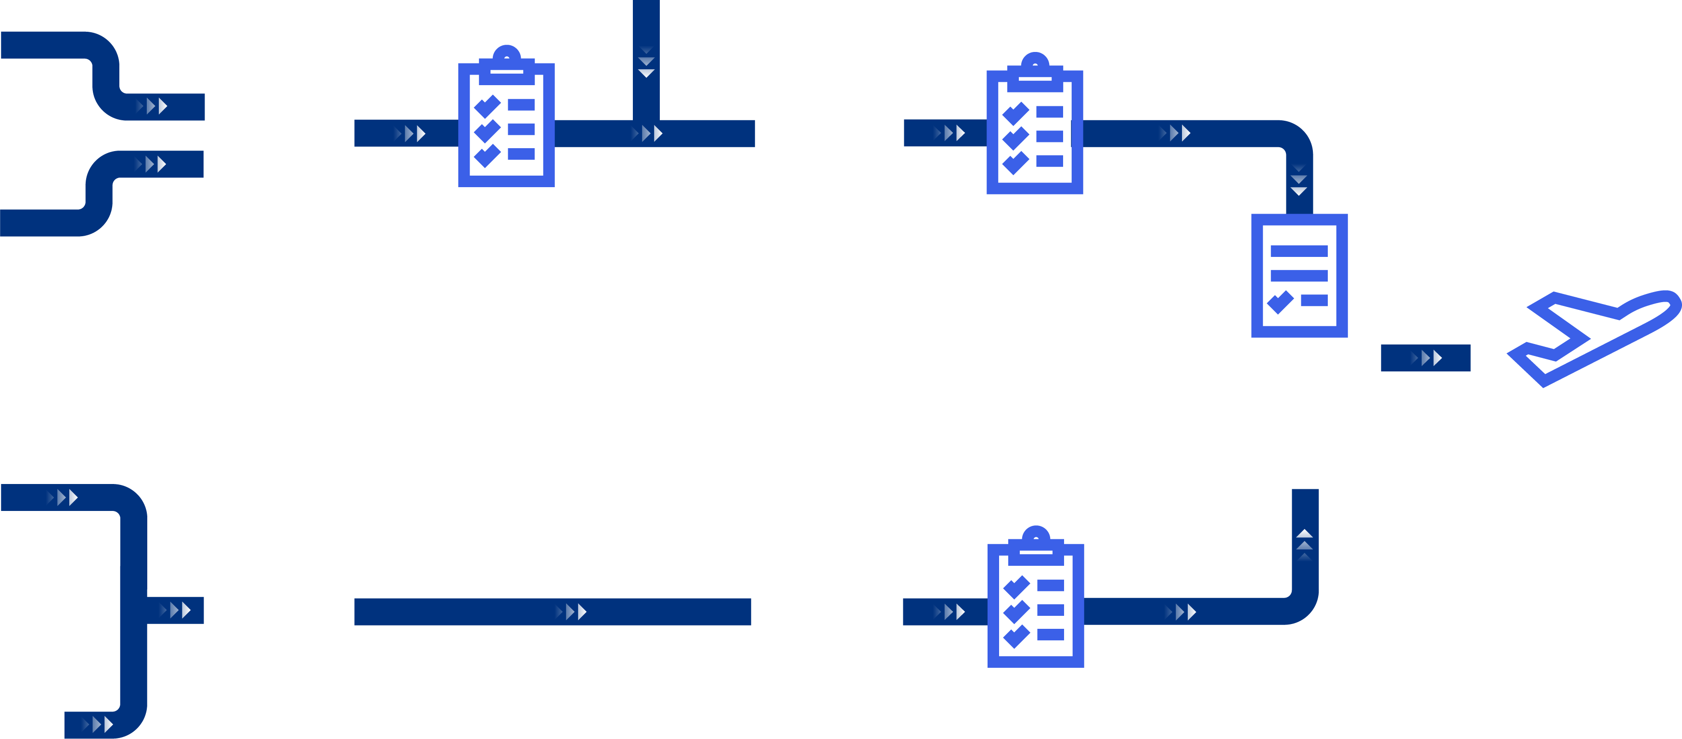
FUEL SYNTHESIS
BLENDING PATHWAY
The AIR TO FUELS™ process produces an FT crude that has been certified through two CORSIA-eligible jet fuel pathways.
CONVENTIONAL
JET FUEL
ALCOHOL-TO-JET
PROCESSING
BLENDED UP TO 50%
NEAT SAF
SAF BLEND
FT CRUDE
FT-SPK & ATJ-SPK
CERTIFICATE OF
ANALYSIS ASTM
7566
PROCESSING
CO-PROCESSING PATHWAY
CERTIFICATE OF QUALIFICATION
ASTM D6155 DEF STAN 91-91
FT CRUDE
BLEND UP TO 5%
CONVENTIONAL REFINING PROCESSES
SAF BLEND
CONVENTIONAL CRUDE
CERTIFICATE
OF ANALYSIS
ASTM D1655
Notes:
The AIR TO FUELSTM process produces an FT crude that has been certified through two CORSIA-eligible jet fuel pathways.
Blending
FT Synthetic Paraffinic Kerosene (FT-SPK) is drop-in jet fuel compatible with existing commercial airline engines, blended up to 50% with conventional jet fuel.
Co-Processing
AIR TO FUELSTM FT Crude can be directly blended with conventional fuel up to 5% without any additional processing necessary.

Slide 31
THANK YOU

