Slide 1

Solids Control: How do you know it’s working?
AADE Fluids Management
February 16th, 2023

Slide 2

About the presenter
  Mike Morgenthaler
  Field level mud engineer in 1980
  Centrifuge Process Engineer for Baker Hughes/Bird Centrifuge
  Engineering Manager for National Oilwell Solids Control
  Founded Cutpoint in 1992
  BSME UT Austin
  Cutpoint’s business is focused on making solids control data meaningful and visible
Copyright 2023 Cutpoint Inc.

Slide 3
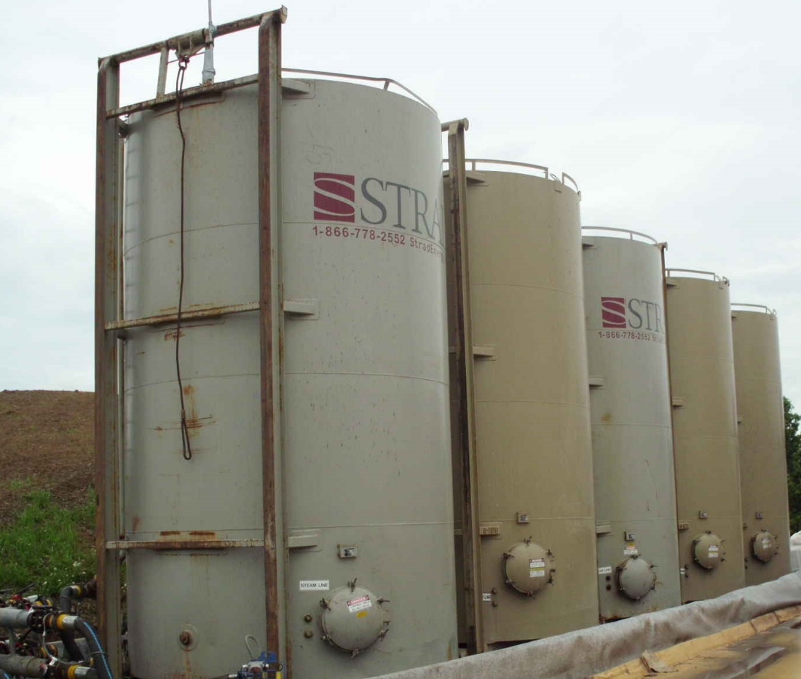
  The volume of drilling fluid required to drill a well is determined by the:
  well geometry
  drill solids content of the drilling fluid
  performance of the drilled solids removal process
Copyright 2023 Cutpoint Inc.

Slide 4
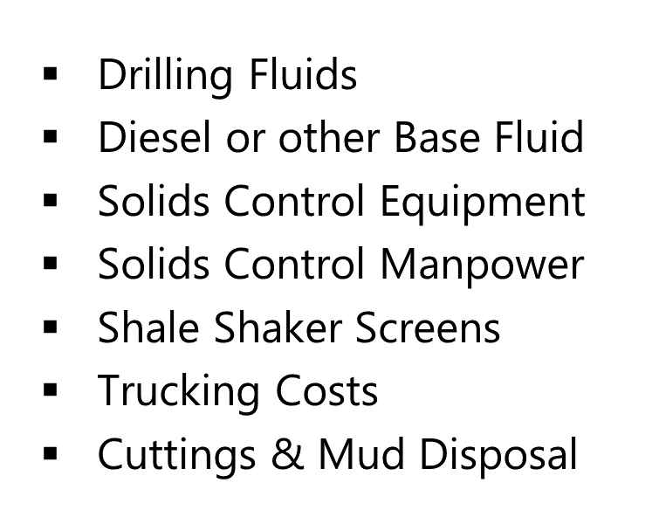
Fluid related costs are “inter-linked” by the performance and cost of the solids control process
Copyright 2023 Cutpoint Inc.

Slide 5
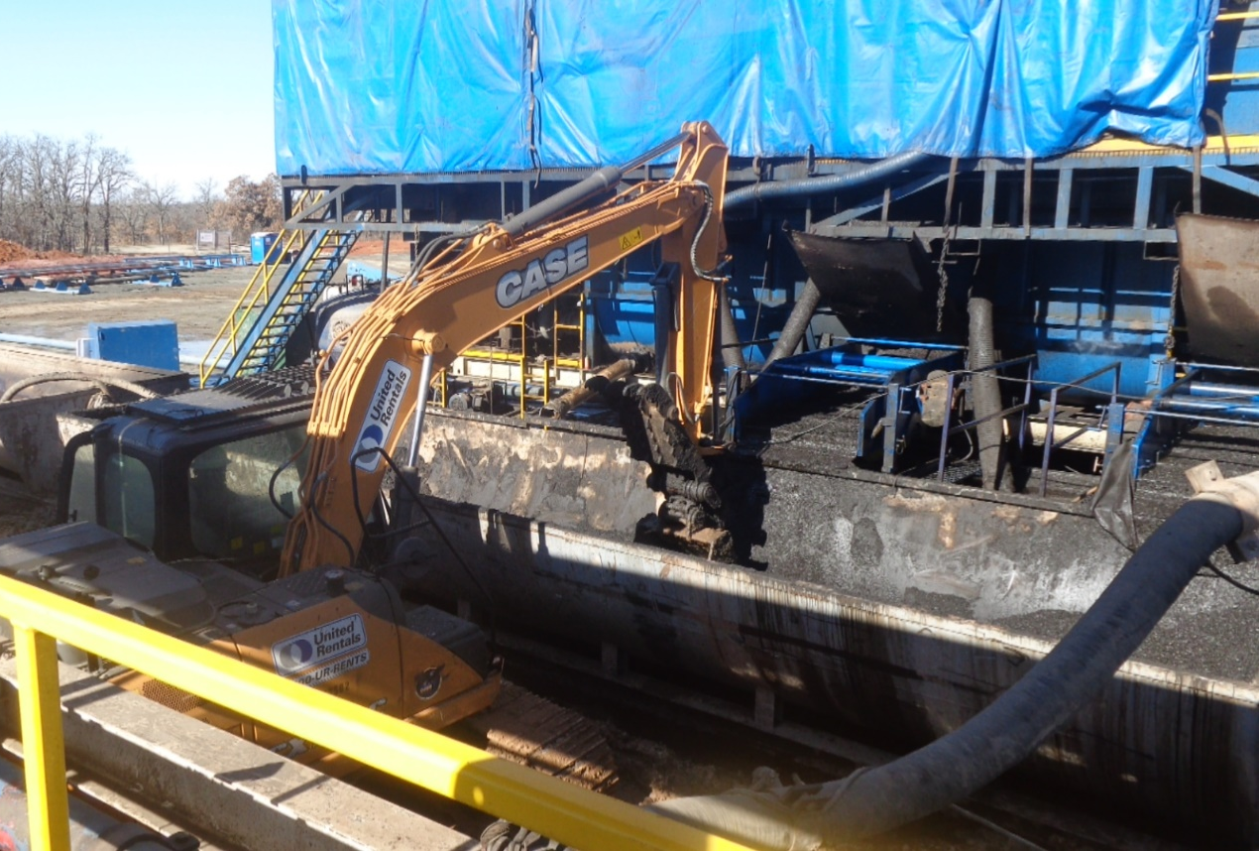
  The improvements made by the drilling industry in the past 20 years have created a perfect storm for solids control.
  Drilling Efficiency
  Walking Rigs
  Lateral Length
  Average ROP
Copyright 2023 Cutpoint Inc.

Slide 6
  High ROP means high solids loading
  Batch drilling means less pit cleaning
  Horizontal drilling means that cuttings are pulverized
  Long and flat flowlines means increased liquid loading to the shakers
Copyright 2023 Cutpoint Inc.

Slide 7
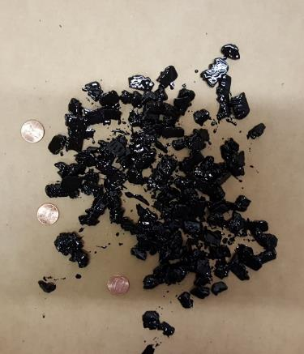
  Good solids control practices start with knowledge about the “usual suspects”
  How big are they?
  How many are there?
  Where did they go?
  How much valuable stuff did they take with them?

Slide 8
Field data useful for quantifying solids control effectiveness
Low Gravity Solids Content
Mud to Cuttings Ratio
Mud (or Base Fluid) Volume
Solids Removal Efficiency
Copyright 2023 Cutpoint Inc.

Slide 9
Copyright 2023 Cutpoint Inc.

Slide 10
Copyright 2023 Cutpoint Inc.

Slide 11
Copyright 2023 Cutpoint Inc.

Slide 12
Copyright 2023 Cutpoint Inc.

Slide 13
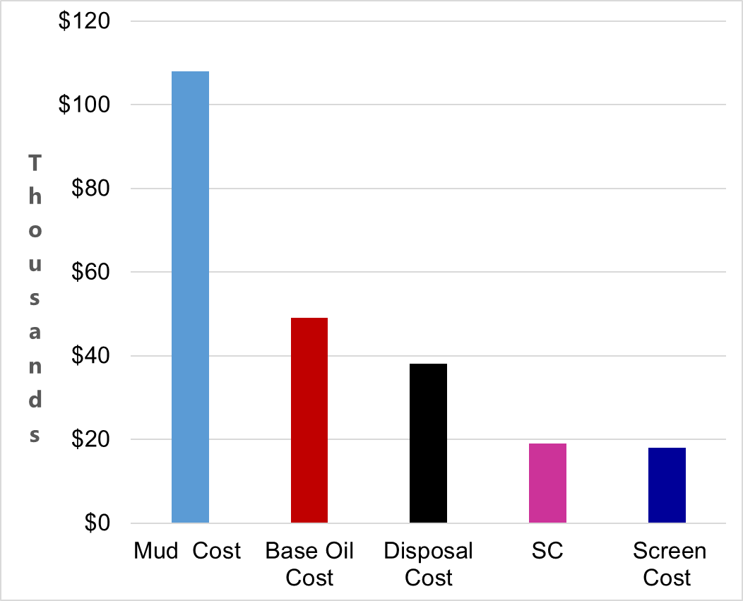
Solids control performance should be quantified when trying to lower fluid related drilling costs
Copyright 2023 Cutpoint Inc.
Notes:
Remember cost are interlinked

Slide 14
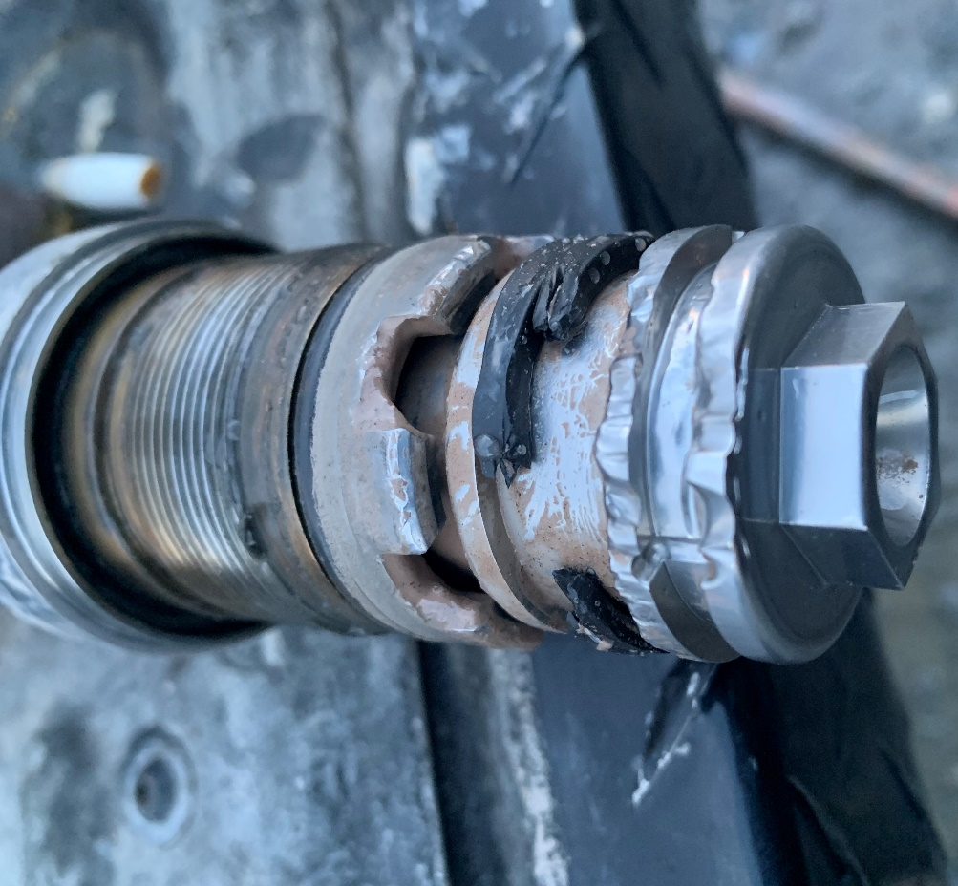
There are other “fluid related drilling costs” affected by the solids control process that are not shown on the previous slide.
Abrasive wear on pumps, tools, tubulars,…
NPT from shortened “mean time to failure”
System pressure limits due to concentration or size of solids
Mud treatment costs
Copyright 2023 Cutpoint Inc.

Slide 15
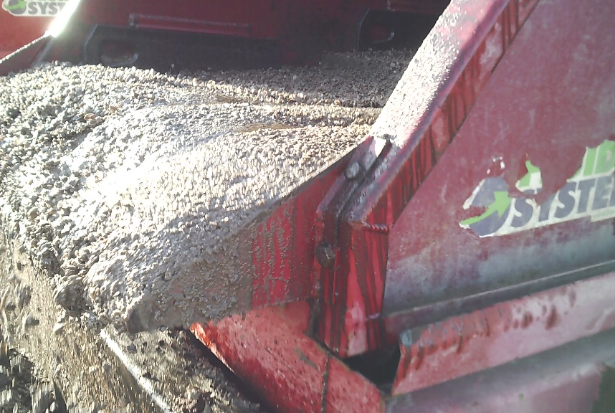
Drilling waste exiting solids control equipment is made up of two components:
dry drill cuttings
drilling fluid
Copyright 2023 Cutpoint Inc.

Slide 16
Drilling fluid volume lost is reported on mud reports as:
SCE losses
coating losses
flooding losses
mud retained on cuttings
Mud to Cuttings Ratio is 2:1
Copyright 2023 Cutpoint Inc.

Slide 17
Copyright 2023 Cutpoint Inc.
17

Slide 18
Copyright 2023 Cutpoint Inc.
18

Slide 19
Copyright 2023 Cutpoint Inc.
19

Slide 20
Copyright 2023 Cutpoint Inc.
20

Slide 21
Copyright 2023 Cutpoint Inc.
21

Slide 22
Copyright 2023 Cutpoint Inc.
22

Slide 23
Copyright 2023 Cutpoint Inc.
23

Slide 24
Copyright 2023 Cutpoint Inc.
24

Slide 25
KPI’s important for determining solids control effectiveness
Solids Removal Efficiency
Mud to Cuttings Ratio
Copyright 2023 Cutpoint Inc.

Slide 26
Any Questions?
Anything you would like to discuss further?
Wrap Up
Copyright 2023 Cutpoint Inc.

Slide 27
A process is a series of steps taken to create a desired outcome.
But, the solids control process has two desired outcomes:
Drill Solids Removal
Drilling Fluid Conservation

Slide 28
Drill
Solids
Removal

Slide 29
Drilling
Fluid Conservation

Slide 30
Step 1
Step 2
Step 3
Step 1
Step 2
Step 3
Drill Solids Removal
Drilling Fluid Conservation
Outcomes Conflict

Slide 33
Solids Control Choices
Low SRE
High Fluid Conservation
High SRE
High Fluid Conservation
Low SRE
Low Fluid Conservation
High SRE
Low Fluid Conservation
Notes:
High SRE & High Fluid Conservation is possible when drilling through a gravel bed, but not possible under normal drilling conditions

Slide 34
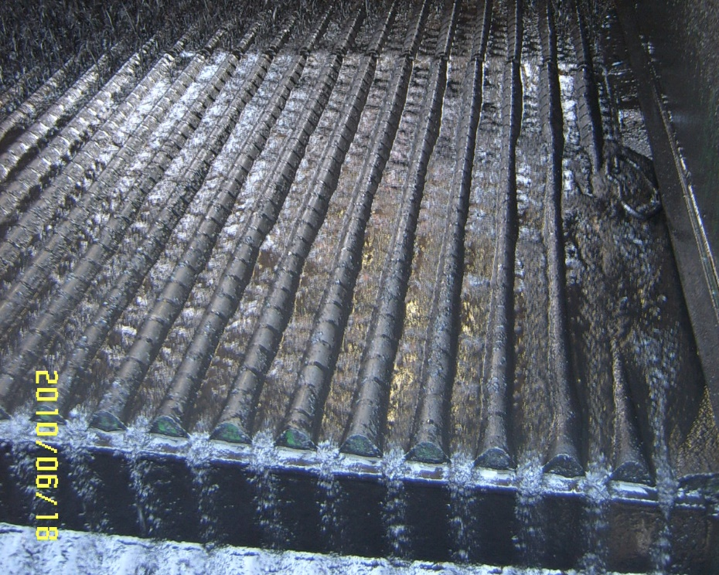
“Optimizing” means compromising between:
  removing drill solids
  conserving drilling fluid
Notes:
What metrics best quantify performance of the solids control process? Solids/Liquid Separation is always a tug of war.

Slide 35
Since there are two desired results, we need at least two KPI’s to quantify performance:
  Drill Solids Removal
  Drill Mud Conservation
SRE
MCR
Notes:
Like everything else in solids control, the KPI’s are interlinked, you cannot change one without changing the other

Slide 36
SRE is the percentage of drill solids removed by the solids control process divided by the hole volume drilled.
Remember drill solids in the mud lost with cuttings are not included
Notes:
SRE is difficult to measure directly and in real time

Slide 37
What is the MCR? If 1,000 bbl of hole is drilled, and:
850 barrels of “dry cuttings” go to disposal
850 bbl of drilling fluid go to disposal
850 bbl cuttings
+ 850 bbl mud
850 bbl mud
850 bbl cuttings
MCR =
MCR = 1:1

Slide 38
What is the density if suction pit mud is 10 ppg?
Notes:
=280+(14*21.678) = 583.5 and 583.5/42= 13.9 ppg

Slide 39
The “Take-Away List”
Dilution equation
SRE
MCR
LGS
Notes:
The solids control industry has been quick to chase the shiny object. Perhaps because we don’t measure anything meaningful

Slide 40
Make sure the data collected is meaningful and relates to drilling cost
Notes:
Don’t waste time measuring everything!

Slide 41
Solids Control Performance has a large impact on drilling fluid cost and other fluid related costs tangible and intangible
Cost to dilute solids not removed by SCE
Cost to replace SCE losses
Cost to treat mud to tolerate solids that cannot be removed

Slide 42
How do we know solids control is working?
BFR lower than offsets
Optimal Shaker Screen cost per foot drilled
High utilization of centrifuges
Disposal Costs are lower than offsets
Minimal LGS related NPT
Notes:
Bring up the take-away questions

