Slide 1
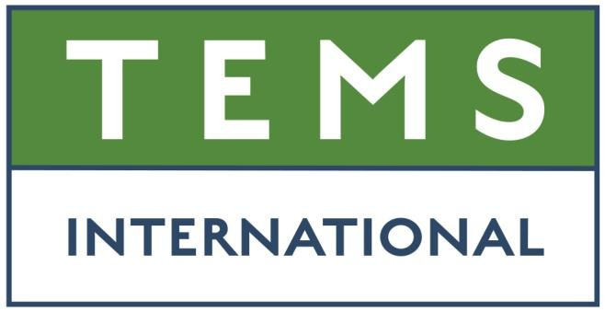
Turnkey Environmental Management Services (TEMS)
Drilling without Cuttings Dryer Technology Application
✓Drilling Operations Optimization ✓Well Cost Reduction ✓Carbon footprint reduction

Slide 2
“Drilling without Cuttings Dryer Technology Application”
  #Environment and Carbon Footprint Reduction
  #Drilling Operations Optimisation
  #Well Cost Reductions
  #Technology Evolution (Pre-EPA, BMP’s,EPA vs current)
  #Best Available Technology (BAT)
  #API/EPA Regulations
  #Collaboration
Key Themes

Slide 3
History of Accomplishment: Gulf of Mexico
Well Type | Well Depth (ft) | Maximum Inclination | OBM System | Shaker Model | Number Shakers | Well Average ROC
Development | 19,090 | 0 | Newpark – Kronos SBM | Brandt VSM-300 | 8 | 3.69%
Development | 17,707 | 19.64 | Newpark – Kronos SBM | Brandt VSM-300 | 8 | 3.55%
Development | 15,950 | 29.4 | Newpark – Kronos SBM | Brandt VSM-300 | 8 | 3.90%
Development | 17,440 | 22.67 | Newpark – Kronos SBM | Brandt VSM-300 | 8 | 4.75%
Development | 17,707 | 19.64 | Newpark – Kronos SBM | Brandt VSM-300 | 8 | 3.55%
Development | 33,098 | 21.24 | Baroid - Encore SBM | Derrick 626 DP | 8 | 3.25%
Exploration | 25,500 | 0 | Baroid - Encore SBM | Derrick 626 DP | 8 | 4.01%
Development | 14,345 | 0 | Baroid - Encore SBM | Derrick 626 DP | 8 | 4.63%
Exploration | 20,487 | 0 | Baroid - Encore SBM | Derrick 626 DP | 8 | 4.10%
Development | 19,287 | 42.02 | Baroid – BaraECD SBM | MI Mongoose | 3 | 1.70%
Development | 32,548 | 0 | Baroid/ BaraXcel4 | Brandt VSM-300 | 8 | 4.21%
Exploration | 27,372 | 0 | BaraXcel4 | Brandt VSM-300 | 8 | 3.75%
Development | 23,275 | 36.04 | MI Swaco – RHEAGUARD X | Derrick 626 DP | 8 | 3.80%
Development | 13,637 | 0 | MI Swaco – RHEAGUARD X | Derrick 626 DP | 8 | 3.78%
Development | 20,956 | 40.00 | Baroid – BaraXcel4 | Brandt LCM-3D/CM-2 | 10 | 4.76%
Development | 24,133 | 19 | BaraExcel/BaraECD | Derrick 626 DP | 8 | 4.20%
Exploration | 27,082 | 0 | BaraXcel4/BaraECD | Derrick 626 DP | 8 | 5.36%
Exploration | 2,551 | 0 | BaraXcel4 | Derrick 626 DP | 8 | 4.40%
Exploration | 21,562 | 0 | BaraXcel4/BaraECD | Derrick 626 DP | 8 | 4.81%

Slide 4
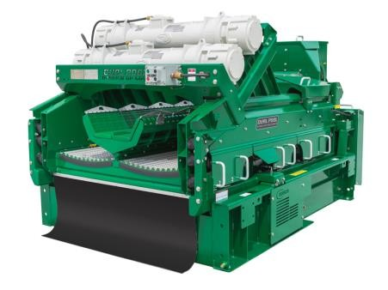
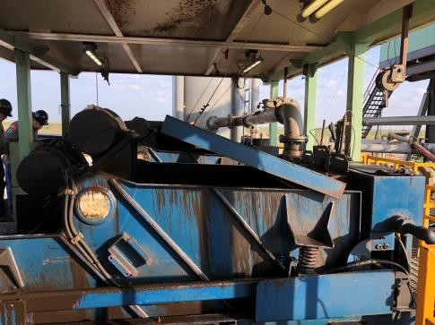
SOLID CONTROL EQUIPMENT - TECHNOLOGY EVOLUTION
TEMS CONCEPT
Massive advancements in solids control equipment since 1999
Now possible to optimize shakers for dry discharge
ROC +/- 5% on well average now proven
TEMS Engineers working to EPA/API guidelines
Significant reduction in operating costs
EPA Regulations (1999)
Introduction of cuttings dryers to meet the newly established 6.9% ROC limit
The need to run shakers wet to feed the augers for the dryers
Re-introduce fines from dryer back into mud system
Resultant dilution of the mud to maintain properties
Also, additional chemicals now required to be added
Increased costs (Dryer + Crew + Mud/Chemicals)
PRE-EPA
Basic technology shakers typically 4x units
No regulated sampling & monitoring
Dry decks on screens
Low operating costs
NO need to feed dryer wet cuttings
NO mud dilution
NO additional chemicals
Secondary cuttings handling packages now redundant

Slide 5
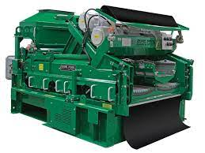
Shakers as Best Available Technology (BAT)
Vastly improved technology including elliptical motion, vibration, G-force, higher flow handling capacity, screen selection true to API standards. Examples of the evolving technology include;
VSM 100, 1st generation of improved shale shakers @1990, ROC 6 – 10%
VSM 300, 2nd & 3rd generation shale shakers @2000, ROC 3.5 – 6%
BEM 650, Balanced elliptical motion, @2000, ROC 3.5 – 6%
SWACO MD-3, three deck shaker, @2010, ROC 4 – 6%
NOV Axiom AX1@2010 first triple deck introduced, ROC 3 – 6%
Derrick 626 VP/VSM 300, ROC 4-6%

Slide 6
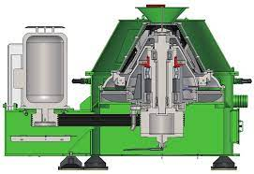
Cuttings Dyers Limitations
Dryers will not process Loss Circulation Materials (LCM) – Additives used in most wells to prevent downhole seepage losses
Increase in shaker screen usage – Finer screens are utilized in order to keep the cuttings wet to facilitate conveying the cuttings through the auger. Finer screens are more susceptible to damage.
Increase in mud usage – More mud volume & dilution required to treat colloidal contaminated mud
Failure of any equipment in the dryer package (Augers, Dryers, Centrifuge) will result in a termination of drilling, causing rig downtime (NPT)
Dryers will not process Cement Cuttings. This means costly rig time and disposal costs
Restricting drilling ROP due to Dryer capacity limitations bottlenecks

Slide 7
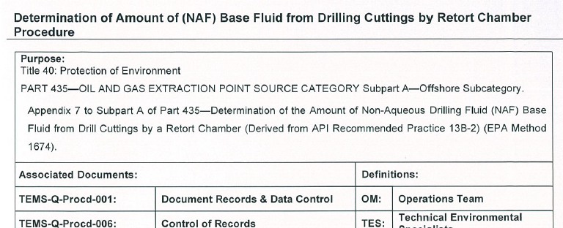
Standard Operating Procedure (SOP)
  The method used by TEMS is an extract from the EPA regulations which are also approved by API as the accepted method of sampling and measuring of oil content via a retort test.
  This method is the only approved and accepted official process for sampling and testing and is widely used and adopted internationally.
  Environmental Protection Agency (EPA) - EPA Method 1674
  American Petroleum Institute (API) - API-RP 13B-2
  BMP’s

Slide 8
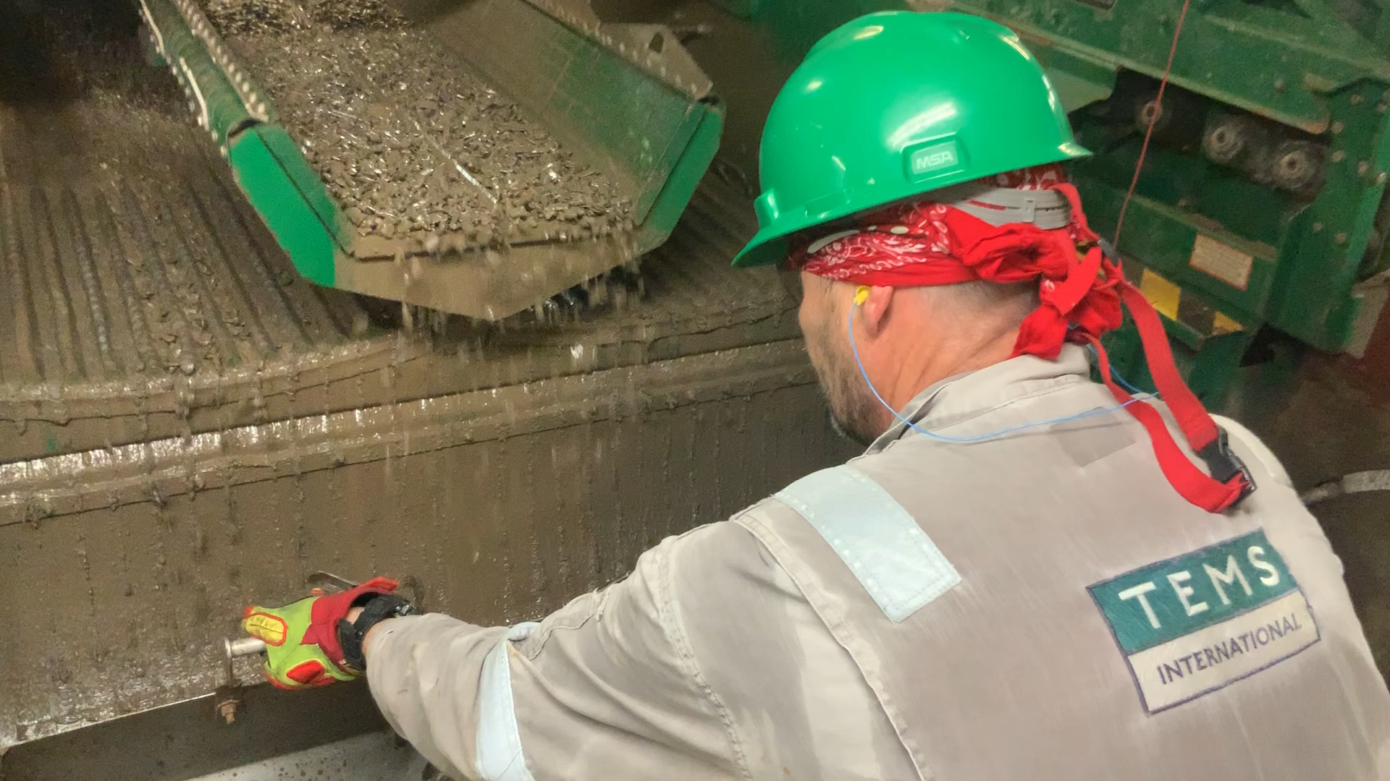
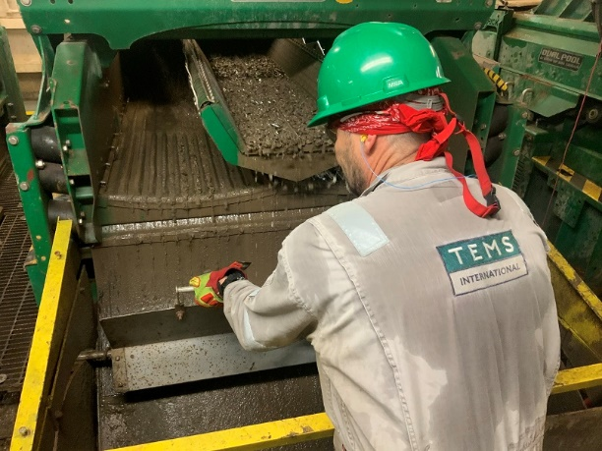
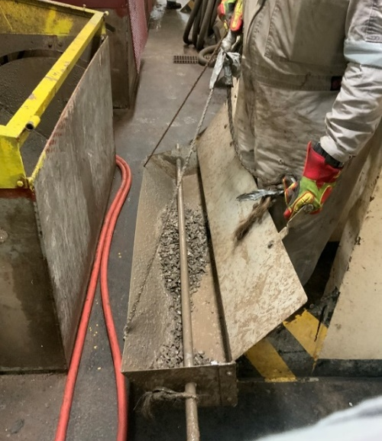
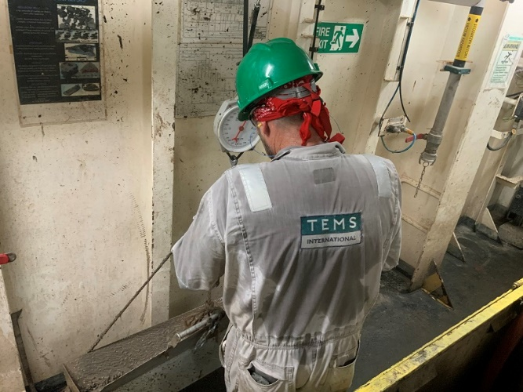
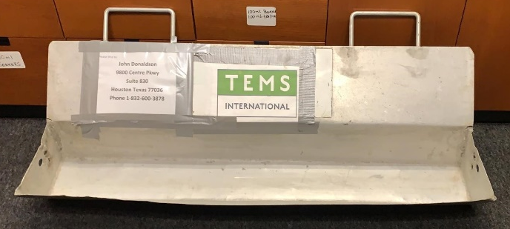
TEMS customized sampling tray
Notes:
Showing cuttings sampling for composite samples

Slide 9
Concept : HSE Benefits
Full Compliance with EPA/API
Improved Drilling Practises
  Achieve ROC below 6.9% without the need for secondary processing equipment
  Reduced drilling days
  Improved ROP/ Reduced downtime NPT
  Remove Solids at first source, without introducing them back into active system
Reduce Environmental Impact & Eradicate Environmental Spills
  Generating an environmental ‘Hit List’ to aid spill prevention
  Compliance with environmental standards
  Improve the environmental competency & awareness of the rig crews
  Implement efficient lock out tag out system for accidental discharge and remove risk of cross contamination
4. Reduce Carbon Footprint
  Elimination of diesel usage to power secondary processing equipment (i.e CO₂ + CO)
  Minimizing discharges from cuttings dryer package
  Eliminate any emissions associated with transportation and disposal
  Eliminate additional personnel to run the dryer
Waste Management
  Reduce the contamination of drilling fluids from colloidal solids generation from dryer
  Reducing the requirement to transport colloidal contaminated drilling fluid & waste back to shore for treatment/ disposal
  Reduce requirement to dilute drilling fluids
  Improve solids control through shakers optimization
  Implement RPE testing at source to reduce un-necessary costly transport to shore for disposal and treatment
All above processes combined dramatically reduce carbon footprint, environmental impact and provide substantial cost savings to any project while exceeding EPA/API environmental regulations

Slide 10
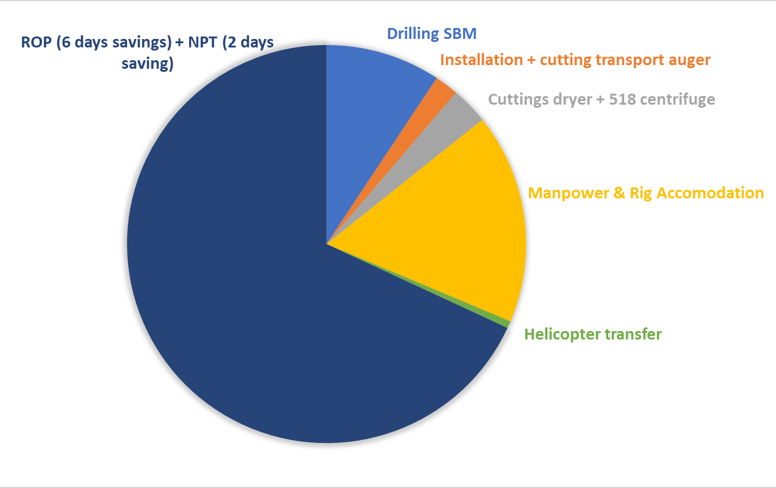
Concept : Cost Savings $$ & Intangible Benefits
Factors Influencing Cost Savings of $$(6 wells)
Improved ROP and Reduce NPT
  Reduce drilling days
  Remove bottlenecks in system
  Rig audit on equipment
  Daily equipment performance, testing & 24-hr monitoring
  Shaker screen selection & repair
Reduced mud costs/ft
  Reduced mud volumes
  Reduce dilution volumes
Reduce surface losses
Improved logistics
  Reduce mud & waste transport
  Reduced manning levels
No requirements of secondary solid control equipment, transport auger, installation cost, etc
Intangible Benefits
1. Corporate Reputation
2. Real time on-line cloud reporting
3. Reduced manning levels
4. Rig Crew training & coaching
5. Reduced mud maintenance
  Optimize mud properties & increased mud lifecycle
  Maximize solids removal
6. Less wear and tear on rig fluids system & downhole BHA

Slide 11

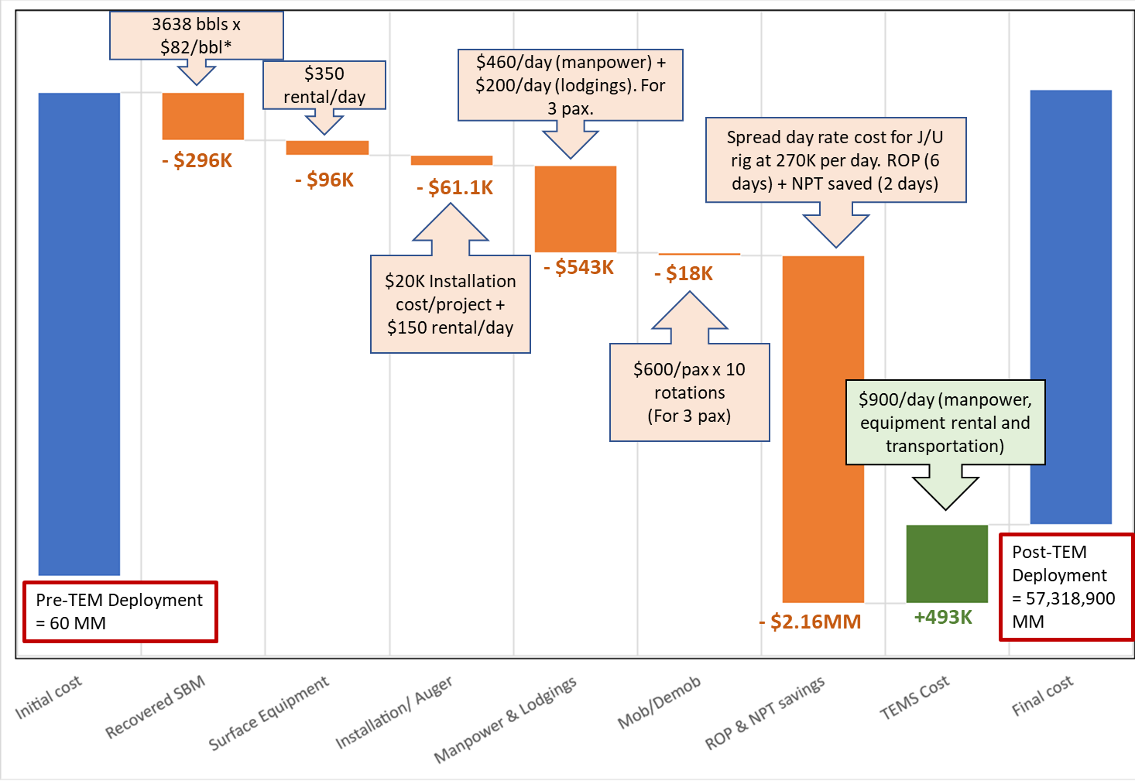
Drilling without cuttings dryer: Cost Savings
Total saving was $$ for a 9 months POC (274 days) involving 6 wells that were drilled without using a cuttings dryer with avg. well ROC = 5.83%
Areas of savings
Recovered SBM (total savings/ total mud saved)
Cuttings dryer + 518 centrifuge
Installation & cuttings transport auger
Manpower & lodgings
Logistic (274 days/ 28 days = 10 rotations)
Operation (Increase ROP, reduce NPT)
TEMS Value Add
Full Compliance with PPGUA/EPA/API/MES
Improved Drilling Practises & Drilling Performance, Increase ROP and Reduce NPT
Reduce environmental impact & carbon footprint

Slide 12
Fluids Well Cost Savings
 | Well 1 | Well 2 | Well 3 | Well 4 | Well 5 | Well 6
Total footage drilled, ft | 7,972 | 13, 558 | 5,700 | 11,269 | 13,663 | 15,568
Maximum Inclination, ° | - | 87 | 15 | 73 | 81 | -
Surface mud consumption, bbls | 698.46 | 855.2 | 951.4 | 2039.7 | 2163.0 | 2859.1
Surface consumption for well, bbls/ft | 0.09 | 0.06 | 0.17 | 0.18 | 0.16 | 0.18
Total mud savings against target, bbls | 778.59 | 1403.0 | 216.7 | 227.15 | 719.0 | 293.3
Total savings for well, $ | $$$$ | $$$$ | $$$$ | $$$$ | $$$$ | $$$$
Official EPA Well ROC, % | 6.71 | 6.85 | 5.23 | 5.88 | 5.40 | 6.05
No of shakers Derrick DP 600 : VSM300 PYR-DX | 5 | 5 | 5 | 5 | 5 | 5
Set Target, bbls/ft | 17.5” – 0.25
 | 12.25” – 0.20
 | 8.5” – 0.15

Slide 13
Waste Fluid Generation
Project | Disposal at rig site Bbls | Sent ashore Bbls | Cost savings through disposal $
Limerock | 13,445 | 2,057 | 873,925.00
Dalmation | 12,414 | 332 | 806,910.00
Wasibi | 23,872.49 | 978 | 1,551,711.58
Winterfell | 27,688.7 | 1,072 | 1,673,360.57
Samurai | 15,745 | 3,415 | 1,023,425.00
Tabasco | 10,850 | 0 | 687,700.00

Slide 14

Positive Impact
To challenge the norms and bring in a change in culture without impacting operations whilst working within Industry Standards
Well average ROC below 6.9% on all drilling projects without the use of a cuttings dryer
Removal of bottlenecks in secondary processing equipment
Reduce drilling costs
Reduce carbon footprint
Minimize any environmental impact through out operations

Slide 15
THANK YOU

