Slide 1
Innovations In Deepwater
High-Performance
Water Based Drill-In Fluids
Autumn Shepherd
May 16, 2023

Slide 2
The Challenge
Deepwater production well pre-salt reservoir, water depth of 2034m
Minimize environmental issues
Provide a high-density reservoir fluid only using CaCl₂ brine
Suspend a high level of solids
Low coefficient of friction
Low ECD
Must bridge a range of porosities
Stable while under static conditions for logging
Compatible with formation for coring
2
Copyright 2023 Baker Hughes Company. All rights reserved.

Slide 3
Gum Free Drill-In Fluid (GFDIF) Highlights
Optimized rheology to provide low ECD
Environmentally-friendly components
Reduces costs by maximizing operational efficiency
Forms a nondamaging, easily removable filtercake

Slide 4
GFDIF Design
Traditional GFDIF
Design for Well
High Brine Density
Low Solids Loading
Drill and complete with minimal down time
Regularly circulate and condition
Lower Brine Density of 11.5ppg CaCl₂
High Carbonate Loadings of 145ppb
Drilled short section then extended time bosting riser
Minimal treatment while coring
279.4 hours Logging
Pushing the limits of GFDIF and succeeding
Successful drilling and coring operation
Successful logging program
  including 279.4 hours of static fluid in the casing and open hole
Zero issues with SAG in the wellbore
4
Copyright 2023 Baker Hughes Company. All rights reserved.

Slide 5
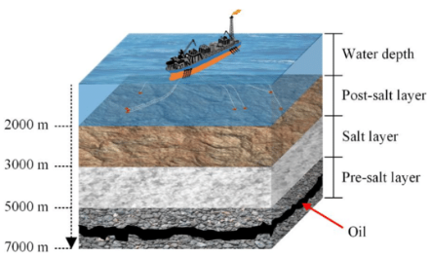
How the Technology Works?
Biopolymer:
Dual function - viscosifier and fluid loss control agent
Targeted density:
13.25 – 13.5 ppg
High density fluid:
              Brine based and/or Solids loaded
Product | Formulation, lb/bbl
11.5 ppg CaCl₂ brine | As needed
Biopolymer | 5.0 – 8.0
Additive 1 | 1.0 – 3.0
Calcium Carb fine | 140 - 170
Calcium Carb Medium | 107.00
Calcium Carb course | 34.80
Oxygen scavenger | 0.5 – 3.0
Brazilian Deepwater Pre-Salt Formation
5
Copyright 2023 Baker Hughes Company. All rights reserved.

Slide 6
Test Plan & Technical Design – Results
13.25 ppg GFDIF Rheology and Lubricity
Properties Measured | Units @120°F | Initial | Post Hot-Roll @ 212°F
pH | - | 7.46 | 7.47
6 | Dial Reading | 11 | 12
3 | Dial Reading | 10 | 11
PV | cP | 35 | 36
YP | Lb/100ft² | 28 | 27
10 second | Lb/100ft² | 13 | 11
10 minutes | Lb/100ft² | 10 | 11
Coefficient of Friction | - | - | 0.15

Slide 7


Stress Test for the System
212°F
16h
pH
pH
212°F
48h
pH
212°F
72h
Rheology
212°F
24h
Rheology
Rheology
pH
Rheology
Properties | Units @120°F | Initial BHR | HR@212°F & 24h | HR@212°F & 48h | HR@ 212°F & 72h
pH | - | 7.5 | 7.47 | 7.38 | 7.35
6 | Dial Reading | 11 | 8 | 8 | 6
3 | Dial Reading | 10 | 7 | 7 | 5
PV | cP | 35 | 34 | 29 | 31
YP | lb/100ft² | 28 | 22 | 28 | 20
10 Second | lb/100ft² | 13 | 6 | 5 | 3
10 minutes | lb/100ft² | 10 | 7 | 6 | 4
7
Copyright 2023 Baker Hughes Company. All rights reserved.

Slide 8
Test Plan & Technical Design – Results
13.25 ppg GFDIF Fluid Loss
20 microns
55 microns
Due to the bridging of the solids in this system we were able to have wellbore stability as well as prevent any micro fractures that could lead to seepage
120 microns

Slide 9
Operational Timeline
Post Tender Clarification Request
Q4-2020
Agree to develop GFDIF
Fluid Built in LMP
Q4-2020
Q4-2022
Fluid Delivered to the RIG side
Q4-2022
Estimated start of next well
R&D Project
Same customer Q3-2023
8.5” Section Drilled
Coring Complete
Logging
GFDIF Displaced from the well
Q4-2020
Q1-2023
Q4-2022 and Q1-2023
Q4-2022 and Q1-2023
Q1-2023
9
Copyright 2023 Baker Hughes Company. All rights reserved.

Slide 10
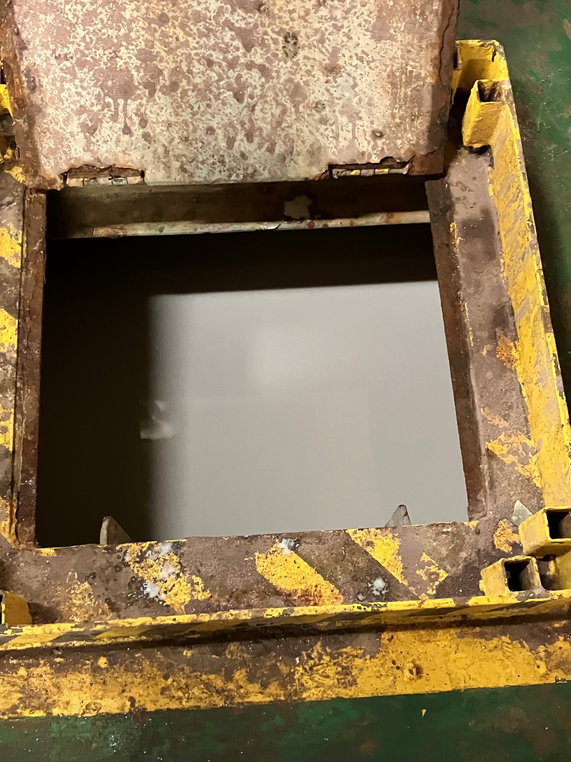
Field Data
Properties Measured | Units @120°F | LMP After Mixing | RiG Site Day 1 | RiG Site Day 15 | RiG Site Day 30
pH | - | 7.84 | 7.9 | 7.8 | 7.9
6 | Dial Reading | 11 | 9 | 6 | 6
3 | Dial Reading | 10 | 8 | 5 | 6
PV | cP | 32 | 38 | 38 | 33
YP | Lb/100ft² | 29 | 26 | 21 | 20
10 Second | Lb/100ft² | 13 | 5 | 5 | 6
10 minutes | Lb/100ft² | 10 | 6 | 6 | 7
Fluid in the pit after Day 30
10
Copyright 2023 Baker Hughes Company. All rights reserved.

Slide 11
Fluid Loss Data from the Field
High Fluid loss in the beginning due to the system not being circulated or conditioned
After circulation and treatment, the fluid loss starts to go down
11
Copyright 2023 Baker Hughes Company. All rights reserved.

Slide 12
ECD/WOB versus Depth
Increased ECD and WOB observed with the:
Displacement
Drilling out the cement at the same time of weighting it up
Pump issues due to shakers
Displacement
Drilling out Cement
Issue with the mud pump
Copyright 2023 Baker Hughes Company. All rights reserved.

Slide 13
Experience summary
Properties | 8.5” planned | 8.5” actual | Comments
Meters drilled | 300 | 300 | No Drilling issues
Meters Cored | 43 in 1 run | 39.8 in three runs | 3 runs due to formation hardness
Fluid Type | Divalent DIF | Divalent DIF | -
Density | 12.9 | 12.9 starting 13.0/13.2 | Weight up prior to start due to formation analysis
6-rpm | 8 | 6 average | Shown it can be run with a 5 and above on the 6 rpm
Static While Logging | Circulate every 3 days | 11.65 days | No Sag, Separation or Density loss. No logging issues
Fluid in the riser | Viscosity decrease | Viscosity decrease | No high pump pressures from high viscosity
13
Copyright 2023 Baker Hughes Company. All rights reserved.

Slide 14
Well Summary
39.8
0
Issues during logging operation
Meters of core cut
145
Issues tagging Bottom
pounds of Carbonate per barrel
bbls Fluid lost to the formation after spotting specialized LCM for large fractures. Drilling through a highly vugular and fractured formation
300
meters drilled
279.6
Hours GFDIF was static while Logging program completed. Longest time a Divalent DIF has been in an open hole
14.5
ppg Density of heavy Slug built with GFDIF. No pump or settlement issues
14
Copyright 2023 Baker Hughes Company. All rights reserved.

