Slide 1
Completion Fluids Design & Selection
Deepwater Applications
Laurie Hayden
May 16, 2023

Slide 2
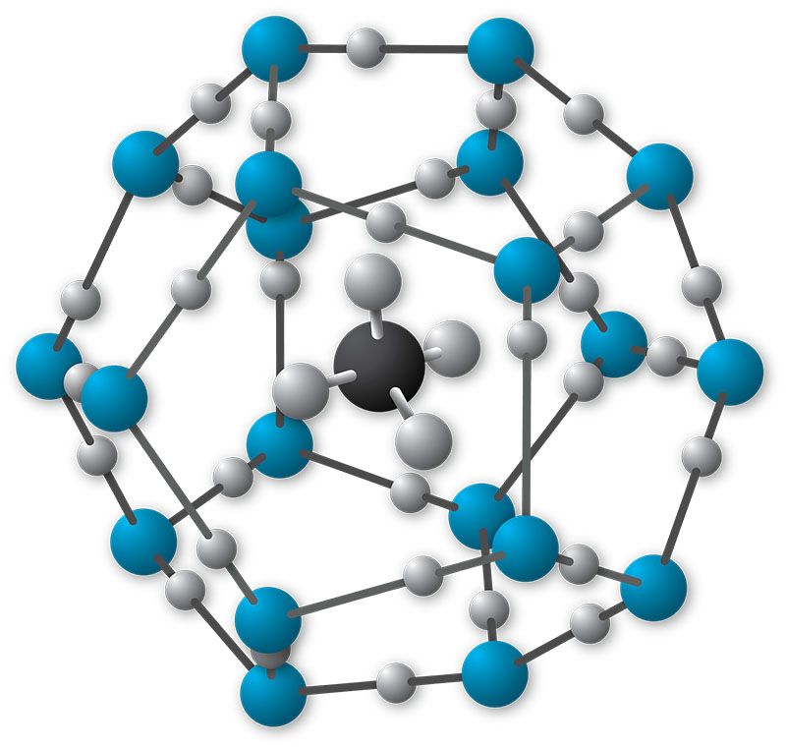
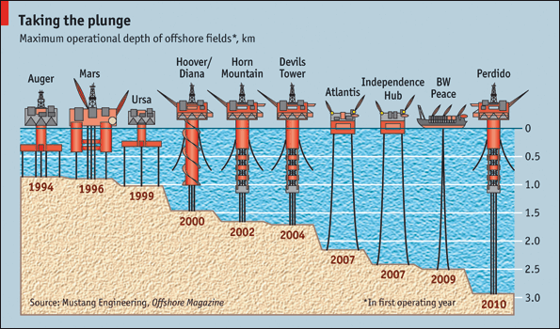
Deepwater Challenges
Deeper wells but also deeper mudlines
  Lower temperature
  Higher pressure
  PVT considerations for equivalent density
Displacement complexity
  Minimum Critical flow rates are difficult to achieve in the riser
Rigtime expense
  May prevent operations like filtration
Logistics and storage complexity
  Longer transit times
  Minimal storage capacity and available footprint for equipment
Environmental regulations, HSE, and zero discharge
Development of alternative high-density brines
Notes:
Same challenges as conventional wells . In addition there are many challenges:
PVT:
Hydrate suppressors
Thermo Dynamic: Add Glycol of methanol
Kinetic: Slow hydrate formation by inhibiting the ability of the hydrates to stick together…..
PCT: Depending on the brine PCT can have a big effect. Only divalent brines are affected, and only are seen on the right of the PCT point
– corrosion
All the previous factor drive the operation to develop higher density brines (Zn free)

Slide 3
Completion Brine Selection – Technical Criteria
Well Hydraulic Requirement
Temp & Pressure Correction
TCT
PCT [Subsea]
Well
RESERVOIR
Final surface density & TCT/PCT
HSE Restriction
Corrosion
Non-CRA Alloys
CRA Alloys
Monovalent Brines
Divalent Brines
No or low Cl
Cation
Formation Damage
Drilling Fluid
Compatibility
Formation water/gases
Compatibility
Produce Crude/gas
Compatibility
Stimulation Fluids
Compatibility
Reservoir Compatibility
3
Copyright 2023 Baker Hughes Company. All rights reserved.
Notes:
As technical folks, these are the criteria that we consider.
What density does the well require?
What brine gives us the best gas hydrate and crystallization protection?
What metallurgy are we using? Is there a potential for corrosion?
Are there HSE considerations?
Is the brine compatible with other drilling or completion fluids, reservoir rock and fluids, and crude oil?

Slide 4
Typical Brine Selection Workflow
Cost
Density
Operational Considerations
Fluid Compatibility
Reservoir Compatibility
Notes:
But the real world works differently. This is a typical brine selection workflow as it actually happens.
Number 1 is almost always density. If the well requires a 13.0 lb/gal brine, you cannot use a sodium chloride brine, for example.
Next is cost. If the well requires a very high-density, but the project doesn’t support the cost of an exotic brine, then your options will become more limited.
Then we have operational considerations. These may include using the same brine as other previous fluids to minimize brine storage or compatibility testing and considerations with metallurgy and elastomers.
Next, we typically test compatibility with other drilling and completion fluids. This usually involves development of displacement fluids or reservoir drill-in fluids.
Finally, we have reservoir and reservoir fluid compatibility. This usually involves testing with shale, crude oil, and formation water compatibility.
Even though everything we’ve done to plan the entire well is in efforts to get to that reservoir, it is often the last consideration in the brine selection process. The biggest shift in mindset we can make is promoting the reservoir to the forefront. It may be costly to make operational changes to support this, such as changing metallurgies, but the reservoir is the one thing we cannot change.

