Slide 1
AADE Houston FMG Meeting – Fluids for Deepwater
May 16th, 2023

Slide 2
Deepwater Completion Fluids
Completion fluids (brines) specifically designed for handling the unique challenges of deepwater wells
Selection Criteria
  Density
  Crystallization control
    TCT or gas hydrate inhibition
  Man-made material compatibility
    Metallurgies, elastomers, control line & hydraulic fluids, etc.
  Formation & reservoir compatibility
    Permeability, scaling tendency, etc.
Criteria leads to a salt (or salts) that will be used to build a completion brine that meets the targets across the multiple phases of selection criteria.
TETRA Technologies, Inc. All rights reserved
Notes:
Unique challenges:
high pressure & low temp
compatibility with formation fluids and sea water

Slide 3
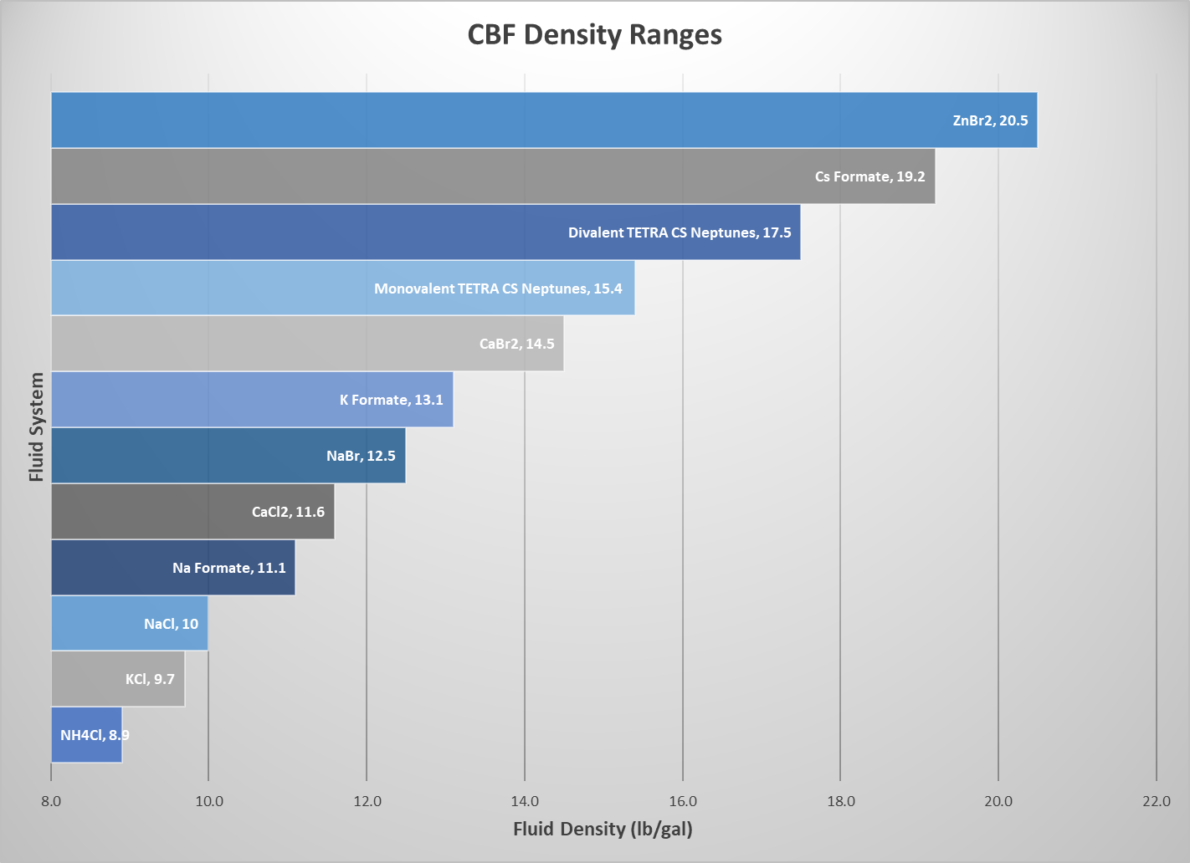
Potential Deepwater Fluid Salts
TETRA Technologies, Inc. All rights reserved
Notes:
VERY simplified version of chart – no multi-salt indications, but they do exist and are used pretty commonly depending on the application

Slide 4
Man-Made Material Compatibility
Compatibility with man-made materials is innate to each salt.
  Can be modified and/or improved through additive treatment packages
  Using different salts that still can satisfy the density/TCT requirements can also affect compatibilities with metallurgies and control/hydraulic fluids
Sometimes treated as an afterthought (at first)
  Causes big problems over the life cycle of a well if ignored
    Can affect displacement & cleanup, post-circulation filtration as well as material longevity
Focusing more on material compatibility can result in finding applications for more “specialty” fluid systems
  Broader markets for different fluid systems previously restricted to specific areas of operation.
TETRA Technologies, Inc. All rights reserved
Notes:
Density & crystallization control are (and will remain) the first focus points when designing deepwater CBF systems.
Pressure balance is the first and best form of well control
Crystallized salts can lock up the well and/or equipment
Gas hydrates can also lock up wells or production pipes (with potentially disastrous consequences)

Slide 5
Contact:
Phillip A. Vincent
936.321.7325
www.tetratec.com
Focused on Energy. Dedicated to Service and Safety.
NYSE: TTI

