Slide 1

Bolstering a Team Through Shared Adversity

Slide 2

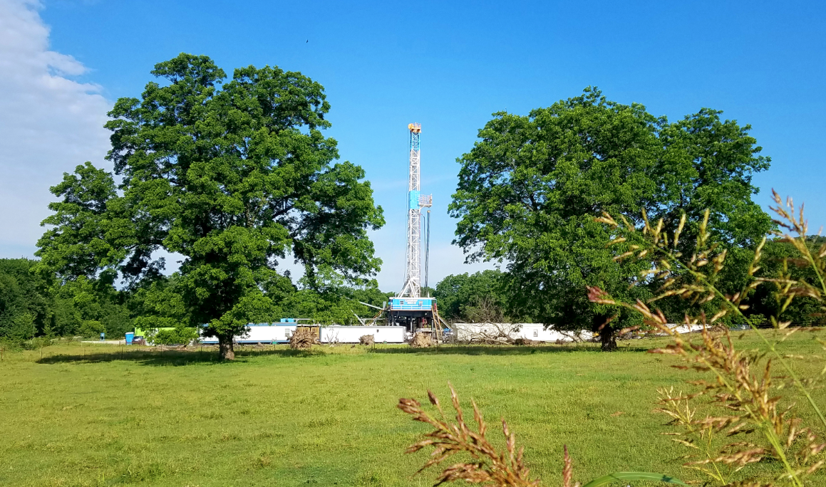
Agenda
87U Background
Hiring
Question Your Team
2 of My Failures
Brothers for Life
Legacy
Non-Standard Hiring

Slide 3
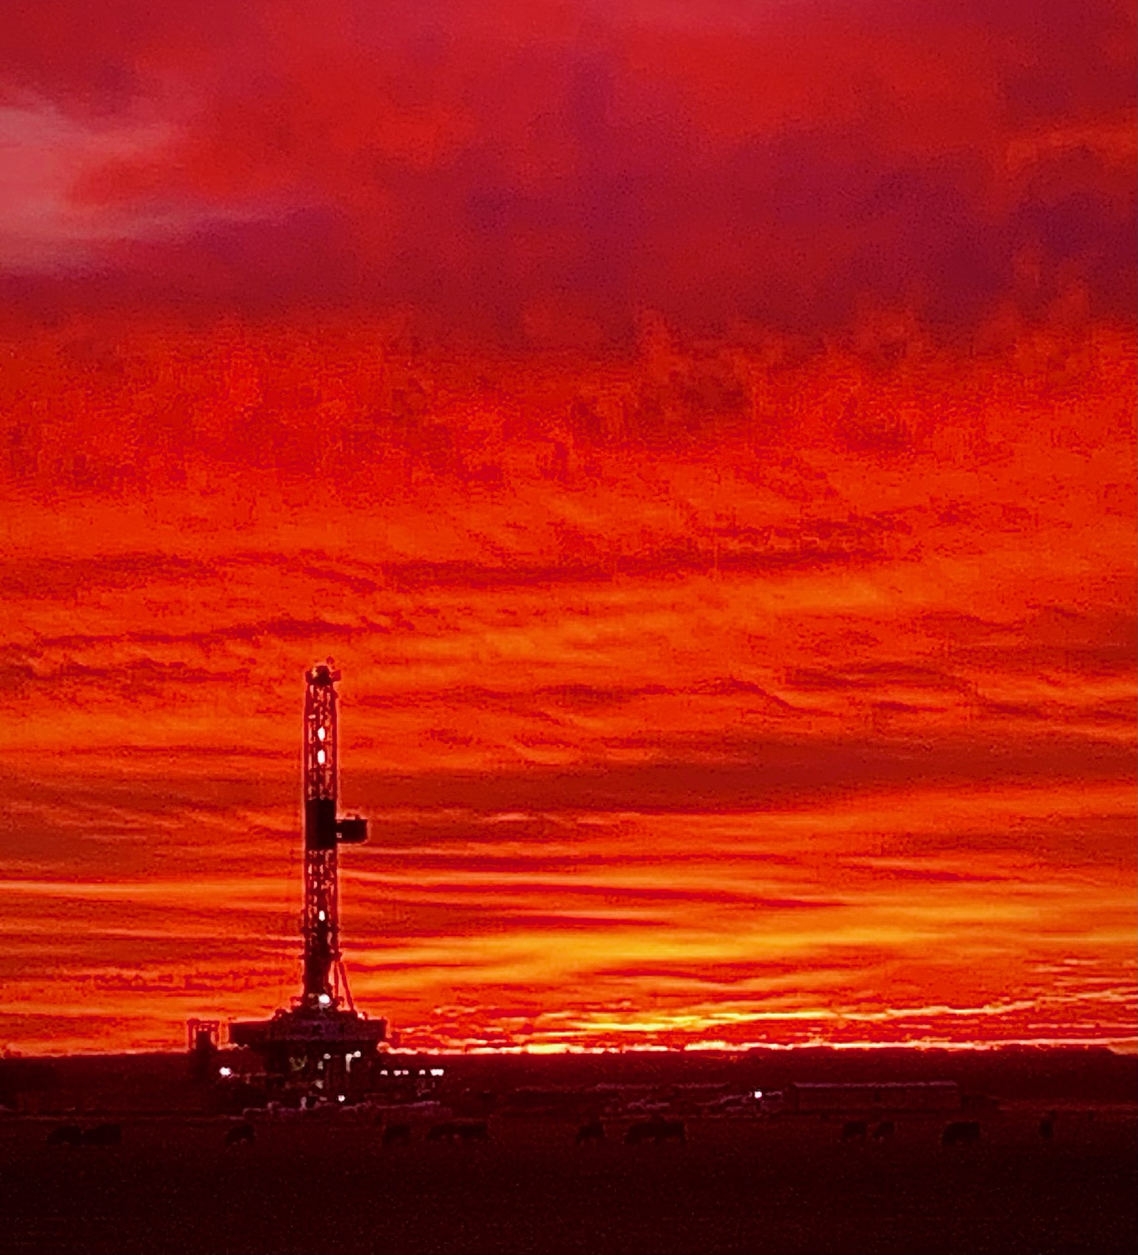
87U Background
Formed 2016
Wellsite supervision in 2019
2022 Past and Current Engineering
Cactus 154 Sanguine Gas Exploration and Canyon Creek
Cactus 151 Canyon Creek
Latshaw 37 Canyon Creek
TBD Rig Loan Sanguine Gas Exploration

Slide 4
Hiring for Team Dynamic
  Company Man Specific
  Stop chasing basin experience at the expense of team
  Promote from within if large enough company
  Interview with purpose
  Don’t be afraid to break out new
  Age gap relatability
  Hire based on your management or investors intent
  Staff and Enablers
  Onsite teamwork
  Housing and office based on forced interaction
  Can’t fire to a good team
  Office support must be involved at a rig level
Creating Your Team

Slide 5
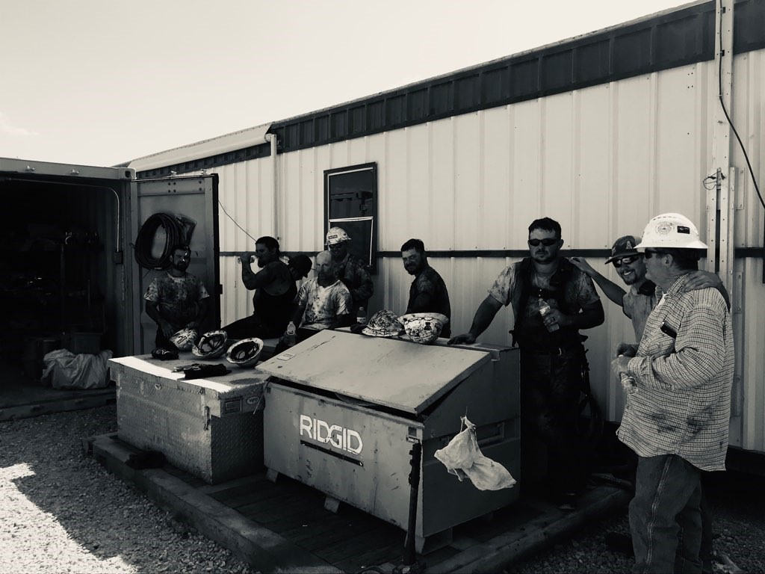
Are you part of your team?
Do you shoulder the blame and pass the praise?
Do you define expectations and support the efforts to reach them?
Are you the Supervisors first call immediately?
On location, do the hands know you by name?
Is there an us (field) verses them (office) mentality?
Do you recognize when you have nothing to offer?
Is It Your Team

Slide 6
2 of My Many Leadership Failures
  Internally Beaten
  APA struggling
  Run too hard too long
  Culture of Supt Kingdoms
  Sick Co Man
  Didn’t force the issue
  Allowed Supt and apathetic management to subdue strong feelings
  Fight with Wife
  Argument with wife
  Have to go to church
  Have to be home
  Hand off Rig Floor 0200
  Didn’t run out the door
  Had a chance to demonstrate my commitment
Do the hands onsite, your charges know you care
Do your subordinate leaders know you have their back
Do you take advantage of situational leadership to demonstrate your love
Influencing Your Team

Slide 7
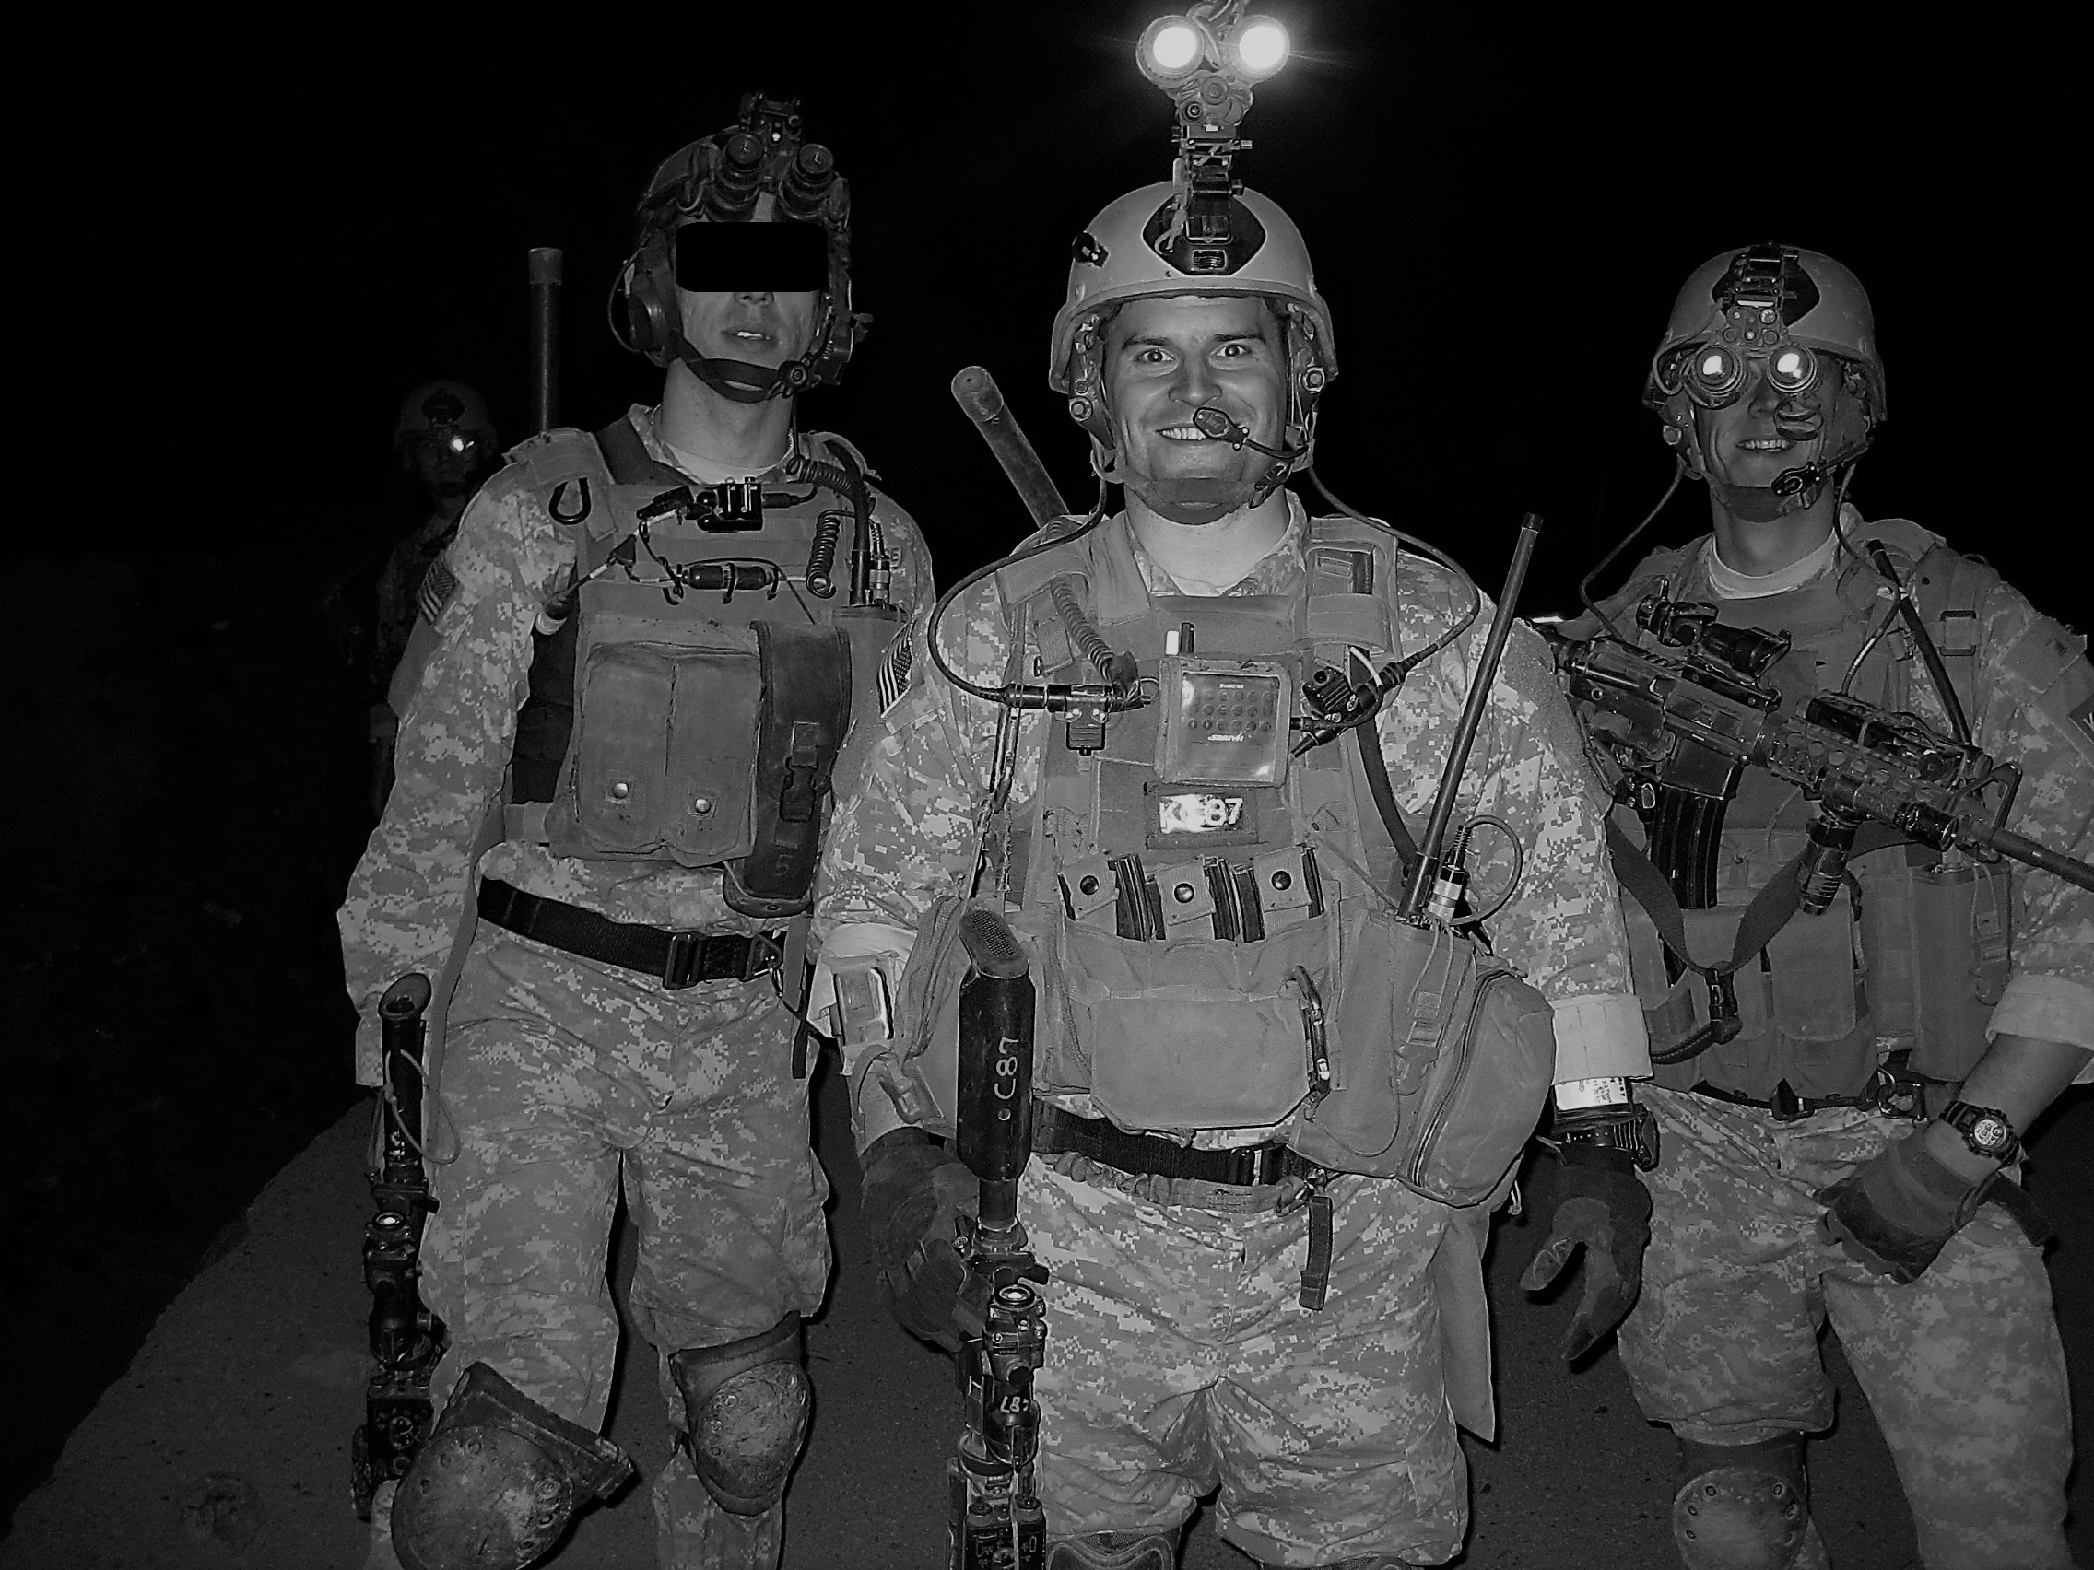

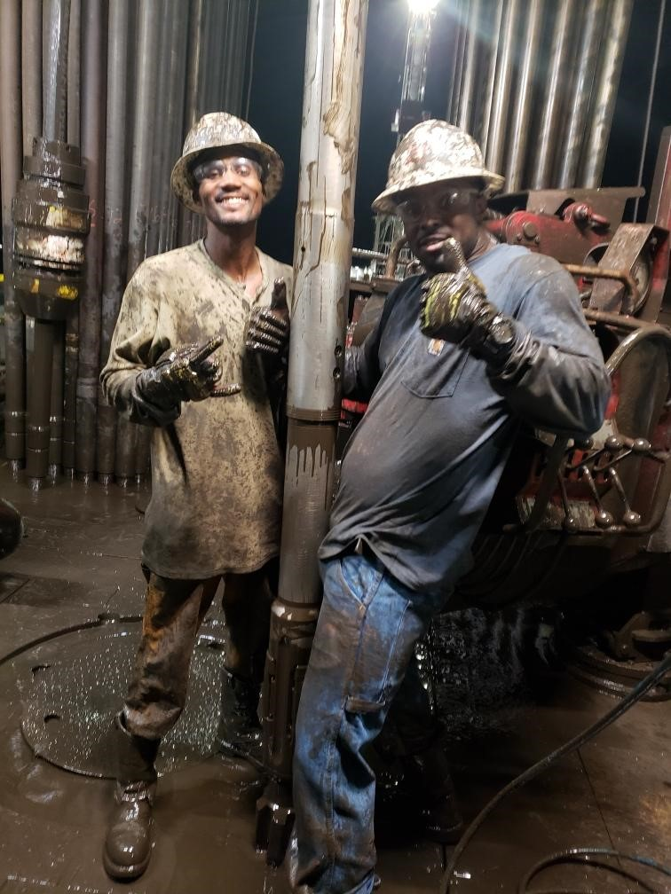
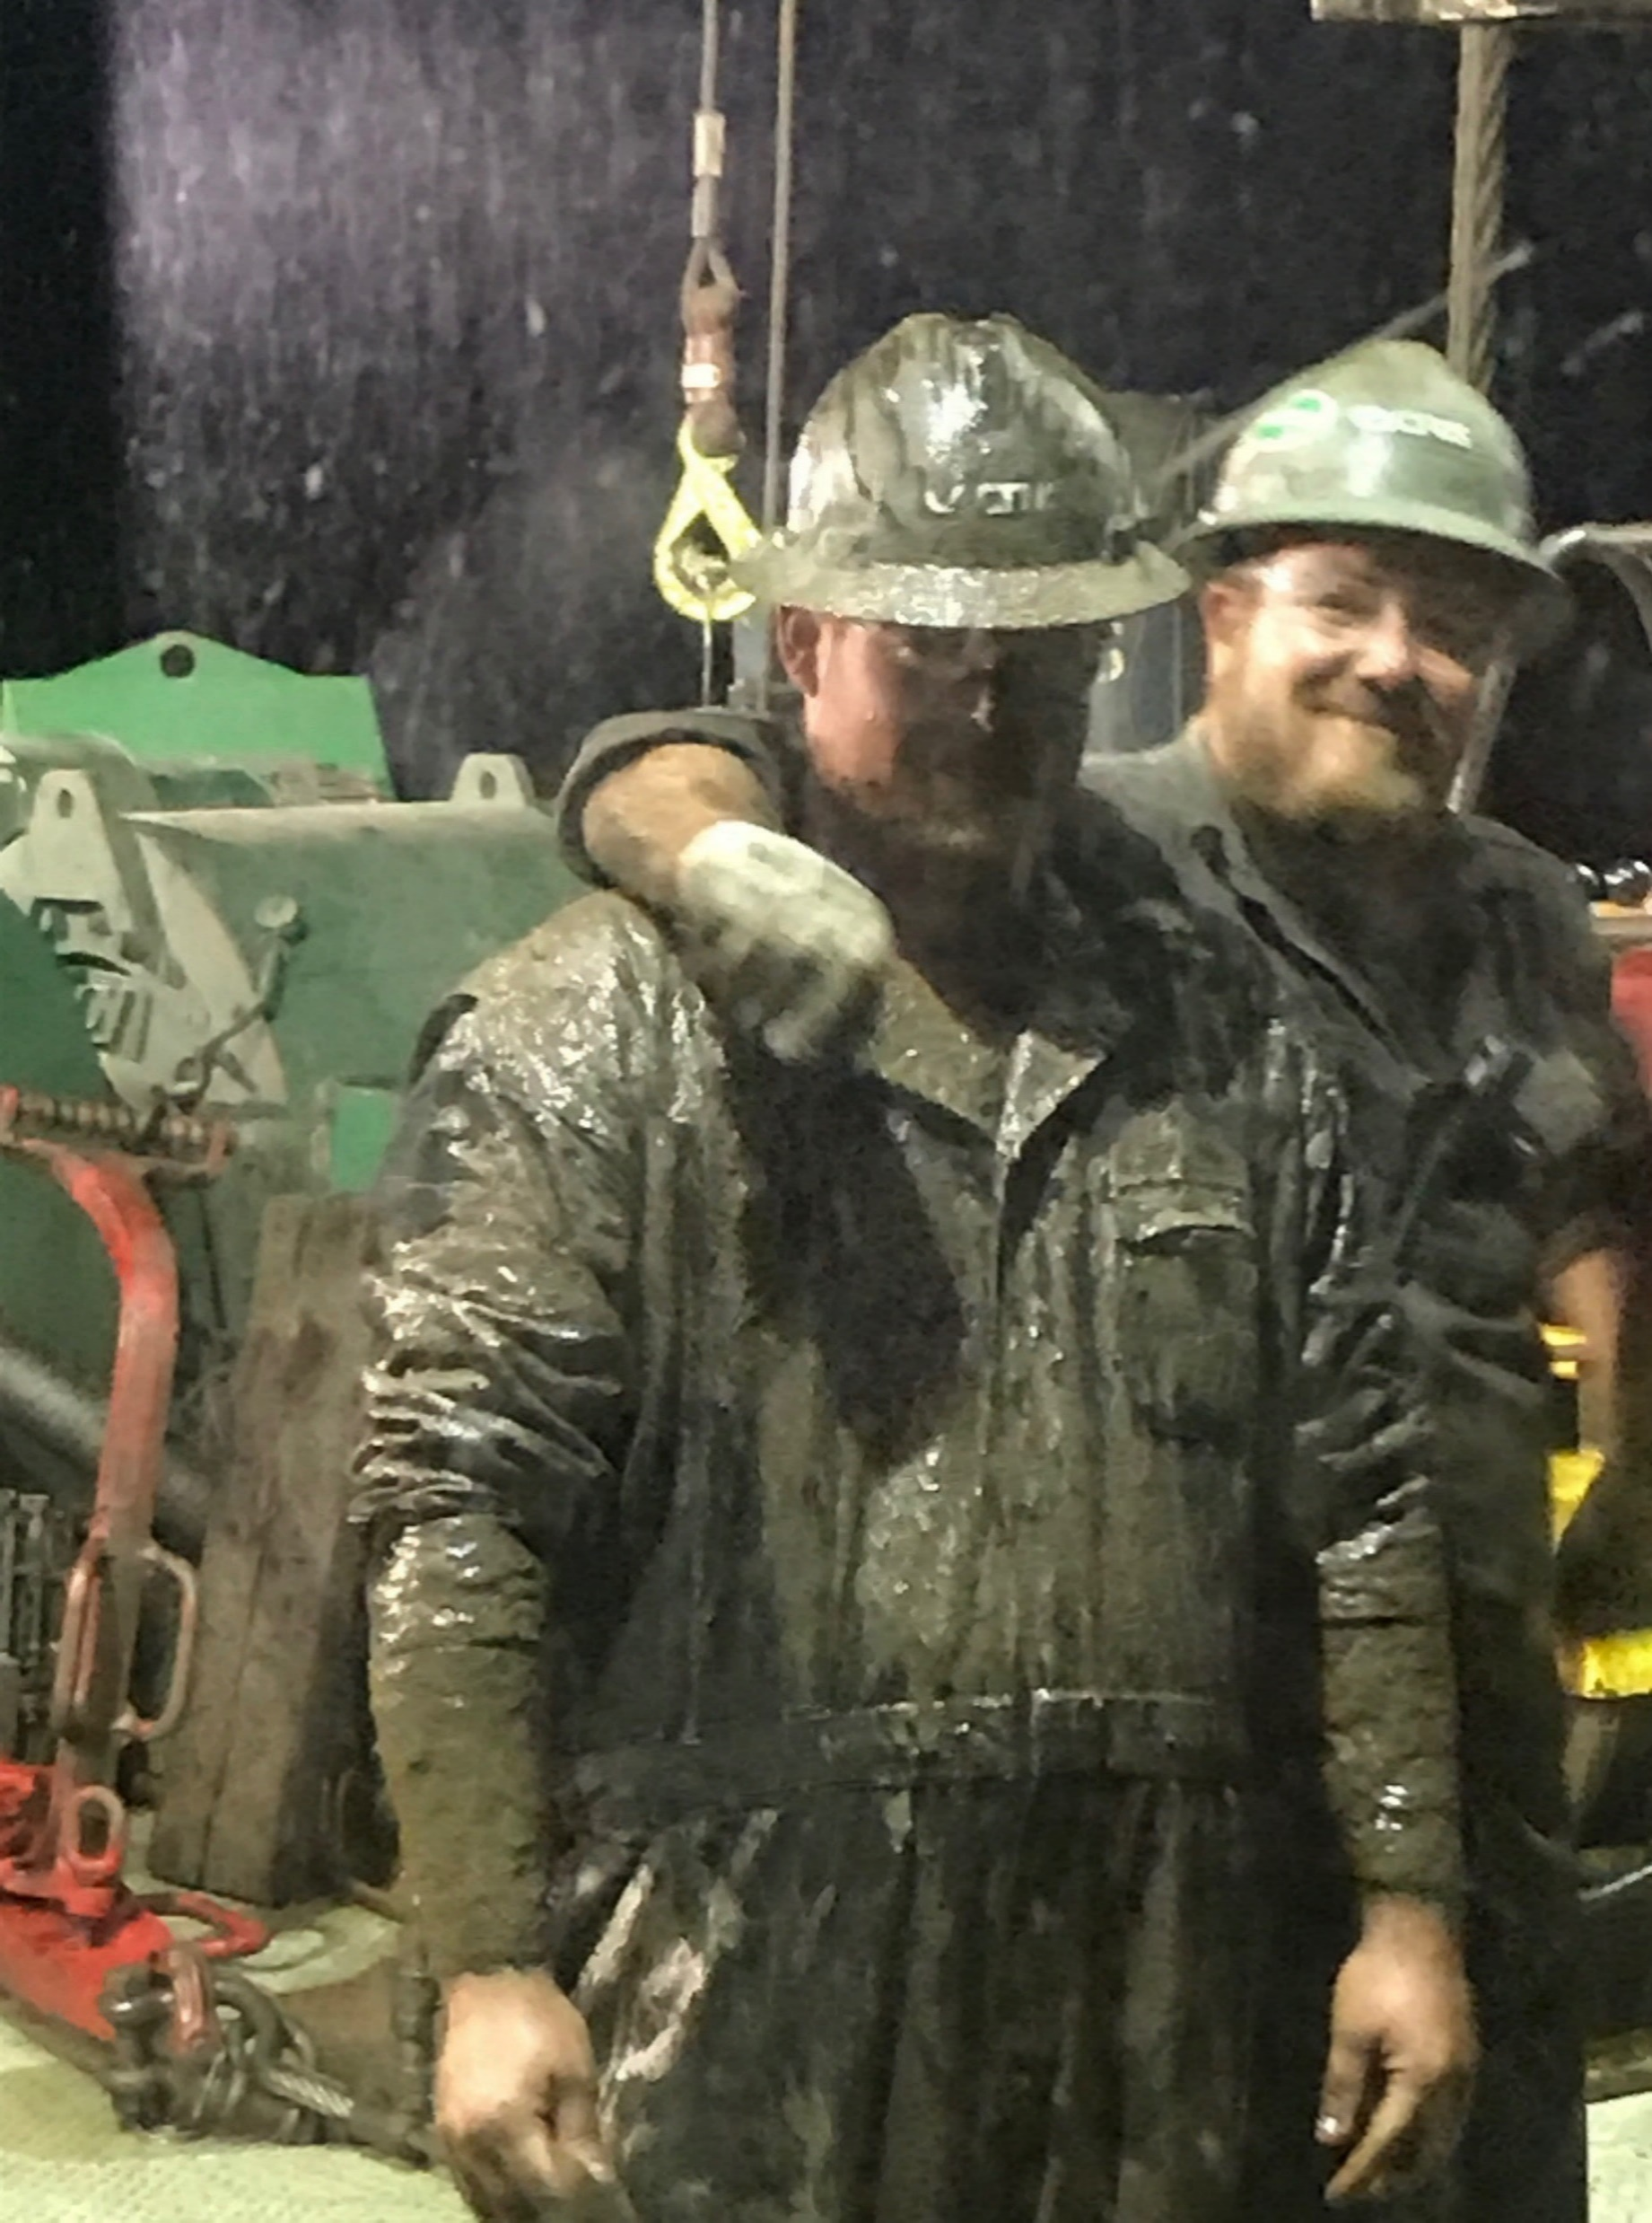
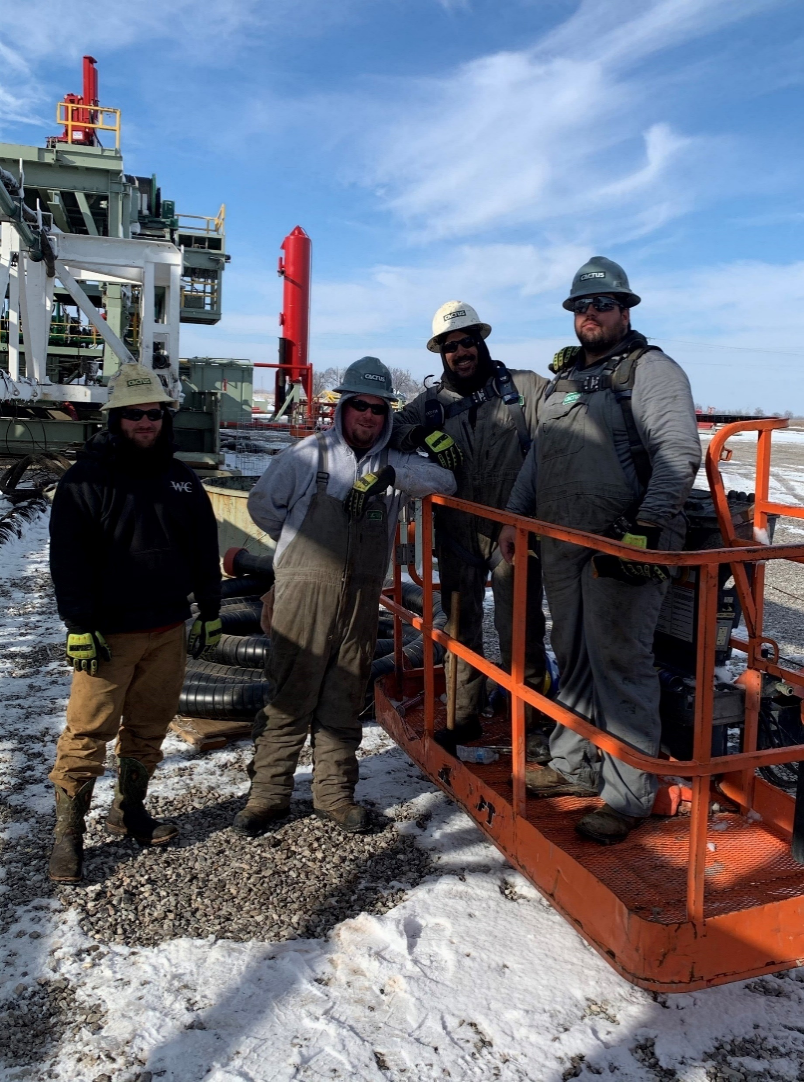
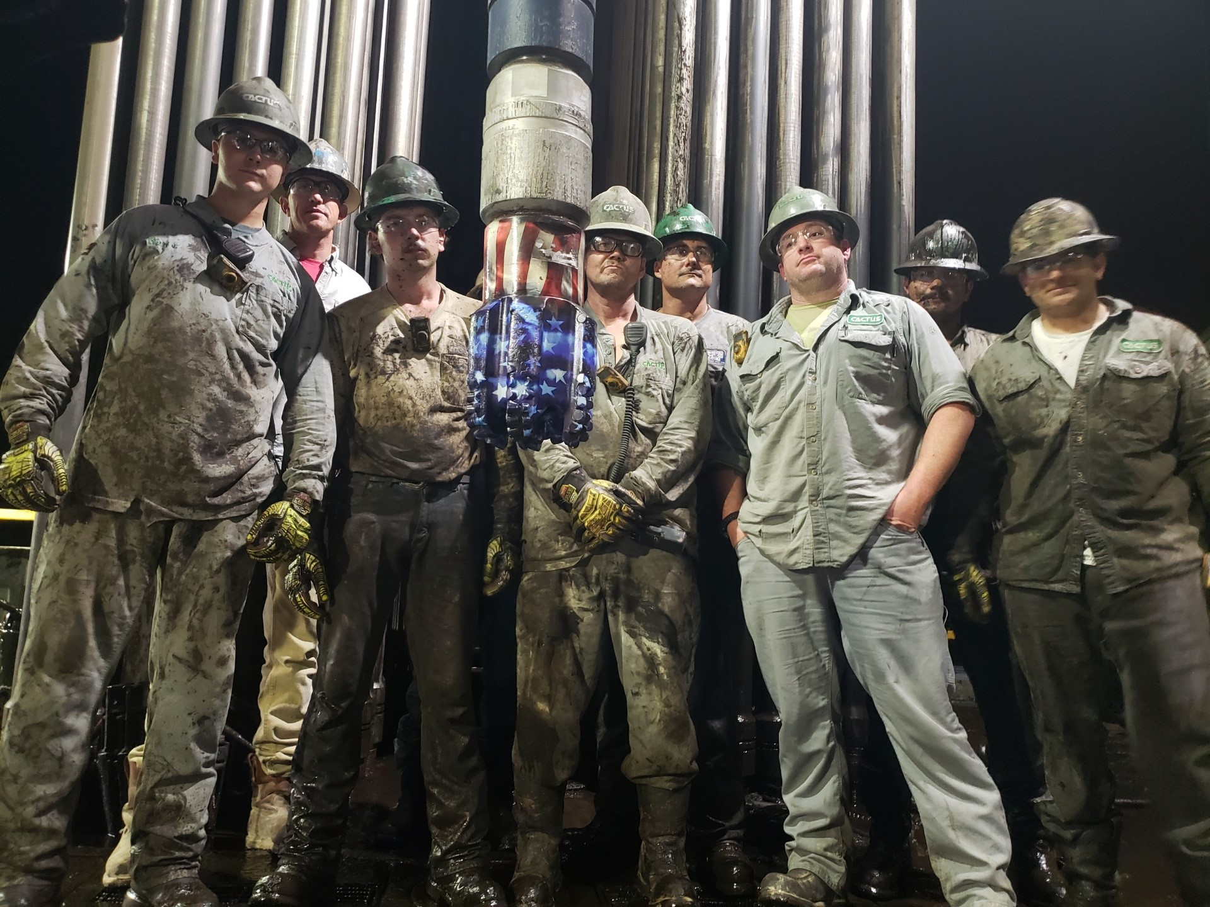
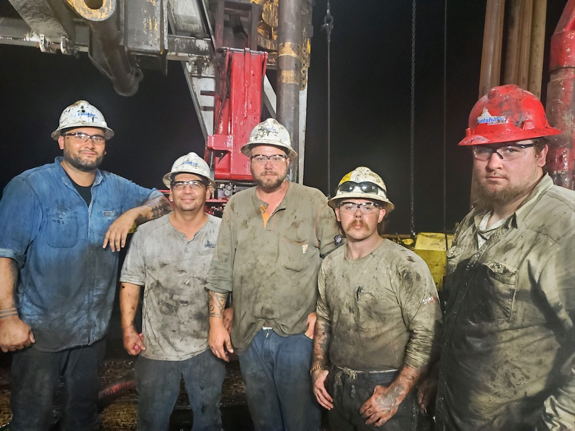
Ranger Buddies for Life
We few, we happy few, we band of brothers. -Shakespeare's Henry V
What Makes Combat So Different?
Shared hardship
Close proximity long duration
Common enemy
Singular focus / Harsh conditions
Daily mortality brief
Can Combat Camaraderie be Replicated in Your Team?
Shared hardship
Close proximity long duration
Common enemy
Singular focus / Harsh conditions
Daily mortality brief
What Your Team Can Become

Slide 8
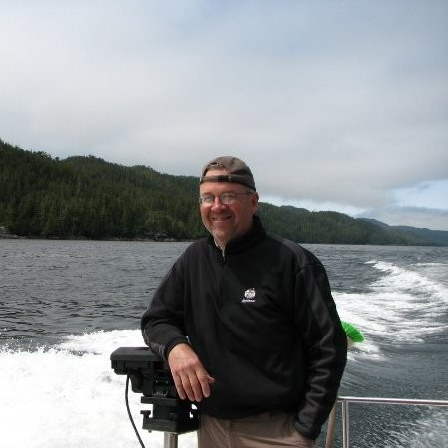
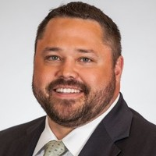
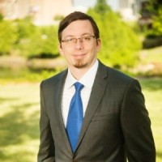
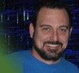
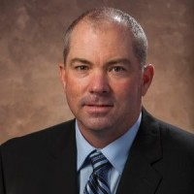

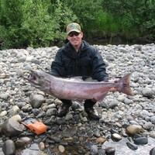
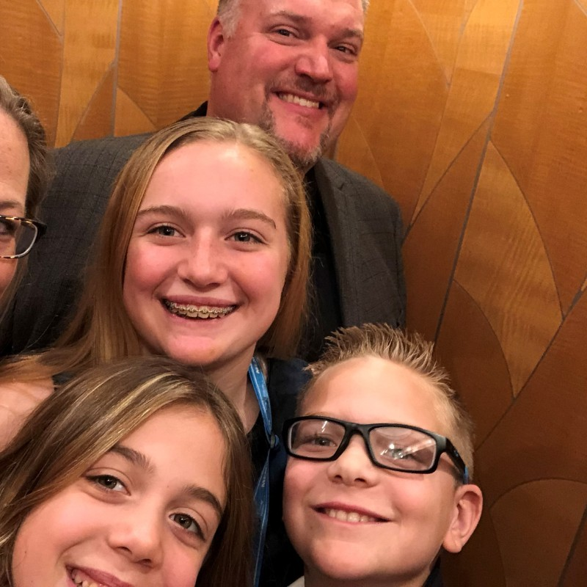
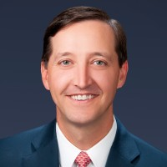
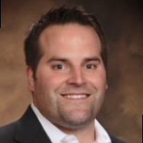
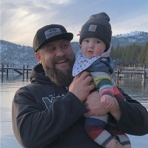
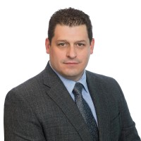
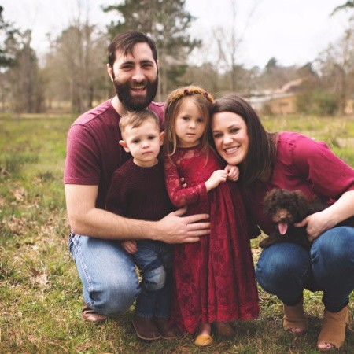
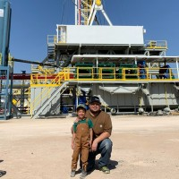
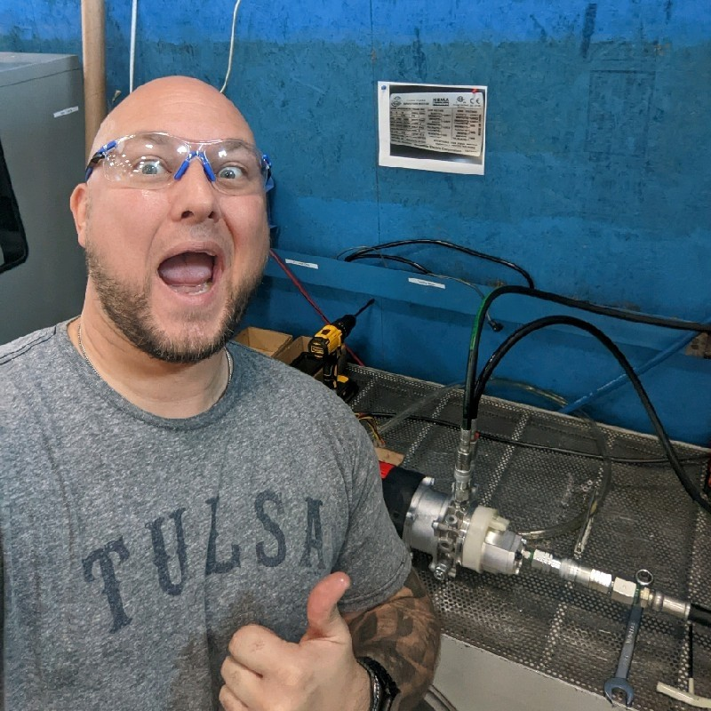
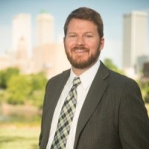
Joe Johnson Coaching Tree ‘07-’09
  Companies Impacted
  Aethon
  Apache
  BHP Billiton
  Canyon Creek
  Casillas
  Corterra
  Coterra
  Denham
  Devon
  Encana
  Halcon
  Navajo
  Ovintiv
  Panther
  Sage
  Samson
  Tecelote
  Trinity
  Vine
  WPX
  … And more
  Team Forward
  Tiger Joeboo Cookoff
  Superbowl Party
  Mandatory Fun
  Jail Break
  Fight for our bonuses
  Drilling against the world attitude
Matt
VP
Brian
Manager
Jon
COO / EVP
Jason
SVP
Jim
Manager
Doug
SVP
Geof
Director
Carey
VP
Pete
COO
Gianni
Present
Jason
COO
Colby
Owner
Aaron
Chief
D. Wayne Manager
Sebastian
Manager
Steve Manager
Brett
CEO
Lasting Legacy Of Your Team

Slide 9


Non-Standard Hiring
  Foster and Seek Out
  Responsibility
  Meritocracy of Ideas
  Mission First
  Adaptability
  Team First
  Aggressively Good
  2007 Success
  Newfield JMO Program
    A. F. – Chief Operations
    A. H. – SVP
    J. B. – Director
    J. G. – SVP
    P. C. – COO
    R. J. – CEO
    S. L. - VP
    Me – Orator to bored audience
Seek out Successful Team Members
Where To Find Human Capital

Slide 10
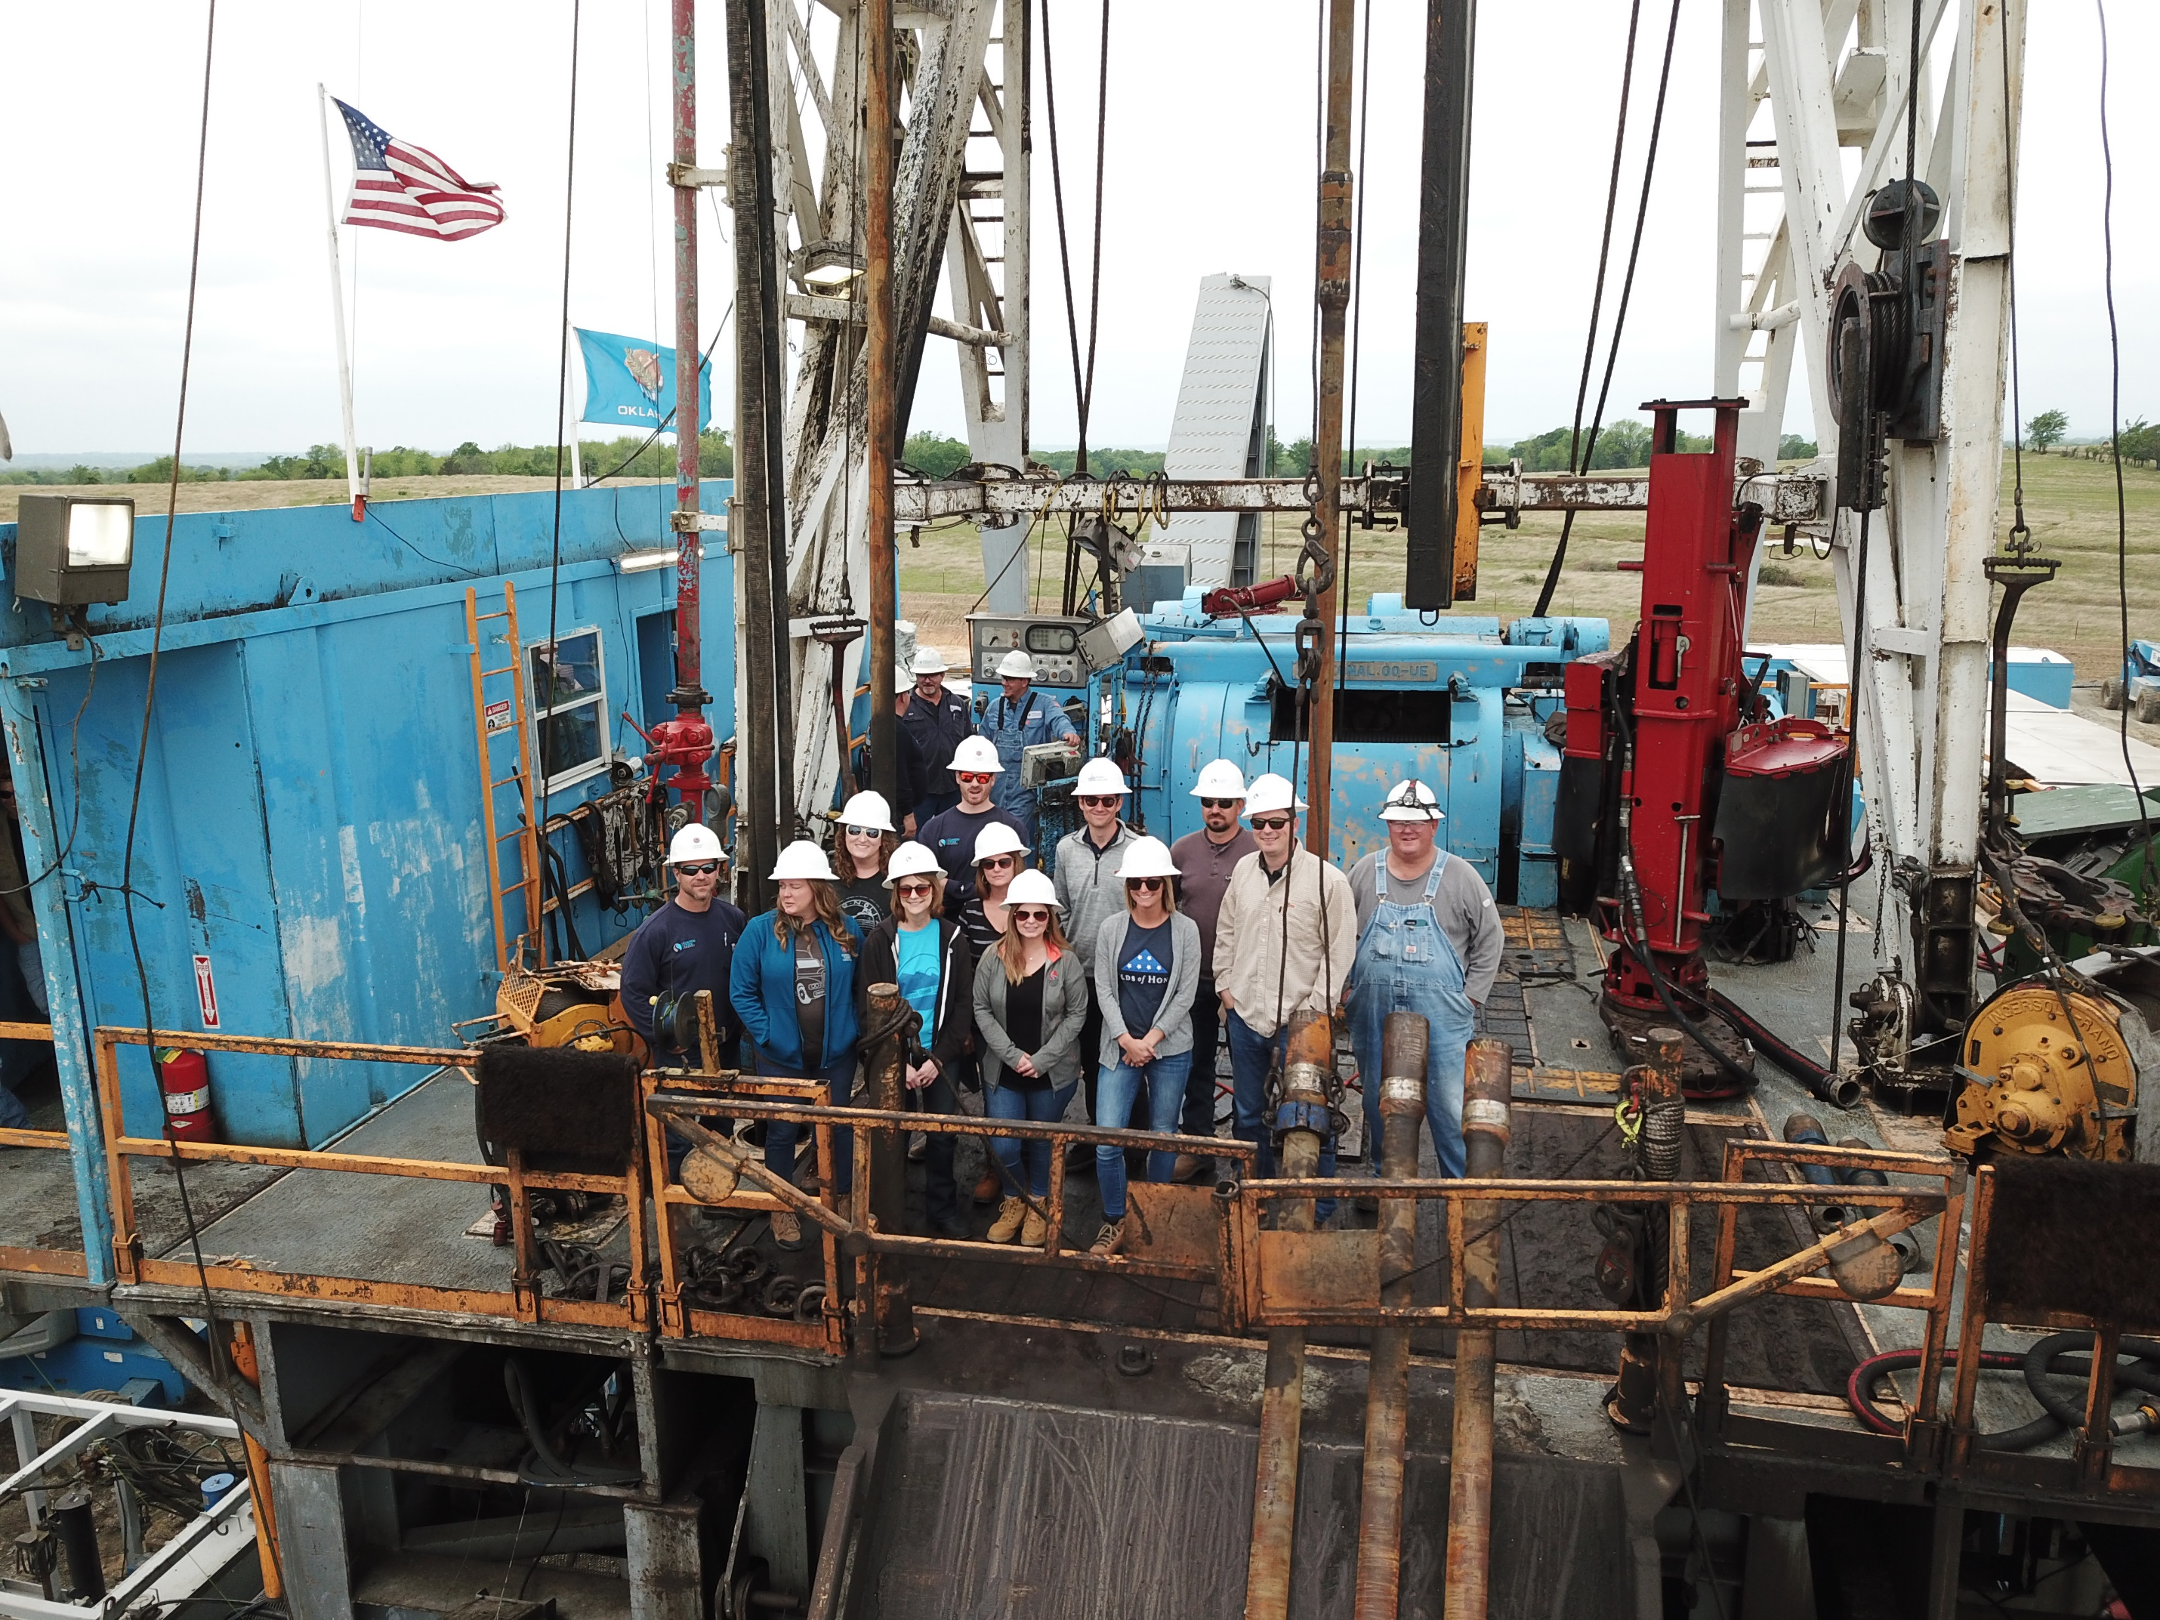
What Constitutes Your Adversity?
  For Some
  Loss of Total Returns
  Stuck Pipe
  Sidetrack
  Pipe Separation
  Blowout
  For Others
  Missing AFE Days
  DBR
  Out of Zone
Adversity is in the eyes of the Team and the norm of the situation.
Bolstering Through Adversity is as easy as being present.
Drive Success

Slide 11
Bolstering a Team Through Shared Adversity

