Slide 1
Extended Reach Lateral Execution (34,036’ MD Gabriel 2H)
AADE - September 2022
CONFIDENTIAL

Slide 2
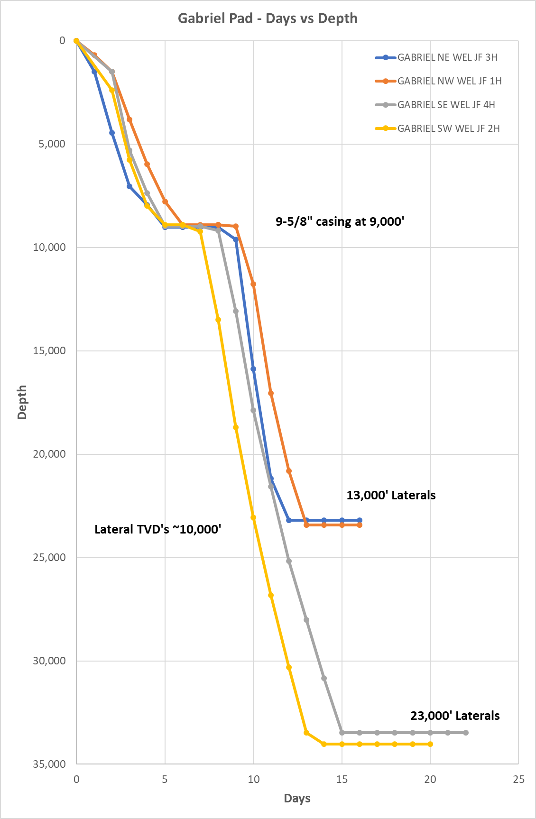
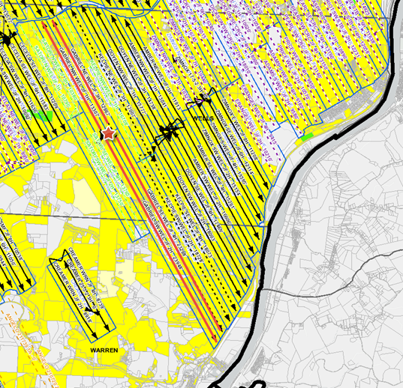
Long Lateral Success
Gabriel SW WEL JF 2H
34,036’ MD – NAM Record
23,828’ Cased / Cemented Lateral - NAM Record
Rigs Patterson 578 (Top Hole) and 581
13.5 days to TD
19.5 days spud to rig release
Curve and Lateral
  Footage: 25,049
  ROP: 203.3 ft/hr
Gabriel SE WEL JF 4H
33,477’ MD
23,183’ Cased / Cemented Lateral
Rigs Patterson 578 (Top Hole) and 581
15.1 days to TD
21.6 days spud to rig release
Curve and Lateral
    Footage: 24,347’
    ROP: 193.2 ft/hr
Result of limited pad sites and acreage position – we were not looking to break records
Execution did not require additional equipment or technology to succeed
This is not the limits of how far we can successfully drill and case a Utica well

Slide 3
Pre-Drill Modeling
Can we execute?

Slide 4
Pre-Planning
Prior to this our longest lateral was 18,632’ (Kelpie 2H), the Gabriel 2H was a stepwise change in LL for our program
Our Approach:
Model drilling parameters to ensure all operations were within technical limits
    Torque
    Circulating pressures
    ECD
    Hook-load
    Buckling
Understand the effect of various parameters on our TOOH and casing run efficacy
    Optimized airlock placement
    Tortuosity
    Torque
    Hook-load
    Cementing pressures
    HP Requirements for cementing
Fine tune our friction factors to ensure they were compatible with OUR operation
  Accurate FF calibration is essential in yielding precise models

Slide 5
Drilling parameters
Torque:
Modeled Torque at TD = 37,500 ft-lbs
Maximum DP Torque = 54,000 ft-lbs
Rig outfitted with NOV TDS-11HD High Torque Top Drive (1200HP)
TOOH Hookload:
Max PU Weight = 500klbs
Max Rig Pull = 580klbs
Pump Pressure:
Modeled circulating pressure at TD = 6,000psi
Max pump pressure = 6800psi
5.5” DP Required to maintain necessary GPMs at TD
ECD:
Modeled ECD at TD = 18.8 ppg
Pressure Gradient at TD = 21.5 ppg
Hazard monitoring screen built via Corva to monitor ECD
Models suggested execution was achievable if carried out properly – can we trust our models?

Slide 6
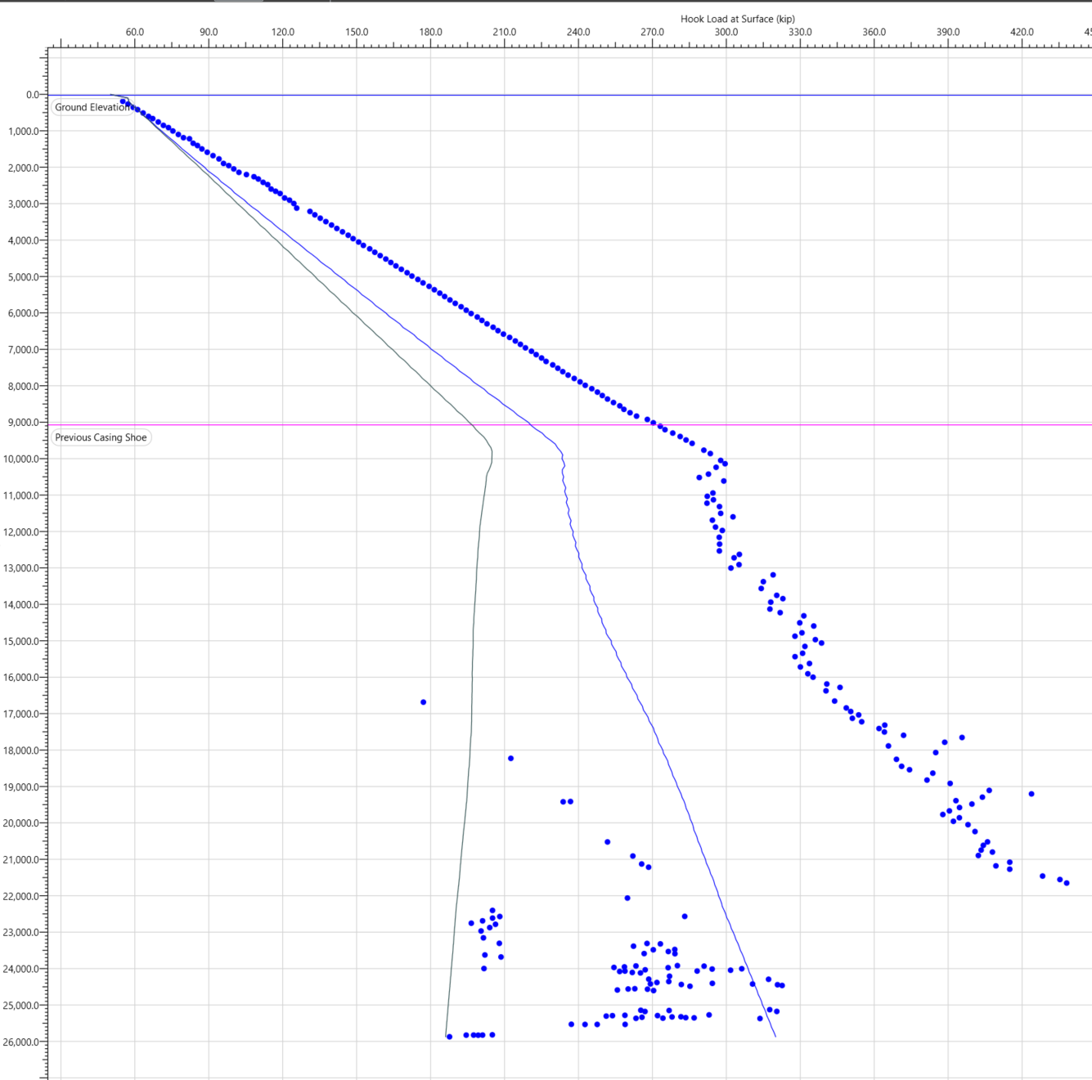
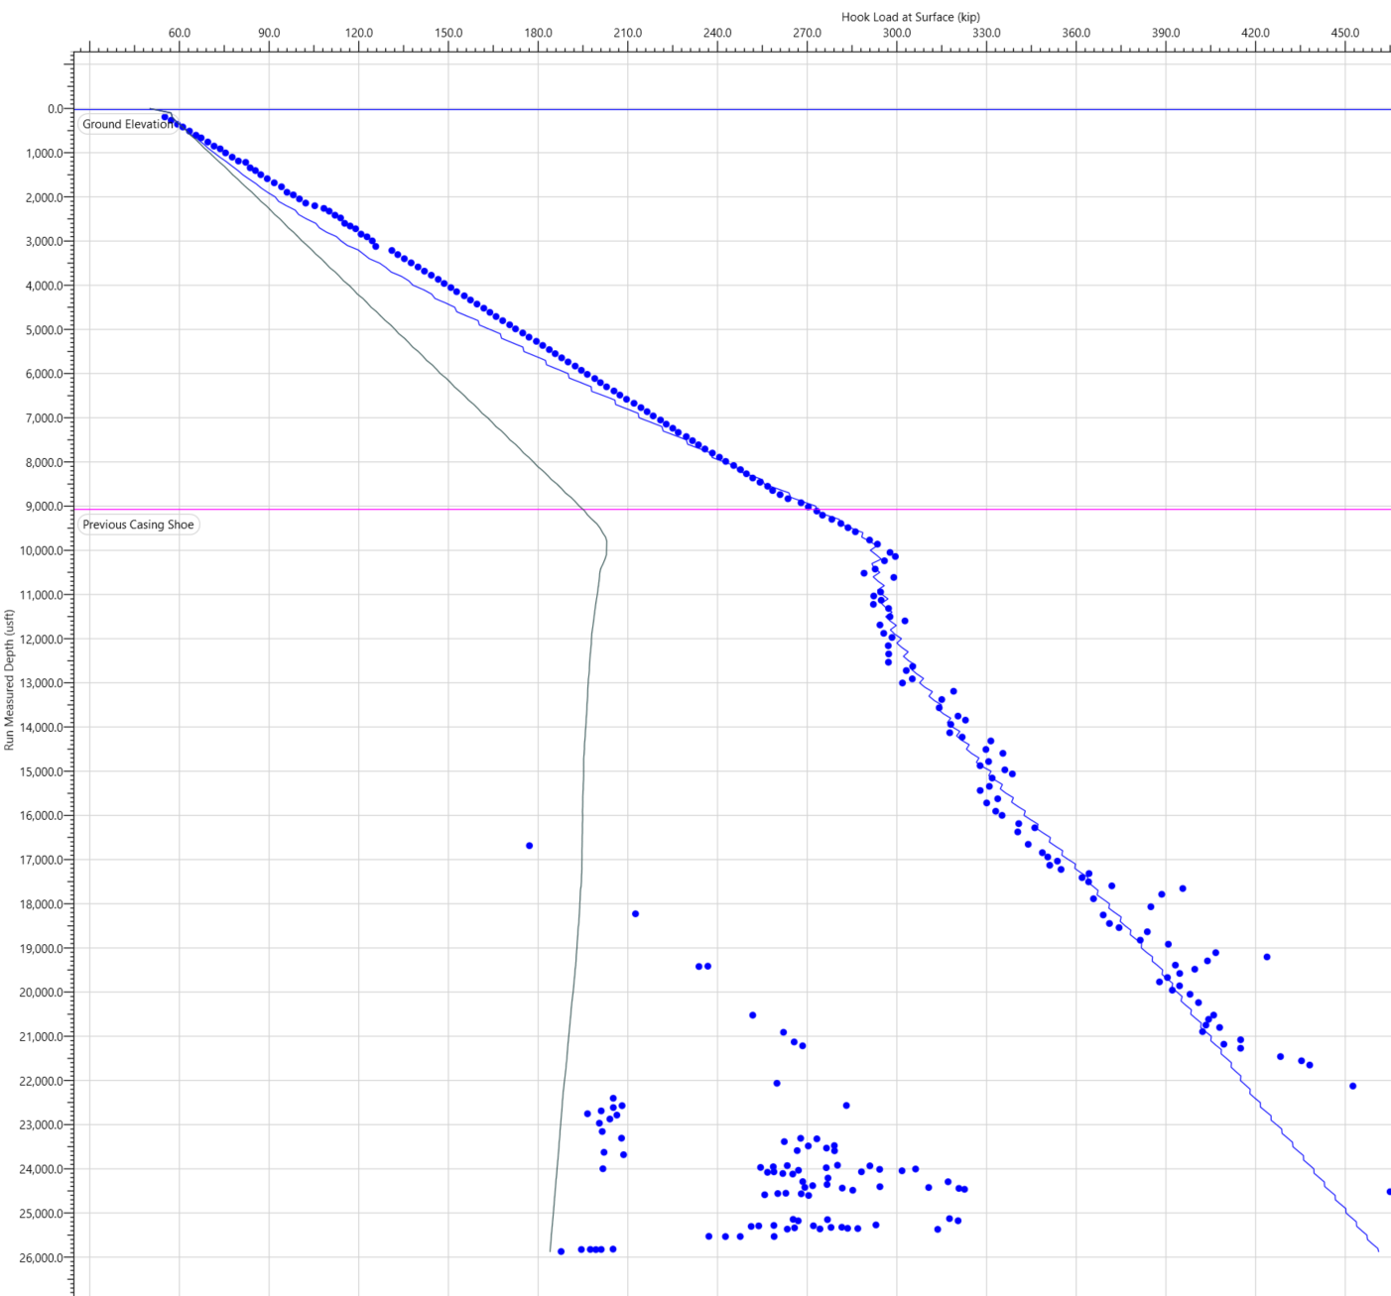
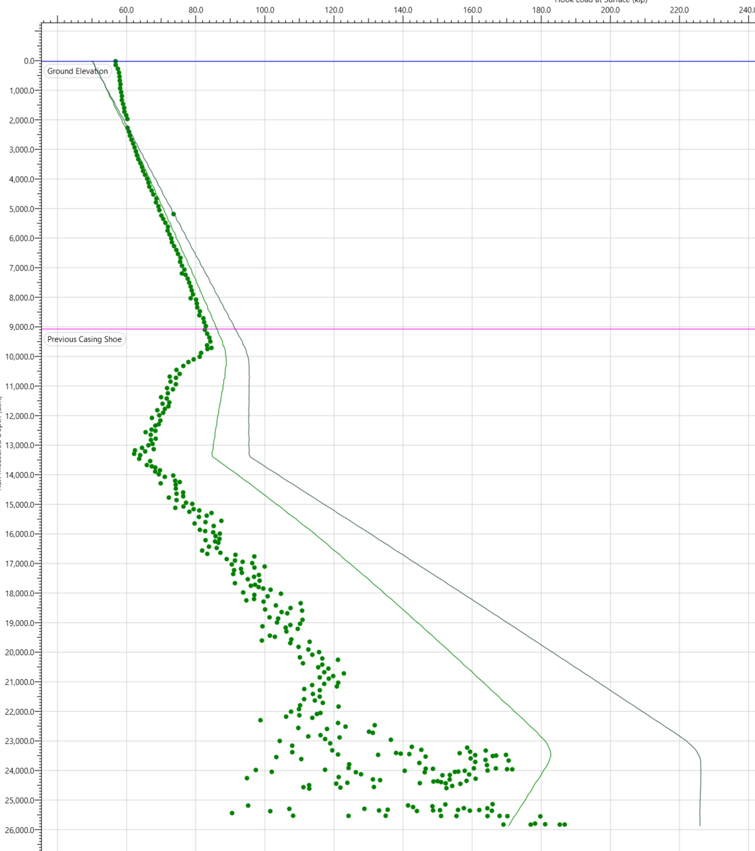
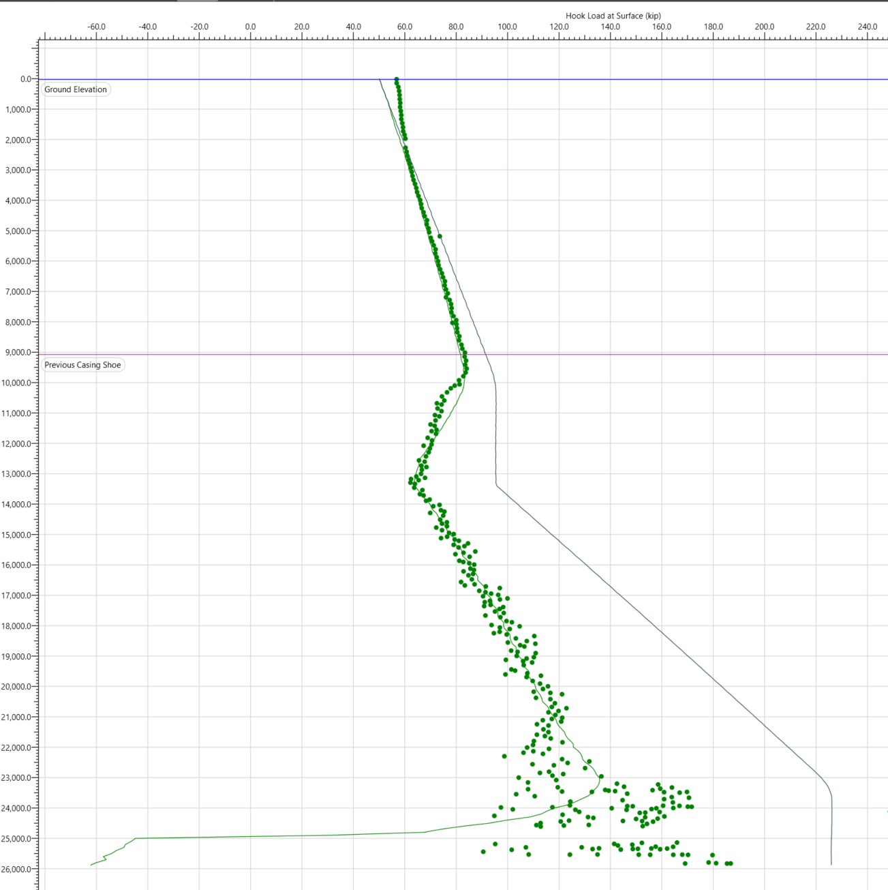
Model Calibration (Industry Standard FF v Fine Tuned)
Industry standard:
Casing FF – 0.15, Curve FF – 0.25, Lateral FF – 0.25
FF calibrated based on results of previous wells in basin

Slide 7
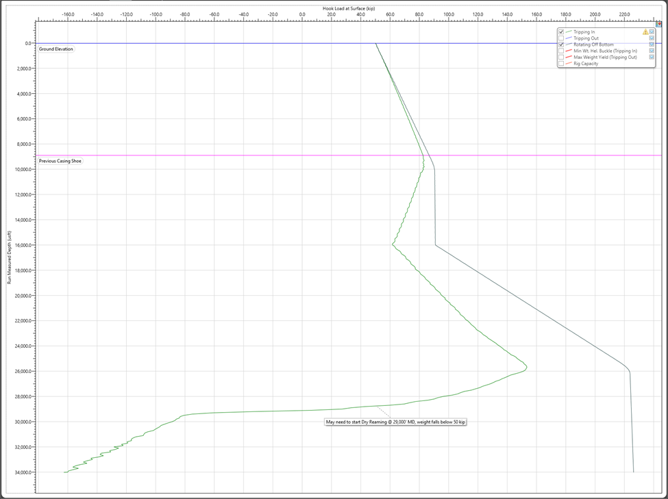
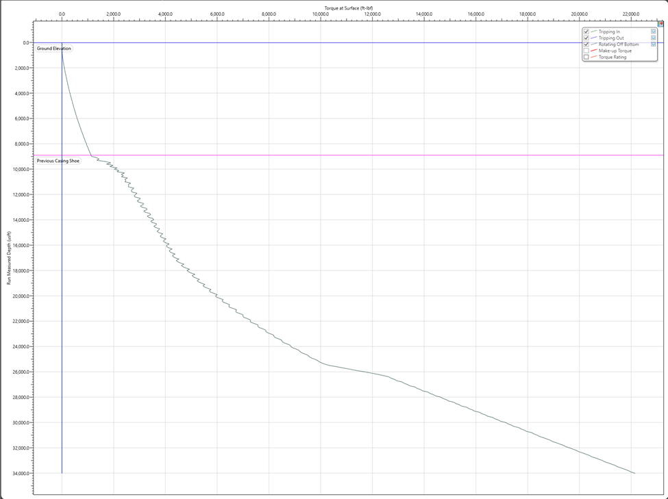
Casing Running Hook Load
Rotating Casing Required @ 29,000’ MD
Modeled Torque @ TD = 22,200 ft-lbs
Operating Torque Limit 34,000 ft-lbs
Start dry reaming at ~ 29,000’MD
Plan to rotate casing to TD at 20RPM
Block Weight = 50klbs

Slide 8
Drilling Execution

Slide 9
Execution- What mattered
Drilling
  Tortuosity-Top Hole Delivery (Dog-Leg Minimization for Torque/Buckling reduction)
  ECD’s and Pressures (Real-Time Hazard Monitoring)
  Mud Lubricant
  Parameter Selection to minimize motor stalls/tool failures
Casing/Cement
  Airlock placement
  Dry Reaming
  SLB Pressure/HP Simulations

Slide 10
Tortuosity – Example
Strong correlation seen between wellbore smoothness and performance during TOOH and casing runs
Up hole smoothness can have a significant impact on overall well performance

Slide 11
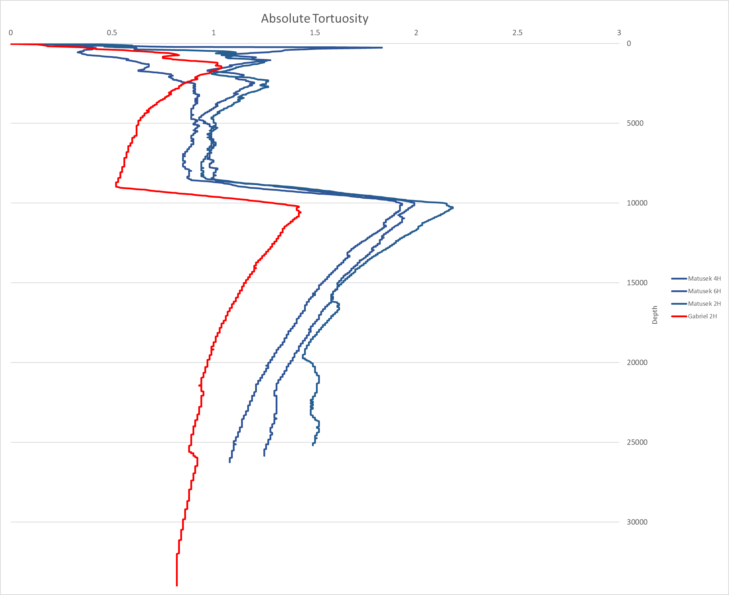
Gabriel – Deep Top-Hole Delivery

Slide 12

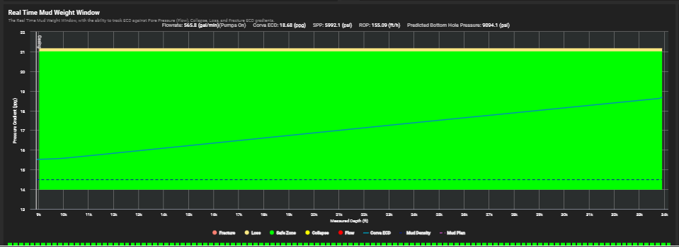
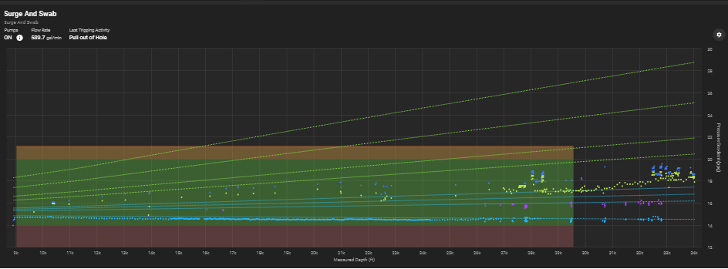
Hazard Monitoring
Real-Time monitoring developed in conjunction with Corva Drilling Analytics
As many aspects of the operation are dynamic it was important, we could analyze conditions on the fly
Real time ECD analysis to ensure staying below frac gradient
Trip speed monitor to minimize effects of surge/swab

Slide 13
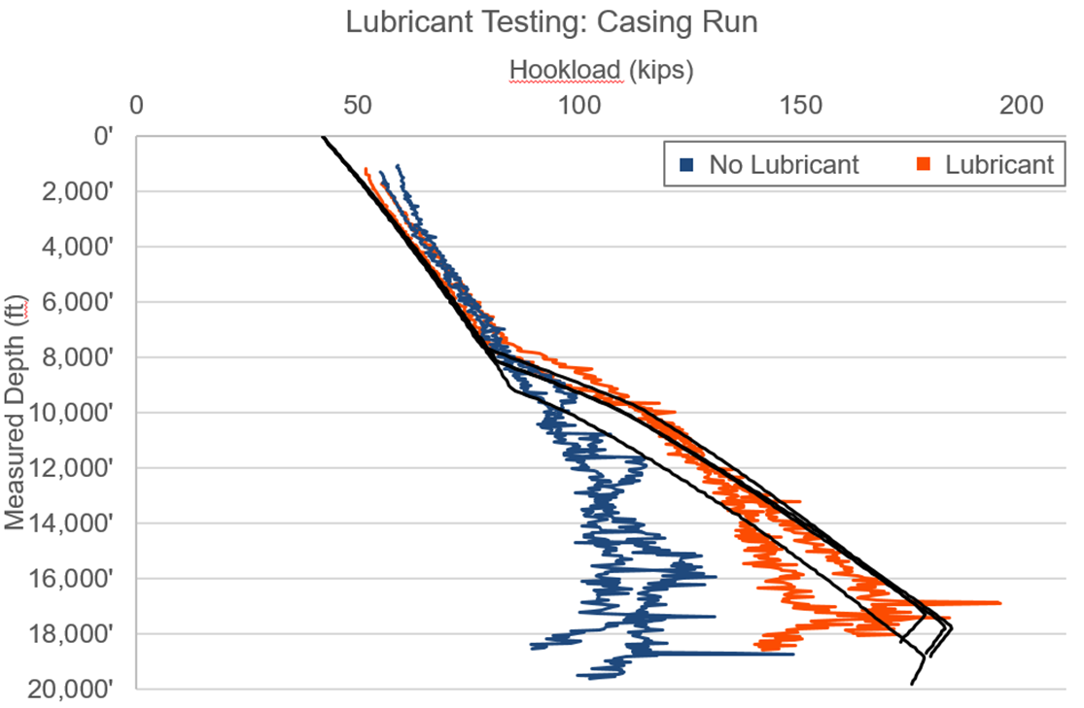
Mud Lubricant Testing

Slide 14
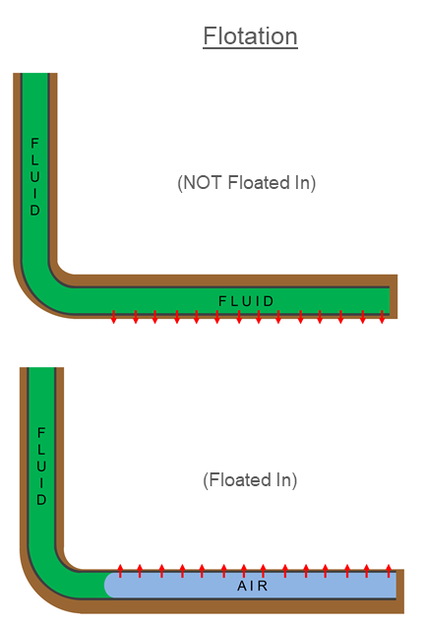
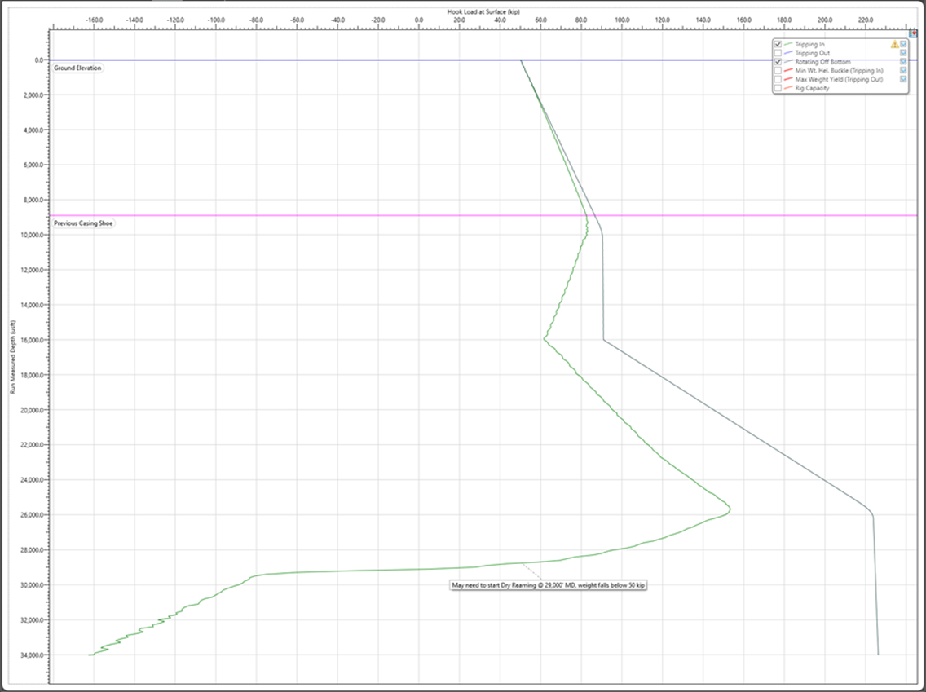

Casing Floatation - Airlock

Slide 15
Summary
We can optimize our drilling, trips and casing runs both in the planning phase as well as how we execute our drilling operations
  Geometry of Wellbore (Design)
  Wellbore Smoothness
  Deep Top-Hole execution/delivery
  Detailed Communication with Ascent personnel and vendors.
Understanding data allows us to better model our depth limits from a drilling/casing running perspective
  Optimized airlock placement
  Updated friction factors (Accurate Modeling)
  Proper Planning (Pad placement, wellbore design, drilling execution)
We have yet to reach our drilling/casing depth limit, but will continue to evaluate data and models as we continue to lengthen our laterals
We did not change our standard operating procedures, we drilled these wells the same as we drill every well with proper planning, communication and teamwork

Slide 16
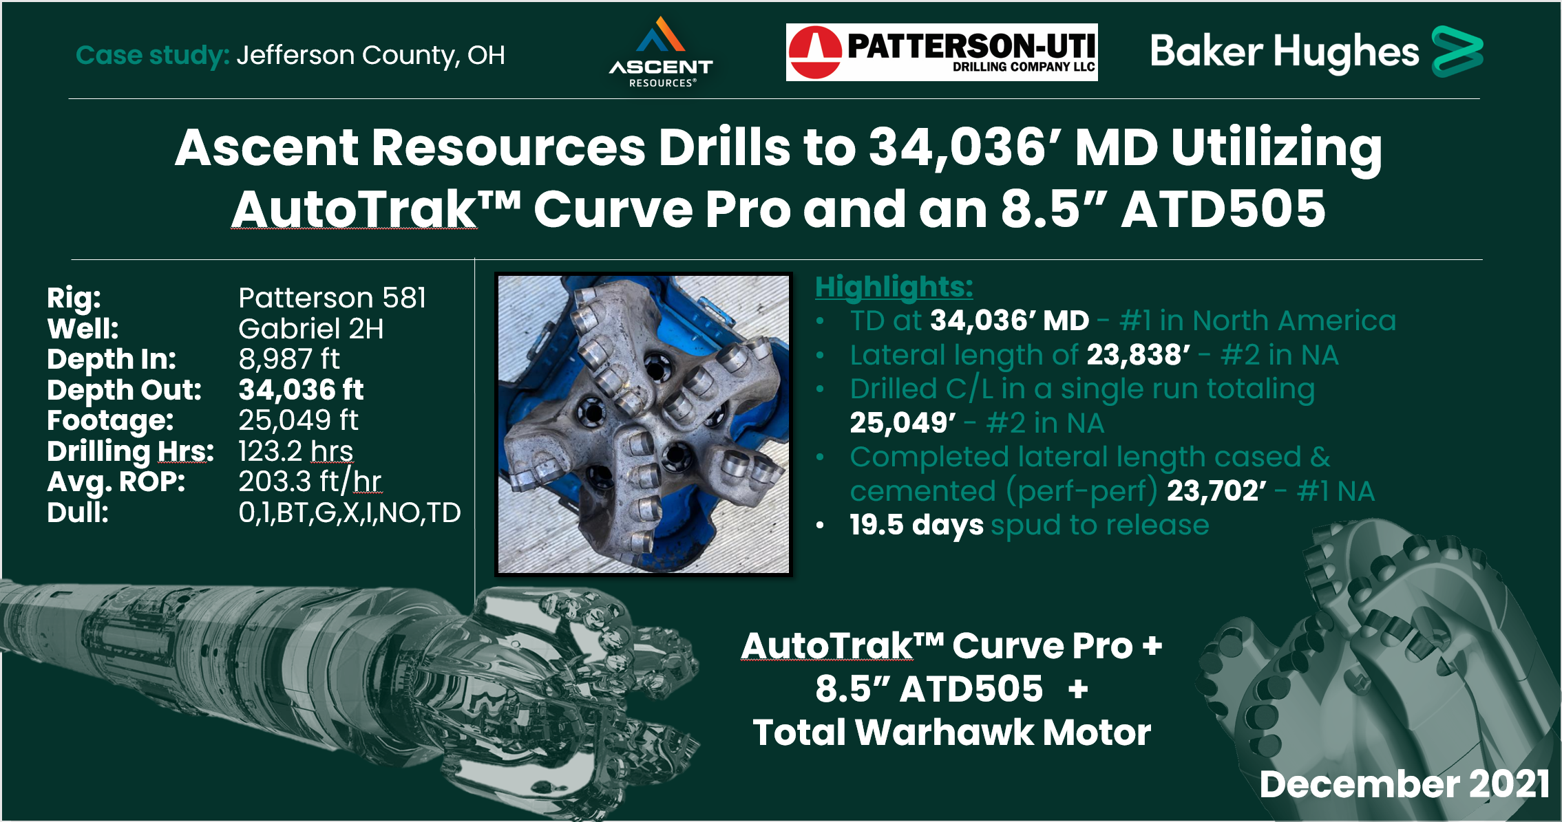
Gabriel 2H North America Land Records!!!!

Slide 17
Thank You

