Slide 1

Closed Loop Drilling Automation with Integrated ROP Optimizer using Big Data Analytics and Machine Learning
21 September 2023
Kriti Singh
Senior Research Data Scientist
1

Slide 2
Agenda
Introduction
Machine Learning ROP Model Review
Semi-automated Training Pipeline
Previous Publications
  Field Test Results
  ROP Optimizer
Hole Cleaning in ROP Optimization
Summary
What’s next?
2

Slide 3

Rotary Automation Milestones
Closed-loop Hardware Control for Remote Drilling
ROP
Optimization Engine
Multivariate Objective
Function
Dysfunction
Filters

Slide 4
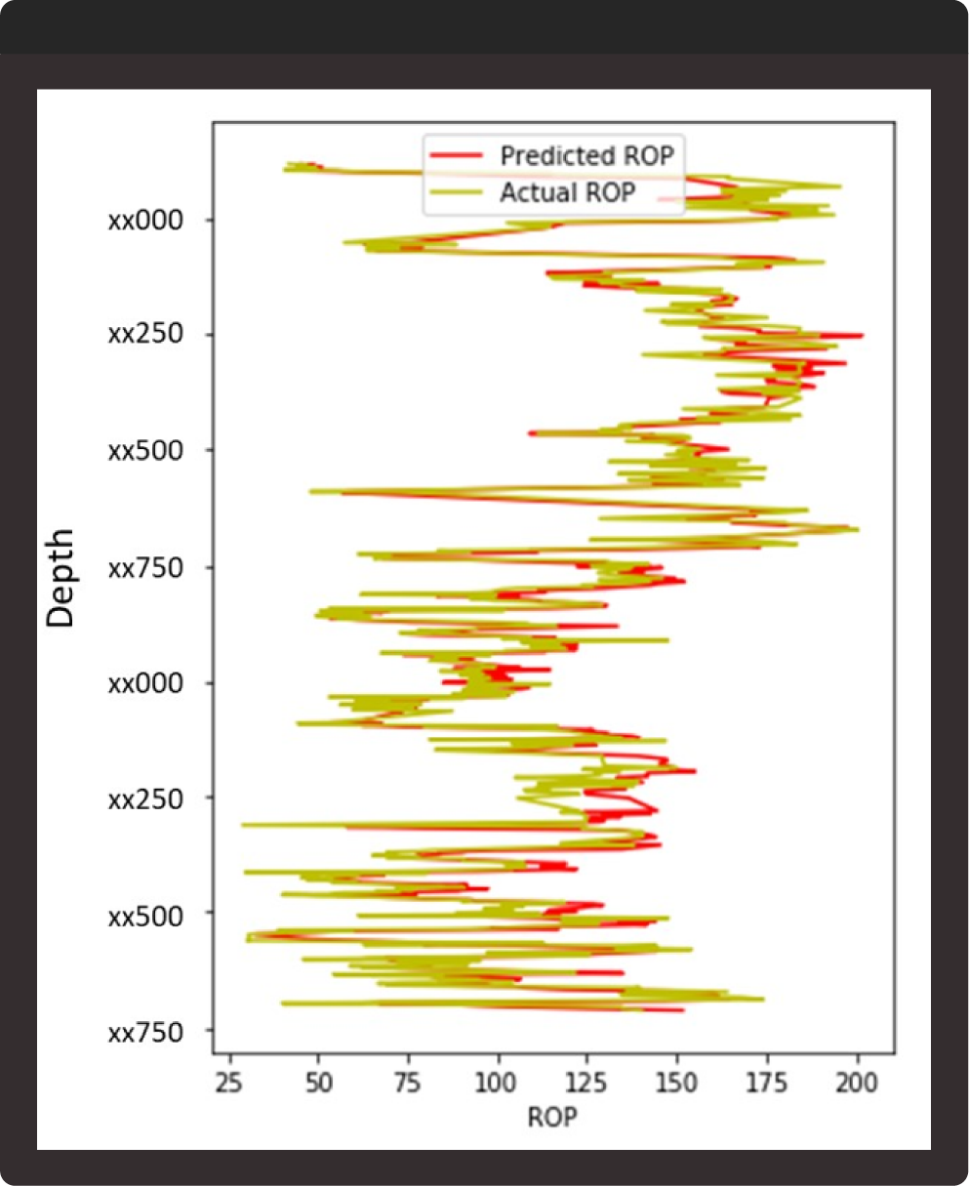
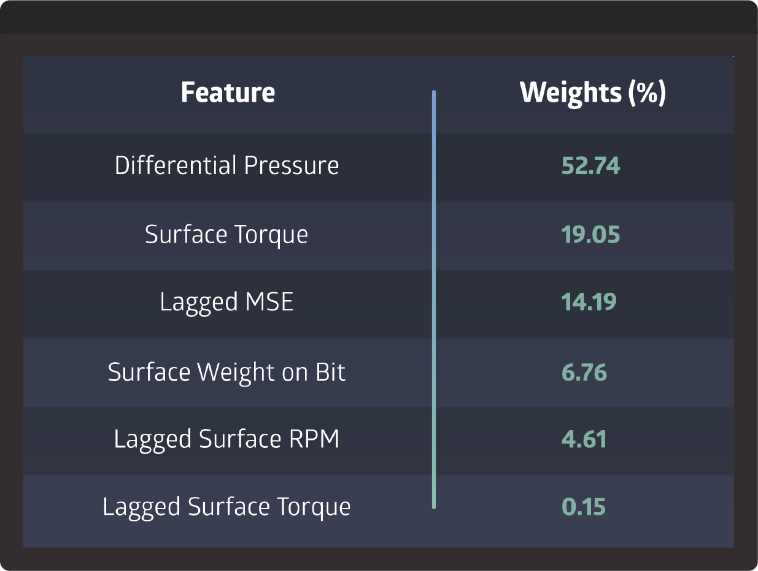
Review - Machine Learning Model Published in URTeC 2019 - 343
MAPE on blind
wells < 15%
4

Slide 5
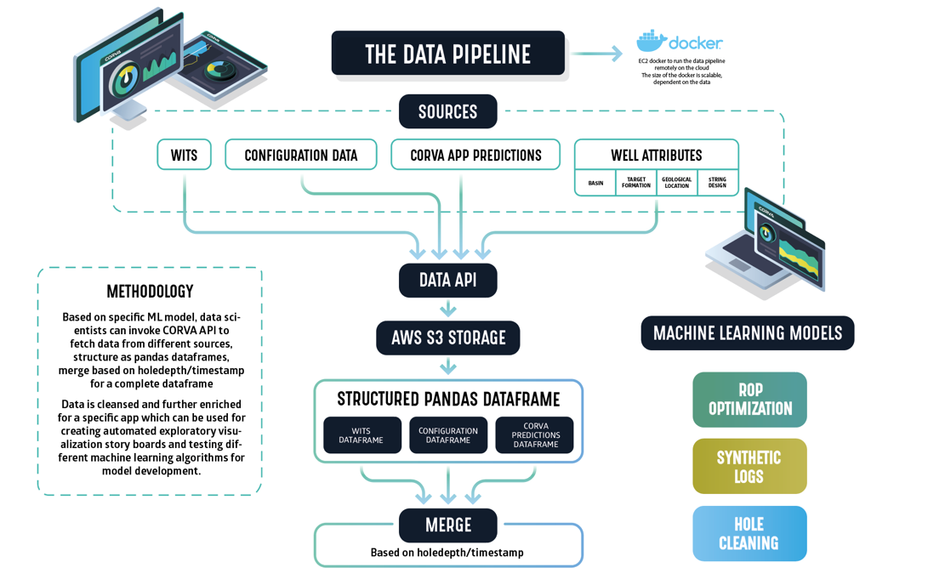
Input Parameters
WITSML data
BHA data
Survey data
Mud data
Corva Engineering calculations
5

Slide 6
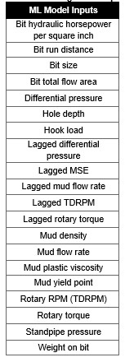
Input Parameters
Engineered Features are added:
Bit Hydraulic Horsepower per Square Inch
Bit Run Distance
Proxy for bit wear
Lagged Features
Lagged MSE is a proxy for formation strength
Current solution:
Multi-Variate Regression Model

Slide 7


Semi-Automated ML Model Trainer
Asset Selector
Asset Downloader
Model Trainer
Model Evaluator
Filter assets by Company/Basin/Rig/Target Formation
Map visualization of asset location
Parallel downloading of training data
Automatic and standardized cleaning process
Automatic combining training data into one dataset
Reduction of download time from 20 to 1 day.
Exploratory data analysis
Ability to train multiple models to evaluate the best performer
Ability to edit/add/remove features
Evaluation on new (blind) data
Export results of all wells into tabular form for easy comparison
Once approved, model is pushed to BETA for further testing

Slide 8
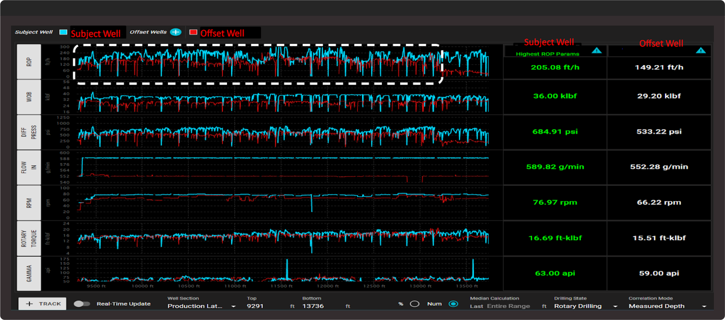
Review – Field Test Results Published in SPE/IADC 2021-204043
Midland Basin –
Operator 1
Wolfcamp A
Same Gamma Ray
Same BHA
Same Bit Size
36% improvement in ROP

Slide 9
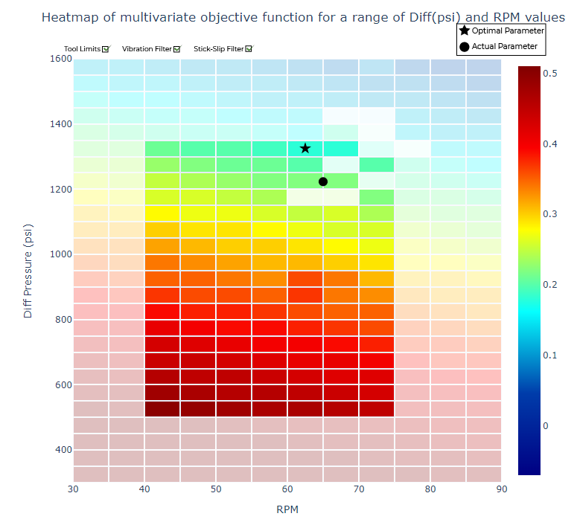
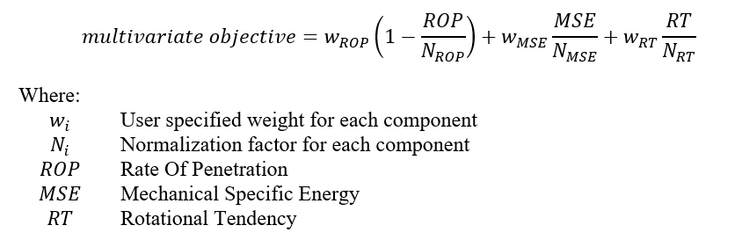
Review – ROP Optimizer Presented in SPE/IADC 2022-208751
Multivariate Objective Function
Filters:
Vibration
Torsional Severity Ratio
Parameter Limits

Slide 10
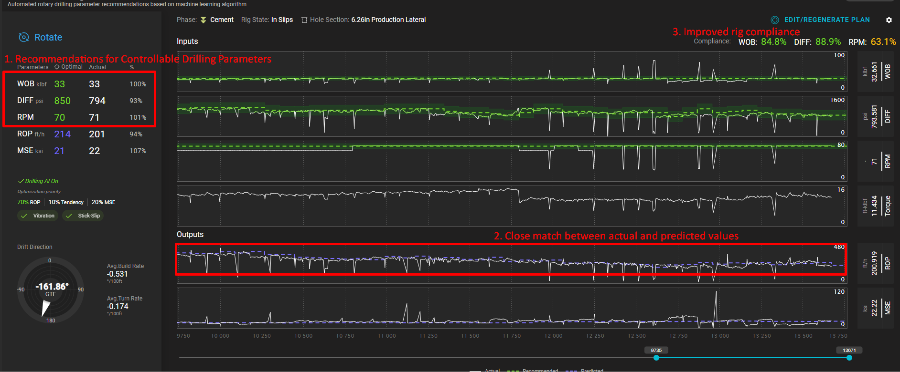
Field Test Results - Accelerate RIG Uptake
Observed improved rig compliance. The actual ROP response was very close to the predicted values

Slide 11
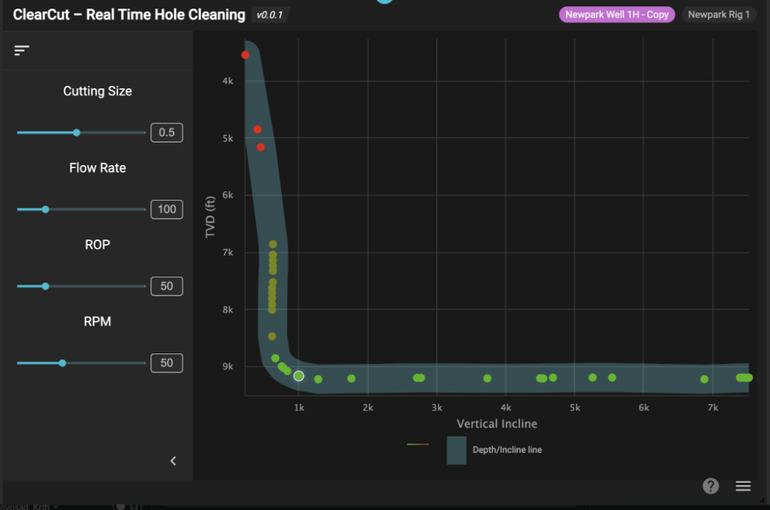
Potential for adding Hole Cleaning factor in ROP Optimization
Developed a POC Hole Cleaning app with Newpark team at the Corva Hackathon 2023

Slide 12
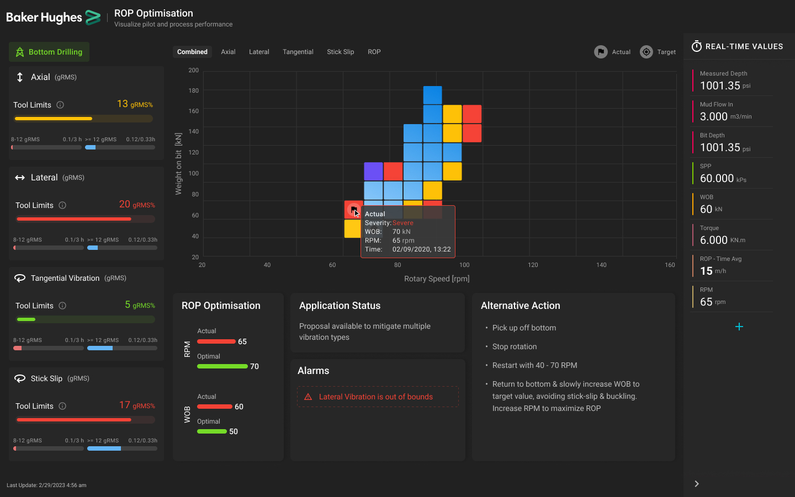



Corva Baker Hughes Digital Collaboration
Hazard Identification
Hole Cleaning
Drill Bit Optimization

Slide 13





Summary
Real-time ROP prediction using Machine Learning
Augments
Driller’s Capability:
Reduces driller’s fatigue by automatically picking the optimal parameters
Identify the optimal set for drilling parameters
Reduce cost per ft of drilling
Reduce hazards by leveraging real-time data (e.g. vibration)
Real-time comparison with offset wells data

Slide 14
What are we working on?
Closed loop automation
Strategic partnership with a major rig contractor
Directly control the AutoDriller setpoints using cloud -> cloud -> HMI connection
Closed loop field testing with major Oil & Gas operators

Slide 15
Thank you!
15

