Slide 1
Upgraded Fluid Management
Opens New Opportunities for Drilling Performance Improvements
11/16/2023
Rosario Jara
Dallas Milligan, P.E.

Slide 2
Agenda
Remote Operations Center
Collaborative Approach
Real Time Fluid Monitoring Technologies
Remote Operations Center Fluid Advisor
Event Detection
Drilling Performance Improvements
Q&A

Slide 3

ExxonMobil Remote Operations Center

Slide 4


Collaborative Approach
Rig Operations & Automation
Analytics/Performance Analysis
Communication
via location visuals/phone/text/wire/etc.
ROC
Data Store
End User
MDP
Analytics
Reporting
Housed internally & securely for all to access
Easy performance lookbacks
Real-time Visualization
Comparative Analytics
Quickly identify Trends/Problems
Increase knowledge transfer
Data Quality checks
Disciplines may include -
Execution Engineers
Geologist
Geo Steer
ROC Fluid Advisor
Various SME (Fluids, Drilling, Tools etc..)
Directional Drilling
Well Planners
Rig Personnel
Visualized by
Various Software Options
EDR

Slide 5
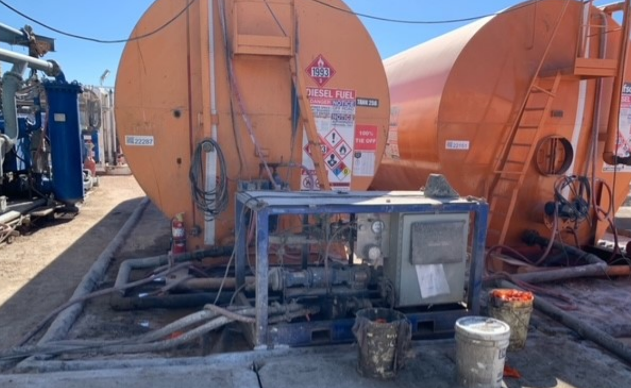
Fluid Monitoring Technologies
Evolving sensor technologies may include:
  Density
  Rheology
  LGS
  pH
  Electrical Stability
  Oil/Water Ratio
  Solids Analysis
Opportunity to upgrade work flow, data quality, and performance
Data Quality
Performance
Early identification of fluid parameter deviations – ability to adjust before issues are evident
Continuous fluid measurements and high data frequency provide opportunity for fast decision making
High frequency data opens opportunity in data analytics space
Optimization of fluid parameters to prevent fluid related NPT
Immediate transfer of key learning across operations
Work Flow
Rig Site – Personnel on site provide feedback and interact directly with ROC fluid advisor
ROC fluid advisor provides insight and learnings from a high level and across rigs
Citation - Petty, W., Offenbacher, M., Jara, R., Rabb, C., and S. Unrau. "Real-Time Drilling Fluid Measurements Provide Value Via Data-Driven Decision Making for Cost-Sensitive Unconventional Environments." Paper presented at the SPE Annual Technical Conference and Exhibition, San Antonio, Texas, USA, October 2023. doi: https://doi.org/10.2118/214949-MS

Slide 6
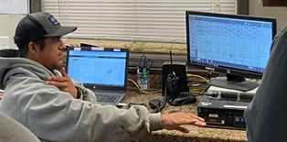
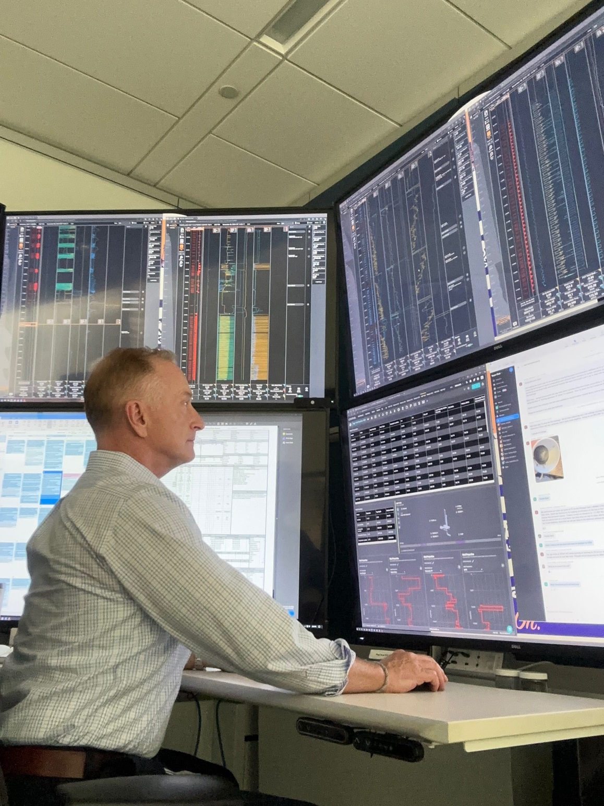
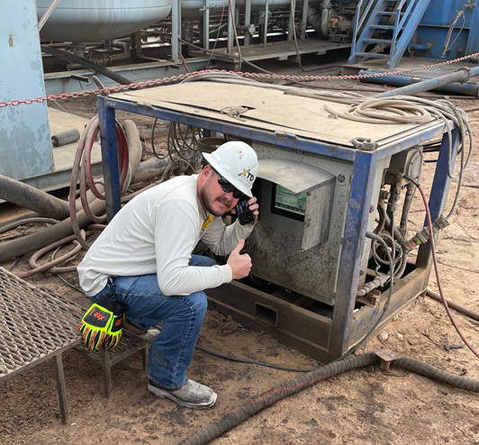
Remote Operations Center Fluid Advisor
Rig Site
ROC
Rig EDR provides 1 sec fluid property data and event detection alarms
Digital mud reports now provide whole well insights and offset well analysis capability
Fluid reports and additional information from rig sites allow all the pieces to come together
Value is derived through timely event detection, decision making, and collaboration

Slide 7
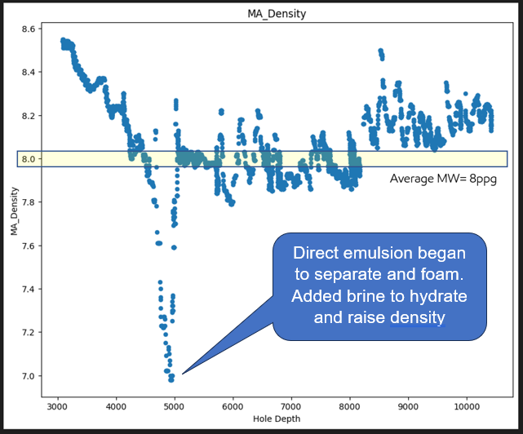

Event Detection
Density Event
Alarm in ROC sounds
ROC Fluid Advisor investigates
Alerts mud engineer and operations supervisor to collaborate on forward plan
ROC Fluid Advisor shares learnings across rigs and mud engineers
Citation - Petty, W., Offenbacher, M., Jara, R., Rabb, C., and S. Unrau. "Real-Time Drilling Fluid Measurements Provide Value Via Data-Driven Decision Making for Cost-Sensitive Unconventional Environments." Paper presented at the SPE Annual Technical Conference and Exhibition, San Antonio, Texas, USA, October 2023. doi: https://doi.org/10.2118/214949-MS

Slide 8
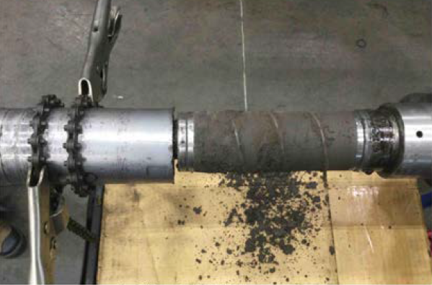
Drilling Performance Improvements
Impact at the rig site
  Tool forensics
  BDE switch strategy
  Consistency in fluid systems and treatments
  Efficiency gains
  Actionable data
    Alarms out of spec properties
  Improved economic fluids management
  Monitoring beyond drilling fluid
    Completions
    Cementing
RSS torquer jammed with mud solids. Correlated to fluid properties to help trace failure.
Notes:
Tool failure picture add!

Slide 9
Q&A

